Slide 1
P.S. 102
Parent Information Session
Grades K-2
The HMH Into Reading Curriculum
March 11, 2024

Slide 2
Agenda
The Science of Reading and the connection to the HMH Into Reading Curriculum
Grades K-5 Phonics Program – Orton-Gillingham
Fluency and Decodables
Vocabulary Instruction
Rigby Library
How to access curriculum resources
Question and Answer Session

Slide 3
The Science of Reading
and the
HMH Into Reading Curriculum

Slide 4
The Science of Reading – Making Connections with the HMH Into Reading Curriculum
In partnership with all schools in District 20, P.S. 102 has implemented the HMH Into Reading Curriculum for Grades K-5.
All staff has received extensive training and workshops from the district and school level on the Science of Reading and the HMH Into Reading Curriculum. Our informational and hands-on workshops are ongoing throughout the year.
HMH Into Reading presents instruction that is explicit, systematic, sequential, multisensory, and cumulative. The purpose of this program is to develop students into successful readers, writers, and communicators.

Slide 5
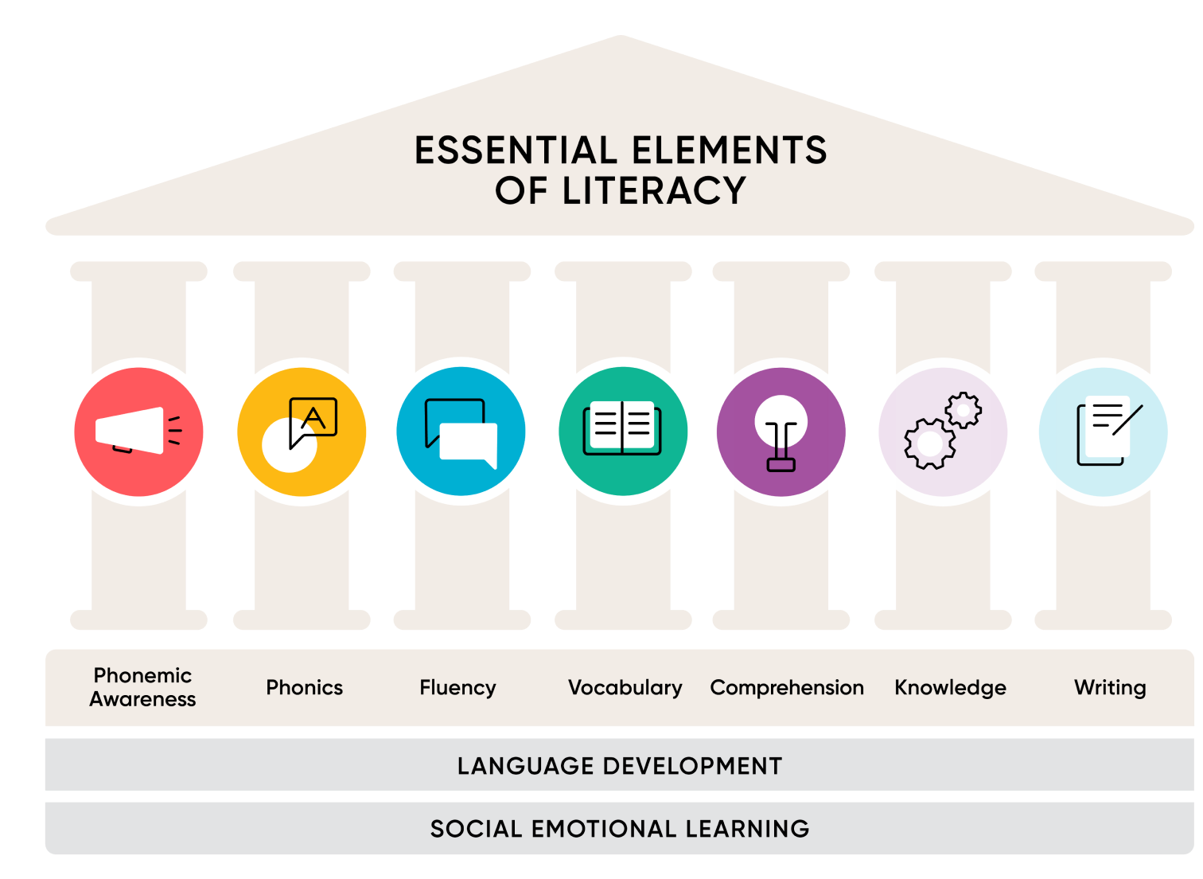

Slide 6
Foundational Program
Orton-Gillingham

Slide 7
What is Orton-Gillingham?
It is an evidence-based phonics program which provides reading instruction methods by breaking down reading and spelling into smaller tasks. This involves learning and identifying the letters and sounds. This teaching occurs in a “direct and explicit” manner in Grades K-2. Students learn the structure of a given sound or word and how it fits into the greater framework of the English language. The Orton-Gillingham program teaches:
Phonemic awareness
Identifying letters and sounds to create words
Reading fluency through repetitive texts and passages
Blending
Segmentation

Slide 8
Decodable Texts
and
Fluency

Slide 9
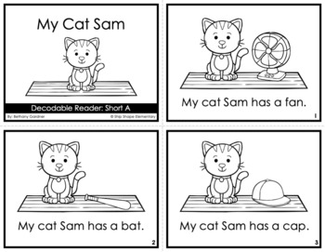
Decodable Texts
Decodable books play an important role in phonics instruction and building confidence in young readers.
They are simple books that are written for the beginning reader and contain the specific grapheme phoneme correspondences students have learned.
These books reinforce separating a word into smaller units, such as syllables, onset-rimes, or individual phonemes.
The students practice blending skills to read words in order to develop automaticity.
This allows for the ability to decode words in print correctly and instantly and to recognize words quickly and effortlessly while experiencing independent reading success.
My Cat Sam

Slide 10
Fluency
Fluent reading sounds smooth and natural and mimics how people sound when they are talking.
How do children develop fluency?
The first step is mastering basic decoding skills. This happens gradually in early elementary school. When young children are first learning to read, fluency is not the major focus. Their focus is on sounding out words, so their reading is naturally slow and choppy. You will know your child is reading fluently when their reading is accurate, it moves at a good pace, and it becomes expressive.
However, as they are learning how to read it is important to start practicing fluency early on. Achieving fluency has a tremendous impact on your child’s reading, especially their reading comprehension.

Slide 11
How can you help your child become a fluent reader?
Model fluent reading – Your child will learn fluency quicker by listening to good models of fluent reading. Children will learn how a reader’s voice can help written text make sense.
Read aloud daily to your child. By reading effortlessly and with expression, you are modeling how a fluent reader sounds during reading.
After you model how to read the text, you must have the child reread it back. By doing so, the child is then engaging in repeated reading.
Have other adults read aloud to children. Encourage other family members to read aloud to your child at home. The more models of fluent reading the children hear, the better.
Re-visit the same books over long periods of time to build on fluent reading. This will help your child become familiar with the parts of the book (characters, setting, plot), which will help build connections and will increase their comprehension.

Slide 12
Vocabulary Instruction

Slide 13
Vocabulary Instruction
  Each grade begins the modules by introducing new vocabulary words. This is taught through visual instruction, parts of speech, pronunciation, meaning, and sentence examples.
  We then use the vocabulary words in class when the students are listening, speaking, reading, and writing.
  Repetitive exposure to new words builds on comprehension.
  Speaking and listening plays a crucial role in learning to read, as emergent readers use the words they hear spoken aloud to make sense of words they encounter in print.

Slide 14

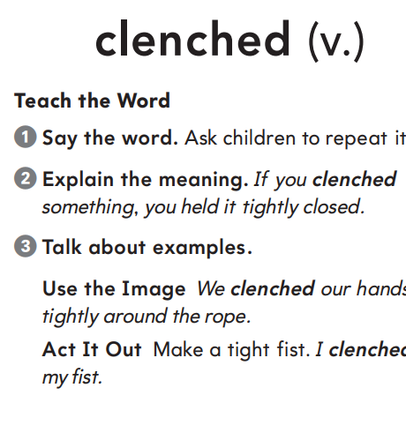

Slide 15
Rigby Library Books

Slide 16
Rigby Library Books
Classroom libraries are arranged by themes and topics connected to the core curriculum.
HMH provides a wide variety of Rigby Books which are recommended to enhance your child’s library book choices in the classroom and at home for student enjoyment and building fluency.
Rigby books consist of fiction and non-fiction texts, predictable language, progressive high-frequency words and repetition to build fluency.
Each of the books connects to the genres of study taught in the classroom throughout the modules.

Slide 17
Module Family Letters

Slide 18
Family Letter
Letters are sent home on or before the beginning of each new module.
The purpose is to inform families about the topic, genre focus, types of texts, and writing expectations.
This includes at home suggestions, that can help connect learning to the classroom instruction, such as discussing the topic, helpful ideas to build knowledge and vocabulary, and exploring the genre of focus.
By encouraging children to explore different genres, we expose them to a variety of storytelling styles, themes, and perspectives.

Slide 19
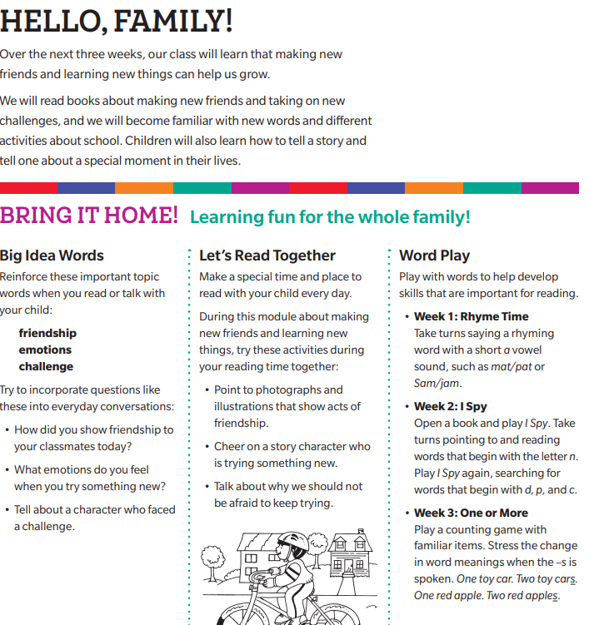

Slide 20
How to Access
the HMH Program
at Home

Slide 21

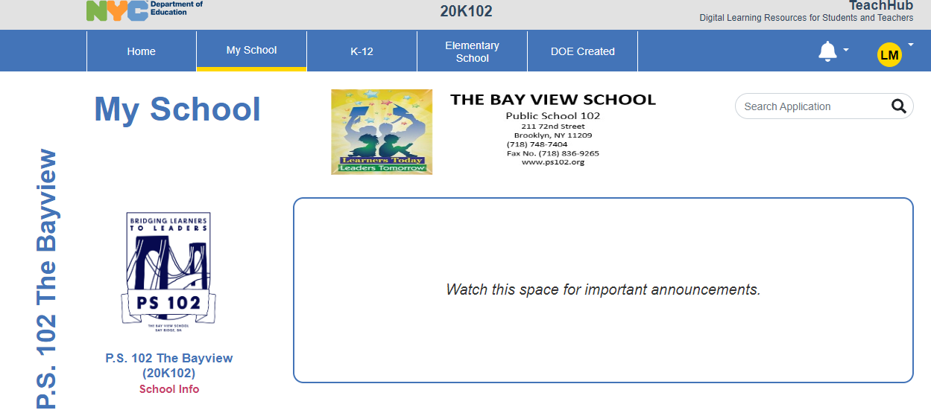
Family Access to the HMH Program
Step 1. Use the following link to access TeachHub https://teachhub.schools.nyc/Home/Index
Step 2: Use your child’s login to access the P.S. 102 Bayview Screen

Slide 22
Family Access to the HMH Program
Step 3. Click on the My School tab at the top of the page:

Slide 23
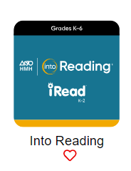

Family Access to the HMH Program
Step 4. Scroll down to the HMH Into Reading App and click to enter.
Step 5. Click on the Discover icon at the top of the page

Slide 24
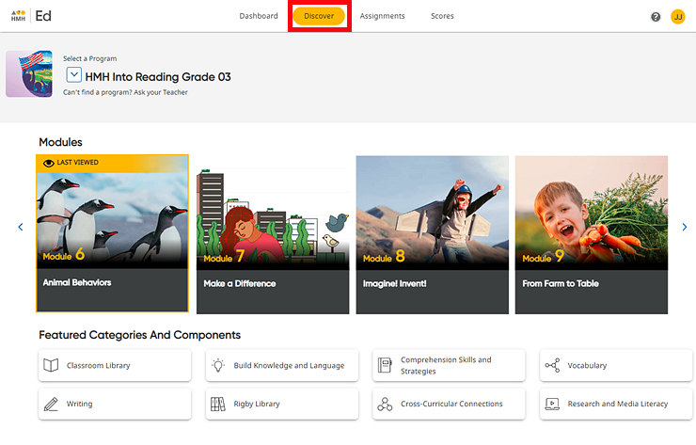

Slide 25


Slide 26


