Slide 1
Building Strong Students,
Strong Careers,
and Strong Communities

Slide 2
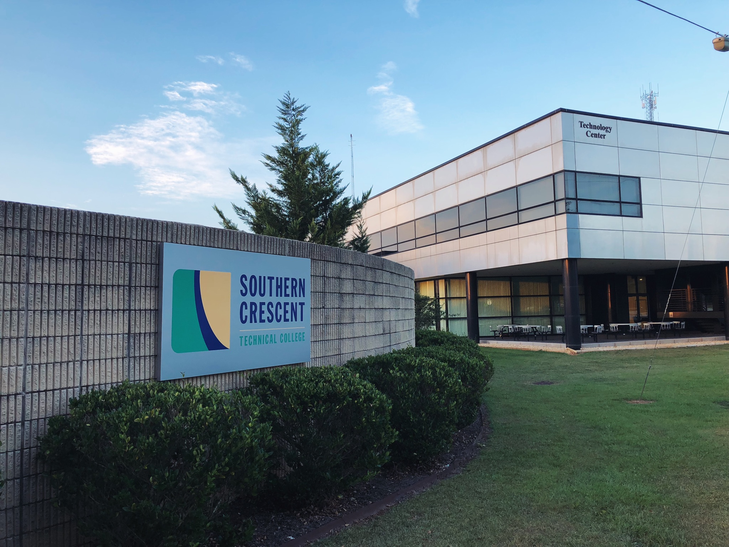
Overview
Southern Crescent Technical College
We are YOUR technical college!
Serve 8 counties: Henry, Fayette, Spalding, Butts, Jasper, Pike, Lamar, Upson
Five locations to serve you:
Griffin Campus/GRCCA
Flint River Campus (Thomaston)
Butts County Center (Jackson)
Jasper County Center (Monticello)
Henry County Center (McDonough)
Online
Our mission is to deliver relevant technical education in the SCTC service delivery area.

Slide 3
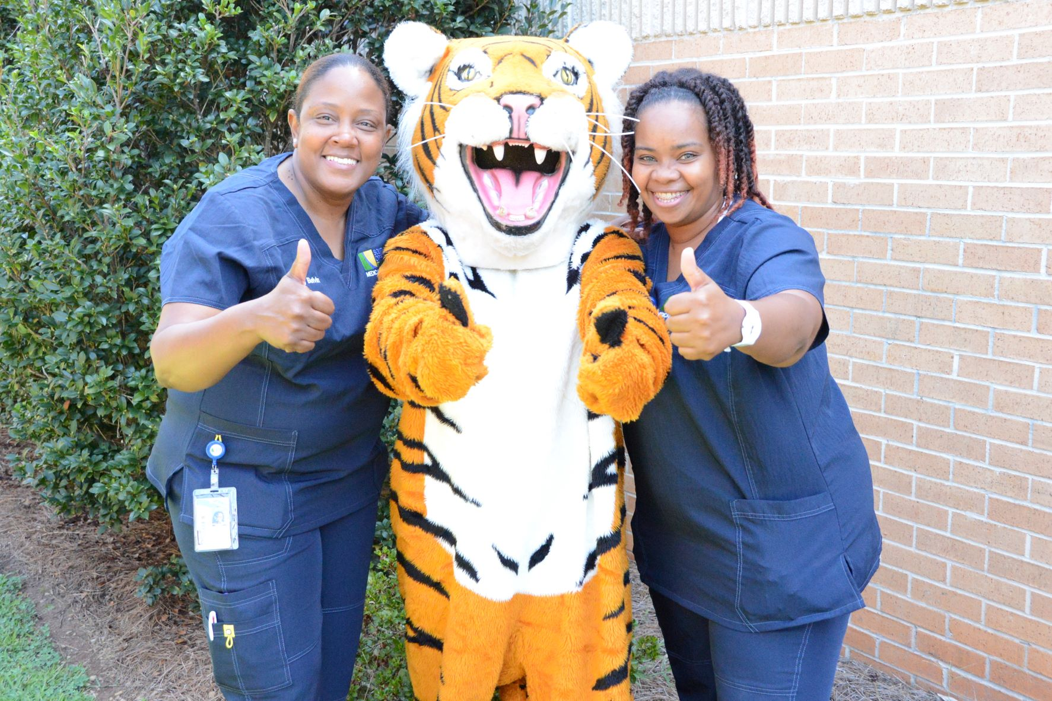
Programs
Why should high schoolers be interested?
College is needed for most jobs
High school courses lay the foundation for success
Grades matter—getting into college and getting scholarships
Dual Enrollment could be or not be the best option
SCTC offers three types of academic credentials:
Technical Certificates of Credit
Diplomas
Associate of Applied Science Degrees
Wide variety of programs (www.sctech.edu):
Allied Health
Business Technology
Computer Information Systems
Film and Television Production
Professional Services
Public Safety
Technical and Industrial
Why these programs?

Slide 4
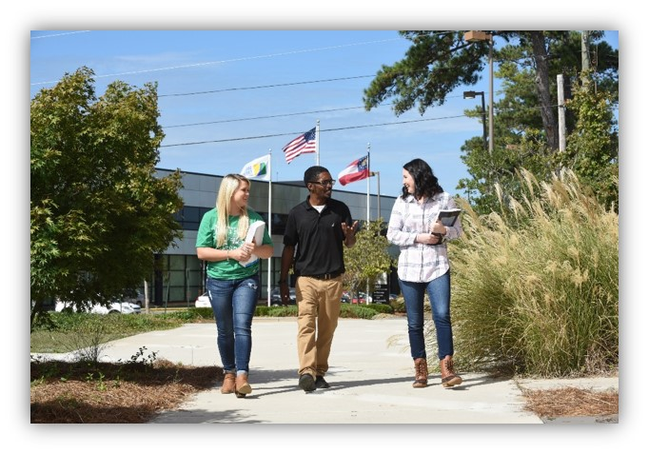
Programs
Wide variety of programs (www.sctech.edu):
Allied Health
Business Technology
Computer Information Systems
Film and Television Production
Professional Services
Public Safety
Technical and Industrial
Why these programs?

Slide 5
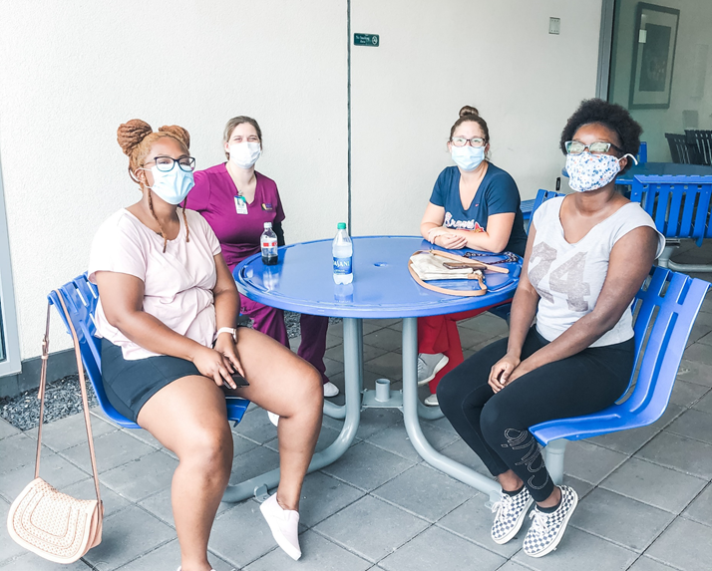
Dual Enrollment
Dual Enrollment students take college classes while still in high school—these courses can be either academic or technical.
Dual Enrollment students receive both high school and college credit.
All Georgia high school students eligible for Dual Enrollment receive funds for up to 30 credit hours—covers tuition, fees, and book costs.

Slide 6
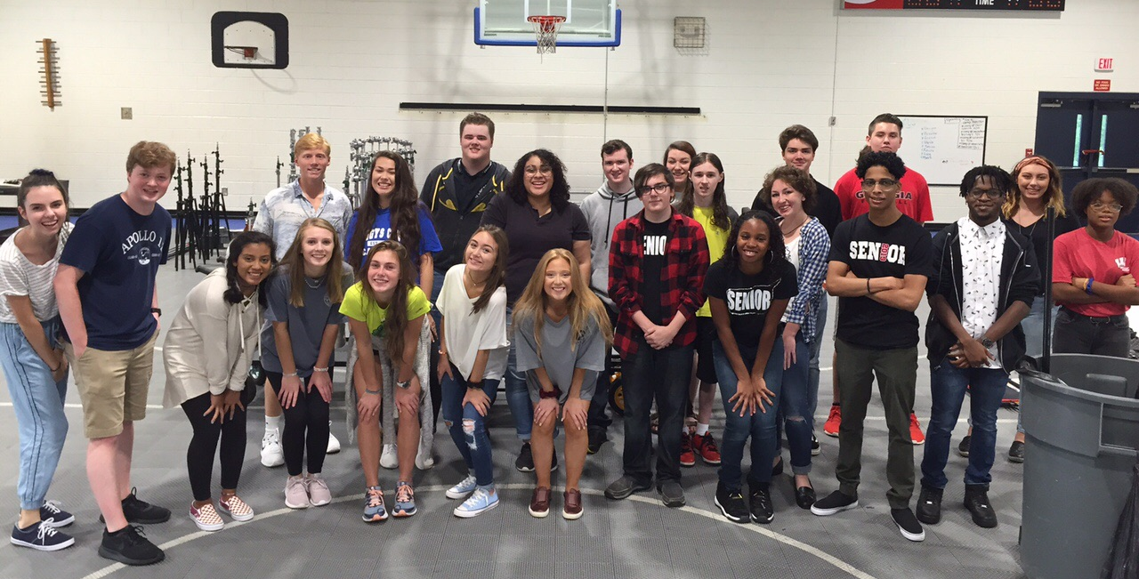
Dual Enrollment
Eligibility:
Must be a high school junior, or senior.
Sophomores who meet SAT score of 1200 or an ACT score of 26 prior to the term may enroll in any approved Dual Enrollment courses at a TCSG, USG or private eligible participating postsecondary institution.
Must have minimum 2.0 gpa or make minimum test scores on SAT, ACT, or Accuplacer test.
Must speak with high school counselor to complete necessary steps to be enrolled.
Must submit an SCTC application for admissions and be accepted.

Slide 7
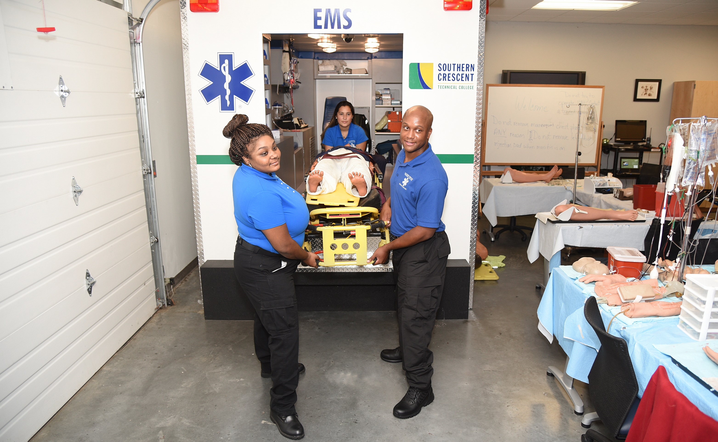
Paramedicine
Griffin Campus

Slide 8
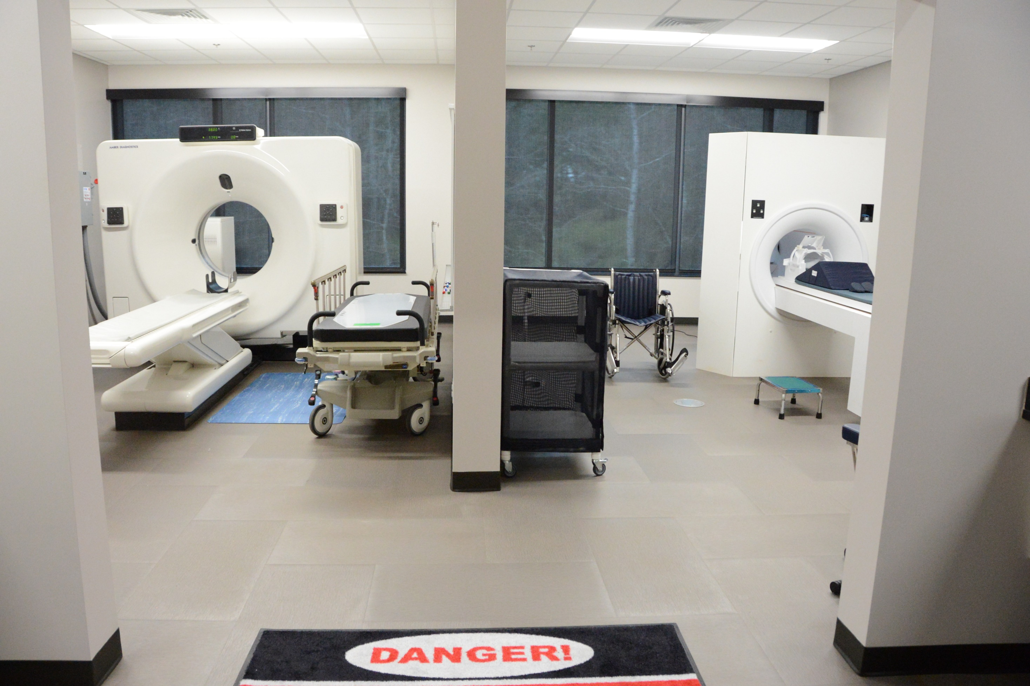
CT & MRI Lab
Henry County Center

Slide 9
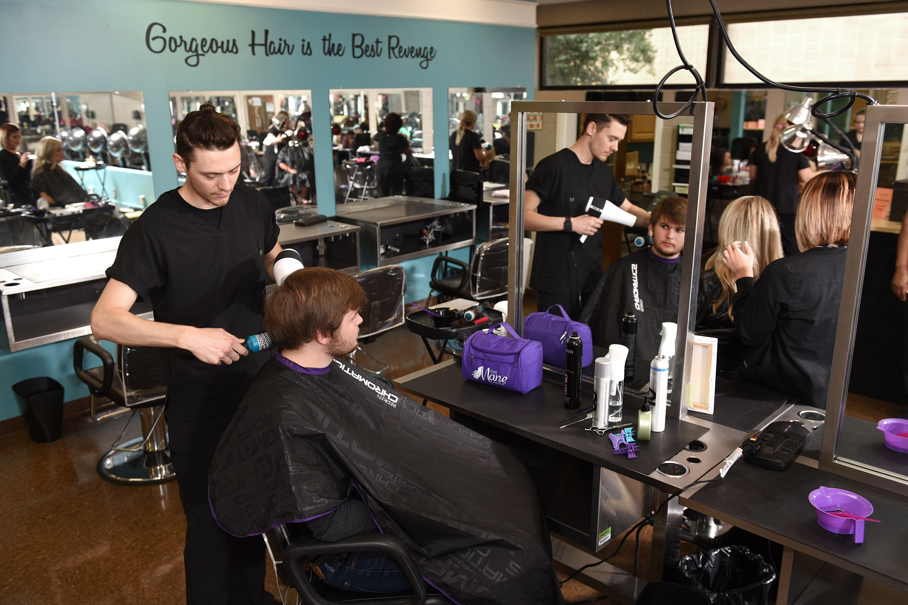
Cosmetology
Griffin Campus

Slide 10
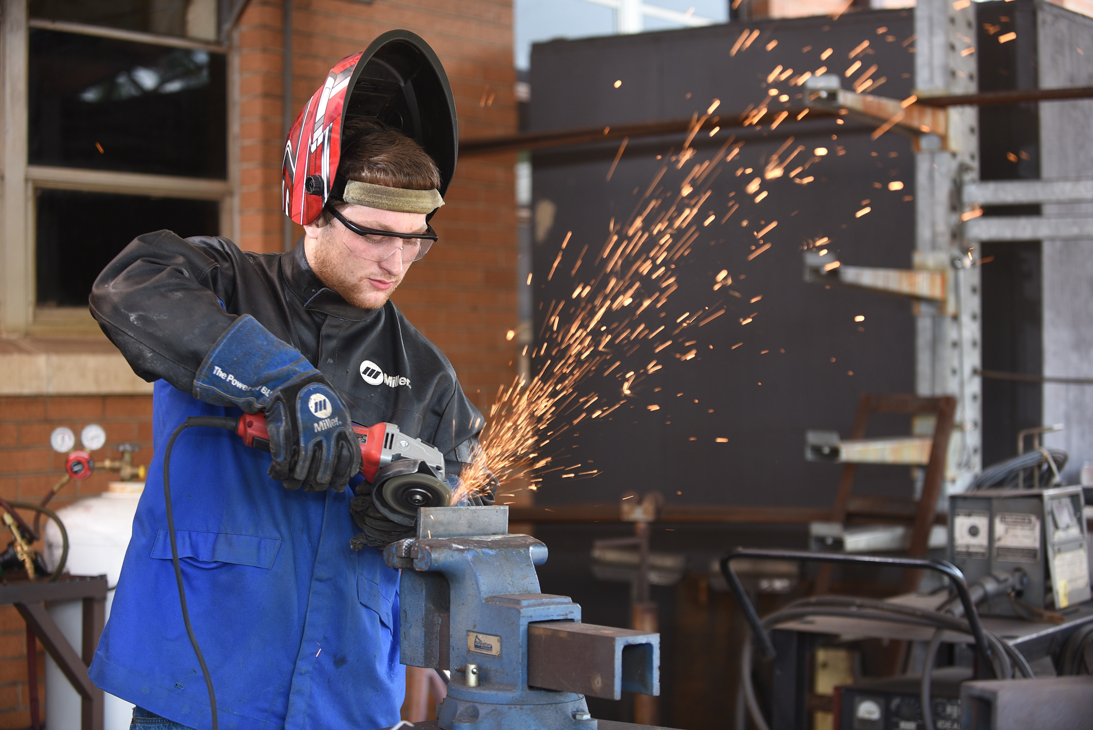
Welding
Griffin Campus/Flint River Campus

Slide 11
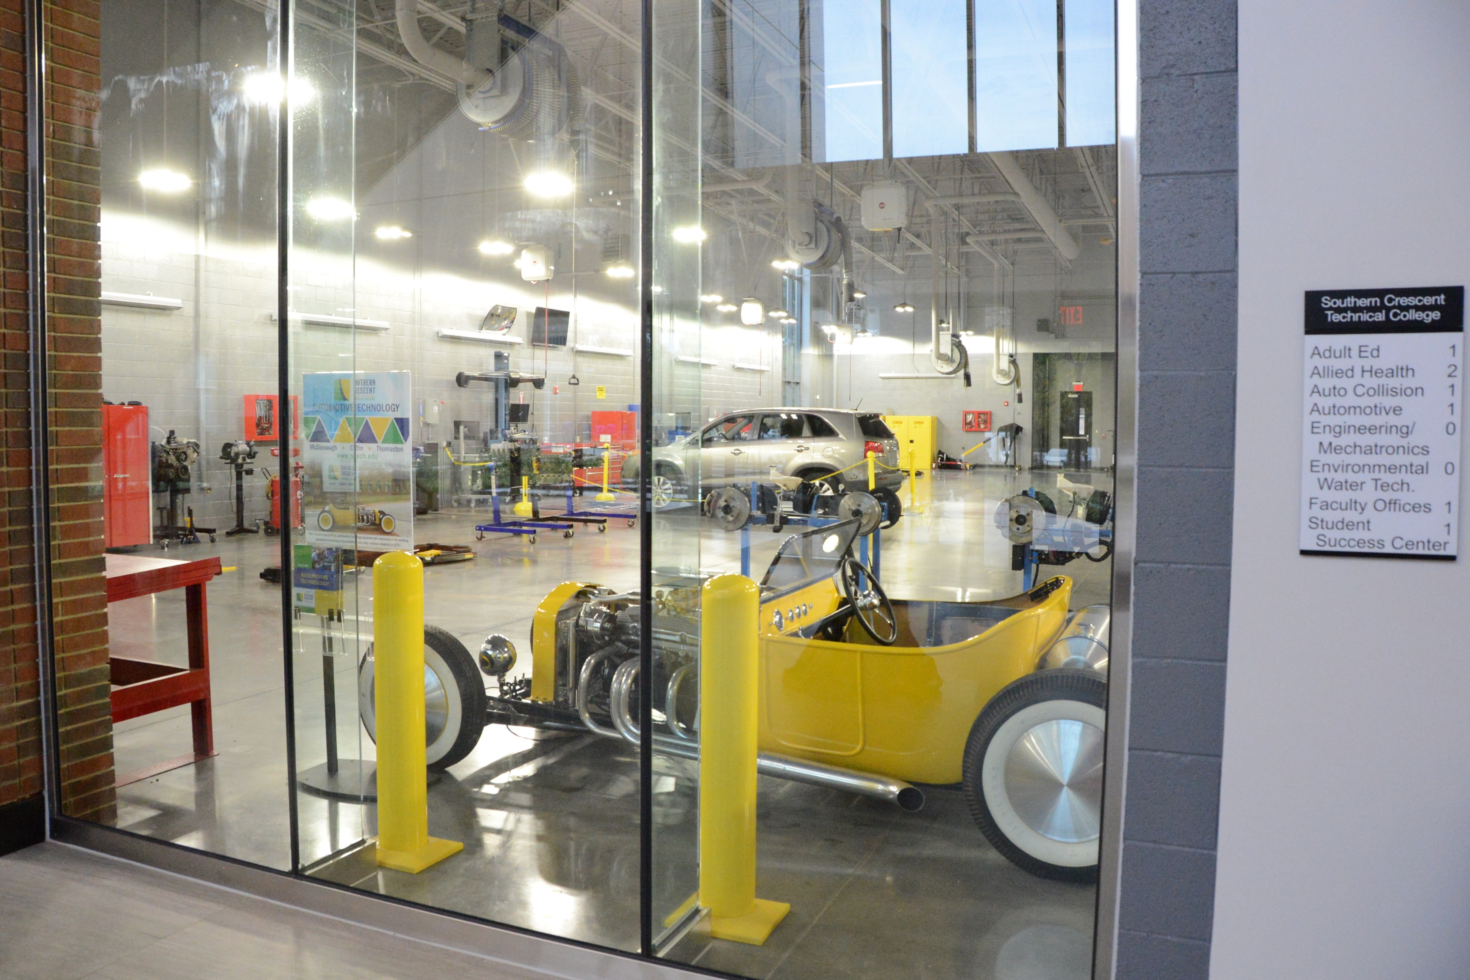
Automotive Lab
Henry County Center

Slide 12
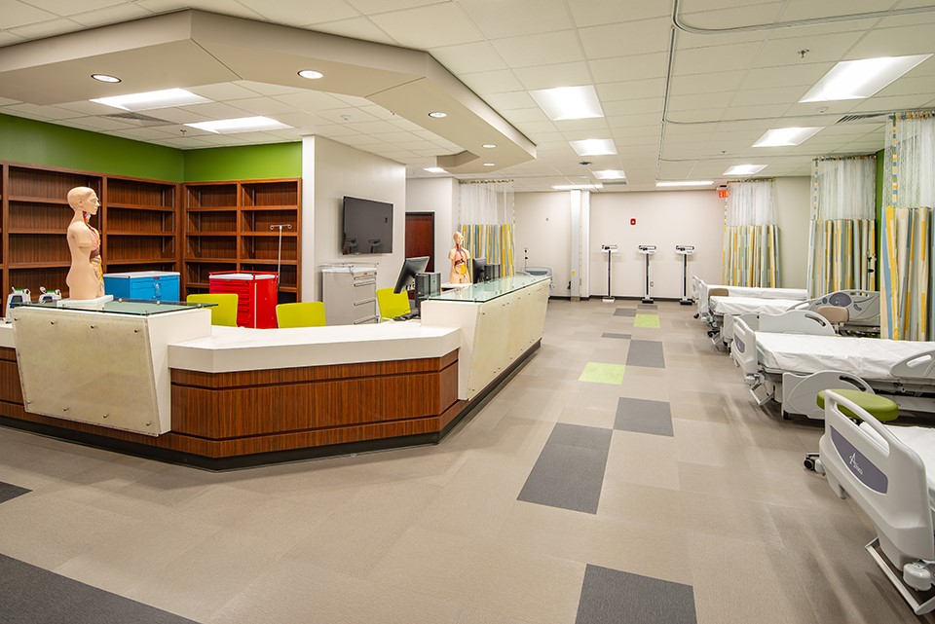
Piedmont Henry Healthcare Wing
Henry County Center

Slide 13
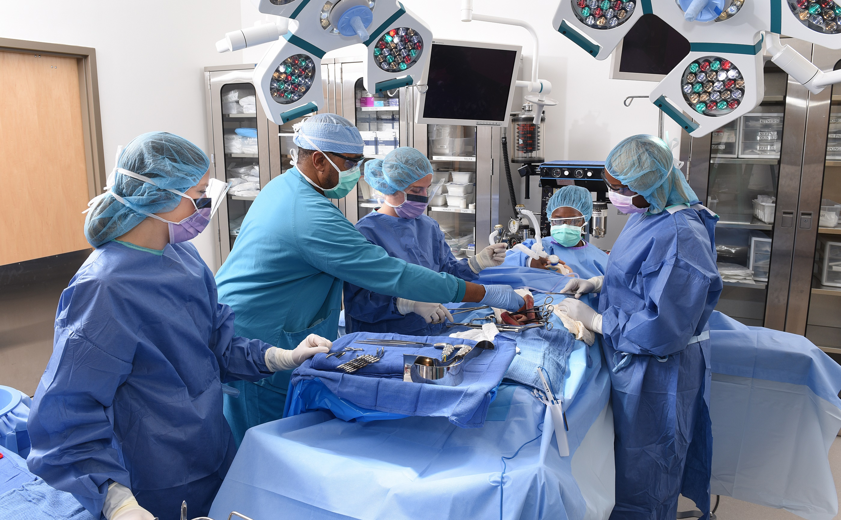
Surgical Technology Lab
Griffin Campus

Slide 14
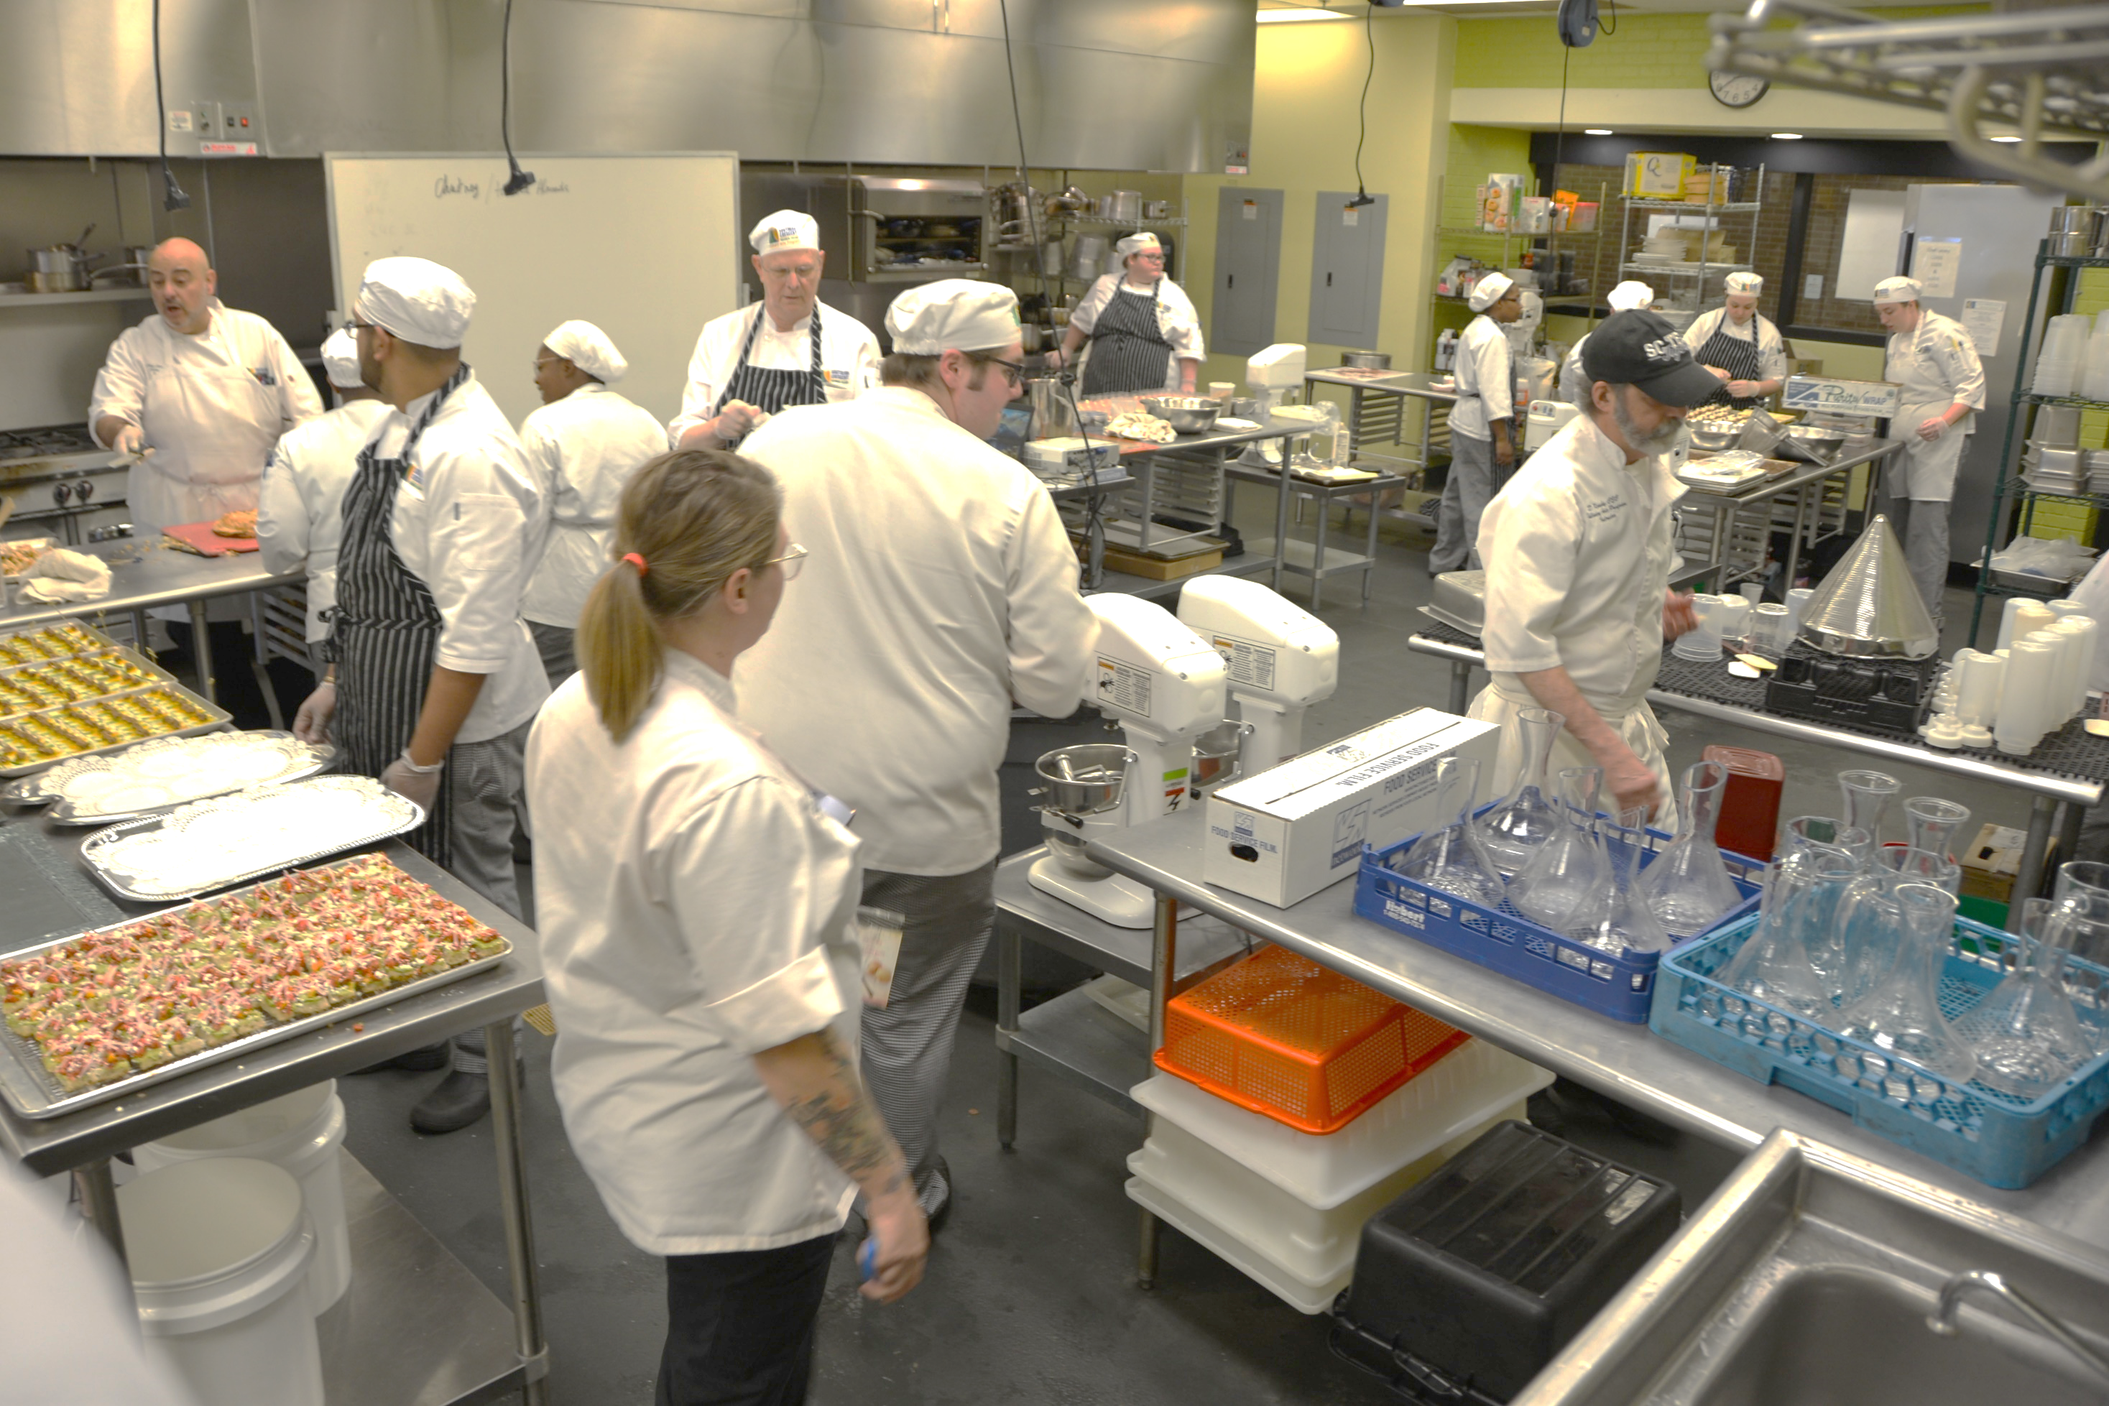
Culinary Arts Lab
Griffin Campus

Slide 15
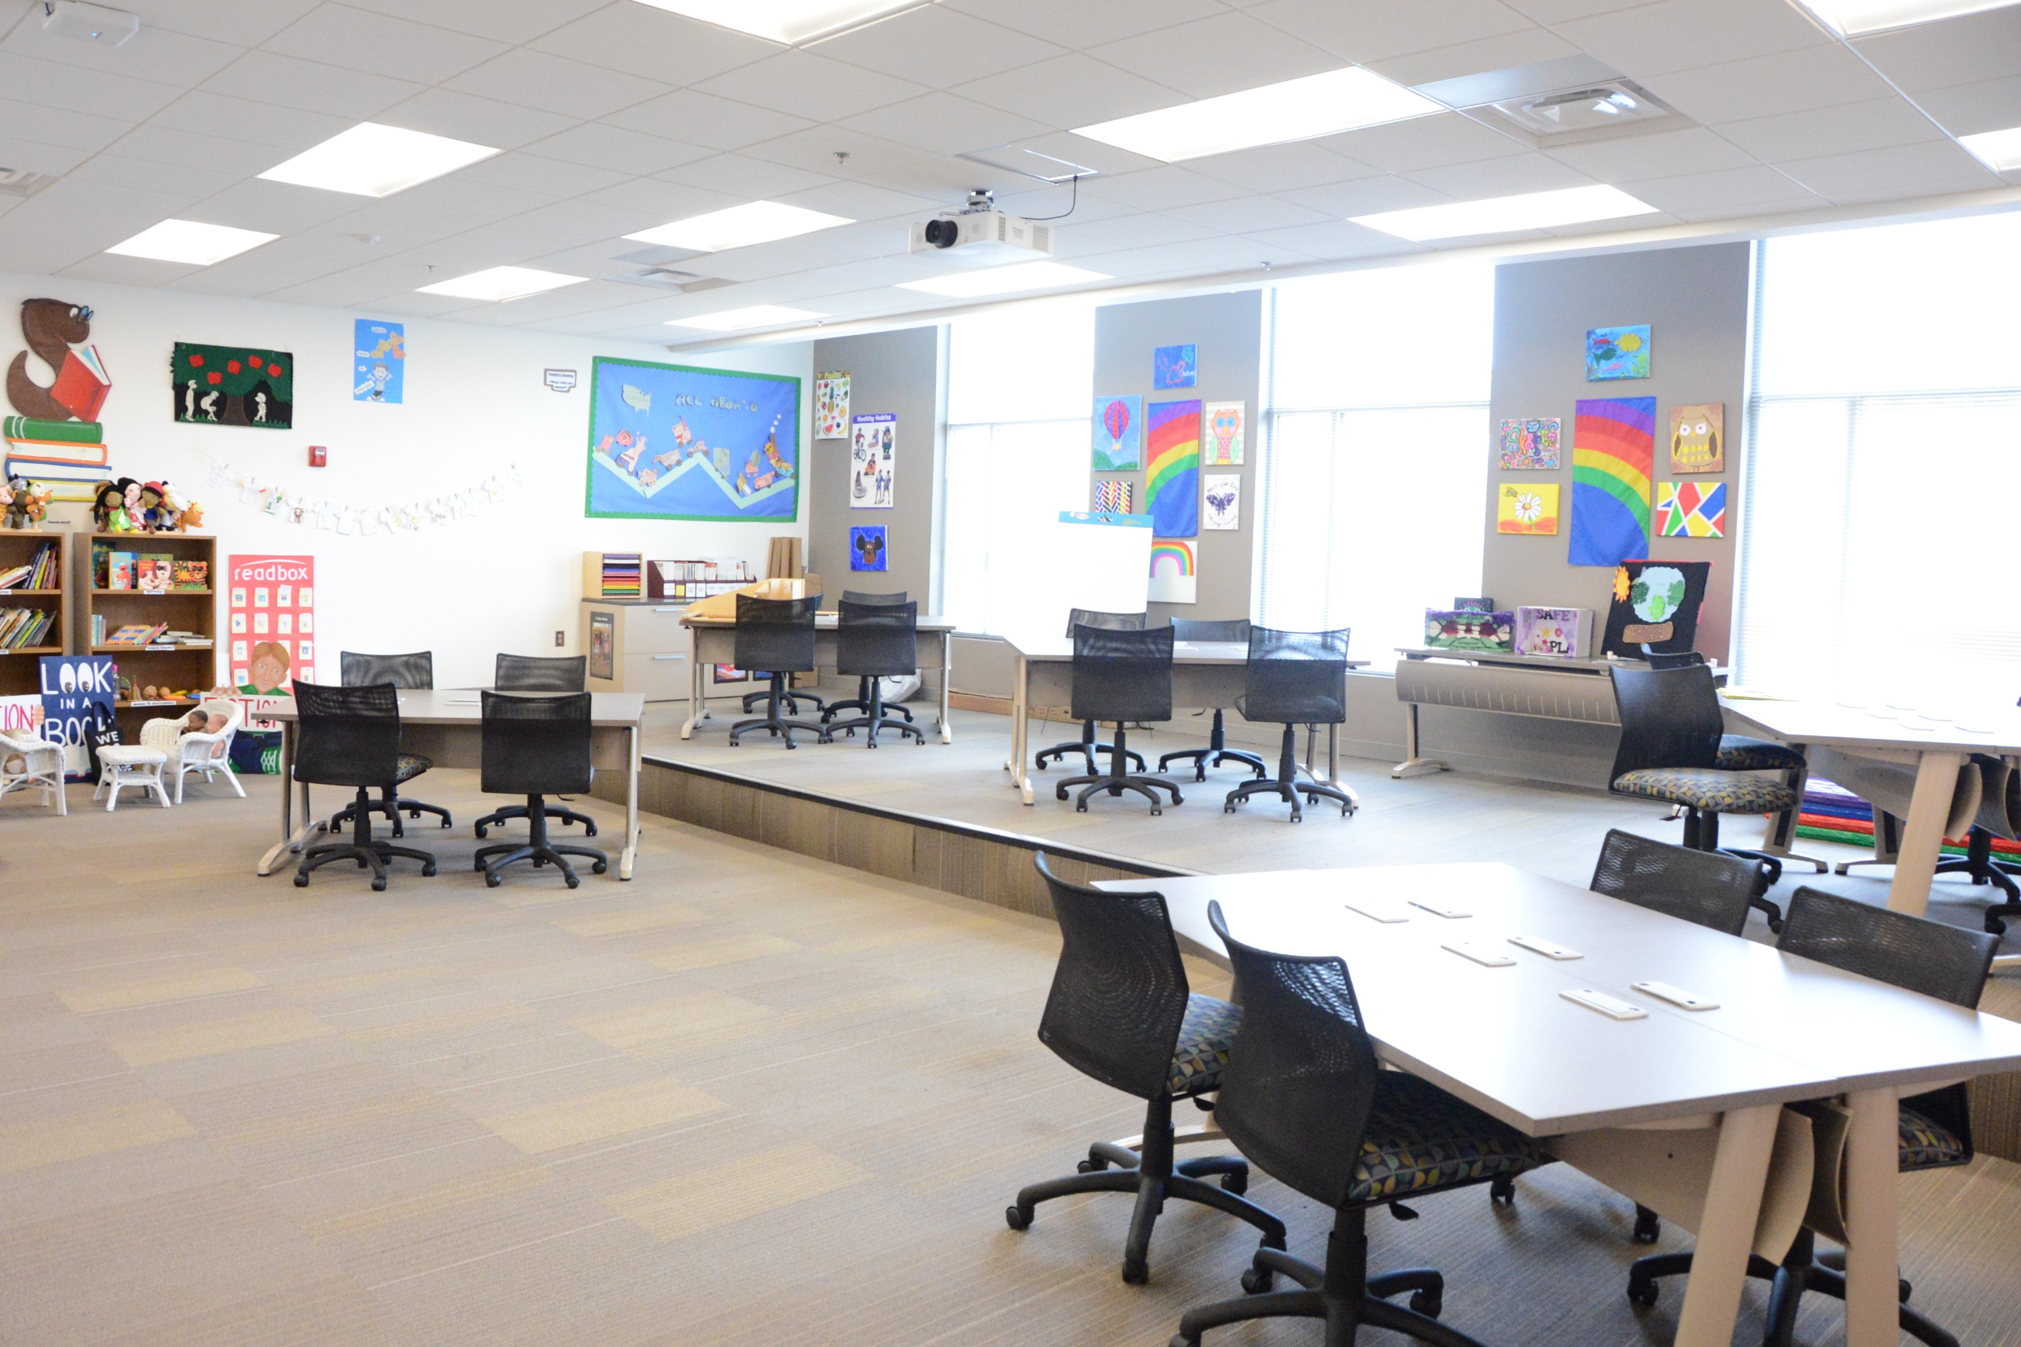
Early Childhood Education
Henry County Center

Slide 16
Contact Me!
Sonya Lawrence
High School Coordinator
Drew Todd
Associate Vice President
of Enrollment Management
E: Sonya.Lawrence@sctech.edu
P: 770-412-5739
E: Drew.Todd@sctech.edu
P: 678-603-5988

