Slide 1
Nyack Public Schools
Strategic Planning:
School Board Update
February 6, 2024

Slide 2
Agenda
Overview of Strategic Planning
Governance Work Update
Management Work Update
Next Steps

Slide 3
Equity, and Continuous Improvement in Core Processes
5
Inputs
Funding, people (students & staff), physical structures and goods, professional development, time
Core Processes
One’s work & position, resourcing, organizational structure, practices, adult behaviors
The KEY leverage point for equity, and continuous improvement
Outcomes
Policy, laws, Race, income, achievement results, satisfaction
Inputs
Financial Resources
Human Resources
Physical Resources
Students & Families
Staff, Contracts, & Time
Professional Develop
Core Processes
Instruction/Learning
Operations
Planning, Prioritization, Decision Making
Consultation
Outcomes
Student Learning
Financial
Operational
Engagement
Satisfaction
PLC- CI Structure
Notes:
Equity Framework
3 key components to this Equity Framework
Inputs- What contributes to the System to ensure
Outcomes- Evidence of how our system is working
Core Processes- What we do with our resources- instruction and learning, Operational Planning, Prioritization, Decision Making and Consultation
Changing the system to get improved outcomes, we have to focus on the Core Processes.
Example:
Chronic Attendance is on the rise so we look at our core processes to determine root cause- Implement Intervention (Check and Connect), make changes in how we use our Inputs, and we monitor the impact in the outcomes- have we improved?
Equitable systems are created by a continuous improvement cycles, innovating over what outcomes that do not live up to the promises we make to our students and families

Slide 4
STRATEGIC PLANNING Process
Superintendent’s Team
Strategic Planning Team
School Board Strategic Planning
Describing Our Vision
Desired Daily Experience
(Jan /Feb 2024)
VisionCard (Feb 2024)
Theory of Action (March 2024)
3-Year Operational Plan
(April-May 2024)
Assessing Our Reality
World Cafe (Nov/Jan 2024)
Thought Exchange (Dec/Jan 2024)
Setting Our Strategic Plan
Strategic Roadmap (March 2024)
3-yr Board Agenda (April 2024)
Long Range Plan (May 2024)

Slide 5
Board of Education
GOVERNANCE
Update on Strategic Work

Slide 6
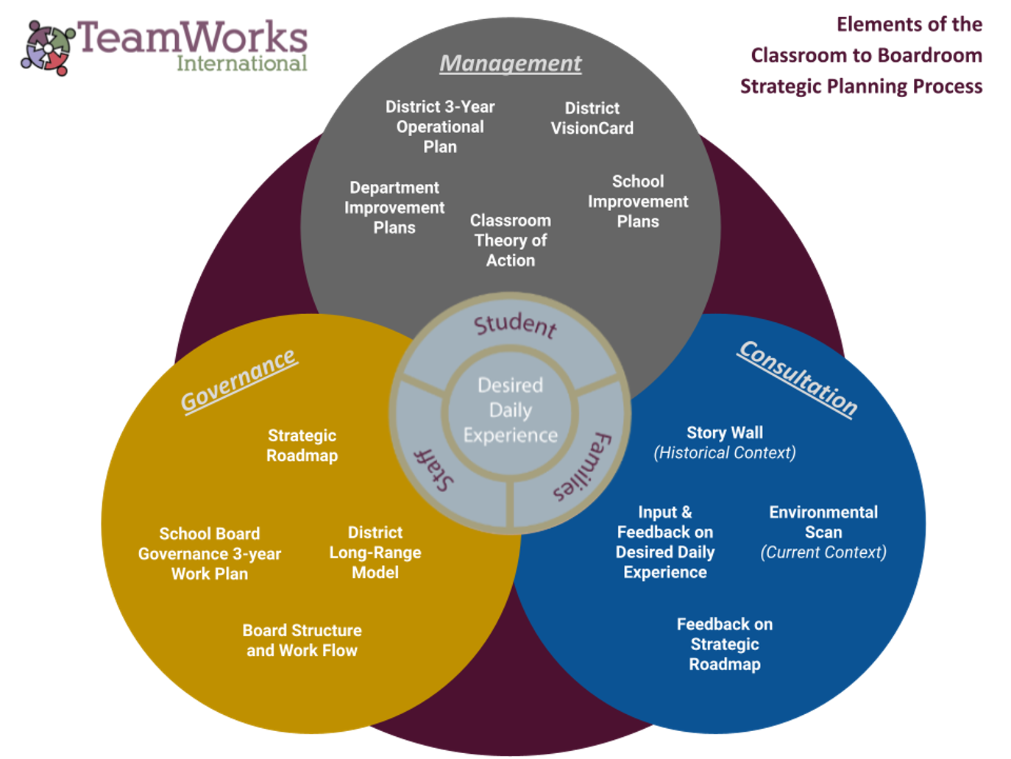
Education Leadership System: Oct 10, 2023
Overview of Education Leadership System
Excellence in Governance, Management, and Consultation
Navigating between the three authorities
What Is...What Ought To Be

Slide 7
Board Structures
BoE Committees Re-established:
Policy Committee
Updating policies
Developing a 3 year review cycle
Public Engagement Committee
Monthly meetings have begun
Vehicle to gain insight on work
Board of Education Member Handbook-Draft
Board Meetings held in throughout district to promote participation.

Slide 8
Board of Education Retreat: Jan. 20, 2024
Overview of Educational Leadership System-
Governance, Management and Consultation
Applications-
Practice Processes- role playing communication
Governance in Management Elements of Strategic Planning
Sample- Desired Daily Experiences (DDE)-Draft
Sample- District Vision Card-Draft
Governance Practices and Preferences
BoE Handbook-Draft
District Policy Basics

Slide 9
Administrative Strategic Planning Team
Management
Update on Strategic Work

Slide 10
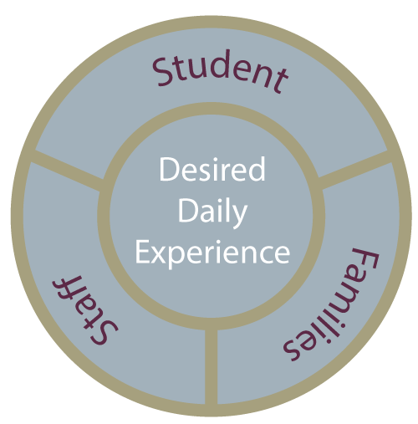
THE DESIRED DAILY EXPERIENCE
The foundation strategic planning process is a clear articulation of the Desired Daily Experience of students, staff and families - recognizing and giving voice to every member of the school district community.

Slide 11
Desired Daily Experiences-gathering stakeholder feedback
World Cafe and Thought Exchange were utilized to gather information with Nyack students, families, staff and community members. (Dec- January).

Slide 12
Strategic Planning Process- Engagements
Hosted Six World Cafes
-Participants were from across the school community
-Building Connections bridged 200+ Parents/Guardians
Thought Exchange Surveys
-30,000 interactions from members of the school community
The Desired Daily Experiences of Students, Families and Staff are in the process of getting drafted using the information gathered.

Slide 13
Thought Exchange and World Cafe Engagements
Themes for Desired Daily Experiences for Students
Student Identity and Voice – Knowing, Seeing, and Valuing Students with Respect for Students’ Identities and Voice
Learning and School Environment - Welcoming, Safe, Affirming, Time with Friends, Inclusive, Joyous (Fun), Culturally Responsive, Respectful, School and Learning Environment
Learning Experiences - Engaging, Hands-On, Collaborative, Culturally Responsive, Relevant, Adaptive, Supportive Learning Experiences
Whole Child - Development of Habits, Skills, Well-being, and Mindsets for Limitless Future Opportunities
Academic Experience - Review of scheduling, policies, grading (including homework, quiz, projects, test) practices
To have a welcoming, culturally affirming, respectful, understanding, and inclusive school environment.
To feel known, heard, have input, and valued in school
To have a sense of belonging and more social emotional learning for personal growth and development
To have a focus on relevant learning and less on grades, homework and tests with exploration of alternative types of testing
To develop practical and professional life skills and knowledge
To experience engagement and collaborative interactions with peers during lessons
To have more opportunities for fun and hands-on learning
To understand all my limitless options for my future
To learn how to navigate diversity and equity in the real world
To have my individual learning needs considered, one size does not fit all
To have more opportunity for field trips and real world experiences
To have a later start time, longer lunch time for relaxation, stress-free spaces, time to complete homework and more quiet time during the school day
To have a clean and safe environment

Slide 14
Thought Exchange and World Cafe Engagements
Themes for Desired Daily Experiences for Students
To have a welcoming, culturally affirming, respectful, understanding, and inclusive school environment.
To feel known, heard, have input, and valued in school
To have a sense of belonging and more social emotional learning for personal growth and development
To have a focus on relevant learning and less on grades, homework and tests with exploration of alternative types of testing
To develop practical and professional life skills and knowledge
To experience engagement and collaborative interactions with peers during lessons
To have more opportunities for fun and hands-on learning
To understand all my limitless options for my future
To learn how to navigate diversity and equity in the real world
To have my individual learning needs considered, one size does not fit all
To have more opportunity for field trips and real world experiences
To have a later start time, longer lunch time for relaxation, stress-free spaces, time to complete homework and more quiet time during the school day
To have a clean and safe environment

Slide 15
Thought Exchange and World Cafe Engagements
Themes for Desired Daily Experiences for Parents and Caregivers
School Environment - My Child is in a Safe, Caring, Welcoming, Supportive, Accepting, Culturally Responsive, Nurturing School Environment.
Positive Relationships - My Child has a positive, strong, kind, supportive relationship with their teacher and other staff as well as other students.
Partner in Education - Being known, respected, informed, welcomed, included, invited, and valued as a partner in their child(ren)’s education
Learning Environment - Real-World, High Quality, Engaging, Active, Hands-On, Collaborative, Problem-Based, Differentiated, Academically Challenging Learning Environments that promote student voice/choice
Diverse Workforce - A diverse and inclusive environment where their children can see staff members who represent their culture and identity so they feel a sense of belonging.
Communication and Collaboration – Access, opportunities, transparency, ongoing communication about their child’s progress, curriculum, activities and events.

Slide 16
Thought Exchange and World Cafe Engagements
Themes for Desired Daily Experiences for Parents and Caregivers

Slide 17
Thought Exchange and World Cafe Engagements
Themes for Desired Daily Experiences for Staff
Work/School Environment – Welcoming, Safe, Supportive, Inclusive, Inspiring, Respected, Recognized, Appreciated, Valued, Kind, Acknowledged as a Professional, Positive Work and School Environment
Staff-Student Relationships – For all students to know they are seen, cared for, responsive support.
Equity, Diversity, Inclusion – Understanding, Embracing of Individual Characteristics of Staff, Students, and Families, Advancing Excellence in Equity
Purpose/Shared Vision – Working together for positive change, inspiring collective and self efficacy
Professional Development and Resources – Experience meaningful growth opportunities and abundant resources

Slide 18
Thought Exchange and World Cafe Engagements
Themes for Desired Daily Experiences for Staff

Slide 19
World Cafe Engagements
Themes:
Systemic Alignment, Coherence for Equity
Student Centered, Culturally Responsive, Engaging, Fun, Hands-On Learning, Differentiated Rich Learning Experiences
Safe, Culturally Responsive Classroom and Inclusive, Belonging Environments
Enrichment Opportunities for K-5 (STREAM, Foreign Language, Field Trips)
Social Emotional Learning, Mental Health, Student Well Being, Trauma Informed Practices with Integrated Support Systems
Professional Development for Staff and Parents
Authentic Engagement Opportunities for Parents to be informed and provide input about curriculum, ways to support SEL and be involved.

Slide 20
Describing your Desired Daily Experiences: January 31 & Feb 7, 2024
Administrative Strategic Planning Team-13 members including Building Principals, Directors, Assistant Superintendents and Superintendent.
Drafting DDE statements using the feedback to develop statements encompassing the Whole System through a lens of equity.
Guidance included
Describe what experiences will be when the strategic plan is being successfully implemented in the future.
Paint the picture of what you want experiences to look like, feel like, and sound like.
Represents individual voice. Consensus is not needed.
Notes:
Based on Surveys, World Cafe’s

Slide 21
Next Steps
Board of Education (Governance)
Strategic Roadmap Draft -(Mission, Vision, Core Values, and Equity Statement)
Feedback will be gathered on draft
Unify with the district’s 3 Year Operational Plan (inclusive of Equity Plan)
School Board 3-yr Governance Work Plan
Long Range District Model
Administrative Strategic Planning Team (Management)
District VisionCard - Communication of progress
District Theory of Action- Classroom
District 3 Year Operational Plan

Slide 22
