Slide 1
Groom ISD
Drone Construction Pics
Phase 1
6/22/18

Slide 2
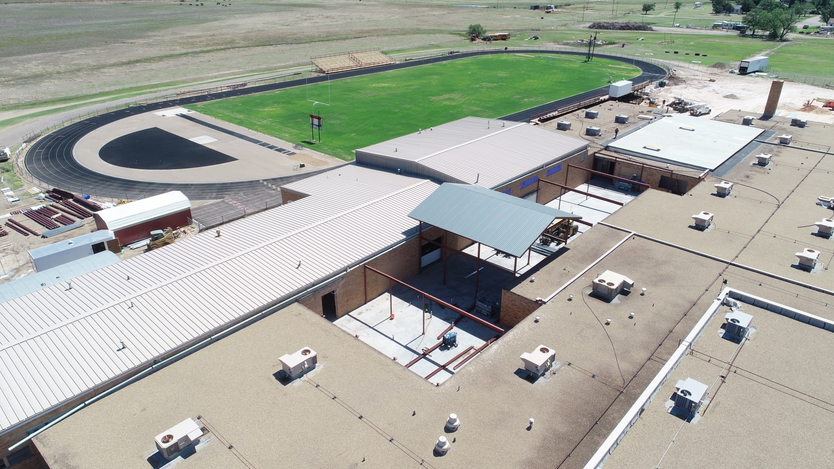
Patio Picture

Slide 3
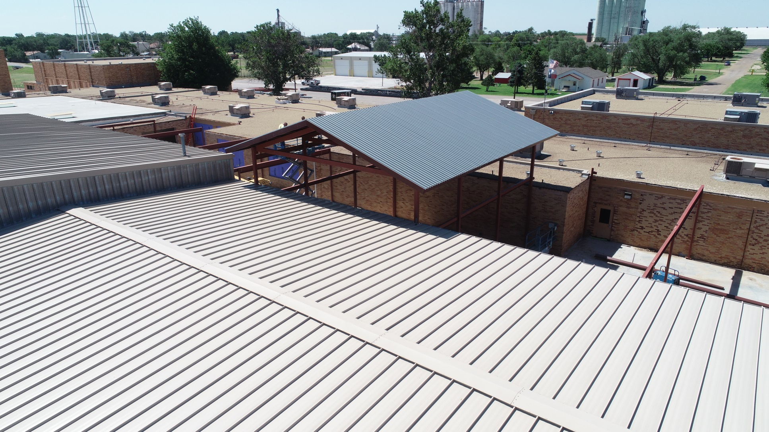
Patio #2

Slide 4
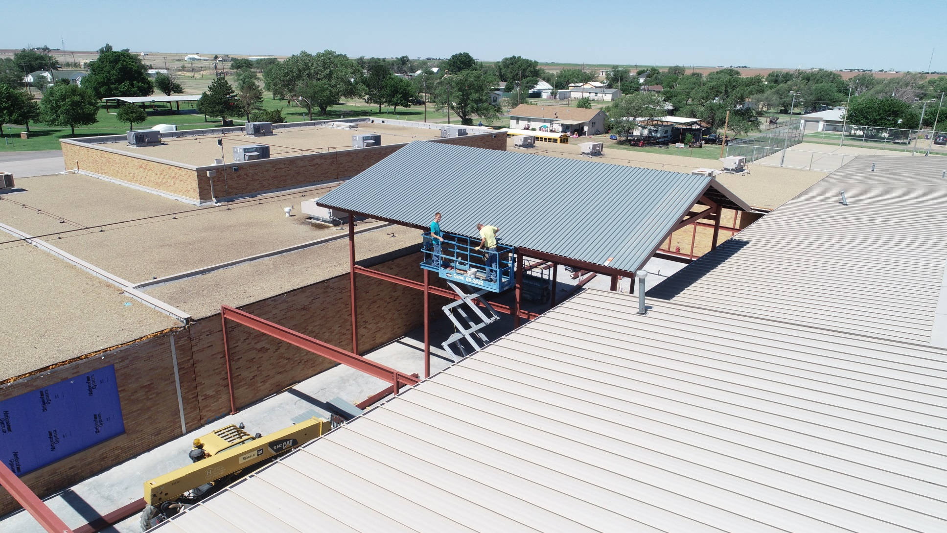
Patio #3

Slide 5
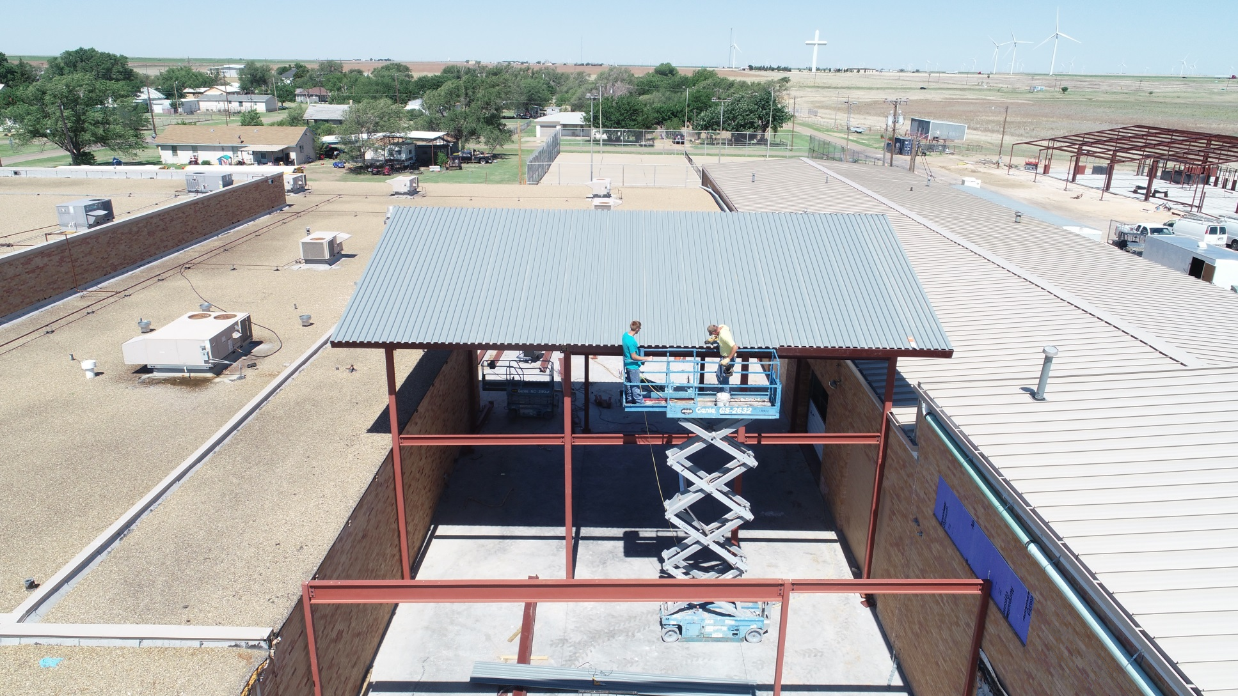
Patio #4

Slide 6
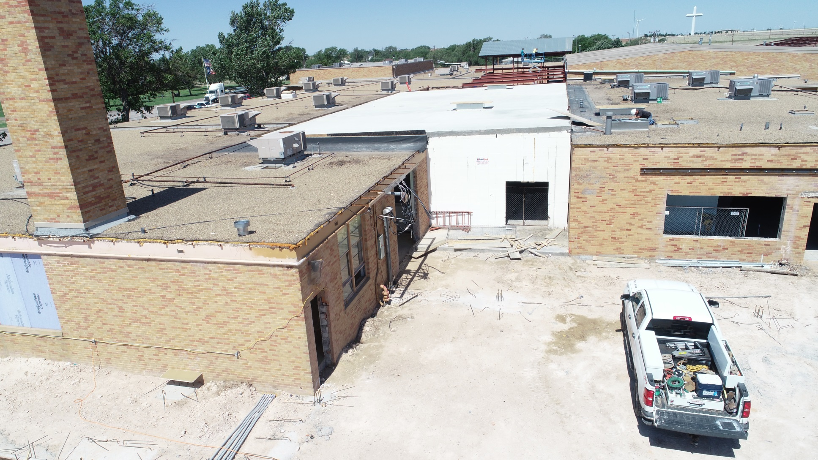
Pre-Kindergarden & Kindergarten

Slide 7
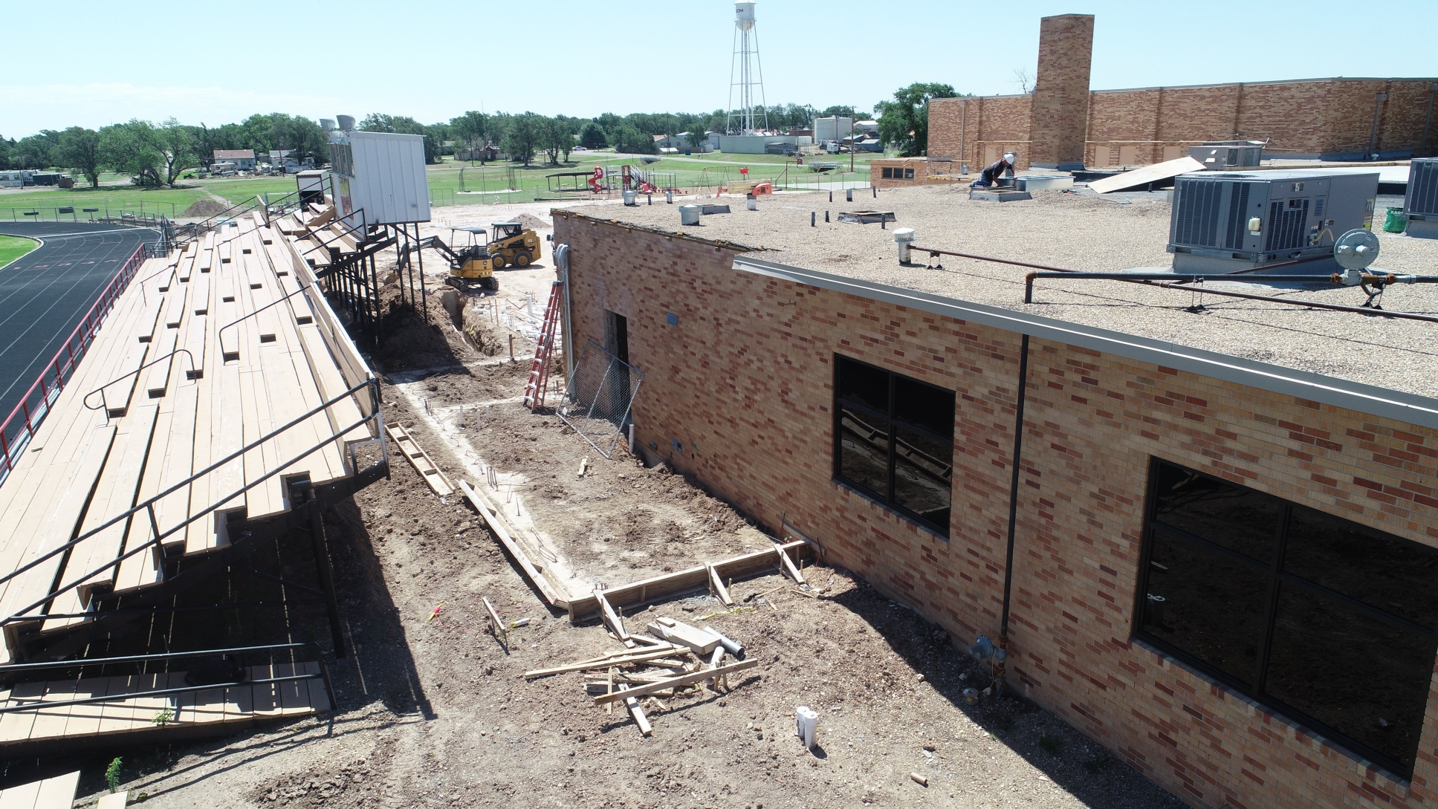
Cafeteria

Slide 8
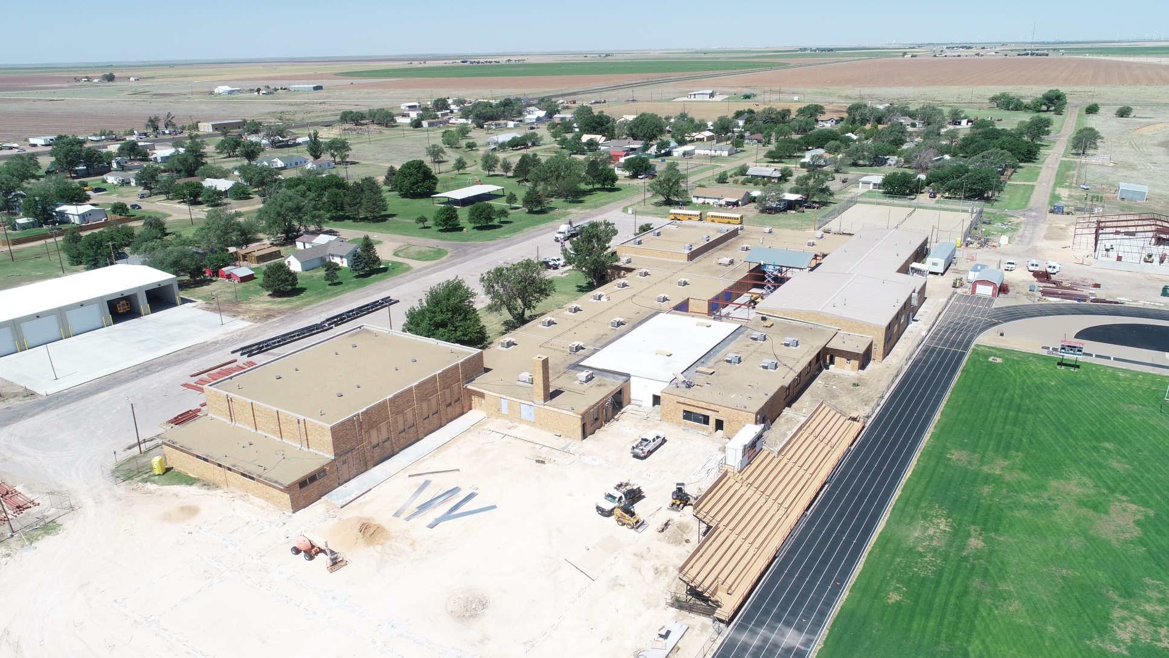
Site Picture #1

Slide 9
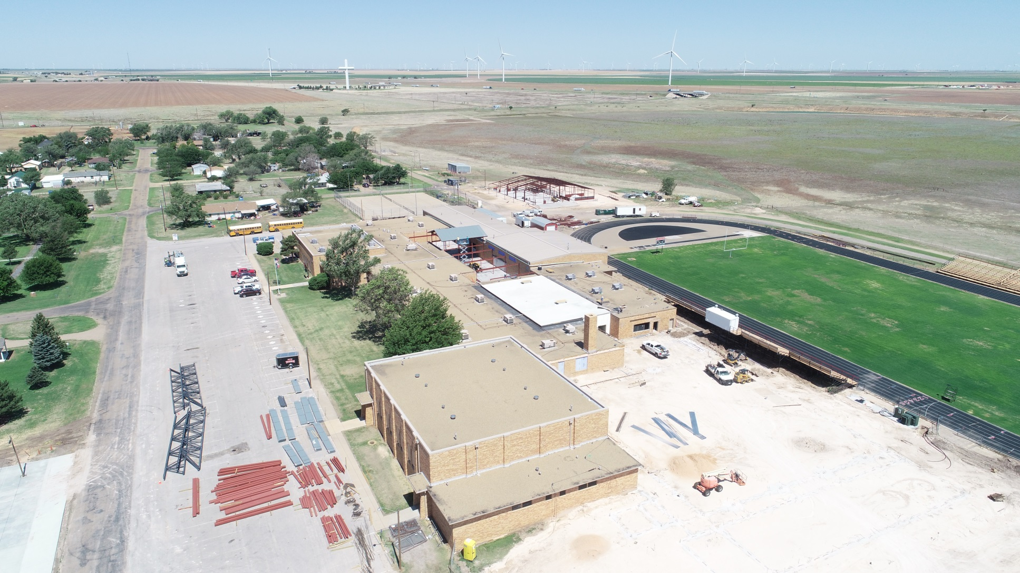
Site Picture #2

Slide 10
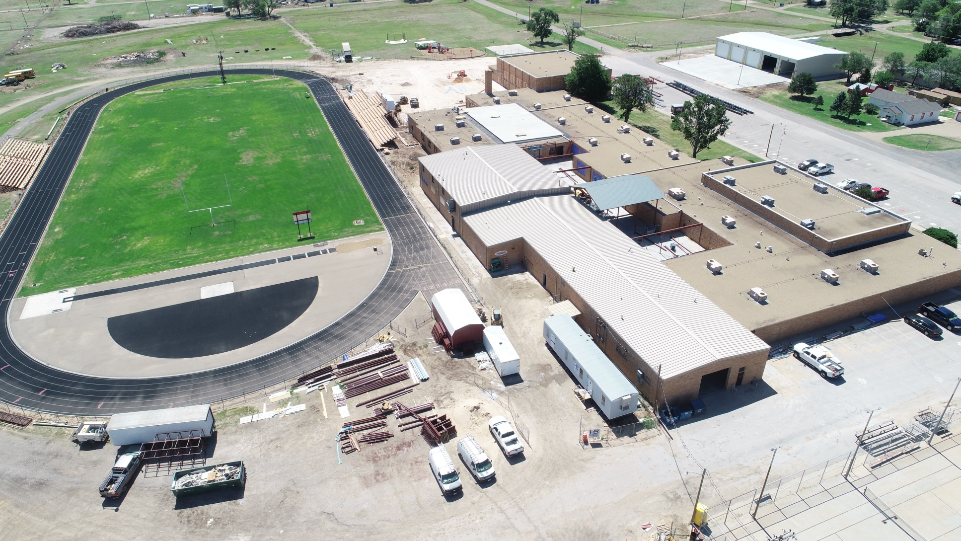
Site Picture #3

