Slide 1
Guided Reading
The Next Step Forward in Guided Reading by Jan Richardson

Slide 2
Purpose
To discover what our understandings of Small Group Guided Reading are and to come to a common understanding and practice.

Slide 3
What is guided reading?

Slide 4
Guided reading is small-group differentiated reading instruction that supports students in developing reading proficiency. It includes instructional-leveled texts and targeted teaching.

Slide 5
The basic tenets of guided reading based upon research are...

Slide 6
Basic Tenets
Teachers match students with challenging books that are at their instructional reading level and support their next reading goal.

Slide 7
Basic Tenets
Students become better readers by reading, self-monitoring, and problem solving their way through text, rereading as needed to check understanding.

Slide 8
Basic Tenets
Teachers are intentional in their instruction and responsive to the specific needs of their students.

Slide 9
Basic Tenets
Teachers know when to step in and scaffold and when to reduce support, enabling students to move forward as independent readers.

Slide 10
The Pre-A Reader - Profile
Student knows < 40 letters
Working on one-to-one correspondence
Working on directionality
Working on basic book skills (Parts of a book, where to start reading, letter vs. word...)

Slide 11
The Emergent Reader (A-C)- Profile
Able to write their first name
Can identify 40 or more letters by name
Know at least 8 sounds

Slide 12
The Early Reader (D-I) - Profile
Know their letters and sounds
Reading and writing CVC words (working on decoding)
Working on phonics skills
Learning to read and write sight words - know about 30 sight words

Slide 13
The Transitional Reader (J-P) - Profile
Able to decode CVC, CVCe, digraphs, blends
Working on decoding multisyllable words
Working on self-monitoring strategies

Slide 14
The Fluent Reader (N-Z)- Profile
Read fluently regardless of genre
Learned how to decode words
Use meaning and word parts to quickly self correct
Vocabulary based on context clues
Have stamina to read
Monitor comprehension of text
Explore deeper levels of thinking in more complex text

Slide 15
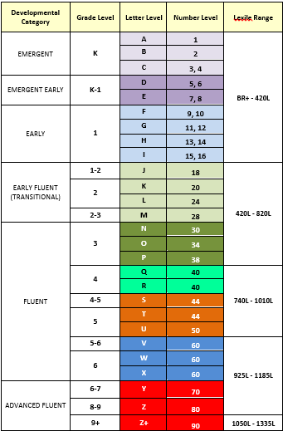
Benchmark Education Reading Level Conversion Chart

Slide 16
Guided Reading Videos
EMERGENT VIDEOS:
Reading the book with a prompt
Selecting a teaching point
TRANSITIONAL VIDEOS:
Reading the book with prompting

