Slide 1
Reconstruction
8-5.1 - 8-5.3

Slide 2
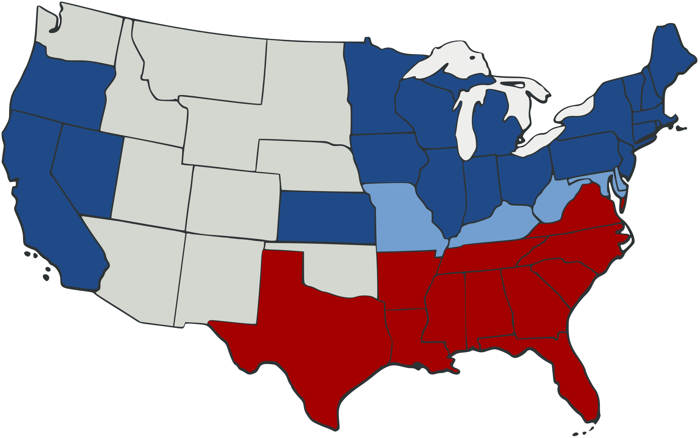
Reconstruction
The Reconstruction era, which lasted from 1865-1877, is where the country has to be put back together again after the Civil War. The time period is controversial because it experienced times of great progress on racial equality, but then the rise of vigilante groups stripped that progress away.

Slide 3
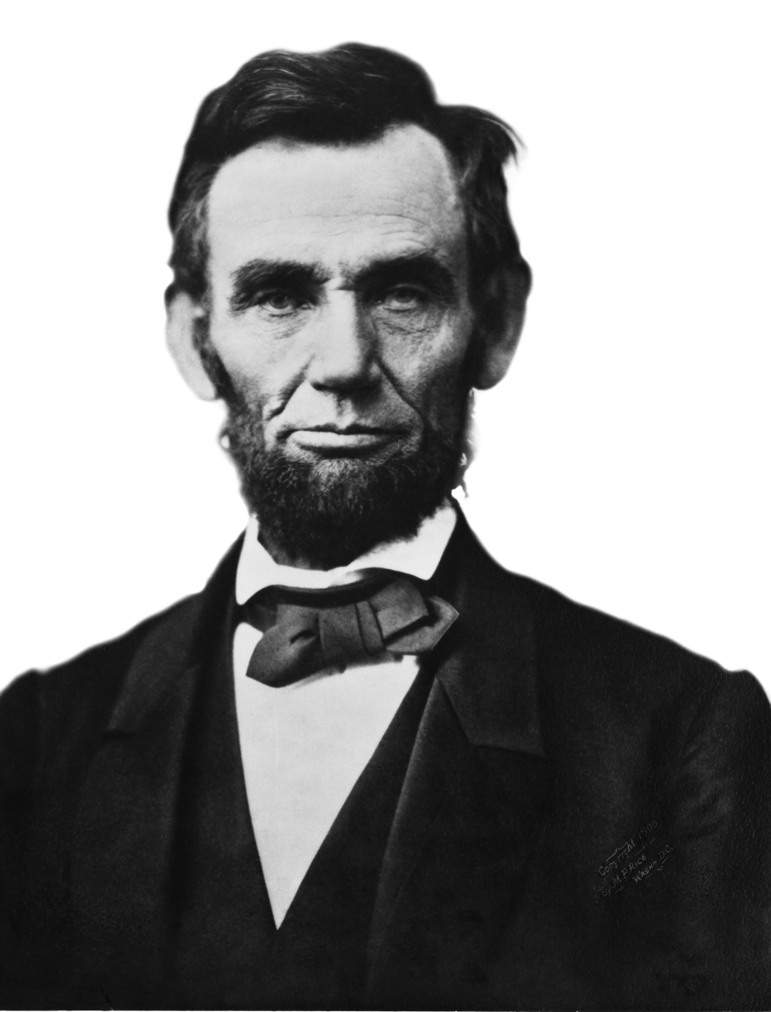
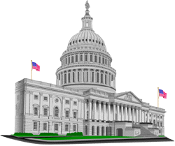
Reconstruction
President & Congress had to solve the following issues during Reconstruction:
-how to bring back the Southern states
-how to help the newly freed former slaves

Slide 4
Freedmen’s Bureau
South Carolina and the other Southern states were destroyed in the war. While the U.S. government did not feel responsible for repairing the economy of the South, they did recognize that the citizens in these states were in a state of emergency.
The U.S. government created the Freedmen’s Bureau (Bureau of Refugees, Freedmen, and Abandoned Lands). This agency provided food, clothing, medical care, education, and some protection to both whites and freedmen. It set up over 1,000 public schools and helped freedmen find jobs or purchase abandoned lands. (Land was often given back to the white owner’s once they were pardoned).

Slide 5
Freedmen’s Bureau

Slide 6
Sharecropping
The Bureau helped Freedmen who had no land, set up contracts to become sharecroppers.
In the sharecropping system, a farmer who can’t afford their own land, rents a plot of land to farm from a large landowner (often the plantation owner). The landowner provides seeds, tools, housing, etc. in exchange for a portion of the sharecroppers crops.
The landowner would often take ½ to ⅔ of a sharecropper’s harvest. In years with a bad harvest, sharecroppers would take out a crop lien or loan on next year’s crop to get by. This led to an endless cycle of debt and poverty for African Americans and poor whites.

Slide 7
Sharecroppers

Slide 8
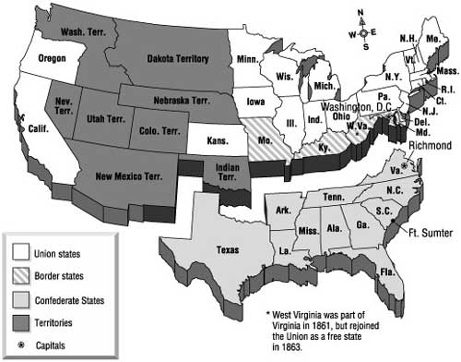
Reuniting the States
The dilemma over reuniting the Southern states with the Union was not easily solved.
Should you punish them for rebelling & starting the war?
Should you make it easy for them to rejoin and run the risk of them seceding again?

Slide 9
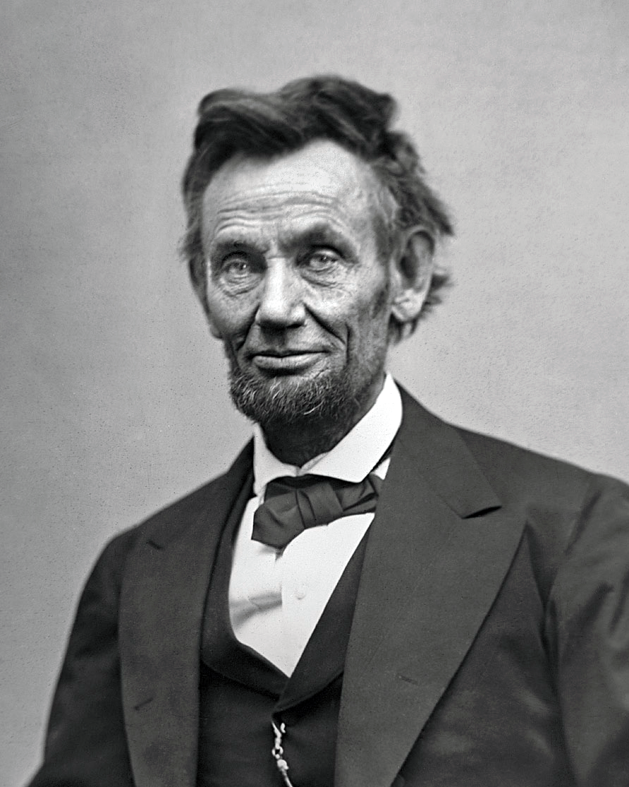
Lincoln’s Plan
President Lincoln’s goal was to reunite the country as quickly as possible.
As the war was drawing to a close, he announced a plan that would require 10% of the state’s population sign an oath of allegiance. They also had to recognize the end of slavery (which would become the 13th Amendment to the Constitution).
After this was done, the state governments could be set up and send representatives to Congress.
Lincoln hoped if he was lenient, the Southern states would surrender faster.

Slide 10
Lincoln’s Assassination
Six days after the end of the war, Abraham Lincoln was assassinated while watching a play at Ford’s Theatre in Washington D.C.
Vice President Andrew Johnson took over as President.

Slide 11
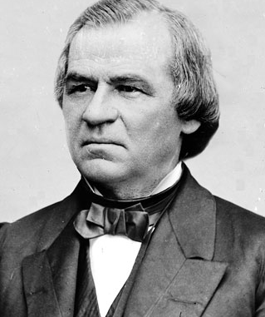
Johnson’s Plan
Andrew Johnson came up with a new plan to readmit the Southern states.
As a Tennessee Democrat, who stayed with the North, Johnson resented the Southern elite. His plan’s goal was to put the country back together, while also humiliating Southern elite.
10% had to swear allegiance, but leaders and high ranking officers had to personally request a pardon (legal forgiveness) from Johnson. States had to ratify the 13th Amendment (outlawed slavery), but did not have to guarantee any other rights to African Americans.
States could then call a convention to establish a new state government.

Slide 12
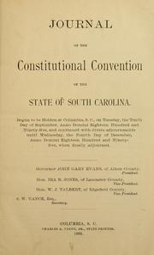
Constitution of 1865
South Carolina called a convention to meet in Columbia. The acknowledged the end of slavery, but little else changed. The people elected to the state legislature were the same office holders as before the war.

Slide 13
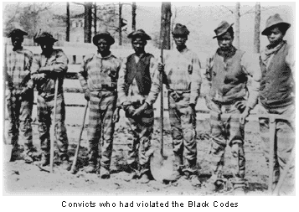
Black Codes
The state legislature quickly passed a group of laws called the Black Codes.
These laws were designed to limit the black population of SC. They were almost identical to the Slave Codes. They limited African Americans from interracial marriages, travel, and owning guns. They had a separate court system and if they signed a sharecropping contract they weren’t allowed to leave the land.

Slide 14
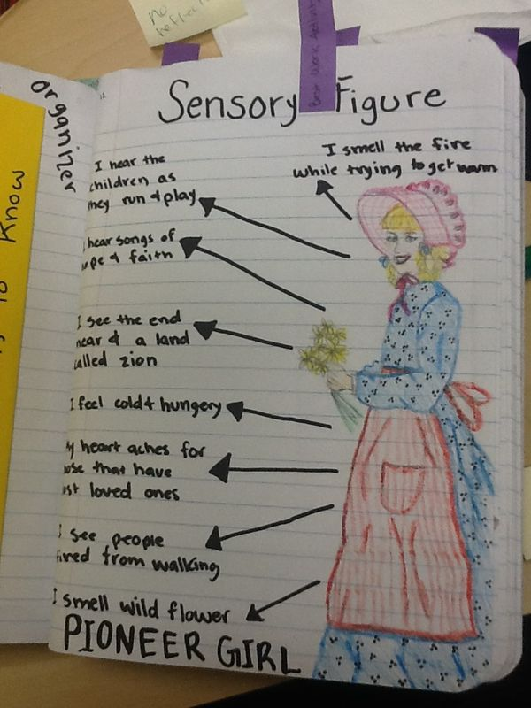
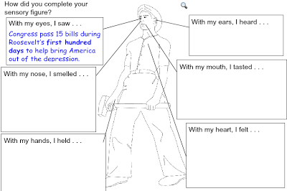
Your Assignment
Compare life as a slave, to life as a sharecropper. Use your prior knowledge of life in slavery and your new knowledge of sharecropping & the Black Codes, to create two sensory figures.
One should show life in slavery and one should show life as a sharecropper in Reconstruction. Is life better? Worse? Somewhere in between?

Slide 15
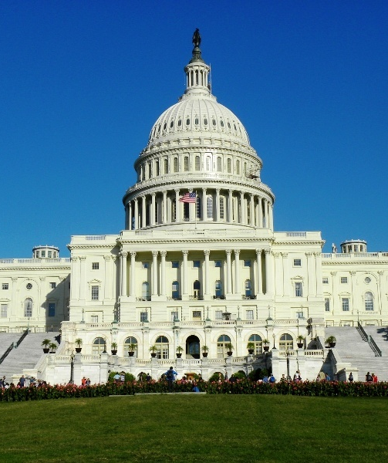
Radical Republicans’ Plan
The Republicans in the U.S. Congress were furious that the Southern states hadn’t really changed anything, so they decided to take action against the Southern states and President Johnson.
Congress overturned presidential Reconstruction and declared that none of the southern state governments were valid.
They then created five military districts and were occupied by federal forces while they wrote another constitution. States had to ratify the 14th Amendment (gave African Americans citizenship & equal protection under the law) and the 15th Amendment (gave all males the right to vote). Finally, they had to disband all military organizations.

Slide 16
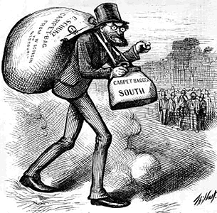
Another Constitutional Convention
White South Carolinians were furious and boycotted the formation of the new government. African Americans made up more than half of the convention. The other delegates were either scalawags (Southerners who cooperated with the Republicans’ Reconstruction plan) or carpetbaggers (Northerners who came down South).

Slide 17
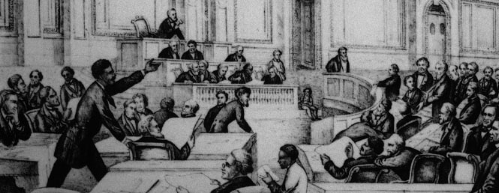
Constitution of 1868
The new Constitution was designed to provide equality for all SC citizens. It had universal male suffrage and guaranteed public education for everyone. It established universities for African Americans.
African Americans finally had political power and could hold office. African Americans held every state office except Governor and SC sent 6 African Americans to the U.S. House of Representatives.
After the constitution was ratified, federal troops were withdrawn from SC.

Slide 18
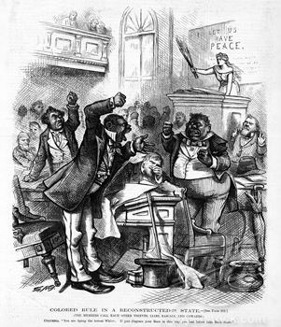
White Backlash
White South Carolinians never accepted the Constitution of 1868. They complained that the cost of public education for everyone was raising taxes too high. They complained that the Republicans (mainly African Americans) had no experience in running a government. They published articles and reports that implied that the legislatures were incompetent or even illiterate.
Finally, widespread violence broke out across the state as vigilante groups like the KKK, Riflemen, and Red Shirts attacked those participating in the Reconstruction government.

Slide 19
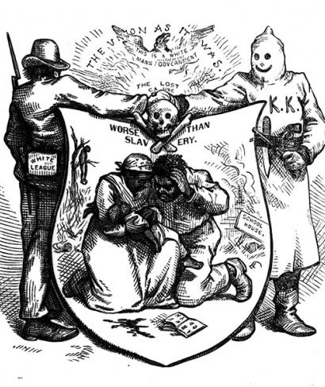
KKK
The violence got so bad that the U.S. government passed the Ku Klux Klan Act---which sent troops back into SC. However, the act did little to stop the violence and very few KKK members were actually convicted of any crimes.

Slide 20
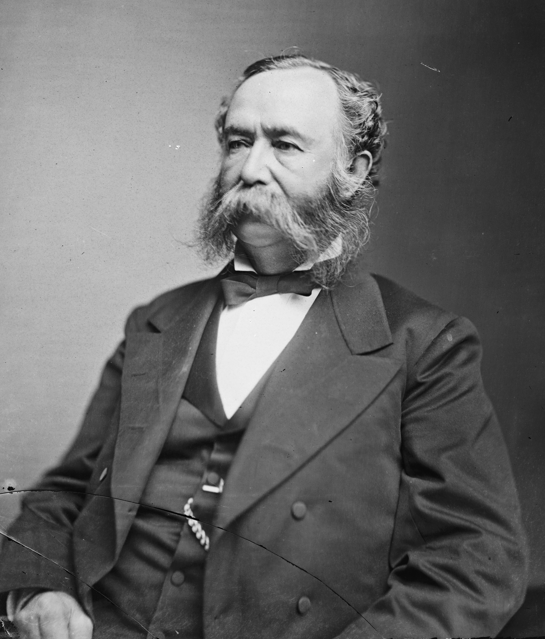
1876 Elections
By 1876, the white Democrats were ready to challenge the Republicans in election. Wade Hampton (former Confederate General) became the leader of the Democratic Party in SC. His followers, called “Red Shirts” or “Redeemers” campaigned on the idea that they would “redeem” SC to its former glory.

Slide 21
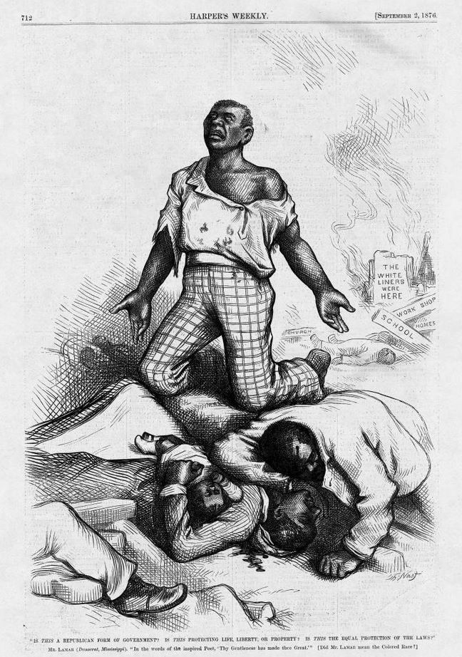
Hamburg Massacre
The Red Shirts committed acts of violence and fraud to ensure that Hampton won. In Hamburg, an argument between a black militia leader and white travelers, resulted in hundreds of armed whites from “rifle clubs” descending on the town. One white and one black were killed in the skirmish, but after the black militia surrendered, six of them were murdered in cold blood.

Slide 22
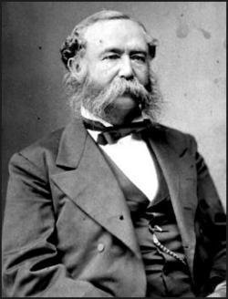
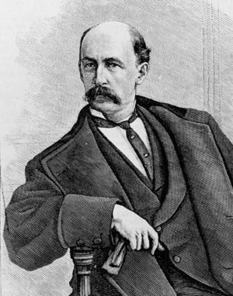
Two Governments
President Grant sent in more troops, but the election was fraudulent. Hampton won more votes in one town then there were people. Republicans declared the election ineligible, but both parties sent representatives to Congress and SC had two “Governors” for four months.
White taxpayers only paid money to Hampton’s government, so if an agency needed money, they had to go to him. That gave Hampton the power in the state.
I’m the real governor!
I’m the real governor!

Slide 23
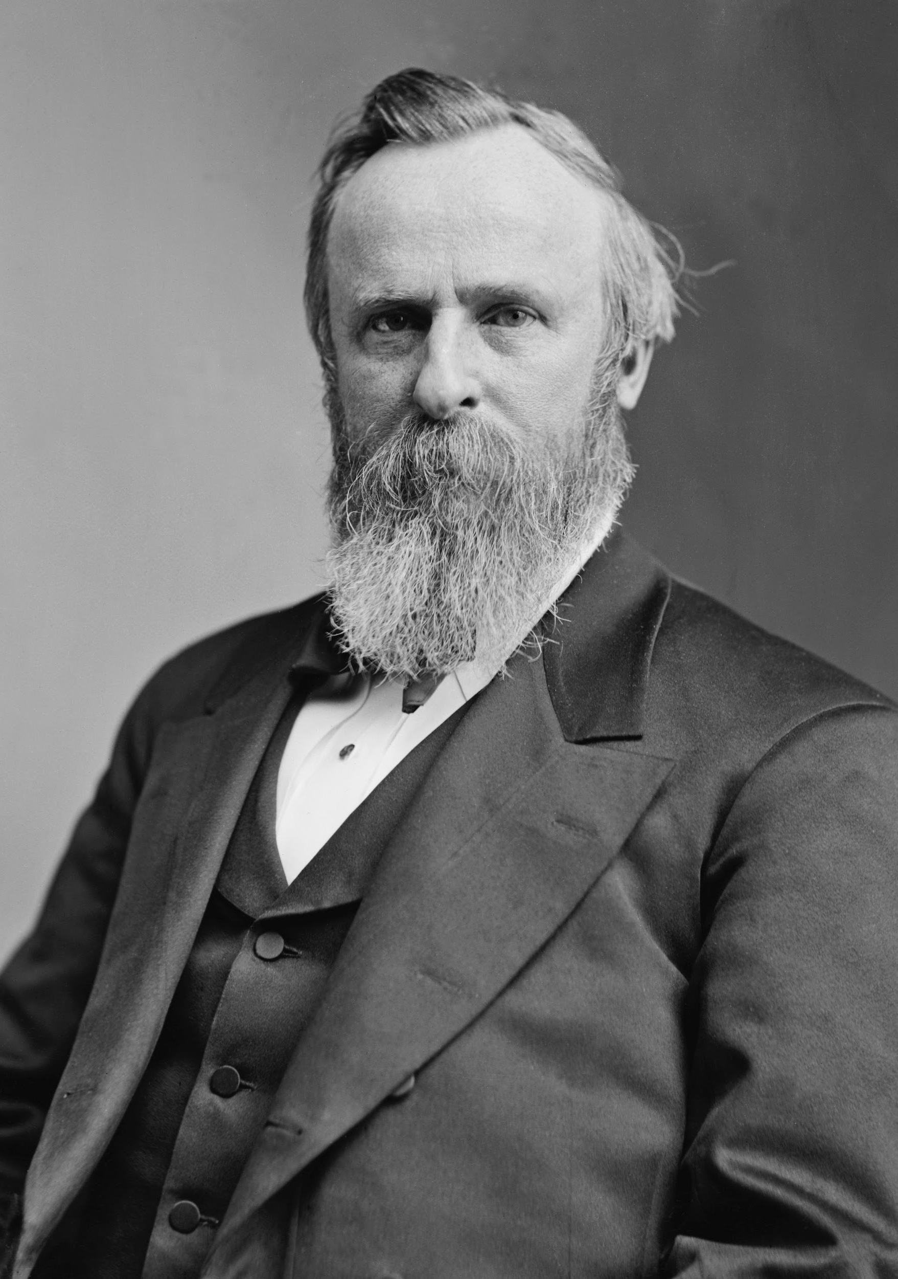
Election of 1876
Meanwhile, the U.S. had election drama of their own. The Democratic nominee Samuel Tilden, was one vote shy of enough to win in the electoral college, but there were 22 disputed votes. (For example, SC’s votes were in dispute, because we weren’t sure who had the power). Congress awarded the 22 votes to Republican Rutherford B. Hayes.

Slide 24
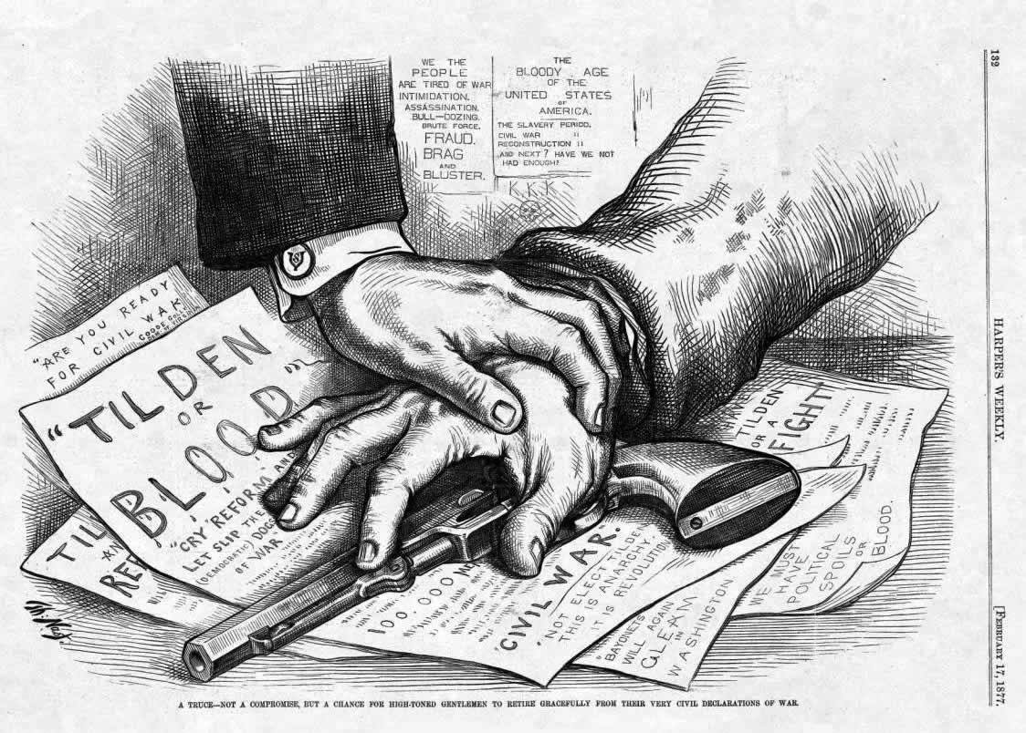
Compromise of 1877
In the Compromise of 1877, Democrats agreed to support Republican Hayes as President. In exchange, Hayes agreed to withdraw all troops from the South. This left the Republican government and African Americans to fend for themselves. Wade Hampton became governor of SC.

