Slide 1
Scholarship Search 101: tips on getting Free Money
Ms. Culver, School Counselor
Prince George High School

Slide 2
Tip #1: Start Early
Be proactive
Create a plan or outline as to what type of scholarships you want to apply to.
Ex: career field, perspective school, etc
Don’t wait until the last minute to look for scholarships
Check with your high school counseling office to see what scholarship they offer.

Slide 3
Tip #2: Avoid scams
If it sounds too good then it’s probably not legitimate
Common signs to look for
If a scholarship advertises that the information is “exclusive” .
most financial aid comes from colleges or federal government. They are looking for candidates to award scholarships too. They don’t want the info to be “exclusive”
“Scholarship guaranteed”
Unfortunately no one can guarantee that you will be awarded a scholarship
Application Fee
You should not have to pay no more than the cost of the a postage stamp. If the organization is going to charge you to submit an application you may not want to continue.

Slide 4
Tip #3: Ask your Perspective school
Most colleges/universities offer their own scholarships. Search their website to see which ones you qualify for.
Speak to a financial Aide Representative
Don’t be afraid to ask questions!

Slide 5
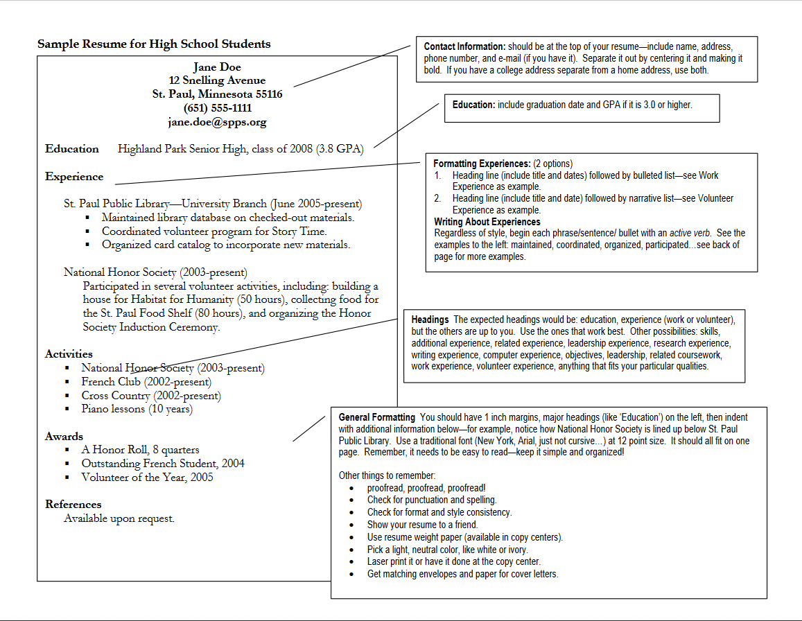
Tip #4: Essay and High School resume
Write one Essay
Most scholarship applications have the same or very similar questions
Tweak when need to
Have English teacher review it
High School resume
Create a resume highlighting all of your academic achievements, as well as extracurricular activities and any volunteer/internship experiences.
You can find Sample templates online. Just search “ Sample high school resume templates”

Slide 6
Tip #5 Online Search
Utilize search engines and other websites to find scholarships
We are technologically driven world so many scholarships are done online now.

Slide 7
Tip # 6: Apply for as many as you can!
Apply Apply apply!.
Most often scholarships that are not from the federal government or College/University are not renewable. Which means even while you are in college you should still be applying.
Remember this is your future
Apply for all that you qualify. The reality is you will not receive them all but your chances of be awarded scholarships are certainly greater when you apply for more.

Slide 8
Tip #7: Do not Give up!
This process may become daunting but keep pushing
! it will pay off in the end!

Slide 9
Scholarship Resources
CollegeBoard
https://bigfuture.collegeboard.org/scholarship-search#scholarship3
Career One stop
https://www.careeronestop.org/toolkit/training/find-scholarships.aspx?&scholarshipid=2014574
Lend EDU
https://lendedu.com/blog/scholarships
College Covered
https://www.collegecovered.com/getting-into-college/college-interviews/7-good-questions-to-ask-during-your-college-interview/

Slide 10
References
https://www.princetonreview.com/college-advice/finding-college-scholarships
https://professionals.collegeboard.org/guidance/financial-aid/scams
http://www.mass.edu/gearup/documents/WritingaResume.pdf

