Slide 1
Making Your Laptop Work for You
Transitioning From iPad
Navigating Your Device
Managing Your Workflow
Device Responsibility and Care

Slide 2
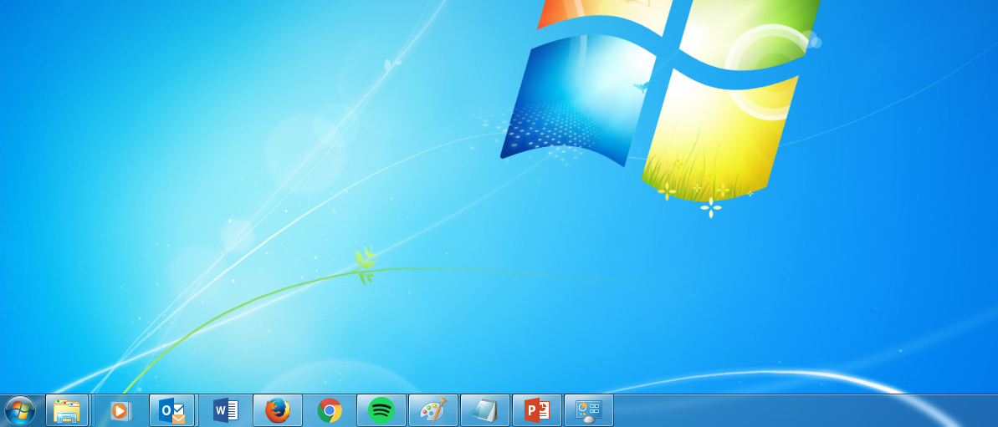
Transition From iPad It’s Different, But Not That Different
iPad | Laptop
iOS Operating System App Based (From Home Screen) Auto Save | Windows Operating System Program Based (From Start Menu) YOU HAVE TO DO THE SAVING!!!!!!! Save to Your H: Drive Save to a Flash Drive

Slide 3
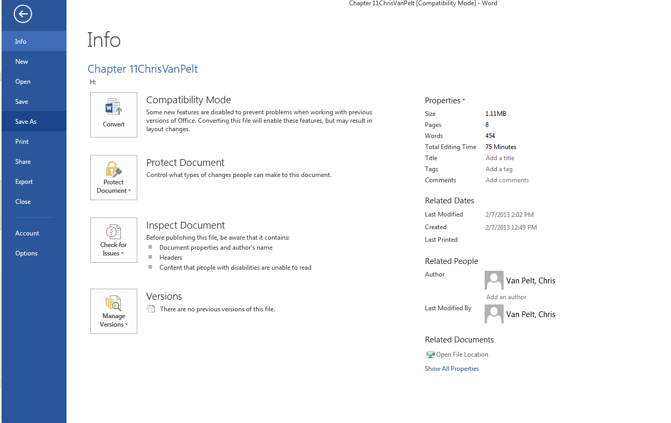
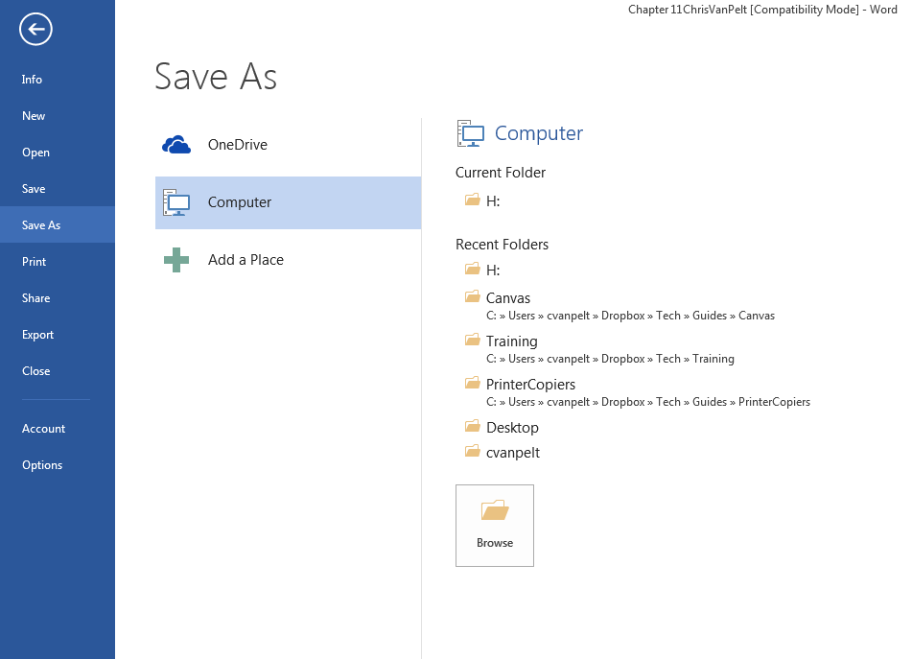
Saving to Your H: Drive
When in Microsoft Office Programs,
Click the
at the top.
Click
Click

Slide 4
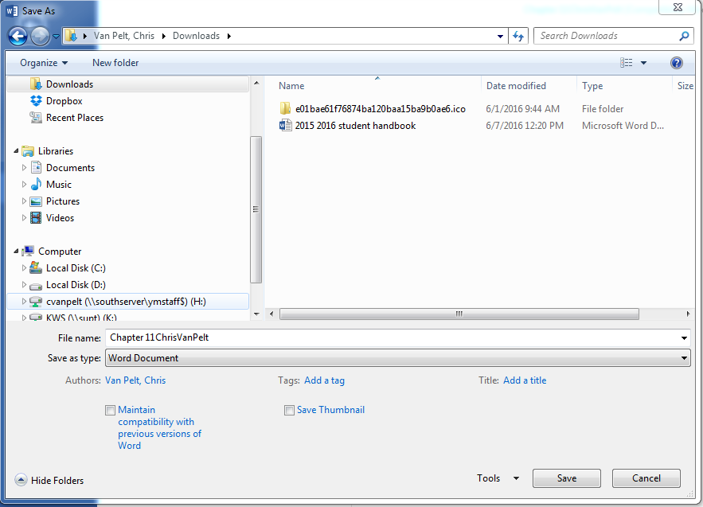
Saving to Your H: Drive
On the pop out menu, scroll down on the left
hand side until you see H: after your login name.
Click it, and click Save!

Slide 5
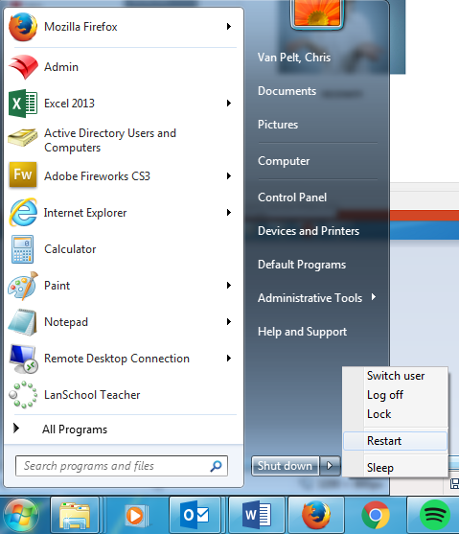
Saving to Your H: Drive
H: Drive not showing??
RESTART!

Slide 6
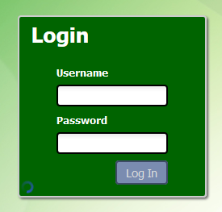
Access H: Drive From Home
My.Yorktown.k12.in.us
Click Desktop

Slide 7
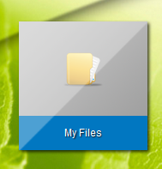
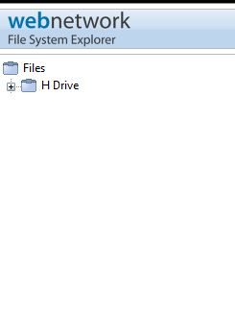
Access H: Drive From Home
Click
On the left hand side,
Click the + next to H Drive

Slide 8
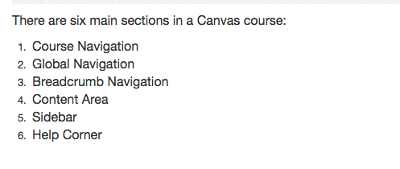
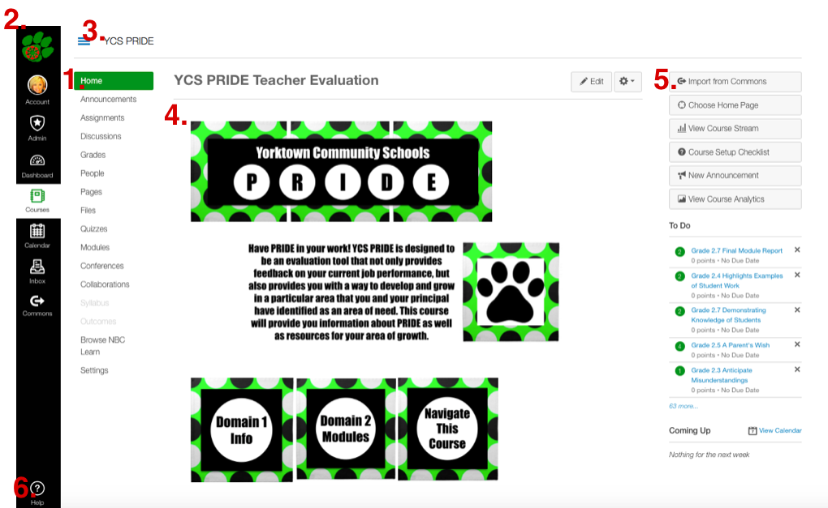
Canvas’ New Look You’ll Access Through the Web Now

Slide 9
Canvas’ New Look
The Global Navigation menu allows you to get where you want to go across all of the Canvas courses you are enrolled in.
The Course Navigation menu allows you to move around inside your individual Canvas Courses.

Slide 10
Your Responsibilities
Bring Your Computer to School Charged Everyday
Your battery will last all day.
Take Care of Your Laptop…It’s yours for the next four years!

