Slide 1
The Dignity for All Students Act (DASA)
Training
2018
Presented by CCSD Social Workers
Karin Brenner
Kirsten Carillo
Kathy MacCarthy
Dana Russo
Angela Sarita

Slide 2

The Dignity for All Students Act
New York State’s Dignity for All Students Act (The Dignity Act or DASA) was established to provide all students from harassment, bullying and discrimination.
It became effective on July 1, 2012
It was amended to include cyberbullying effective July 1, 2013

Slide 3

Purpose of The Dignity Act
Students need a safe, secure and effective learning environment.
Notes:
The whole thrust of this law is that harassment reduces educational achievement and that is not acceptable. Students must be provided a safe environment so that they can achieve to their potential.

Slide 4



The Dignity for All Students Act
Effective July, 2012
Amended July, 2013
Curriculum
Code of Conduct
Information in all languages
DASA Coordinators
Employee Training
Reporting
Notes:
Curriculum must include instruction that supports the development of a school environment free of discrimination and harassment.
The Code of Conduct must be amended to include provisions prohibiting discrimination and harassment against any student by employees or students, and provisions for responding to such acts.
Material incidents of discrimination and/or harassment on school grounds or at a school function must be reported to NYSED annually.

Slide 5
Professional Certification
Professionals applying for certificate or license must complete training on social patterns, identification and mitigation, and strategies for effectively addressing exclusion, bias, and aggression in educational settings.
Curriculum
Curriculum must include instruction in safe and responsible use of the Internet and electronic communications and emphasize discouraging acts of harassment, bullying and discrimination.

Slide 6

The Dignity Act emphasizes the creation and maintenance of a positive learning environment for all students
The amended Dignity Act requires the development of measured, balanced progressive and age-appropriate responses
Notes:
Professional Certification: Professionals applying for certificate or license, including but not limited to classroom teachers, school
counselors, school psychologists, school
social workers, school administrators or
supervisors, and superintendents of schools,
must complete training on the social patterns
of harassment, bullying and discrimination,
identification and mitigation of harassment,
bullying and discrimination, and strategies for
effectively addressing exclusion, bias and
aggression in educational setting.

Slide 7
Definitions
According to the United States Department of Education (USDOE), www.stopbullying.gov/what-is-bullying/definition/index.html, bullying generally involves the following characteristics:
  An Imbalance of Power
  The Intent to Cause Harm
  Repetition

Slide 8
Definitions
Bullying
Is unwanted, aggressive behavior that involves a real or perceived power imbalance. The behavior is repeated, or has the potential to be repeated, over time.
Can occur before and after school hours, in a school building, on a playground, on a school bus while a student is traveling to or from school, or on the Internet.
Cyberbullying occurs when harassment or bullying happens through any form of electronic communication.
Students who are bullied and those who bully others may have serious and lasting problems

Slide 9
Definitions
Harassment
is defined as the creation of a hostile environment by conduct or verbal threats, intimidation, or abuse.

Slide 10
Definitions
Discrimination
is the act of denying rights, benefits, justice, equitable treatment or access to facilities available to all others, to an individual or group of people because of the group, class or category to which that person belongs.

Slide 11
Harassment, Bullying, Discrimination
Reasonably causes or would be expected to cause a student to fear for his or her physical safety
Reasonably causes or would be expected to cause physical injury or emotional harm to a student

Slide 12
What Does the Law Include?
Harassment, bullying, and/or discrimination includes, but are not limited to: threats, intimidation or abuse based on a person’s actual or perceived race, color, weight, national origin, ethnic group, religion, religious practices, disability, gender, sexual orientation, or sex.
Notes:
This list of categories of discrimination has a somewhat new addition – weight. Later on you will see that weight and body image are the most frequent subject of taunting and harassment.

Slide 13
Does It Matter…
Race
Color
Weight
National origin- Ethic Group
Religion-Religious Practices
Disability
Sexual orientation
Gender
Sex
If it’s real or perceived?
What’s the line between real and unreal?
Notes:
Discuss how these categories exist as real factors and as perceived factors. Help drivers and attendants understand how perception and reality can be one in the same. If a person is perceived to be overweight, or gay, or black, it doesn’t really matter how much they weigh, what their sexual preference is or what the color of their skin is. If they are treated as a member of that discriminated class of persons, that behavior is just as illegal as if they were in fact in that category.

Slide 14

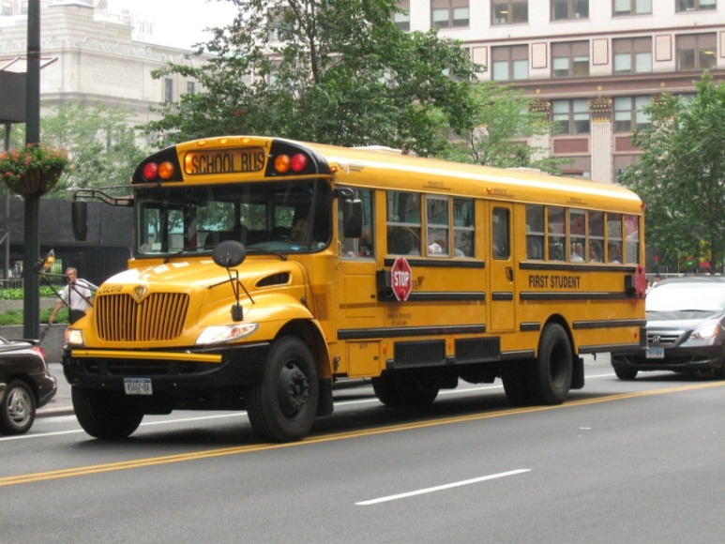
How Does the Dignity Act Involve Me?
“Employee” shall mean any person receiving compensation from a school district OR employee of a contracted service provider.
Notes:
The definition of “employee” is also clarified in education law to include contracted employees such as school bus drivers and attendants/monitors.

Slide 15

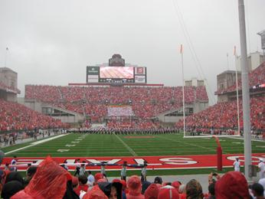

What is School Property?
School Property means any:
Building
Structure
Athletic playing field
Playground
Parking lot
School bus
School land

Slide 16
Off Campus Incidents
Occurs off school and creates or would foreseeably create a risk of substantial disruption within the school environment, where it is foreseeable that the conduct, threats, intimidation or abuse might reach school property.

Slide 17

Cyberbullying
Cyberbullying is defined as harassment or bullying by any form of electronic communication, and include incidents occurring off school property that create or would foreseeably create a risk of substantial disruption within the school environment.

Slide 18

Cyberbullying
Texting
Social Media
  SnapChat, Twitter, Facebook, Instagram,
Email
Online gaming
Notes:
Flaming, also known as bashing, is hostile and insulting interaction between Internet users, often involving the use of profanity. Flaming usually occurs in the social context of an Internet forum, Internet Relay Chat (IRC), Usenet, by e-mail, game servers such as Xbox Live or PlayStation Network, and on video-sharing websites.
The use of Internet services or software with Internet access to defraud victims or to otherwise take advantage of them, for example by stealing personal information, which can even lead to identity theft.

Slide 19
Reporting Requirements
Oral report to administrator/designee
required within ONE (1) school day
Written report required within TWO (2) days after making oral report

Slide 20
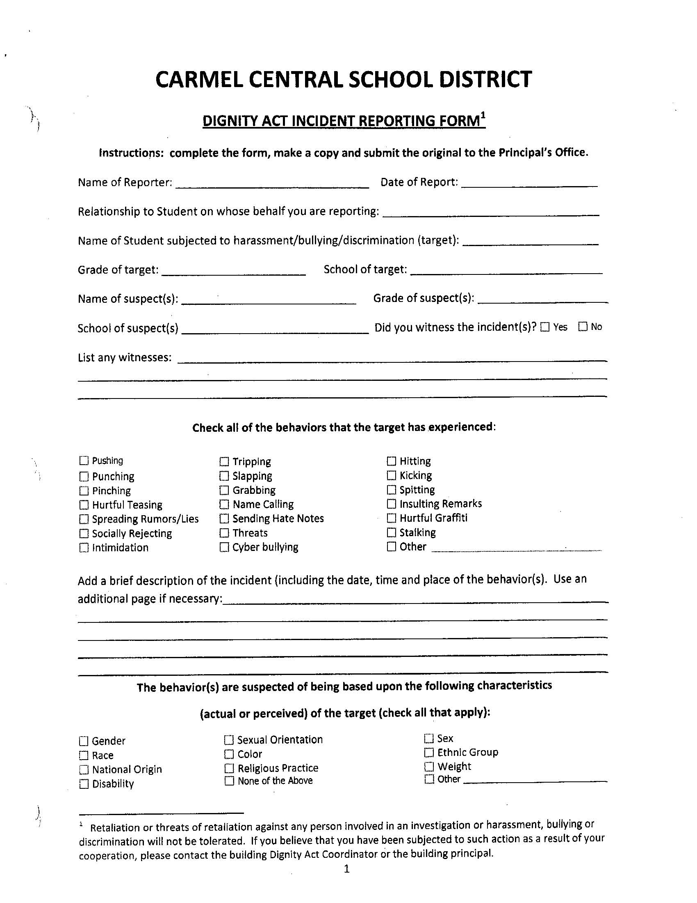
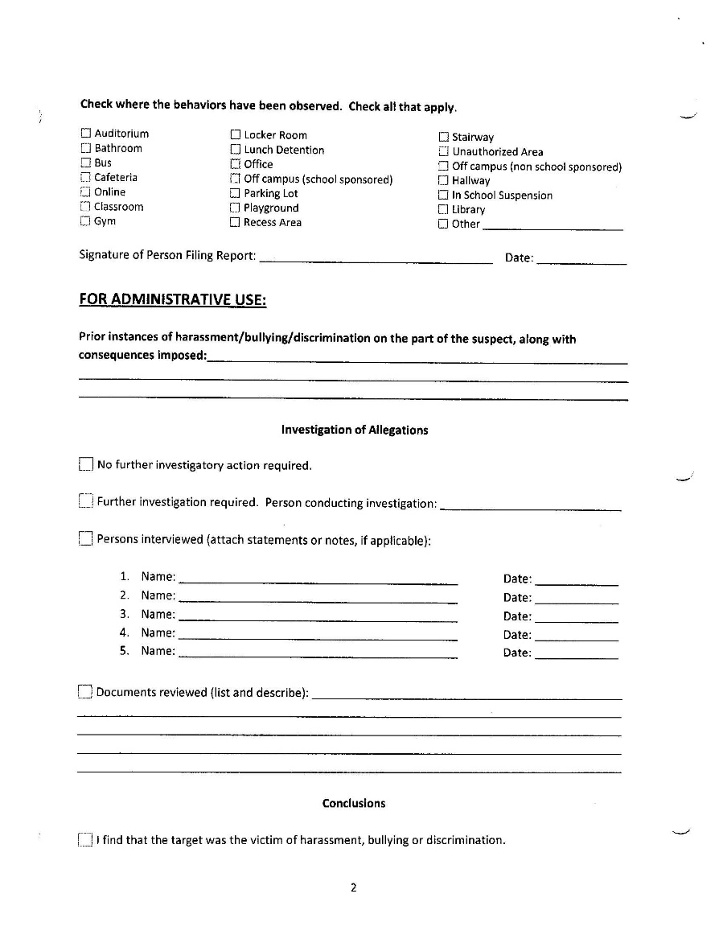
DIGNITY ACT REPORTING FORM

Slide 21
Investigating Reports
The principal, superintendent, or designee must lead or supervise the prompt and thorough investigation of reports.

Slide 22
Response to Verified Reports
The school must take prompt actions reasonably calculated to END the harassment, bullying or discrimination, ELIMINATE any hostile environment
AND
Create a more positive culture and climate, prevent recurrence and ensure the safety of the student(s) toward whom the harassment, bullying or discrimination was directed

Slide 23
Protection for You
Any person acting in good faith who reports such information to school officials or law enforcement shall have immunity from civil liability
“Prohibition of any retaliation against an individual who, in good faith, reports, or assists in the investigation”
Notes:
There is a whistle-blower provision in the law to make sure that employees are not sued for reporting bullying or harassment. This should reassure folks who might be concerned that they could get into trouble for reporting something.

Slide 24

Failure to Report
Could lead to serious disciplinary and/or legal consequences for the staff member and/or school district.

Slide 25
Notification of Law Enforcement
The Principal, Superintendent or designee will be required to notify appropriate local law enforcement when they believe that any harassment, bullying or discrimination constitutes criminal conduct.

Slide 26
Bullying, Harassment, Discrimination Can Lead to…
School Avoidance
Avoiding bus, bathrooms, locker rooms, sport teams
Difficulty concentrating/learning
High risk behaviors
  Drug/Alcohol Abuse
  Cutting
Suicide
Notes:
Before clicking in the content of this slide ask your class what they think that some of the consequences of harassment can be.
These are just some of the negative outcomes of bullying and harassment. These concerns will be covered in more detail later in the presentation.

Slide 27

Identify the Red Flags for
Students Being Bullied
Become aggressive and unreasonable
Begin to bully others
Grades drop, lose interest in school/activities
Money, books or clothes destroyed or “lost”
Withdrawn, start stammering, lack confidence
Avoid the school bus
Distressed and anxious
Sitting alone, stop hanging with friends
Attempt or threaten suicide
Unexplained bruises, cuts, scratches
Refuse to talk about it
Notes:
This list shows examples of behaviors you might see if a child has become the target of harassment or bullying. Ask your audience to identify any of these red flags that they have observed on their bus.

Slide 28

Create a Culture of Caring
Set expectations
Create trust
Build a culture of safety
Be hyper-vigilant
Respond consistently
Get the whole story
BELIEVE students
Notes:
We can create a Culture of Caring, or we can allow a culture of cruelty to grow on our bus. When a driver says, “I just drive ‘em, I can’t manage them too,” they are setting the stage for a culture of cruelty to grow on their bus. We need to work at creating trust, to be hyper-vigilant and to believe students when they tell us they have been bullied or harassed. There is nothing as psychologically crushing as to be told something didn’t happen. When the bus staff joins in the bullying, it tells the student that adults are not to be trusted.

Slide 29
What Can I Do?
Commit to children’s emotional and physical safety
Get to know children and their interests
Identify potential victims
Use referrals effectively
Make connections in the schools
Interior lights on in the hallways and classrooms
Staff move around classroom and playground yard
Observe change – ask about it
Inquire without embarrassing
Maintain confidentiality
Have 0% tolerance
Notes:
Take time to walk through this list of strategies. We talked in one of the 2009 refreshers about the importance of building relationships, and that is the cornerstone of successfully handling bullying and harassment on your bus.
It is also a key to develop relationships with persons in the schools that you are serving so that you can work together at dealing with harassment issues and so that you can communicate through the referral process effectively.
A few strategies to limit bullying include keeping interior lights on in the dark, having bus attendants, chaperones and coaches move around the vehicle during trips, keeping the activity level down in the bus so that you can hear and see anything unusual, and finally, consider using assigned seats.
Whenever you see something suspicious, have 0% tolerance and inquire, but do so in a way that doesn’t put a potential victim on the spot or embarrass them.
Maintaining confidentiality doesn’t mean, “Don’t tell anyone.” It means tell the people identified in your policy as the individuals(s) who are supposed to receive that information.

Slide 30


L.K vs. NYC
The complaint is that L.K. was deprived of an appropriate education because her assigned public school did nothing to prevent her from being so bullied by other students as to seriously reduce the opportunity for an appropriate education. The court ordered that the DOE reimburse parents for one year of private school tuition.
Notes:
Curriculum: Curriculum must include instruction in safe and responsible use of the Internet and electronic communications and emphasize discouraging acts of harassment, bullying and discrimination.
Guidance and Educational Materials: The
State Education Department will provide
guidance and educational materials, including best practices in addressing cyberbullying, and best practices in helping families and communities to work cooperatively with schools in addressing cyberbullying.

Slide 31

T.E. v. Pine Bush CSD
July 2015
Civil case brought by five current and former students who suffered years of anti-Semitic discrimination, harassment and bullying by other students with the District officials allegedly failing to take action to protect the students and stop the bullying and harassment.
A federal judge approved a $4.5 million settlement between the District and the five students and ordered the District to conduct mandatory training on recognizing anti-Semitic harassment and to implement an anti-bullying curriculum.

Slide 32
Scenario
An upper elementary student who was male assigned at birth wears long hair and uses mannerisms associated with being female. During recess two male students tell him he can't play on their team because only boys can play in the game. One states, "you look like a girl" and the other says "he's gay." In harmony both look at him and simultaneously call him a "fag."
They are overheard by the recess monitor who tells them to stop. Another student tells the monitor that she has heard those boys call the target names, and they approach other kids in the class and makes comments about him looking like a girl and being gay. S/he is unsure about the next steps.
Q. What would be appropriate follow up from the monitor?
Q. What might ensue after the monitor follows up?

Slide 33
Scenario
Two high school students did the “Heil Hitler” salute to each other during class.
  Q. What do you think the teacher should do in this scenario?
  Q. What should the administrator should do ?

Slide 34
Scenario
A student called an ENL student “Spic” during class. He also told the same student “ …. You were busy talking to your Mexican friend”. The ENL student went to the teacher.
  Q. What do you think the teacher should do?

Slide 35
Scenario
A student posted a video on social media targeting another student whom she was warned numerous times to have no contact with and refrain from all forms of harassment.
Q. What do you think was the administration’s response in this scenario?

