Slide 1
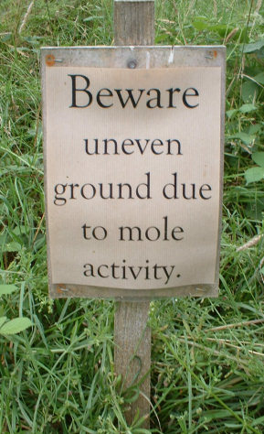
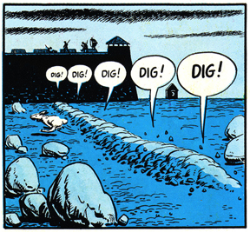
Moles/Stoichiometry

Slide 2
Compounds
Compound: a substance made of two or more different elements that are chemically united together in a definite proportion
For example, water is a compound because 2 Hydrogen molecules are chemically bonded to an Oxygen molecule
2 different elements: Hydrogen and Oxygen
Chemically bonded: covalent bonds
Definite proportion: H2O (always 2 H molecules and 1 O molecule)

Slide 3
Compounds Continued
Chemical compounds can be broken down into new substances by chemical means
Water (H2O) can be broken down with an electrical current into the two elements
2H2O can be broken down into 2H2 and O2

Slide 4
Naming and Formulas
A chemical compound is given a name based on the IUPAC system of naming
A chemical compound can be represented by a specific chemical formula.

Slide 5
Naming
In ionic compounds, metals are written first and nonmetals come afterwards.
If a compound is made of only two elements, or an element and ammonium (NH ₄⁺), its name ends in –ide.

Slide 6
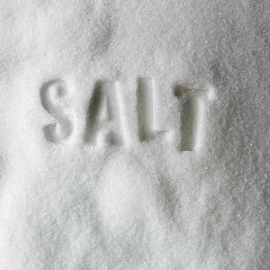
Examples:
NaCl
NH₄Cl

Slide 7
Naming Cont.
If a compound is made up of an element and a polyatomic ion, the element is named first and then the polyatomic ion is named

Slide 8
Examples:
NaClO₂

Slide 9
Naming Cont.
Compounds that contain a metal, a nonmetal, and oxygen are named showing the amount of oxygen that they contain

Slide 10
Number of Oxygens | Formula | Compound Begins With | Compound Ends With | Name of Compound
Most | NaClO₄ | Per- | -ate | Sodium perchlorate
More | NaClO₃ | -- | -ate | Sodium chlorate
More | NaClO₂ | -- | -ite | Sodium chlorite
Least | NaClO | Hypo- | -ite | Sodium hypochlorite

Slide 11
Formulas
Chemical formulas describe the composition of elements or compounds
Chemical formulas can be classified as molecular formulas, empirical formulas, or structural formulas

Slide 12
Molecular Formulas
Molecular Formula: indicates the total number of atoms of each element needed to form the molecule
It is the actual ratio of atoms
Examples:
C₄H₁₀
C₄H₈Br₂

Slide 13
Empirical Formulas
Empirical formula: the simplest ratio in which atoms combine to form a compound
The empirical formula of H₂O₂ is HO
To find the empirical formula, divide each element by the greatest common factor (the largest number that goes into each evenly)

Slide 14
Structural Formulas
Structural formula: shows how the atoms are joined or connected to each other in a molecule
Example:
Propanone is 3 carbon atoms single bonded together, 6 hydrogen atoms single bonded to the end carbons, and an oxygen atom double bonded to the middle carbon

Slide 15
Finding the Molecular Formula
It is possible to find the molecular formula of a compound from the empirical formula.

Slide 16
Find the molecular formula of CH if the molecular mass is 26
Step 1: find the mass of the empirical formula

Slide 17
Find the molecular formula of CH if the molecular mass is 26
Step 2: Divide the mass of the molecular formula by the mass of the empirical formula
Step 3: Multiply the empirical formula by the answer found in step 2
=
=

Slide 18
Chemical Equations
A chemical equations shows which bonds are broken and which bonds are formed
In the equation, the number of atoms on the left side must equal the number of atoms on the right side
You can only change the number before the element or compound (the coefficient), you cannot change the formula of the compound

Slide 19
Chemical Equations Cont.
If there is no coefficient in front of the compound or the element, it means that there is one molecule
To make water, Hydrogen and Oxygen must combine in the molecular formula of H₂O
H₂ + O₂ → H₂O
However, there are 2 oxygen atoms on the left and only one on the right. The equation needs to be balanced.

Slide 20
H₂ + O₂ → H₂O
Add a 2 in front of the right side to make sure that there are 2 oxygen atoms
H₂ + O₂ → 2H₂O
Now there are 4 hydrogen atoms on the right. Add a 2 in front of the hydrogen molecule on the left.
2H₂ + O₂ → 2H₂O
Now the equation is balanced. There are 4 hydrogen atoms on each side and 2 oxygen atoms on each side.

Slide 21
Conservation in Reactions
In all chemical reactions, there is a conservation of mass, energy, and charge.
Matter cannot be created or destroyed.
Energy can be changed from one form to another, but the amount does not change.
The number of positive/negative charges on one side of the reaction must equal the number on the other side.

Slide 22
Matter
2H₂ + O₂ → 2H₂O
There are the same number of hydrogen atoms (4) and oxygen atoms (2) on both sides
If 10 grams of H₂ react with 80 grams of O₂ completely (meaning they are both used up), there will be 90 grams of H₂O on the left side because of conservation of matter.

Slide 23
Model of Conservation of Matter
Mg + Cl₂ → MgCl₂
Magnesium + chlorine → magnesium chloride

Slide 24
Charge
Na⁰ → Na⁺ + e⁻
Al⁰ → Al⁺³ + 3e⁻
The total amount of charge is equal on both sides of the equation.

Slide 25
Gram Formula Mass
6.02 x 10²³ particles = 1 mole of particles
Avogadro's number
The mass of one mole of an element or a compound is equal to its molar mass
To find the molar mass, add up the mass of every element, don’t forget to include 2 hydrogen atoms in H₂O for example

Slide 26
Density
Density = mass
volume

Slide 27
Percent Composition
% composition by mass=mass of part x 100
mass of whole

Slide 28
Chemical Reactions
1. Synthesis Reaction: two or more elements or simpler compounds unite to form a compound

Slide 29
Chemical Reactions Cont.
2. Decomposition Reaction: a compound is broken down into 2 or more elements or simpler compounds

Slide 30
Chemical Reactions Cont.
3. Single Replacement Reaction: a free element replaces an element that is part of a compound

Slide 31
Chemical Reactions Cont.
4. Double Replacement Reaction: two elements replace each other or switch partners. Two new compounds are formed

Slide 32
Converting Moles to Grams
1 mole of an element or compound is equal to the molar mass of that element or compound in grams
2 moles is equal to the molar mass times 2

Slide 33
Mole-Mole Stoichiometry
Mole to mole problems answer how many moles of one element or compound react with a given number of mole of another element or compound

Slide 34
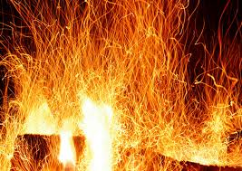
How many moles of Ca are needed to react completely with 6 moles of H₂O in the following reaction? Ca + 2 H₂O → Ca(OH)₂ + H₂

Slide 35
How many moles of Ca are needed to react completely with 6 moles of H₂O in the following reaction? Ca + 2 H₂O → Ca(OH)₂ + H₂
Step 1: write the number of moles given in the problem underneath the element or compound
Ca + 2 H₂O → Ca(OH)₂ + H₂
x 6

Slide 36
Step 2: cross multiply to find the answer
Ca + 2 H₂O → Ca(OH)₂ + H₂
X 6
2x = 6
x = 3
3 moles of Ca

Slide 37
Volume-Volume
These problems give you liters or mL of one element or compound and you have to find liters or mL of the other element or compound.
Moles and volume are proportional

Slide 38
What is the total number of liters of carbon dioxide formed by the complete combustion of 28L of C₂H_{6(g)}? 2C₂H_{6(g)} + 7O₂ → 4CO₂ + 6H₂O

Slide 39
What is the total number of liters of carbon dioxide formed by the complete combustion of 28L of C₂H_{6(g)}? 2C₂H_{6(g)} + 7O₂ → 4CO₂ + 6H₂O
Step 1: write the number of L under the compound.
2C₂H_{6(g)} + 7O₂ → 4CO₂ + 6H₂O
28L X

Slide 40
Step 2: cross multiply
2C₂H_{6(g)} + 7O₂ → 4CO₂ + 6H₂O
28 L X
2x = 112
x = 56
56 L of CO₂

Slide 41
Graham’s Law
Under the same conditions of temperature and pressure, gases diffuse at a rate inversely proportional to the square roots of the molecular masses
Gases diffuse at a faster rate when the molecular mass is smaller (when it’s lighter)
Gases diffuse at a slower rate when the molecular mass is bigger (when it’s heavier)

