Slide 1
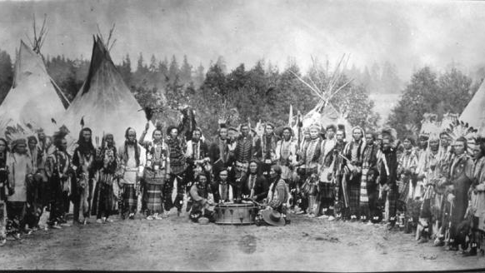
kʷu snəqsilxʷ
snəqsilxʷ ʔasil

Slide 2
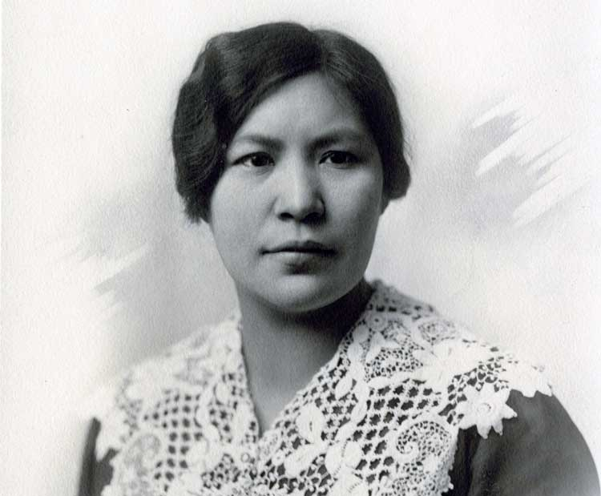
swaw̓ásaʔ
Maternal Aunt

Slide 3
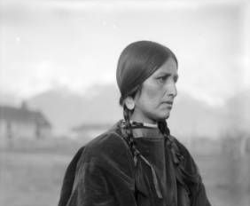
Click to statákʷaʔtext
Paternal Aunt

Slide 4
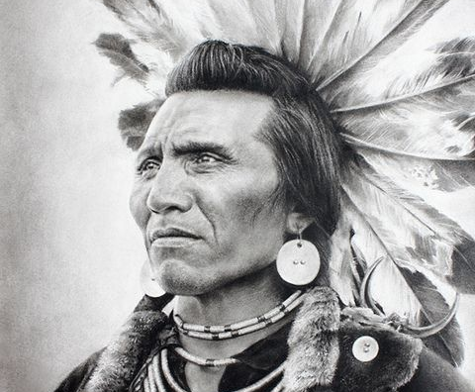
səsiʔ
Maternal Uncle

Slide 5
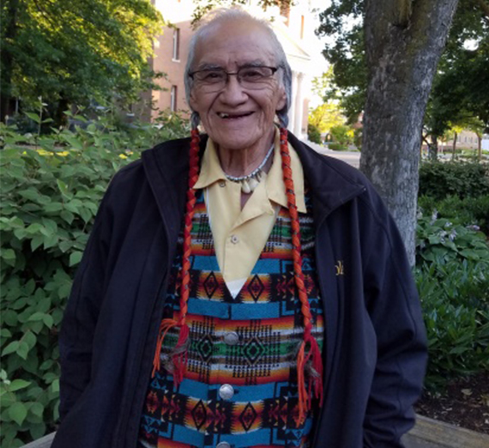
smiʔł
Paternal Uncle

Slide 6
sntxʷus
Cousin, sibling

Slide 7
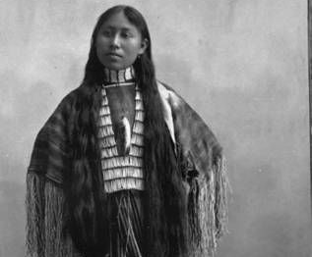
słəłwilt
niece, nephew

