Slide 1
HIGH SCHOOL ADMISSIONS
A Basic Overview
80,000 Applicants
REQUIRED
OPTIONAL
YOUR CHILD
High School Application
700+ Programs at 400+ High Schools
Specialized High Schools
8 Testing Schools LaGuardia HS
Receive HS Application
from guidance counselor.
Complete Specialized High School Survey; receive SHSAT and/or audition
ticket(s) from guidance counselor.
Early Fall
Group Three
Complete Application by listing 12 programs in order of preference. Return to counselor.
Late Fall
SHSAT
Audition
1 Offer*
March
1 Offer*
1-6 Offers*
Round 2 (if necessary)
*if applicable
Notes:
There are two paths that students may take to receive a high school offer.
The first is the High School Application (point to left of screen), which is used to apply to over 700 programs at over 400 high schools. Students will receive high school applications from me in October. You and your child will complete it by writing on the application the 12 programs you’d like to apply to. You will give it back to me by December 1st. Every eighth-grade student must complete a High School Application.
The optional, second path is for the Specialized High Schools (point to right of screen). There are nine specialized schools: eight of them take top-scoring students on the Specialized High School Admissions Test (called the SHSAT). The ninth, LaGuardia requires an audition and also looks at academics. Last year, over 27,000 students took the SHSAT for around 5,000 seats at the specialized testing schools. [Make mention here of students who at your school who typically receive an offer to a Specialized High School]
If you are interested in any of the specialized schools, please return this Specialized High School Registration Survey to me in September telling me that you would like to register your child for the SHSAT or a LaGuardia High School audition. (Tell parents when and how they can complete the surveys.) Students receive a test or audition ticket from me by mid-October, and then take the SHSAT and/or audition during the fall. Taking the test or auditioning means students have applied. On the SHSAT, students rank the testing Specialized Schools in their order of preference.
In March, I will give all students a letter from the DOE that tells them if they received an offer from the HS Application, an offer from a testing Specialized school, and/or an offer from any of the six studios at LaGuardia. (Point to bottom row.) If a student has received multiple offers, the student must choose one.
If your child does not receive an offer in Round 1, your child can participate in Round 2 for schools with availability. Those results will be available in May

Slide 2
YOUR 8TH GRADE YEAR
Summer
•
•
Attend Family Workshops.
Review High School Directory & Specialized High Schools
Student Handbook.
September – Early October
•
Register for SHSAT and/or LaGuardia audition with school counselor.
Late September
•
Attend the Citywide High School Fair.
Mid-October
•
Receive and review high school application.
Late October
•
•
Attend Borough High School Fairs.
Obtain SHSAT test ticket or LaGuardia High School audition ticket.
Late October – Early November
•
Take Specialized High School Admissions Test (if applicable).
December
•
Submit 12 choices on the high school application.
Early March
•
•
Receive Round 1 results.
Participate in Round 2 & attend Round 2 Fair (if applicable).
May
•
•
Receive Round 2 results (if necessary).
Opportunity to appeal.

Slide 3
Grade 8 Senior Activities with Ms. Santarpia
Expectations
  Only Positive behavior marks on report card
  No record of detentions or suspensions by teachers or administration
  Appropriate behavior on any other class/school trip
  Passing and on track for graduation
Senior Dues
  $200
Winter Overnight Trip
  Pinegrove Dude Ranch
  Costs around $250 (varies with dates)
Senior Celebration with Dinner
  Grand Prospect Hall, $62
Senior Trip
  6 Flags Great Adventure, $68
    Agenda Book
    Senior portrait package
    Yearbook
    Graduation cap and gown
    Graduation exercises
    Flowers, programs, invitations, etc for graduation
    Diplomas
    Graduation awards, medals, and plaques
    Senior tee shirt

Slide 4
STUDENTS WITH DISABILITES (“SWD”)
  Students with Individualized Education Programs (IEPs) may apply to any high school program in New York City; all high schools must provide services for students.
  For the purposes of High School Admissions, seats at each high school program are divided into two groups:
    General education students (“GE”); or
    Students with disabilities (“SWD”) who receive special education services for more than 20% of their instructional school day
Notes:
Read bullets

Slide 7
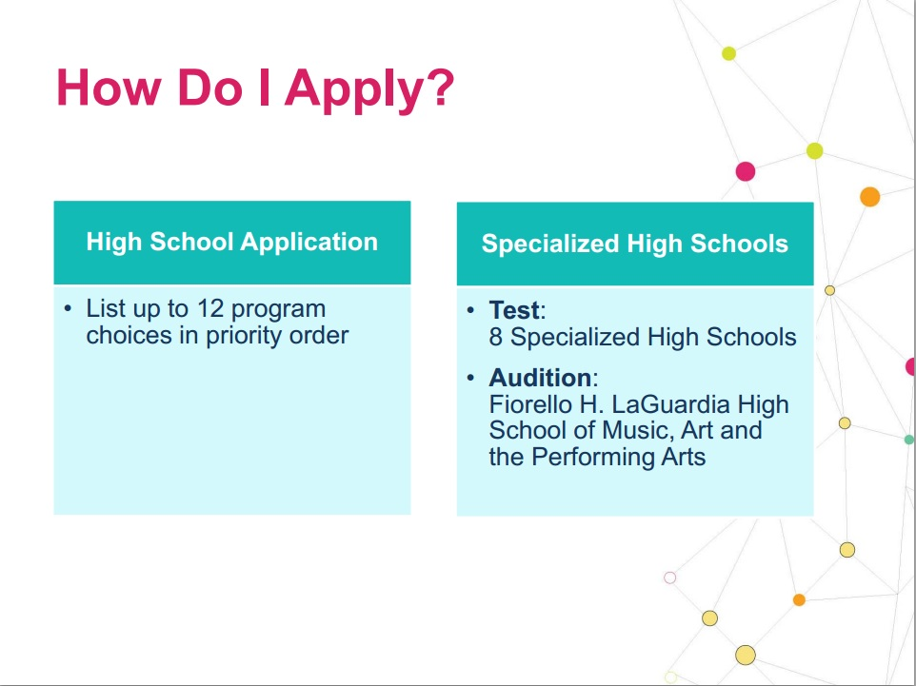

Slide 8

OCTOBER/NOVEMBER
AUDITION & TEST FOR SPECIALIZED HIGH SCHOOLS
Audition
Fiorello H. LaGuardia High School
of Music & Art and Performing Arts
Dance
Drama
Instrumental Music
Technical Theatre
Fine Arts
Vocal Music
Take the
Specialized
High Schools
Admissions
Test (SHSAT)
The Bronx High School of Science
High School of American Studies at Lehman College
Brooklyn Technical High School
The Brooklyn Latin School
Stuyvesant High School
High School for Mathematics, Science and Engineering at the City College of NY
Queens High School for the Sciences at York College
Staten Island Technical High School

Slide 9

TIP #1
EXPLORE MANY OPTIONS & KEEP AN OPEN MIND
▪ Students who chose 10 to 12 programs across
multiple schools on their application matched to one
of their choices 97% of the time.
▪ Listing more programs on your application will offer a
higher likelihood of matching in Round 1.

Slide 10
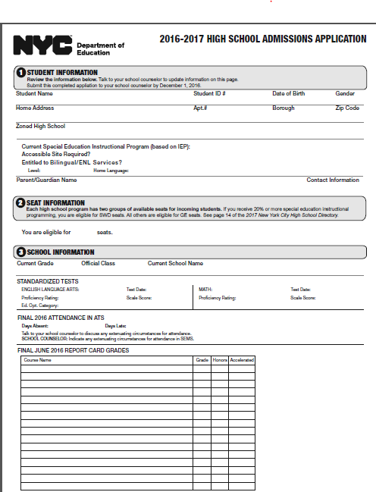
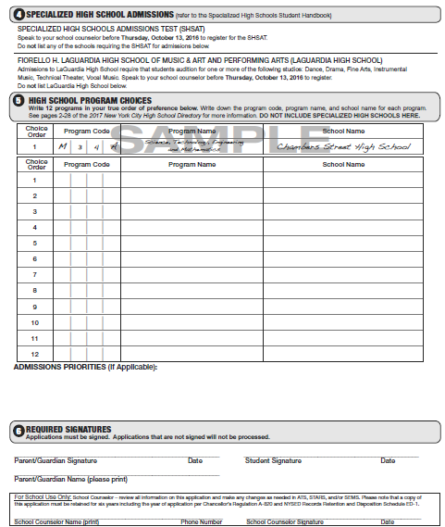
ROUND 1 HIGH SCHOOL APPLICATION
Receive, Review, and Complete
RECEIVE from me in October
REVIEW that all the information is correct
COMPLETE by writing 12 program choices in order of preference
PAGE 1
PAGE 2
Notes:
Students will receive their High School Application from me in October. Here is a Sample. (Point to screen.)
The Application will come printed with your child’s information and 7th grade academic record (grades, test scores, attendance and punctuality). Review that all information is correct. If anything is inaccurate, please tell me immediately.
You will complete the High School Application by writing 12 program choices in order of preference starting with your top choice. You’ll return your completed application to me by December 1.

Slide 11
TIP #2
RANK CHOICES IN ORDER OF PREFERENCE
▪ High Schools cannot see how you rank their
programs on your list.
▪ Do not list programs you are not interested in
attending just for the sake of getting in somewhere.

Slide 12

HOW OFFERS ARE DETERMINED
Admissions Methods
An Admissions Method is the way a school program matches with applicants.
Remember that students are first grouped by Admissions Priority and then considered by Admissions Method.
These programs DO NOT see applicant’s school record
ZONED Based on address | UNSCREENED Random selection | LIMITED UNSCREENED Random selection Higher priority to students who demonstrate interest | SCREENED FOR LANGUAGE Based on students’ English language skills and/or years in the country.
These programs DO see applicant’s school record
SCREENED Screened programs rank students using seventh grade core course grades, attendance, and state test scores. Additional requirements possible, such as portfolios or interviews. | AUDITION Same as Screened, but require an audition. (Some auditions require pre-registration.) | EDUCATIONAL OPTION Seats reserved for students with high, medium, and low NY State ELA scores. Half of seats filled by students who were ranked by the school. Half of seats filled through random selection.
Tip: Before listing a program on your Application, please check all details about that program’s Admissions Priorities and Admissions Methods in the HS Directory!
Notes:
The last factor is Admissions Methods.
Read note on the top of the page.
Programs each use one of the Admissions Methods you see here. Those on the top do not look at an applicant's academic record; those on the bottom do.
Your child’s academic record may affect which programs you choose for the application. It’s a good idea to have programs with different Admissions Methods on your application to help make sure you get an offer.
Notice that programs with a “Limited Unscreened” admissions method give priority to students who have demonstrated interest. If you’re interested in one of these programs, it’s especially important you visit these programs and sign in. Also, programs with an “Audition” Admissions Method require you to take action. We’ll talk more about that shortly.
You can find each program’s Admissions Methods in the High School Directory.
Does anyone have any questions about Admissions Methods?
FAQs:
Question about a particular screened school?
Screened schools manage their own rankings. It’s best to learn directly from a screened program how they consider and match with applicants. How do we know what Ed. Opt. group our child is in?
It will be on the front of the Application.

Slide 13
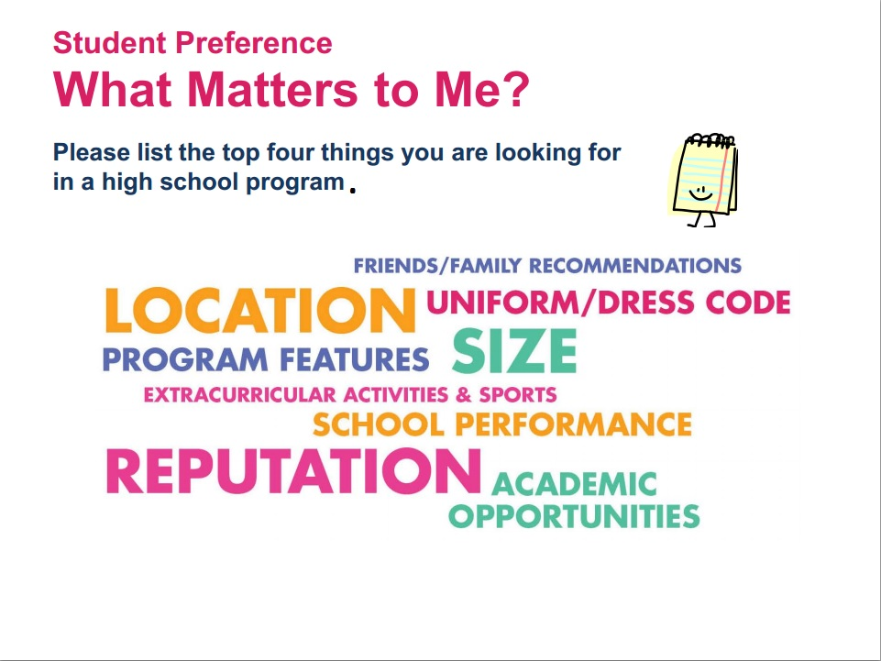

Slide 14
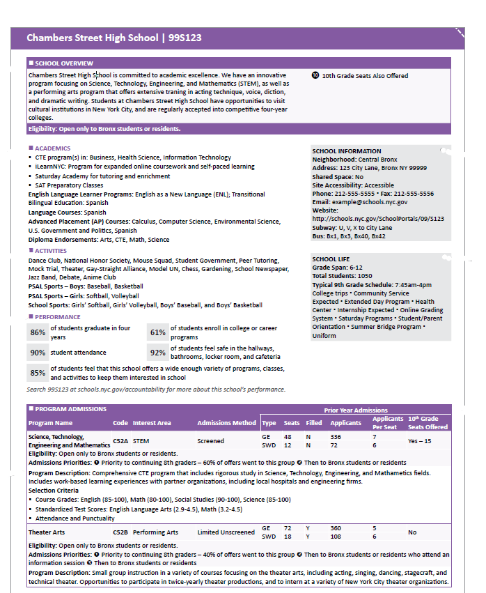
Program INFORMATION
Notes:
Now let’s move to the three program factors.
We will refer to sections of this sample high school directory page, which you can find on page 4 of the high school directory

Slide 15
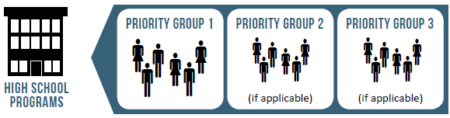
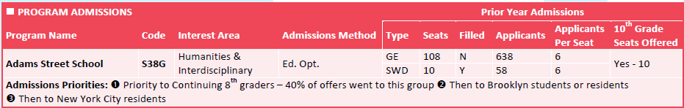
NEW YORK CITY HIGH SCHOOL DIRECTORY
Admissions Priorities
Admissions Priorities determine the order in which applicants are considered for placement.
Continuing
8th graders
Brooklyn
students
residents
NYC
students
residents
Notes:
The next factor that affects offers is Admissions Priorities.
Read bullets
Admissions Priorities can be based on where a student lives or goes to school, if a student signed in at a school fair or open house, or if a student attends a continuing 6-12 school.
Here is an actual example of Admissions Priorities.
Read example
Note that the Directory now tells you what percent of offers went to students in the first priority group. In this example, 40% of the offers went to continuing 8th grade students. This means that 60% of the offers went to students outside the first priority group.
Remember, your child’s address and school location can affect Admissions Priority
You can find information about each program’s Admissions Priorities in the High School Directory.

Slide 16
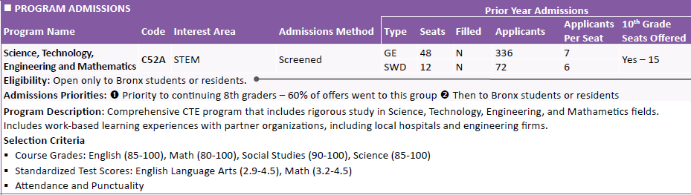
HOW OFFERS ARE DETERMINED
Eligibility
Eligibility: Some programs are only open to certain students.
Students must meet a program’s eligibility requirements to list the program on the application.
Students who go to school and live outside of the Bronx are not eligible to apply to this program!
Notes:
Some programs have eligibilities that limit who can apply. Eligibilities and priorities are displayed together on each school’s directory page.
Read example on the slide.

Slide 17
HOW OFFERS ARE DETERMINED
Seat Availability
Review the number of seats in a program and the number of applicants for those seats. The number of applicants per seat will affect a student’s chances of being matched.
The average demand for programs is
6 applicants per seat.
The data refers to the previous year’s admissions cycle.
You can learn about Seat Availability in the Directory!
Tip: Don’t list only programs with high demand on your Application!
Notes:
The next factor is seat availability, which refers to how much space a program has for incoming students. This means that not every applicant to a program will be offered a seat.
Read first bullet
This program has average demand. There are 108 seats available, and there were 638 applicants last year. That means there was an average of 6 applicants who listed the program anywhere on their Application for each available seat.
Read third bullet
You can find information about a program’s seat availability in the High School Directory. This information is in the Program Admissions section, usually at the bottom of the page.
Read tip box

Slide 18
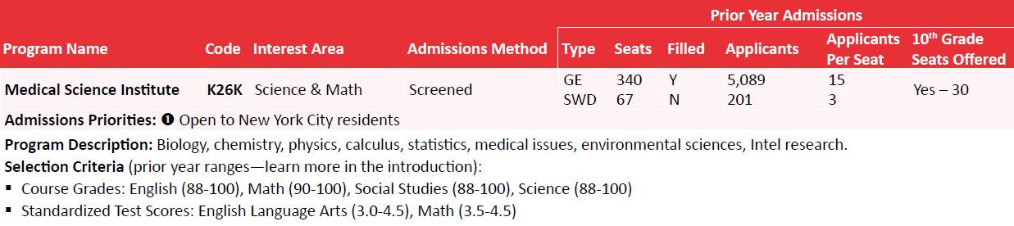
HOW OFFERS ARE DETERMINED
Selection Criteria
A program’s Selection Criteria is useful to know how a student’s application compares with other applicants.
This is only relevant for programs that see an applicant’s school record.
Notes:
Read bullet on slide and this applies to programs with Screened and Audition Admissions Methods only.
These programs look at your school record (grades, test scores, and attendance). Some of these programs require other activities, such as submission of a portfolio of work, an on-site test, or an on-site interview. You can find relevant information about each program’s selection criteria in the directory.
[Point to slide] The ranges shown here reflect the academic record of the students who received offers to this program last year. Not all students who fall within last year’s ranges may get an offer based on factors we’ve mentioned before such as Admissions Priorities, Eligibilities, and demand. Remember, this is why you have the opportunity to list 12 programs on the Application.

Slide 19

HOW OFFERS ARE DETERMINED
Matching Students With Programs
STUDENT FACTORS
PROGRAM FACTORS
Choices on Application
The order in which
applicants are considered.
The 12 programs listed on the application AND the order in which they are listed.
Admissions Priorities
How programs consider and match with applicants.
Admissions Methods
Student Information*
Student’s academic record, audition, and/or address.
*(Only for some programs)
The number of seats available for applicants.
Seat Availability
Notes:
Students will receive one offer from the 12 choices on their High School Application. Multiple factors affect what offer your child will receive.
Read boxes under “Student Factors” and boxes under “Program Factors.”
Remember that your child’s address and school may affect the order in which your child is considered.
Let’s talk more about each of these factors.

Slide 20
EARLY MARCH
RECEIVE SPECIALIZED HIGH SCHOOL RESULTS
▪
Your Specialized High School results will be included with your
High School Round 1 offer letter.
Offers to schools requiring the SHSAT are based on:
▪
▪
▪
▪
Student’s score
Student’s priority of choices as listed on the answer sheet
Seat availability
▪
Offers to LaGuardia High School are based on audition(s) and
an academic review.
All Specialized High School offers are final.
▪

Slide 21
EARLY MARCH
RECEIVE ROUND 1 RESULTS
High School Admissions results in Round 1 last year for NYC:
▪ 92% received an offer to one of their choices.
▪ 86% received an offer to one of their top 5 choices.
▪ 48% of students received an offer to their 1st choice.
▪ 8% did not receive an offer.
High School Admissions results in Round 1 for MS 51
97% received an offer to one of their choices
93% received one of their top 5 choices
45% of students received an offer to their 1st choice
3% did not receive an offer.

Slide 22
NEXT STEPS FOR FAMILIES
Explore!!! | Use the High School Directory or NYC School Finder to find schools of interest!
Plan to attend High School Fairs and school open houses | Citywide – September 24 and 25 Borough – October 15 and 16 Consortium Fair – October 19
Audition Registration | All Students submit form by Friday, September 23rd
Specialized High School Registration
Start learning about high school programs today!
Notes:
Here are some next steps for applying to high school.
If your child is interested in any of the Specialized High Schools or Audition Programs the require pre-registration, please complete the correct survey and return it to me. (Tell parents when and how they can complete audition and specialized high school surveys.) This survey will allow me to register your child for the SHSAT and the auditions that require pre-registration. Note that some Audition programs require me to pre-register your child; others ask your child to show up for an audition on the dates listed in the Directory.
Start exploring options! Look through the Directory today and start learning about programs for your child.

Slide 23
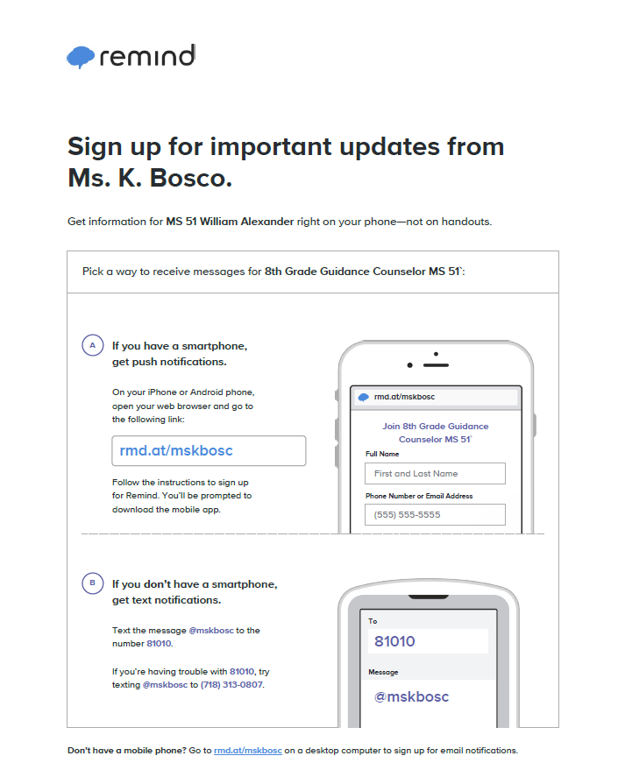
This app is being used for reminders only. It is not a point of contact. Please call 718-369-7603 x 1311

