Slide 1
Acadience Math

Slide 2
What is Acadience Math?
By design, the Acadience Math measures are brief, powerful indicators of mathematical skills that:
are quick and efficient to administer and score;
serve as universal screening (or benchmark assessment) and progress monitoring measures;
identify students in need of intervention support;
evaluate the effectiveness of interventions; and
support the Response to Intervention (RtI)/multi-tiered model.

Slide 3
Why use Acadience Math?
Acadience Math provides reliable and valid universal screening to find students who may be at risk for math difficulties. These measures also help identify the skills to target for instructional support. Acadience Math also provides progress monitoring measures for at-risk students while they receive additional, targeted instruction to close achievement gaps. Finally, these measures assist educators in examining the effectiveness of school-wide math supports.

Slide 4
Why use Acadience Math?
The advantages of Acadience Math are that it:
directly measures math skills that are responsive to instruction;
is standardized;
is thoroughly researched, reliable, and valid;
is designed for use within a problem-solving, Outcomes-Driven Model of decision-making;
provides research-based benchmark goals for interpreting results; and
is efficient and economical.

Slide 5
Acadience K-1 Early Numeracy Math Assessments
Beginning Quantity Discrimination BQD assesses discrimination between two quantities. It is an indirect measure of subitizing, the ability to instantly judge the number associated with a group of items. BQD is administered from the beginning to the end of kindergarten.
Number Identification NID assesses ability to orally name the numerals 1 through 99. It is administered from the beginning of kindergarten to the beginning of first grade.
Next Number Fluency NNF assesses the ability to extend the counting sequence. The task is administered orally, with the assessor saying a number and the student saying the next higher number. NNF is administered from the beginning of kindergarten to the beginning of first grade.
Advanced Quantity Discrimination AQD assesses discrimination between two quantities. The student is asked to name the larger of two numbers. AQD is administered from the beginning to the end of first grade.
Missing Number Fluency MNF assesses the ability to extend a counting sequence counting by 1s, 5s, and 10s. The student is provided with a sequence of four numbers with one number missing and asked to name the missing number. MNF is administered from the beginning to the end of first grade.

Slide 6
Acadience 1-4 Math Assessments
Computation Computation assesses the basic skills of math computation. It can be administered individually or to groups. Students work basic computation problems under standardized conditions and time limits, which depend on grade level. Computation is administered in grades 1–4.
Concepts and Applications Concepts and Applications assesses the basic skills of understanding mathematical concepts and vocabulary and applying that knowledge to solve mathematical problems. It can be administered individually or to groups. Students work problems under standardized conditions and time limits, which are dependent on grade level. Concepts and Applications is administered in grades 2–4.

Slide 7
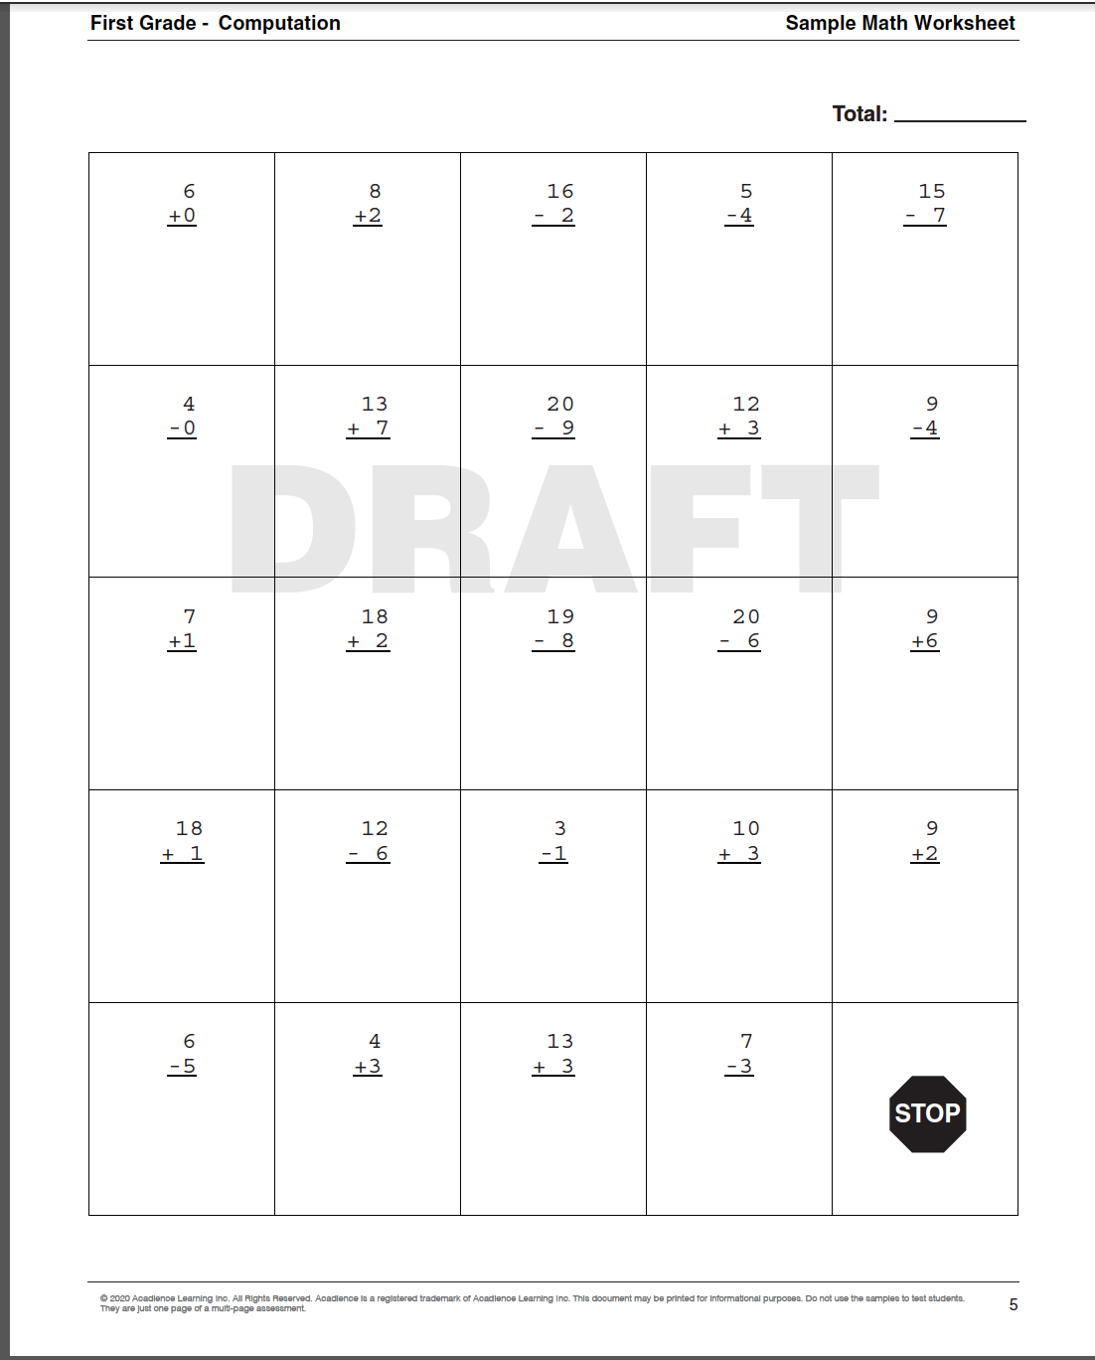
Example Computation Worksheets

Slide 8
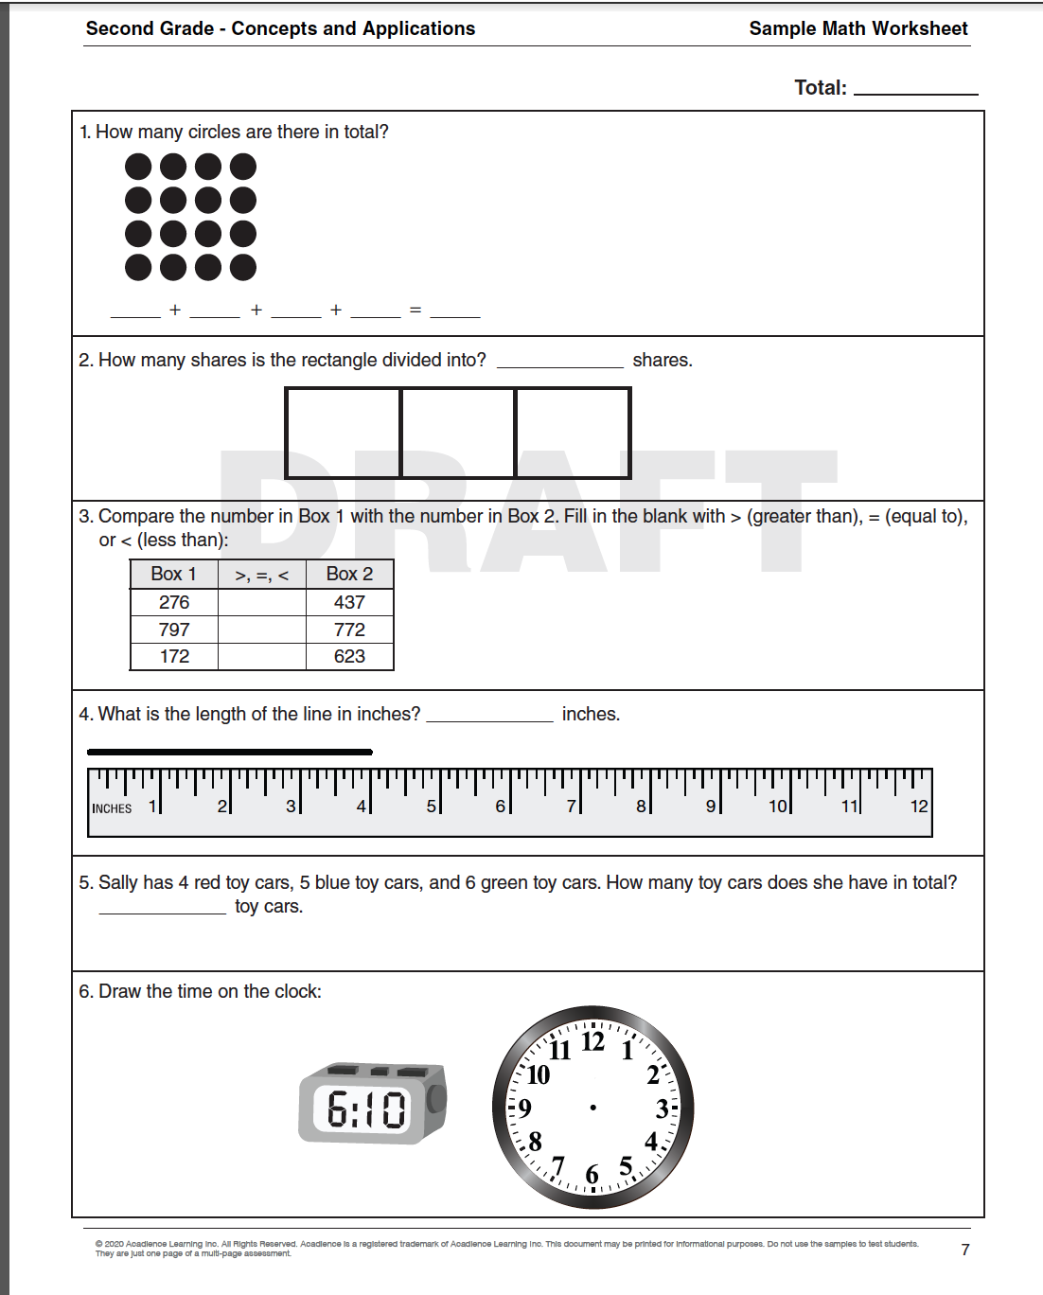
Example Concepts & Applications Worksheets

Slide 9
Sample Reports
Kindergarten
First Grade
Second Grade
School Overview
Status Report
Grouping Worksheet
Progress Monitoring Graph

Slide 10
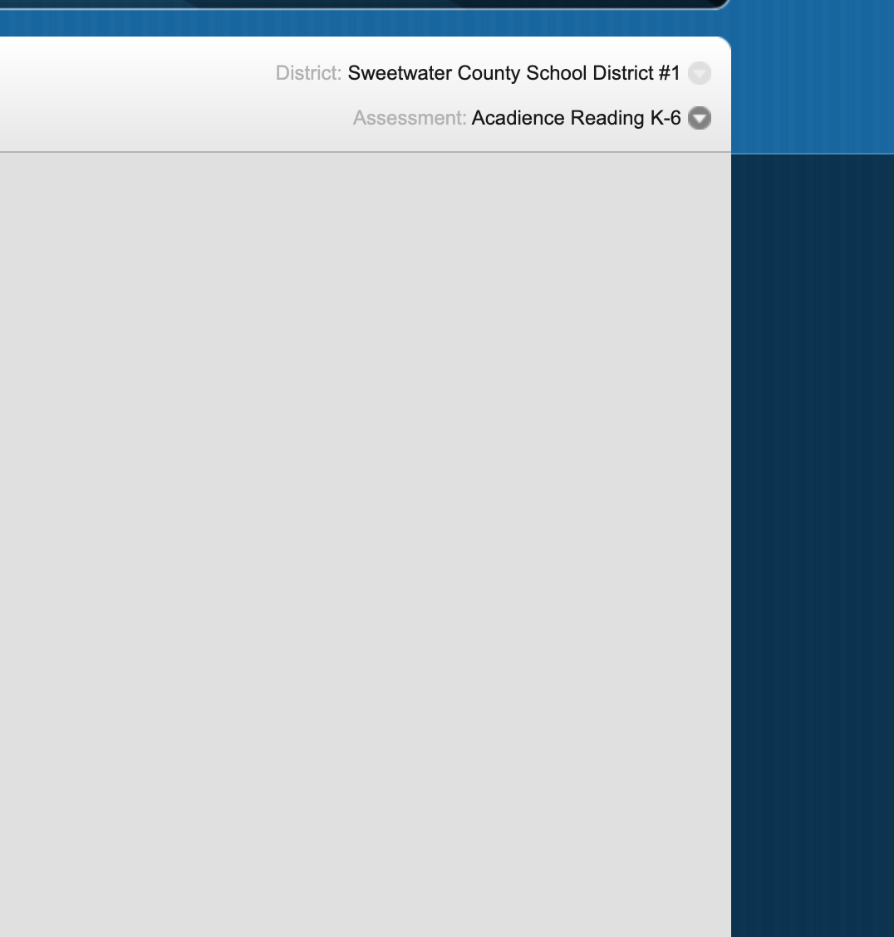
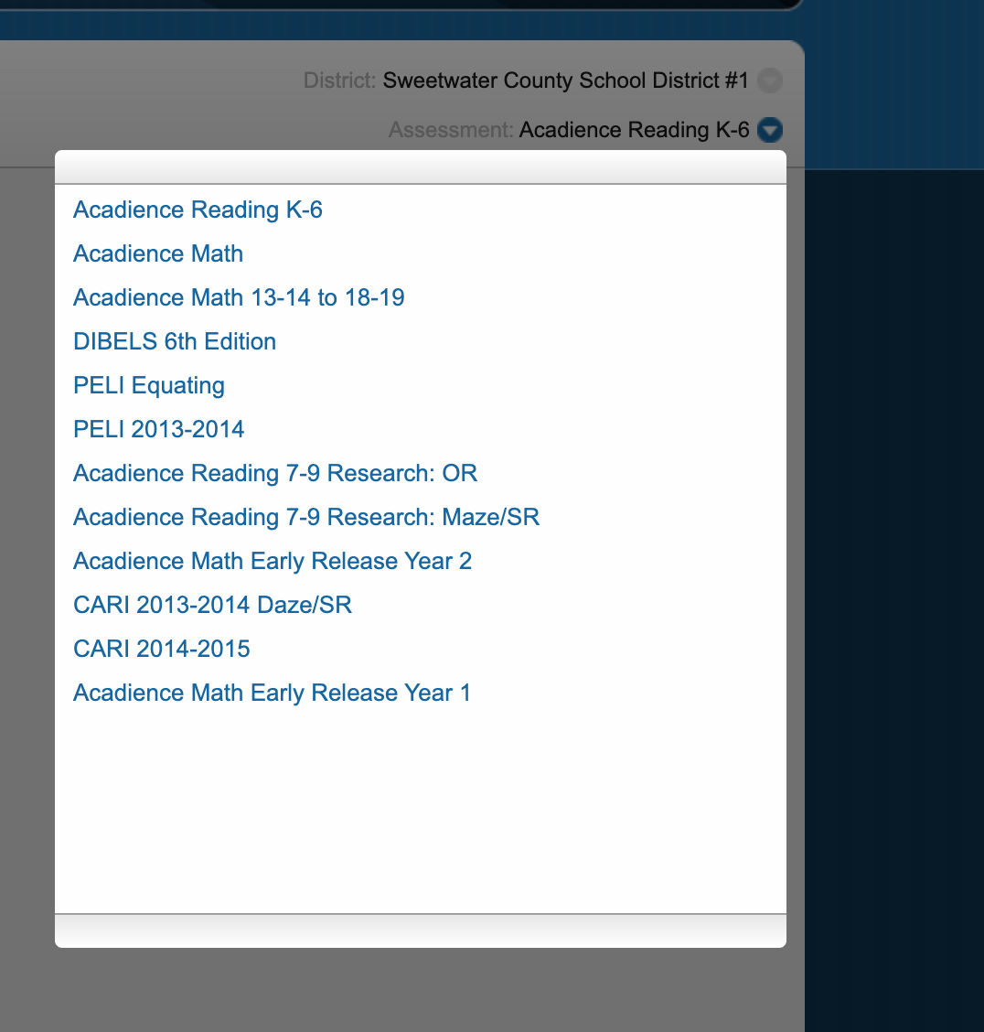
Accessing Student Scores & Reports
This is the default screen.
Click on the arrow.
When you click on the arrow, it will prompt this screen. Pick Acadience Math to access the Math scores and reports.

