Slide 1
Carmel High School Counseling Department
College & Career Planning
for
Junior Parents
Zoom meeting Q & A:
January 31, 2024
7:00 pm

Slide 2
Agenda
Types of Colleges/post-secondary institutions
Timeline for helping your student
Preparing for a College Search
Tools to research colleges
College Admission Testing
College Fairs/College Visits
Financial Aid/Scholarship basics

Slide 3
2-year and 4-year colleges
2-year (Community/Junior) Colleges:
Offer an ASSOCIATES degree after 2 years of full-time study
Prepare students for entry-level positions or to transfer to a 4-year institution
Typically charge lower tuition than 4-year counterparts
4 Year Colleges
Usually offer a BACHELOR’S degree after 4 years of full-time study
Prepares student to enter the workforce or continue on to graduate study
State Schools (SUNY/CUNY) typically charge lower tuition than private institutions

Slide 4
DO NOW (February Junior year): Prepare for a College Search
Develop a list of College Priorities:
Location: (Have a family conversation regarding home v. away)
Campus Environment (urban, rural, suburban)
Size of Institution: (Consider student’s learning style/preference)
Money: (have a family conversation about parents' ability to contribute toward education. Are loans a realistic possibility?) Net Price Calculator
Intended career path/major
Athletics, extra-curriculars and any other “must haves”

Slide 5
Online Tools to Help with a College Search
SCOIR (www.scoir.com)
All seniors will need to activate their Scoir accounts
The College Board (www.BigFuture.org)
College search engine sponsored by the creators of the SAT
Niche (www.niche.com)
College search engine with reviews and rankings
College Insight: (www.college-insight.org)
College profiles including research-level data
College Navigator: (www.nces.ed.gov/collegenavigator)
A consumer information tool from the National Center for Education Statistics

Slide 6
What is SCOIR?
Planning and research tool
Individual accounts for students and parents
Explore college and career options
Assess strengths and interests
Track and organize key information

Slide 7
Welcome to SCOIR Video

Slide 8
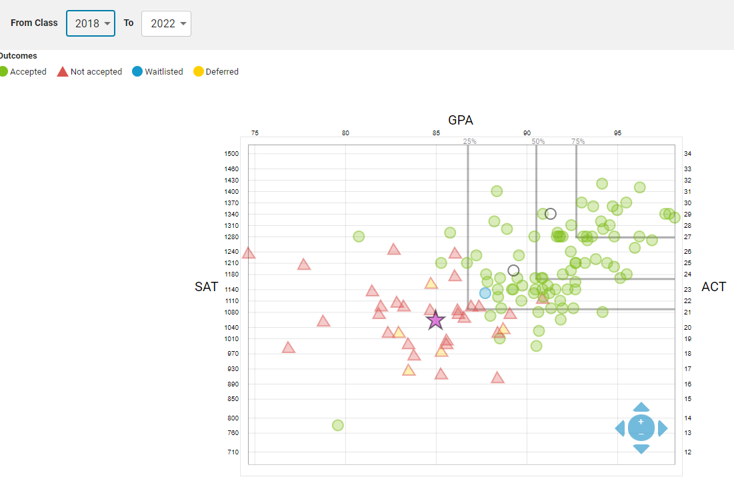
Provides College & Admission Information
“SCATTERGRAMS” show a quick snapshot of how your student compares with prior applicants from CHS.
To view a scattergram, click on "View Application Scattergram" under the Admissions Tab for any college
Scattergrams can help your students gauge whether a school is a "reach", "target", or a "likely" school.

Slide 9
How Do I Access SCOIR?
Students were sent an invitation to their CHS email to create a SCOIR account.
Parents can request to have a parent account. Please contact your student’s counselor for SCOIR info.

Slide 10
You Can Also Access SCOIR from the CHS website
Under the CHS website, select “CHS Counseling” from the DEPARTMENT menu
Scroll down to “Links” and select “SCOIR” which will bring you to the login screen

Slide 11
Standardized Testing (Spring junior year)
The ACT (www.actstudent.org)
Admission test with subscores including: English, Math, Reading, Science
Scored on a 1-36 scale for each section and an overall composite score
Has optional essay
The SAT (www.collegeboard.org)
Admission test with Evidence-Based Reading & Writing, Math scores
Scored on a 200-800 point scale for each section

Slide 12
Future Test Dates
THE SAT
$60.00
$85 with essay
$60.00
THE ACT
TEST DATE | Registration Deadline | Late fee ($30) | Offered at CHS?
March 9th | February 23, 2024 | 2/27/24 | NO
May 4th | April 19, 2024 | 4/23/24 | YES
June 1st | May 16, 2024 | 5/21/24 | NO
August 24th |  |  | NO
October 5th
November 2nd
December 7th
TEST DATE | Registration Deadline | Late Fee ($36) | Offered at CHS?
April 13th | March 8, 2024 | 3/24/24 | YES
June 8th | May 3, 2024 | 5/19/24 | YES
July 15th | June 7, 2024 | 6/24/24 | Not in NY
September
October
December

Slide 13
TEST OPTIONAL COLLEGES
Applicants can choose to report or not report standardized testing
Specific rules can vary from institution to institution
The majority of 4-year institutions now have test-optional policies
List maintained on www.fairtest.org

Slide 14
Spring 2024: College Fairs
Gathering of College Representatives, in-person or virtually, looking to spread the word about their school to interested students and answer questions.
Held either in-person at a local location or via online links, live streams or Zoom platforms or signing up online.
Easy way to learn about a variety of colleges at once.

Slide 15
Upcoming Virtual College Fairs
FREE Registration at:
www.nacacattend.org/fairs.
February 18th
March 24th
April 21st

Slide 16
Upcoming In-Person College Fairs www.westchestercollegefair.com
Northern Westchester College Fair
Thursday, May 2, 2024 6:00-8:30PM
Putnam/Northern Westchester BOCES, Yorktown Heights, NY
Southern Westchester College Fair
Wednesday, May 1, 2024 6:00-8:30PM
Westchester County Center, White Plains, NY

Slide 17
Now-Summer 2024: Visit Prospective Colleges
Most colleges offer in-person and/or virtual campus tours
Students can also tour college campuses through virtual tours on SCOIR
We strongly suggest doing a visit/tour of campus (either in-person or virtually) at all/most schools a student is considering applying to before the beginning of a student's senior year..

Slide 18
Admissions Website Visit Options: (Example - Marist College, www.marist.edu)

Slide 19
Information Sessions, Campus Tours & Open Houses
Campus Tour & Info Session
Open House
Offered regularly (daily, weekly, etc.)
Typically includes a tour of campus and a general information session from Admissions Office.
Can schedule online or by calling Admissions
Semi-Annual event (fall/spring) where college showcases its offerings for prospective students
Opportunity to meet with professors, current students, and campus offices
Campus rolls out the red carpet
*Students can receive UP TO 3 EXCUSED absences for college visits each year*

Slide 20
Summer 2024/Fall 2024: Narrow your List of Colleges
Go back and review your search criteria…which schools best meet them?
Think back to your visit to the school…is it a good fit for you?
Consider your admissibility to the college. Is it a….
REACH? (your academic credentials fall below average admitted freshman profile and/or the school has an extremely low admission rate)
TARGET? (your academic credentials fall within a typical admitted freshman profile)
HIGHLY LIKELY? (your academic credentials fall above a typical admitted freshman profile…can be reasonably assured an offer of admission).

Slide 21
Financial Aid Basics
WHAT IS FINANCIAL AID?
Grant, scholarship, loan, or paid employment offered to help a student meet his/her college expenses
WHAT DOES FINANCIAL AID COVER?
Tuition & fees, Room & Board, Books/Supplies
WHAT IS NEED-BASED AID?
Aid based solely on the assets and income of the prospective student and his or her family. Factors such as test scores or athletic ability have no bearing on need-based aid.
WHAT IS MERIT-BASED AID?
Merit-based scholarships are awarded based on individual achievements, such as academic, athletic or artistic accomplishments. Finances are not a factor in determining merit aid.

Slide 22
FAFSA (the Free Application for Federal Student Aid)
FAFSA® Application | Federal Student Aid
Determines your eligibility for financial aid (“need”)
TAP (Tuition Assistance Program) (NEW YORK PROGRAM)
Grant to help eligible students pay TUITION at approved schools in NY State
FAFSA links to the TAP application
CSS PROFILE
CSS Profile – CSS Profile | College Board
required by many private colleges and universities to determine eligibility for non-government financial aid, such as the institution's own grants, loans and scholarships.
There is a cost to file this application

Slide 23
Determining Financial Need
COST OF ATTENDANCE
- (SAI) Student Aid Index
= FINANCIAL NEED
 | College A | College B | College C
COA | 5,000 | 35,000 | 65,000
SAI | 14,000 | 14,000 | 14,000
Financial Need | 0 | 21,000 | 51,000

Slide 24
Special Programs for New York Students*
EXCELSIOR SCHOLARSHIP
AGI less than $125,000
Plan to attend a SUNY or CUNY 2 or 4-year degree program
Take 30 credits per year (to make progress toward graduation)
COVERS FULL TUITION
Recipients must agree to live in NYS for the number of years equal to the number of awards received and if employed during such time, be employed in NYS.
Must file a FAFSA and TAP application along with Excelsior Application
ENHANCED TUITION AWARDS
Participating private (not-for-profit) colleges in NYS
Combination of TAP and matching award from college, can cover UP TO $6,000 off tuition
NEW YORK STEM INCENTIVE PROGRAM
Plan to attend a SUNY, CUNY, 2 or 4 year degree program leading to a degree in Science, Technology, Engineering, or Mathematics
Maintain a minimum GPA of 2.5+ each term in college
Execute a service contract agreeing to reside and work in NYS for 5 years in the field of STEM after college graduation
*Please note that the COVID-19 pandemic has dramatically reduced state revenues Awards may have to be reduced and/or prioritized for current recipients as provided for under the program.

Slide 25
What Can I Do Now?
Estimate your financial aid eligibility with Federal Student Aid Estimator Federal Student Aid Estimator | Federal Student Aid
Linked to FAFSA website, can estimate what your EFC will likely be
Review the Net Price Calculator for prospective colleges/universities
Use the Net Price Calculator to find out what financially similar students to attend the institution in the previous year, after taking grants and scholarship aid into account.
Calculate Your College Costs – BigFuture | College Board
Net Price Calculator Center (ed.gov)

Slide 26
Recommended Readings: Where You Go Is Not Who You’ll Be: An Antidote to the College Admissions Mania Frank Bruni The Financial Aid Handbook: Getting the Education You Want for the Price You Can Afford Carol Stack and Ruth Vedvik

Slide 27
Counselor Contact Information
Ms. Heather Jaffe, Department Chair -- 845-225-8441,ext. 451 - hjaffe@carmelschools.org
Mr. Tom Feliciotto, School Counselor -- ext. 416 or ext. 452 - tfelicio@carmelschools.org
Ms. Kristen Mancini, School Counselor -- ext. 442 - kmancini@carmelschools.org
Mr. Tim Mahon, School Co -- ext. 444 - tmahon@carmelschools.org
Ms. Juliette Powers, School Counselor -- ext. 443 - jpowers@carmelschools.org
Mr. Nicholas Ruotolo, School Counselor -- ext. 418 - nruotolo@carmelschools.org
Ms. Danielle Schulman, School Counselor -- ext. 440 - dschulma@carmelschools.org

