Slide 1
Entrepreneurship
Management Leadership and Motivation
Presented By
Mrs. Bowden

Slide 2
Today we will:
Identify management functions
Define the role of a manager for the entrepreneur
Discuss management Styles, Leadership, and Motivation

Slide 3
Recap:
FOUR MAIN FUNCTIONS OF BUSINESS
Production: Planning and Strategy
Finance
Marketing
Management = Operations and human resources

Slide 4
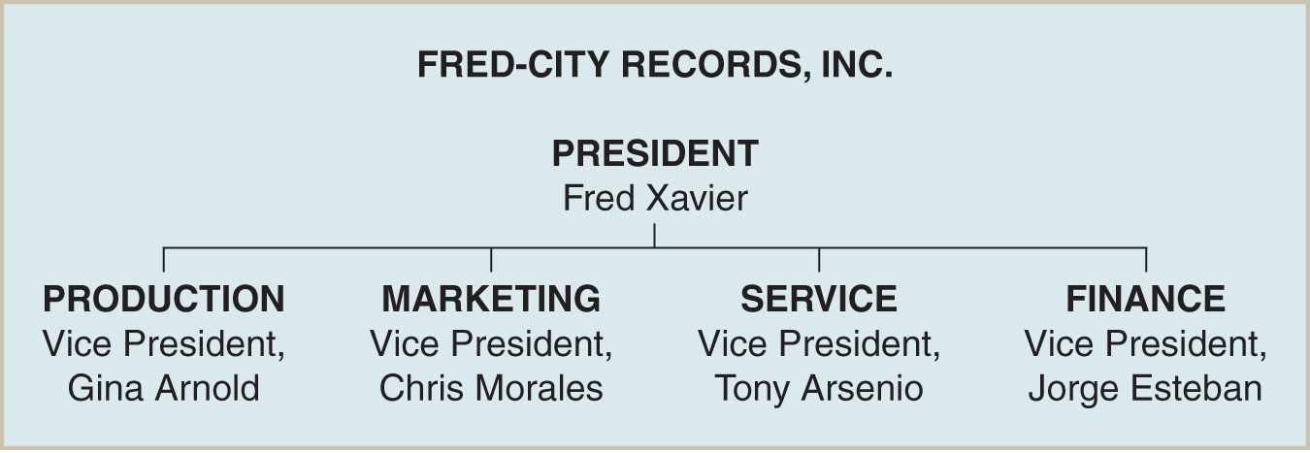
Management
The art of planning and organizing a business so it can meet its goals.
Entrepreneurs tend to be creative people who get bored with day-to-day details of running a business. Smart entrepreneurs understand this & hire managers.
A corporation can sell stock to raise capital to hire managers.

Slide 5
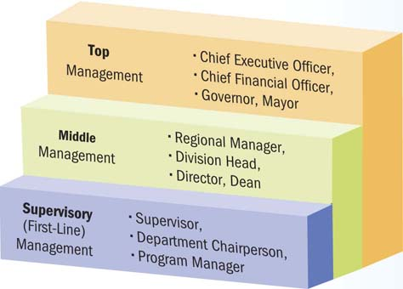
What is Management?
Management is the process of achieving organizational objectives through people and other resources.

Slide 6
Top Management
Develop long-range strategic plans for the organization.
Inspire executives and employees to achieve their vision for the company’s future.

Slide 7
Middle Management
Focus on specific operations, products, or customer groups within an organization.
Responsible for developing detailed plans and procedures to implement the firm’s strategic plans.

Slide 8
Supervisory Management
Implement the plans developed by middle managers.
Responsible for non-manager employees.
Motivate workers to accomplish daily, weekly, and monthly goals.

Slide 9
Skills Needed for Management Success
Technical skills
Manager’s ability to understand and use the techniques, knowledge, and tools and equipment of a specific discipline or department.
Human skills
Interpersonal skills that enable a manager to work effectively with and through people.
Conceptual skills
Ability to see the organization as a unified whole and to understand how each part of the overall organization interacts with other parts.

Slide 10
Management Functions
manager
the person responsible for planning, organizing, staffing, implementing and controlling the operations of a business
management
the process of achieving goals by establishing operating procedures
making effective use of people and other resources

Slide 11
Management Functions
Planning
Organizing
Staffing
Implementing/Directing
Controlling
Leading/Directing
Coordinating
Representing
Innovating
Motivating

Slide 12
Planning
Strategic planning
planning for the 3-5 year time horizon
setting broad, long-range objectives
Intermediate-range planning
planning for the one-year time period
set target dates for task completion
Short-term planning
planning for daily operations

Slide 13
Organizing
Assignment of tasks
determining which employee is responsible for specific tasks
Grouping of tasks into departments
grouping closely related tasks together

Slide 14
Organizational structure
a plan that shows how the various jobs in a company relate to one another
often represented by a chart
Allocation of resources across the organization
determining the most effective use of personnel

Slide 15
Staffing
Managing the personnel needs of a business through:
hiring
training
compensating

Slide 16
Implementing
implementing
directing and leading people to accomplish the goals of an organization
management style
the way a manager behaves toward and works with employees

Slide 17
authoritative management
the manager is directive and controlling
democratic management
employees are involved in decision making
the manager provides less direction
delegative (mixed) management
a combination of authoritative and democratic management

Slide 18
Controlling
Controlling is the process of:
setting organizational standards
ensuring those standards are met
comparing actual revenues and expenses with projected revenue and expenses
determining if operations are running effectively
inspecting products and services to ensure they are meeting performance standards

Slide 19
Today we will:
Identify the role of leadership in an organization
Define leadership styles
Define non traditional leadership styles
Personally identify individual leadership styles

Slide 20
Leader vs. Leadership
LEADER: Person who directs or is in charge of others
LEADERSHIP: focuses on the talents, skills, and personal qualities that a person uses to influence others

Slide 21
Entrepreneurs must be leaders::Leaders are managers
What type of leader are you
Authoritative
Democratic
Delegative

Slide 22
Non traditional leadership styles
Technocrat –
leads by having a strong sense of the bottom line – results oriented and driven
Often spend time figuring out numbers ad strategy than working with and figuring out people

Slide 23
Non traditional leadership styles
The Artist
leads by imagination and intuition
Has a distinct vision of the big picture
Actively invites others to share ideas
Isn’t afraid of emotion or laughter

Slide 24
Non traditional leadership styles
The Craftsman
leads by common sense and integrity
Trustworthy, well balanced, and excellent listener
Caring, logical person who values getting the job done but will not sacrifice people and their views or feelings

Slide 25
Planks of Leadership
Plank 1: A leader has a sense of VISION
Plank 2: A leader is willing to ACT
Plank 3: A leader makes good DECISIONS
Am I knowledgeable about the issues and the people involved
Am I making decisions in the correct order
Am I aware of the risks involved

Slide 26
Planks of Leadership
Plank 4: A leader can HANDLE CONFLICT
Shut up,
Look up,
Hook up,
Chill down
Plank 5: A leader works to AVOID PITFALLS
Plank 6: A leader knows how to MOTIVATE

Slide 27
Pitfalls of Leadership
Pitfall 1 : Being afraid to fail
Pitfall 2: Not paying attention to details
Pitfall 3: Forgetting people and the original objectives
Pitfall 4: Not listening to others

Slide 28
Effective Leaders
Discuss a situation where you have been a leader
List out all of the qualities that you think make an effective leader

Slide 29
Activity
Identify an effective BUSINESS leader of the 21st century.
Research what made that leader a good leader.
Write a 1 page paper about the leader, their effectiveness, their successes and/or failures, and relate it to your personal leadership style.

Slide 30
Empowering Employees
Empowerment - giving employees authority and responsibility to make decisions about their work without traditional managerial approval and control
Sharing information and decision-making authority
Keeping them informed about company’s financial performance
Giving them broad authority to make workplace decisions

Slide 31
Motivation
Motivation is defined simply as what causes people to behave as they do.
all organizations need motivated employees and motivation is also critical to our own personal success
motivation is particularly important and governmental organizations--the public sector is aimed at the achievement of public purposes
in a very real sense, the quality of our neighborhoods, communities, and world depends upon motivation

Slide 32
Where do we begin?
To enhance our experience at work it is import understand what motivates us
When we are highly motivated we can influence others in a constructive way
understanding what motivates us can help us make prudent career choices that allow us to work in organizational settings that keep us excited and interested in our work

Slide 33
Projection and Motivation
Looking inward can help us resist the temptation to think what motivates us is what motivates others-- --this process is called projection
projection is a mental process in which we attribute or assign our own feelings, motives, or qualities to other people
we generally project feelings that we are not conscious of or are not comfortable with
projection is a mental shortcut that makes it seem as though understanding other people's behavior is much simpler than it actually is

Slide 34
Motivation in Organizations
Motivation is defined simply as what causes people to behave as they do
There is a lack of a single commonly accepted meaning of motivation and organizational development-- --however there are some areas of consensus
motivated behavior is goal-directed behavior
motivation is limited and directed by situations and environments in which people find themselves

Slide 35
Motivation in Organizations
motivation is not:
directly observable
the same as satisfaction
always conscious
directly controllable

Slide 36
Maslow's Hierarchy of Needs
A basic assumption of this model is that humans are perpetually wanting
the level does not need to be fully satisfied only that it must be partially or adequately satisfied

Slide 37
Maslow’s Hierarchy of Needs
The model has five levels of need:
Level 1: Food, Clothing, and Shelter
Level 2: Safety and Security
Level 3: Love and Belonging
Level 4: Self-Esteem
Self-esteem is self-respect and recognition from others.
Level 5: Self-Actualization
Self-actualization is the need to reach one’s full potential, to grow, and to be creative.

Slide 38
Maslow’s Hierarchy of Needs
Level 5
Self- actualization
Level 4
Self-esteem
Level 3
Love and Belonging
Level 2
Safety and Security
Level 1
Food, Clothing, and Shelter

Slide 39
Participation As a Motivator
a participative approach is positively related to employee motivation and performance
this can be seen as a continuum from authoritarian to Democratic
Democratic systems management has complete confidence in trust and workers
workers are motivated by participating in goal setting,development of reward, improving methods, and evaluating goal attainment

Slide 40
Participation As a Motivator
participation influences motivation because it increases the amount of information that people have on the expected outcomes of performance
it helps ensure rewards of high valence for workers and helps people to see the relationship between performance and outcomes

Slide 41
Anti-motivation Theories
some argue that motivation theories are a way of thinking that essentially amounts to manipulation
according to this viewpoint motivation theory and practice is fundamentally flawed for the following reasons:
it seeks to cause or stimulate action, assuming that there was none prior to the initiative
as a consequence, it is incidental, not continuous-- therefore it, must be reinstated as often as action is desired

Slide 42
Anti-motivation Theories
according to this viewpoint motivation theory and practice is fundamentally flawed for the following reasons:
It relies too heavily on rewards to achieve objectives
Not all of the same rewards motivate the same people

Slide 43
Anti-motivation Theories
the idea that rewards actually might destroy people's natural interest in work
The idea that too many rewards cause a sense of entitlement.
the idea is that people who are allowed a degree of freedom will become voluntarily dis-engaged in work that is interesting and enjoyable to them
people choose work that they are good and enjoy

Slide 44
Anti-motivation Theories
We should think about partnerships rather than subordinates
Negotiate projects rather than give assignments
Develop new competencies rather than merely track past performance

Slide 45
Ways of Acting
Be self-reflective and proactive about your own motivation
Be aware of what motivates you, not necessarily what motivates others
Have realistic expectations about the extent in which we can influence the motivation of others
Participate in setting clear and challenging goals
Think about the salience of various rewards

Slide 46
Ways of Acting
Be honest with people about what rewards are possible what rewards are not
Although people might be different in terms of personality, wants, goals, and needs -- -- they all want to be treated fairly
Motivation is not about the characteristics of people, it is about the work that you can ask them to do
It can be helpful think about the life-stages and what it means for employees – and offer appropriate support

Slide 47
Activity
Silent Graffiti – List all the other ways that you can think of that you as an entrepreneur can motivate your employees.
List them on the white board

Slide 49
Teams
A team is a group of employees who are committed to a common purpose, approach, and set of performance goals.
Mutually responsible and accountable for accomplishing objectives.
Ability to work on teams often emphasized during the hiring process.
Work teams are groups of people with complementary skills who are committed to a common purpose.
Two-thirds of U.S. firms currently use work teams.

Slide 50
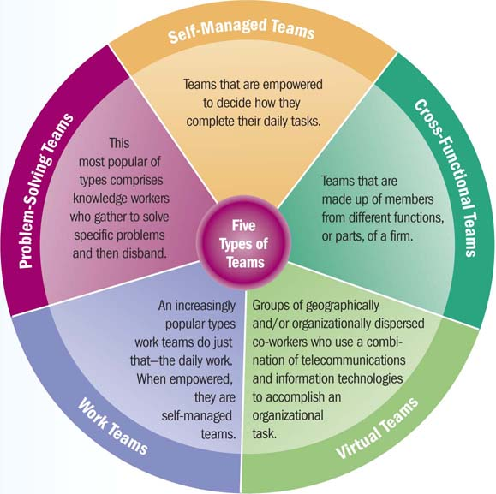
Five Species of Teams

Slide 51
Team Characteristics
Team Size
Can range widely, but most have fewer than 12 members.
Ideal size is often six or seven members.
Team Level and Team Diversity
Team level - average level of ability, experience, personality, or any other factor on a team.
Team diversity - variances or differences in ability, experience, personality, or any other factor on a team.

Slide 52
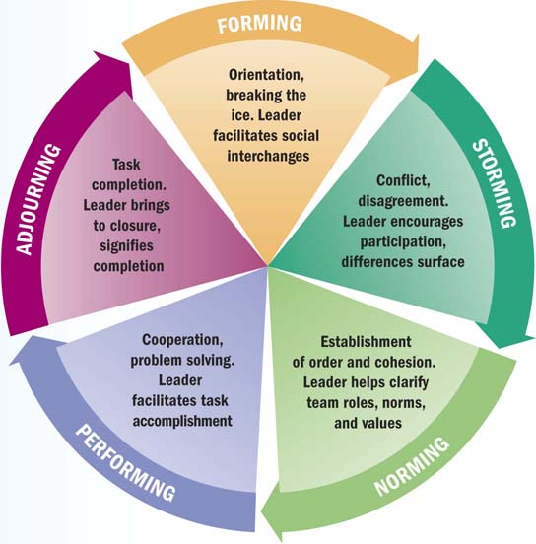
Stages of Team Development

Slide 53
Team Cohesiveness & Norms
Team cohesiveness is the extent to which team members feel attracted to the team and motivated to remain part of it.
Increases when members interact frequently, share common attitudes and goals, and enjoy being together.
Cohesive teams quickly achieve high levels of performance and consistently perform better.
Team norms are the informal standards of conduct shared by team members that guide their behavior.
Can be positive or negative.

Slide 54
Team Conflict
Conflict - when one person or group’s needs do not match those of another, and attempts may be made to block the opposing side’s intentions or goals.
Cognitive conflict focuses on problem-related differences of opinion.
Reconciling these differences strongly improves team performance.
Affective conflict refers to the emotional reactions that can occur when disagreements become personal rather than professional.
Team leaders should facilitate good communication so that teammates respect each other and work cooperatively.

