Slide 1
News or Not?
What is it? How can I tell?

Slide 2
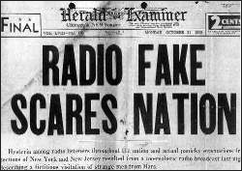

Slide 3
How to Spot Fake news
https://youtu.be/AkwWcHekMdo

Slide 4
False, Misleading, Op/Ed, Clickbait, and Infotainment?????????
draw a distinction between fake news and false news.
fake news is disinformation for profit
false news is biased speech
Opinion
blur the line between news and opinion

Slide 5
Is a Craigslist ad proof that counterprotesters at a white nationalist rally were “paid to make chaos”? No. The ad called for “actors and photographers” in Charlotte, North Carolina, not Charlottesville, Virginia, where the rally took place. Aug. 24, 2017
Did NASA confirm that there will be 15 days of darkness on Earth in November? No. Variations of that false claim have been circulating since at least 2015. Aug. 11, 2017
Was Malia Obama fired from an internship for smoking marijuana? Was she arrested for buying marijuana in Chicago? No. Those spoof stories were made up to troll conservative readers. Aug. 10, 2017

Slide 6
Consequences
“Fake news became all too real over the weekend after a North Carolina man entered a Washington pizzeria with an assault rifle in an attempt to "self-investigate" a false but persistent conspiracy theory about Hillary Clinton.”
http://www.politifact.com/truth-o-meter/article/2016/dec/05/how-pizzagate-went-fake-news-real-problem-dc-busin/

Slide 7
Is it satire?
the use of humor, irony, exaggeration, or ridicule to expose and criticize
Satire
humor factor that is obvious to the reader
created with the purpose to foster critical thinking
encourage the audience to observe matters from different perspectives
wit is employed to expose something foolish
Not
deliberately peddling falsehoods
intended to deceive individuals
Could be insensitive
unnecessarily alarmist
risk of helping to spread misinformation

Slide 8
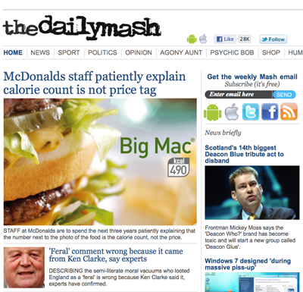
Satirical News

Slide 9
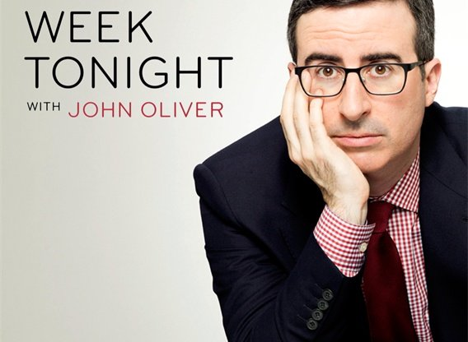
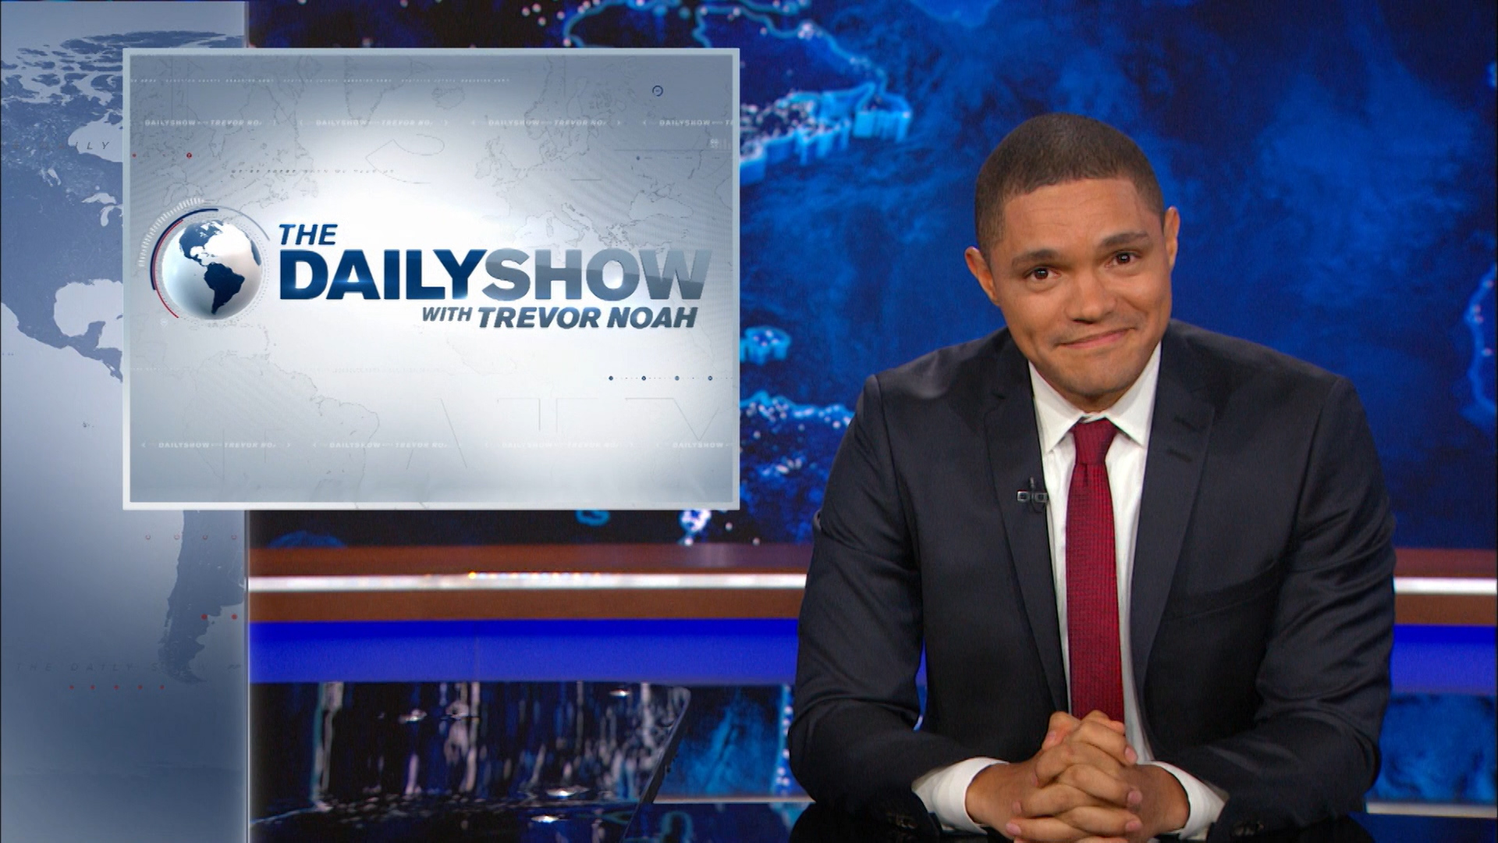
Satirical TV Shows

Slide 10
Three of the news stories below were recently published in The New York Times. One is from the satirical site The Onion. Which is the fake news story?
With a $1,000 Price Tag, Apple’s iPhone Crosses a Threshold
Equifax Impressed By Hackers’ Ability To Ruin People’s Finances More Efficiently Than Company Can
In the Future, Warehouse Robots Will Learn on Their Own
Under Trump, Job Market Has Improved More for Clinton Supporters

Slide 11
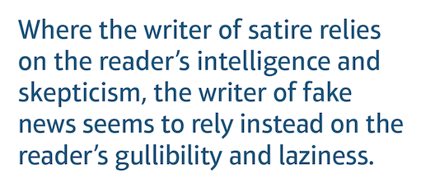
https://www.middleweb.com/35047/beersprobst-responsible-reading-and-fake-news/

Slide 12
C.R.A.A.P. question everything you read, hear, and see in the media
Currency
Relevancy
Accuracy
Authority
Purpose

Slide 13
Articles
With your group, take a look at the articles provided and evaluate them…
Refer to the hand out “Ten Questions for Fake News Detection”
Be ready to explain your reactions and analysis

Slide 15
“According to a 2009 study, radiation-induced fasciation in wild plants is extremely unlikely.
Fasciation - otherwise known as cresting - is a rare mutation that can affect the stem, root, flower head, and sometimes even the fruit of over 100 species of vascular plants around the world. The mutation manifests in the plant tissue as a flattened, ribbon-like, crested, or contorted shape, just like how the yellow centres of the daisies in the image above and below have been elongated and split in half.”
https://www.sciencealert.com/new-photos-show-mutated-daisies-growing-near-fukishima

Slide 16
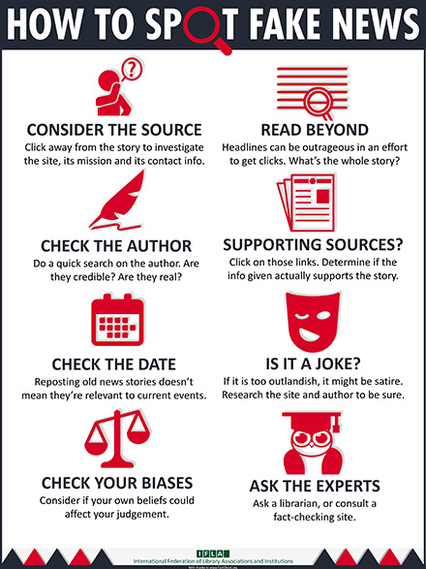
ReCap

Slide 17
Please respond:
What is one thing you learned today?
What else would like to know?

Slide 18
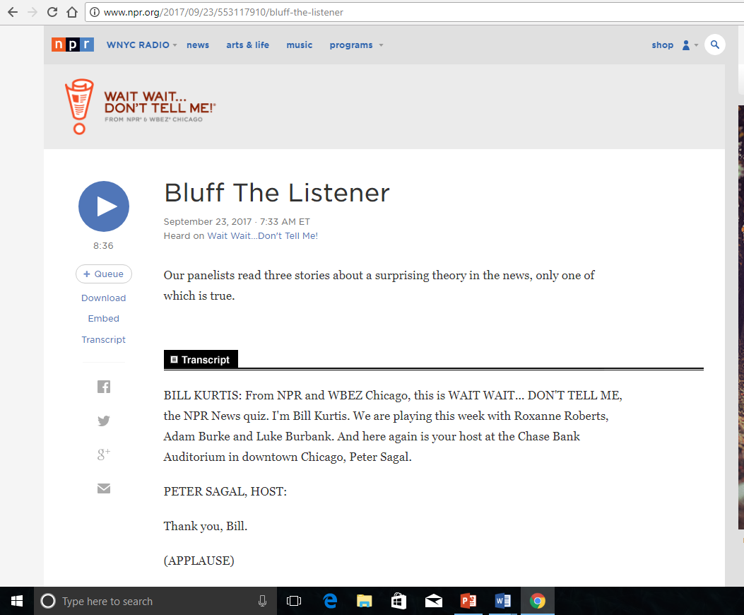
http://www.npr.org/2017/09/23/553117910/bluff-the-listener

Slide 19
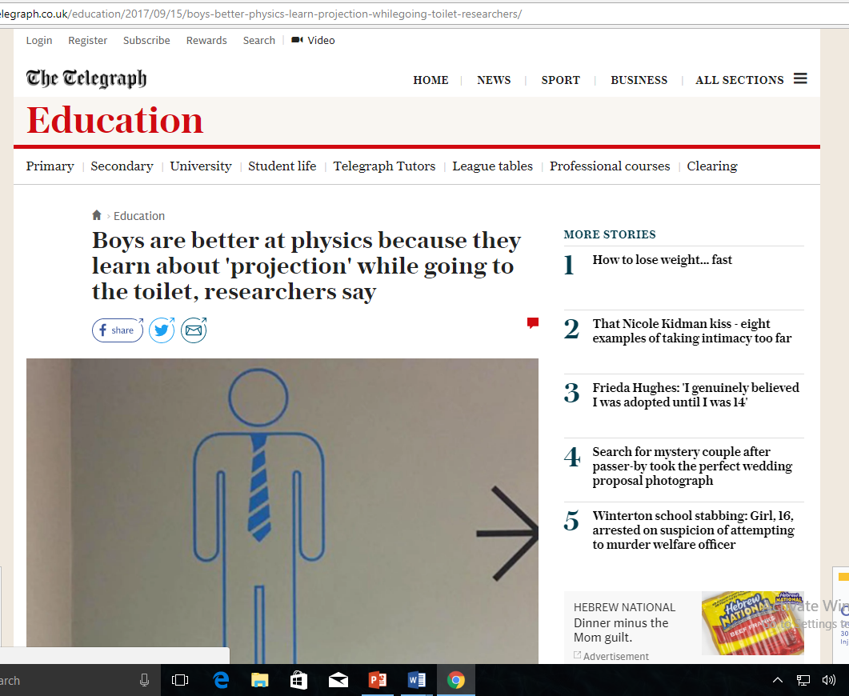
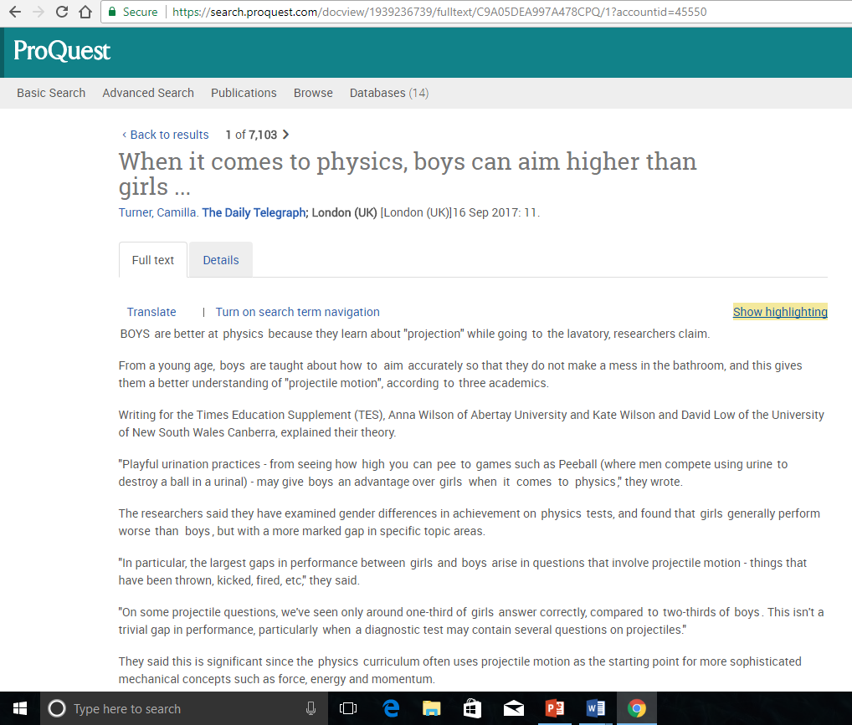

Slide 20
Three of the education-related news stories below were recently published in The New York Times. One is from the satirical site The Onion. Which is the fake news story?
As Coding Boot Camps Close, the Field Faces a Reality Check
Cash-Strapped School District Furloughs Hundreds of Nonessential Children
Even With Affirmative Action, Blacks and Hispanics Are More Underrepresented at Top Colleges Than 35 Years Ago
Betsy DeVos Says She Will Rewrite Rules on Campus Sex Assault

