Slide 1
Tattnall County Schools Annual Title I Parent Meeting 2023 – 2024
North Tattnall Elementary School
In Person Meeting
October 19, 2023
4:00 -5:00 PM

Slide 2
Presenter
Nitonia Purdiman

Slide 3
Welcome
N.T.E.S. is proud to be a partner with parents in educating our community’s children.
Notes:
Welcome! We are proud to be a partner with parents in educating our community’s children. As a parent, you are a vital part of helping your child succeed. During this meeting, we want to tell you about some of the programs we are offering children to give them the skills and knowledge they need. This meeting is also a chance for you to tell us what we can do to help you.

Slide 4
Title I Annual Parent Meeting Agenda
What is a Title I School?
How does our district/school spend Title I money? How is Title I Parent and Family Engagement money spent?
What is required by law for Parent and Family Engagement?
What are our school’s Title I Schoolwide requirements?
Schoolwide Program participation – Past and Present
What are our Schoolwide goals?
What programs/supports are in place to help students?
What is the state’s grades report for our school?
What curriculum does our school use?
What tests will my child be taking?

Slide 5
Title I Annual Parent Meeting Agenda continued….
Does my child’s teacher meet professional qualifications and a parent’s right to know?
What opportunities does the school provide for family engagement?
How responsive will the school be to my questions when staff is contacted?
McKinney-Vento Education for Homeless Children and Youth
Closing and evaluations
BOE Contact Information

Slide 6
What is a Title I school?
Title I is the largest federally funded program for
elementary, middle, and high schools.
The U.S. Department of Education provides each state
with an allocation based on census poverty data.
The focus of the Title I program is on helping all students
meet the same high standards expected of all children.
For more information visit Georgia Department of
Education website at www.gadoe.org.
All of Tattnall County’s schools are Title I schools.

Slide 7
Title I money
Title I funds may only be used to supplement, not supplant existing services.
Our district/school utilizes the 1% of our Title I funds for parent engagement – this pays for our student handbooks, agendas, printing, parent communication, parent newsletters, parent and family engagement activities, translations and interpretation, family resource centers, and other parent resources.
Title I meeting supplies/materials.
If you have any questions about the Title I budget for the county, please contact Dr. Tisha Holland at 557-4726.
Notes:
Title I provides a variety of services that may include:
Additional teachers and support staff
Extended time for instruction
Smaller class sizes
Additional training for staff
A variety of teaching methods and resources
Parent Resource center at your child’s school

Slide 8
Title I Parent and Family Engagement Requirements
District Parent and Family Engagement Policy
(Available at www.tattnallschools.org under Departments tab then select Federal Programs from drop down.)
Available in the Student Handbook
School Parent and Family Engagement Policy
School-Parent Compact
Annual Title I Parent Meeting (prior to November 1st)
Annual Evaluation
While the ESSA has many requirements, there is a strong focus throughout the law on parent and family engagement notification and involvement…..
Notes:
The annual Review and Parent Input Meeting of the District and School Parent & Family Engagement Policy and School-Parent Compact will take place in the Spring. All parents, guardians, students and community stakeholders are encouraged to take part.
*Provide copies of School Level Parent and Family Engagement Policy & School-Parent Compact.

Slide 9
LEA Parent and Family Engagement Policy ESSA Section 1116 (a) (2)
Each Local Educational Agency (LEA) that receives Title I funds must jointly develop, and agree on with, and distribute to parents and family members of children receiving services a written parent and family engagement policy. The LEA parent and family engagement policy outlines how the district will implement programs, activities, and procedures for the engagement of parents in Title I programs. The policy will establish the district’s expectations for parent and family engagement and how the district will carry out the parent and family engagement requirements.

Slide 10
School Parent and Family Engagement Policy
ESSA Section 1116 (b) and (c)
Each school that receives Title I funds must jointly develop, agree on with, and distribute to parents and family members of children receiving services a written parent and family engagement policy. The school parent and family engagement policy describes how the school will carry out the parent and family engagement requirements to ensure effective engagement of parents and to support a partnership among the school, parents, and the community to improve student academic achievement.

Slide 11
School-Parent Compact
ESSA Section 1116 (d)
Each school that receives Title I funds must jointly develop and revise with parents a school-parent compact as part of the school-level parent and family engagement policy. The school-parent compact is an agreement that outlines how parents, the entire school staff, and students will share the responsibility for improved student academic achievement and the means by which the school and parents will build and develop a partnership to help children achieve the state’s high standards.

Slide 12
Annual Title I Parent Meeting ESSA Section 1116 (c) (1)
Convene an annual meeting, at a convenient time, to which all parents of participating children shall be invited and encouraged to attend, to inform parents of their school’s participation under this part and to explain the requirements of this part, and the right of the parents to be involved.

Slide 13
Annual Evaluation ESSA Section 1116 (a) (2) (D) & (E)
Each Local Educational Agency (LEA) that receives Title I funds must conduct an annual evaluation of the content and effectiveness of the parent and family engagement policy in improving the academic quality of the Title I schools, including identifying possible barriers to greater participation of parents in activities and programs.

Slide 14
Title I Schoolwide Program requirements & participation
A Title I Schoolwide Program (SWP) addresses the educational needs of all students with comprehensive strategies for improving the whole school so that every student achieves high levels of academic proficiency.
SWP can improve academic achievement throughout a school so that all students, particularly the lowest-achieving students, demonstrate proficiency related to the state's academic content standards.
SWP builds on schoolwide reform strategies, rather than separate, add-on services.
The Title I Annual Schoolwide Plan is developed with input from various stakeholders.
Title I districts and schools are required to conduct a comprehensive needs assessment to identify student and staff needs and to determine appropriate programs, services and activities.

Slide 15
N.T.E.S. Schoolwide Goals
The number of students in grades 3-5 scoring a level 1 proficiency on the GA Milestones EOG assessment will decrease by 3% on the spring 2024 Milestones EOG assessment in all academic areas, compared to spring 2023 scores.
The number of students receiving office referrals will decrease by 3% with continued implementation of Positive Behavioral Intervention and Supports (PBIS) and implementation of Class Dojo, during the 2023-2024 school year as compared to the 2022-2023 school year.

Slide 16
Schoolwide programs/supports
Georgia Standards of Excellence
Amplify (K-5)
Eureka Math Squared (k-5)
Check & Connect
RTI Interventions
Free Breakfast & Lunch Programs
Migrant paraprofessional
Parent & Family Activities
School Council
* You, as Title I parents, have the right to provide input in the development of the schoolwide improvement plan. You are encouraged to submit suggestions at any time throughout the school year to the school principal.

Slide 17
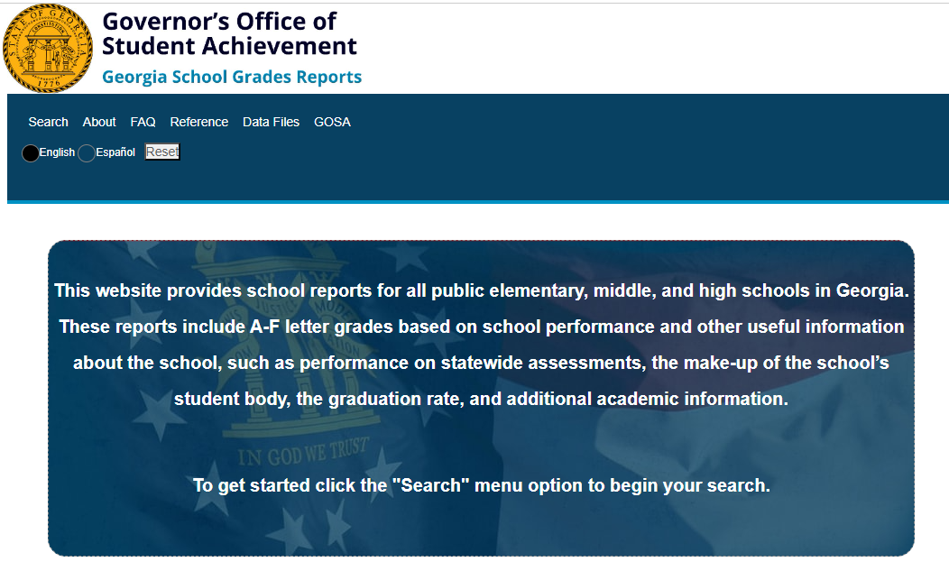
School State Report Card
https://public.gosa.ga.gov/noauth/extensions/SchoolGrades-Georgia/SchoolGrades-Georgia.html
https://schoolgrades.georgia.gov/school-search?f[0]=field_district:144

Slide 18
School’s Curriculum and Testing
Kindergarten Only:
BOY: First 6 weeks of school
EOY: May 2024
January –March 2024
GMAS Testing Dates:
April 30 - ELA 1
May 1 - ELA 2
May 2 - ELA 3
May 7 - Math 1
May 8 - Math 2
May 9 – Science 1 & 2
GSE website and information for parents.
https://www.georgiastandards.org/Georgia-Standards
Georgia's academic content standards establish high expectations for all students. The Georgia Standards identify what your child needs to know and be able to do in all content areas by grade levels. The Georgia Standards form the framework of everything taught at school.

Slide 19
Student Academic Expectations
How do these tests measure my child’s progress?
GMAS measures how well student have learned the knowledge and skills outlined by
Georgia’s standards of excellence in ELA, Math, & Science. ACCESS measures language proficiency.
What proficiency levels is my child expected to meet? GMAS: Levels 1-4 (Expect 2 Developing, 3 Proficient, or 4 Distinguished) ACCESS: Levels 1-6 (Entering –Reaching)
How to access previous test performance, standards, and attendance about my child using the Statewide Longitudinal Data System (SLDS) through the school’s parent portal…Login to Powerschool account and click SLDS Portal button. You can look at performance, assessment, attendance, etc.

Slide 20
Parents’ Right to Know
In compliance with the requirements of the Every Student Succeeds Act, parents may request professional qualifications of student’s teacher(s) and/or paraprofessional(s).
A copy of notification can be viewed on Tattnall County Schools district page by selecting Departments and Federal Programs from drop down. Copy of notice is located under Parent and Community section.
If you wish to request information concerning your child’s teacher(s) and/ or paraprofessional’s qualifications, please contact the principal at your child’s school or Mrs. Gwenda Johnson at the Tattnall County Board of Education (912)-557-4726.
Notes:
Under the reauthorization of the Elementary and Secondary Education Act of 1965 as the Every Student Succeeds Act (ESSA) of 2015, Highly Qualified (HiQ) is no longer required or reported to the United States Department of Education (USDE). Instead, ESSA, under Title I, Part A, says that state education agencies (SEAs) and local education agencies (LEAs) must ensure teachers meet applicable state certification requirements.

Slide 21
Family Engagement Opportunities
Open House
Grade Night/Science & Math Night
Literacy Night
PTO
Fall Festival
Weekly Newsletters
Pre-K Field Trips & Activities
School Council
Fundraisers
Facebook, Remind, Class Dojo
School’s Responsiveness
Contact your child’s teacher by school email or Dojo if you would like to volunteer.

Slide 22
N.T.E.S. Contact Information 26189 GA Hwy 23 Collins, GA 30421 Phone: 912-693-2455 Fax: 912-693-4908 7:00AM - 3:30 PM
Principal: Dr. Christine Jenkins
chjenkins@tattnall.k12.ga.us
Assistant Principals: Dently Crews
dcrews@tattnall.k12.ga.us
Melanie Kirby
mkirby@tattnall.k12.ga.us
Counselor: Angie Costen
acosten@tattnall.k12.ga.us
Academic Coach: Nitonia Purdiman
npurdiman@tattnall.k12.ga.us

Slide 23
McKinney-Vento Education for Homeless Children and Youth
Tattnall County Board Of Education
2023-2024

Slide 24
What is McKinney-Vento?
The McKinney-Vento Education for Homeless Children and Youth (EHCY) is a program designed to address the problems that homeless children and youth face when enrolling, attending, and succeeding in school. Under this program, each homeless child and youth has equal access to the same free and appropriate public education, including preschool, as other students.

Slide 25
McKinney-Vento Law
Definition of Homeless Students
Individuals whose nighttime residence is NOT:
Fixed – stationary, permanent, and not subject to change
Regular – used on a predictable, routine, or consistent basis
Adequate – sufficient for meeting both the physical and psychological needs typically met in the home (42 U.S.C.§11434A(2)(B)(i))

Slide 26
“Homeless” includes children who are:
Sharing the housing of other persons due to loss of housing, economic hardship, or a similar reason
Living in a motel, hotel, trailer park, or camping ground due to lack of alternative adequate accommodations
Living in an emergency or transitional shelter
Abandoned in hospitals

Slide 27
“Homeless” includes children who are:
Living in a public or private place not designed for or ordinarily used as a regular sleeping accommodation
Living in a car, park, public space, abandoned building, substandard housing, bus or train station, or similar setting
Migratory children

Slide 28
McKinney-Vento Act
Unaccompanied Homeless Youth (UHY)
Unaccompanied = not in the physical custody of a parent or guardian
There is a 2-Step Process for determining
Unaccompanied youth have the same rights as other students experiencing homelessness.

Slide 29
How many are there?
The number of students experiencing homelessness has decreased: The number of identified students experiencing homelessness in Georgia increased every year from 2011-12 (34,379) to 2018-19 (40,337); however, the number identified in 2019-2020 has decreased (36,753). There was a 9% percent reduction from 2018-19 to 2019-20.
According to HUD, the state’s homeless population was 7,905 in 2022, including 2,784 people in families with children and 479 unaccompanied homeless youth.
In Tattnall County we had the following number of homeless students:
2013-2014 – 39
2014-2015 – 39
2015-2016 – 37
2016-2017 – 50
2017-2018 – 39
2018-2019 - 34
2019-2020 – 34
2020–2021 – 22
2021-2022 – 18
2022-2023 - 28
Notes:
Read Slide
HUD – U.S. Department of Housing and Urban Development

Slide 30
Common Signs of Homelessness
Lack of continuity in education
Poor health/nutrition
Transportation and attendance problems
Poor hygiene
Lack of personal space after school
Social and behavioral concerns
Reaction/statements by parent, guardian, or child

Slide 31
Who do I contact for help?
The local Homeless Liaison is Dr. Tisha Holland. You can contact her at any time with questions or concerns.
(912) 557-4726
tholland@tattnall.k12.ga.us
146 West Brazell St. Reidsville, Ga
(Board of Education)

Slide 32
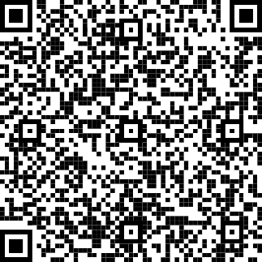
Questions/Evaluations
Please complete the survey at the following link or use the QR Code.
The results of this survey will be utilized to help in the development of the Title I School-Level Parent and Family Engagement Plan and future parent and family engagement activities and events.
If you have a question or suggestions, please contact your child’s school at the number previously provided.
https://docs.google.com/forms/d/e/1FAIpQLSdcnHvBv-8f7rXK98IjF1EEA-Zvrn55yzzu3_VQfpLqd2B6CA/viewform?usp=sf_link
THANK YOU FOR YOUR SUPPORT
Notes:
This survey is to evaluate the effectiveness of the meeting.
Parents may request a paper survey from the school if they prefer.

Slide 33
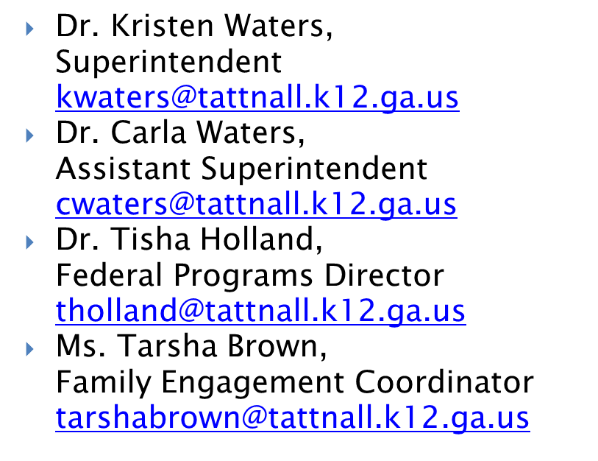
Tattnall BOE Contact Information
Address:
146 West Brazell St.
Reidsville, GA 30453
557-4726
557-3036 (fax)
Central Office Hours: Monday - Thursday (8:00-4:30) Friday
(8:00-4:00)

Slide 34
Tattnall County Schools | www.tattnallschools.org
North Tattnall Elementary School South Tattnall Elementary School | https://ntes.tattnallschools.org http://stes.tattnallschools.org
North Tattnall Middle School South Tattnall Middle School | ntms.tattnallschools.org stms.tattnallschools.org
Tattnall County High School | tchs.tattnallschools.org
Georgia Department of Education | www.gadoe.org
U.S. Department of Education | www.ed.gov
Georgia Standards | www.georgiastandards.org

Slide 35
“Whatever It Takes”
The Tattnall County School District is committed to doing whatever it takes to ensure a quality education that affirms ALL students' value and worth and will lead to high school graduation and productive citizenship.

