Slide 1
Essential Communications
Ethics
Presented By
Mrs. Bowden

Slide 2
GOALS:
Define ethics and specifically communication ethics
Discuss Principles of ethical communication
Define interpersonal ethics
Identify Ethical frameworks
Discuss human rights and ethics
Discuss ethical communication in the workplace and corporate ethics

Slide 3
What is Ethics?
ethics
the study of moral choices and values
choosing between right and wrong

Slide 4
Communication Ethics

Slide 5
Communication
the act or process of communicating; fact of being communicated.
the imparting or interchange of thoughts, opinions, or information by speech, writing, or signs.

Slide 6
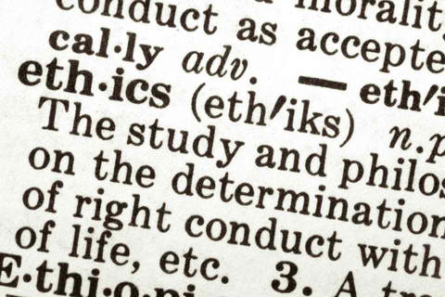
Ethics
a system of moral principles
deals with values relating to human conduct, with respect to the rightness and wrongness of certain actions and to the goodness and badness of the motives and ends of such actions.

Slide 7
Communication ethics
The principle governing communication, the right and wrong aspects of it, the moral-immoral dimensions relevant to Interpersonal communication are called the ethics of Interpersonal communication.

Slide 8
Communication ethics
Maintaining the correct balance between the speaking and listening
the legitimacy of fear and emotional appeal
degree of criticism and praise

Slide 9
Communication ethics
A death or an overdose of either of the factors could result in unfavorable consequences.
The principle of honesty on both sides should be completely applied because any amount of insincerity from either the listener or the speaker would not be prudent.

Slide 10
Fundamentals of ethical communication
responsible thinking
decision making
development of relationships and communities
Contexts
Cultures
Channels
Media

Slide 11
Unethical Communication
threatens the quality of all communication and consequently the well-being of individuals and the society.
Plagiarism
Copy write infringement
SOCIAL MEDIA? How has social media contributed to communication in an ethical way? In an unethical way?

Slide 12
Principles of ethical communication
advocate truthfulness, accuracy, honesty, and reason as essential to the integrity of communication.
endorse freedom of expression, diversity of perspective, and tolerance of dissent to achieve the informed and responsible decision making fundamental to a civil society.
strive to understand and respect other communicators before evaluating and responding to their messages.

Slide 13
Principles of ethical communication
promote access to communication resources and opportunities as necessary to fulfill human potential and contribute to the well-being of families, communities, and society.
promote communication climates of caring and mutual understanding that respect the unique needs and characteristics of individual communicators.
condemn communication that degrades individuals and humanity through distortion, intimidation, coercion, and violence, and through the expression of intolerance and hatred.

Slide 14
Principles of ethical communication
Being committed to the courageous expression of personal convictions in pursuit of fairness and justice.
advocate sharing information, opinions, and feelings when facing significant choices while also respecting privacy and confidentiality.
accept responsibility for the short- and long-term consequences for our own communication and expect the same of others.

Slide 15
Interpersonal Communication Ethics

Slide 16
Interpersonal communication
Interpersonal communication refers to communication with another person. This kind of communication is subdivided into:
dyadic communication
public communication
small-group communication.

Slide 17
Four Principles of Interpersonal Communication

Slide 18
Principles:
Inescapable
Irreversible
Complicated
Contextual
Psychological context
Relational context
Situational context
Environmental context
Cultural context

Slide 19
Functions of Interpersonal Communication

Slide 20
Gaining Information
Building a Context of Understanding
Establishing Identity
Interpersonal Needs
Inclusion
Control
Affection

Slide 21
Distance
Provides necessary space for each communicative partner to contribute to the relationship.
Is interpersonal space that nourishes the very thing that keeps persons together interpersonally—relationship.
Is an ethical responsibility, not a flaw or a limitation.
The importance of distance keeps us from equating interpersonal communication with ever more closeness.

Slide 22
Interpersonal responsibility
Begins with each person’s commitment to active care for the interpersonal relationship, owned by neither and nurtured with or without the support of the Other.
Adheres to the insight of Emmanuel Levinas, abandoning the expectation of reciprocity for attentiveness to a call to responsibility with or without the approval of the other.

Slide 23
Interpersonal responsibility
Involves:
Caring for an interpersonal relationship. As one seeks a path in life, interpersonal relationship responsibility invites a balance between distance and closeness in each relationship, which defines the quality of our interpersonal lives (Stewart, 2006).
Sympathy
Empathy

Slide 24
ETHICAL FRAMEWORKS

Slide 25
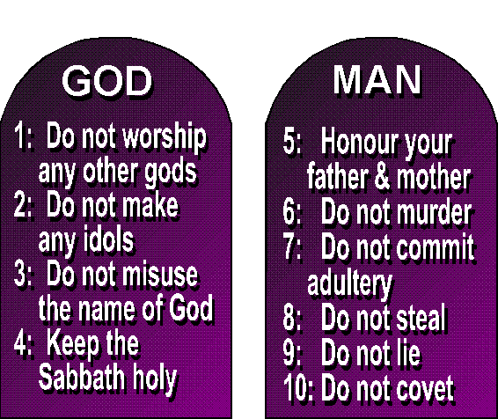
Deontological Ethics
the most frequented basis of our decision making process, expressing a commitment to the most basic principles.
It is regarded as universal, always applicable whatever the circumstance is.
We follow these rules since we think of them as duties.

Slide 26
Utilitarian Ethics
focuses on the results and whether or not it would benefit the majority.
Utilitarianism focuses on the consequences of each action or decision.

Slide 27
Virtue Ethics
concerned with moral character and places more weight or value on the dignity of an individual and a humanity’s task of caring for one another.
It emphasizes character as opposed to duty or consequence.

Slide 28
Situational or Contextual Ethics
There is no absolute approach to situations, each situation should be addressed as different from each other.
Every problem should be evaluated in its particular context or situation.

Slide 29
Human Rights and Ethics

Slide 30
Freedom of Expression
Freedom of Expression is a basic human right, It refers to right to freedom of expression, including the freedom to seek, receive, and impart information and opinions of any kind in any form.

Slide 31
Freedom of Expression
Internationally, freedom of expression is protected under the Universal Declaration of Human Rights and the International Covenant of Civil and Political Rights.
Used to seek answers and express opinions

Slide 32
Ethical Freedom of Expression
Freedom of Expression must be balanced against society’s need to maintain order, protect general welfare and public morality
There should be limits to free expression, but only when it involves harm to others
People should refrain from hate speech, the public use of derogatory and offensive language denigrating others, particularly on the basis of race, ethnicity, gender and/or sexual orientation.

Slide 33
Ethics and Information
What information should be gathered?
How is the information gathered?
How is the information disseminated?
FOIA – Freedom of Information Act

Slide 34
ETHICS IN THE WORKPLACE

Slide 35
Mass Communication
Mass communication is used to describe the various means by which individuals and entities relay information through mass media to large segments of the population at the same time.
It is the mass production of messages (message) or information that is intended to reach a large amount of people
Uses mass media; such as newspapers, TV, radio, books etc.

Slide 36
Mass Communication Ethics
Ethics
Truth
Censorship
Laws
Privacy
Appropriateness
Sensitivity to other cultures
Respect dignity, privacy, and well being of a person

Slide 37
Codes of Ethics
code of ethics
a set of standards or rules that outlines the ethical behavior demanded by:
an individual
a business
a culture

Slide 38
Ethic Codes
Ethic Codes (or Ethical Codes) are moral guidelines that are used to help assist people in making decisions, to tell the difference between ‘right’ and ‘wrong’ and to utilize this understanding to make ethical choices
There are 3 levels;
Code of ethics (social issues and social responsibility)
Code of conduct (influence the behavior of employees)
Code of practice (professional responsibility)

Slide 39
Ethics and Business
business ethics
the application of the principles of right and wrong to issues that arise in the workplace
Set High Standards
Treat business associates fairly and ethically.
Inform your customers of your ethical business practices.

Slide 40
Corporate Codes of Ethics
Honesty - Professional communicators are honest, accurate and candid in all communications. This practice encourages the free flow of important information in the interest of the public

Slide 41
Corporate Codes of Ethics
Confidentiality - Protecting the confidences and privacy rights of employees and customers is the duty of professional communicators. Additionally, they must abide by legal requirements for disclosing information that affect the welfare of others
Credit - Give due credit to those who you get ideas from.

Slide 42
Corporate Codes of Ethics
Free Speech - Principles of free speech and free ideas should be encouraged.
Courtesy - Sensitivity to cultural values and beliefs are crucial.

Slide 43
Types of Unethical Communication Behaviors in the workplace | Example
Coercive | Intimidation and threatening others.
Destructive | Backstabbing and inappropriate jokes.
Deceptive | Euphemism and lying.
Intrusive | Eavesdropping, tapping telephones or monitoring Internet use
Secretive | Hoarding information and cover-ups
Manipulative-exploitative | Acts which attempt to gain compliance or control through exploitation

