Slide 1
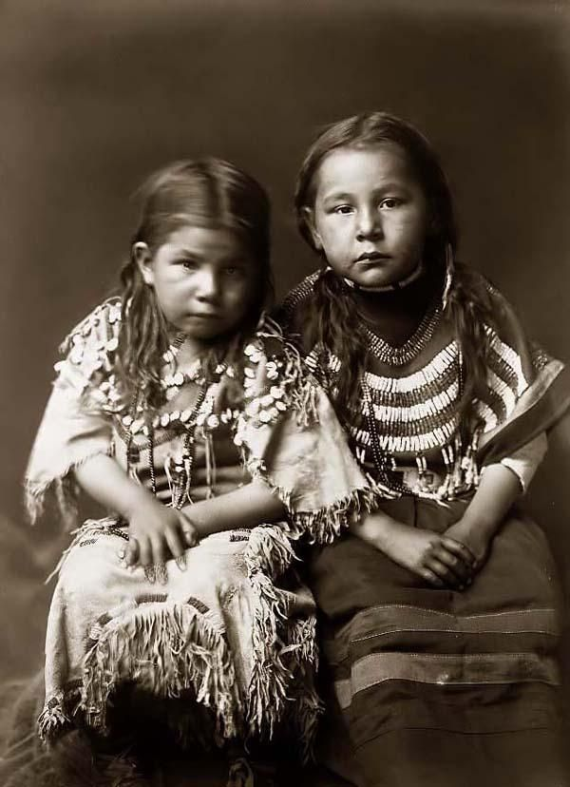
Commands

Slide 2
tiłxəx
stand up

Slide 3
mutx
sit

Slide 4
xʷistx
walk

Slide 5
ƛ̓lapx
stop

Slide 6
c̓aq̓ʷnt
point

Slide 7
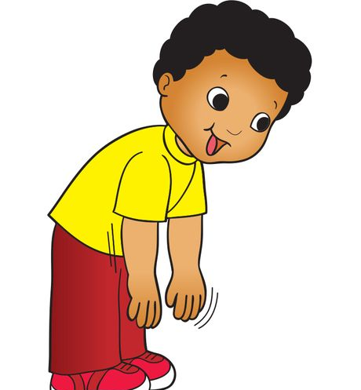
tqant
touch

Slide 8
kʷint
Take it

Slide 9
utánt
put

