Slide 1
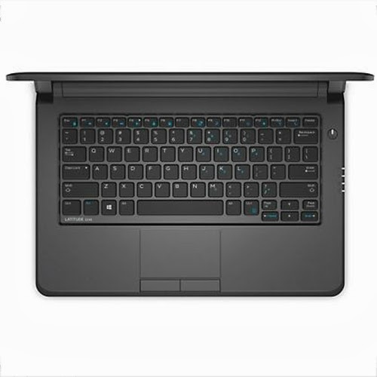
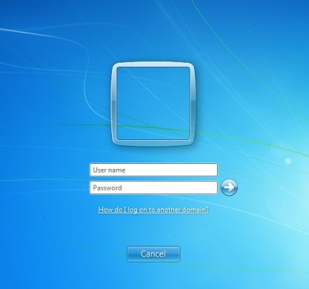
Power On Laptop and Login Bae!
Power Button
Login using PowerSchool username and password

Slide 2
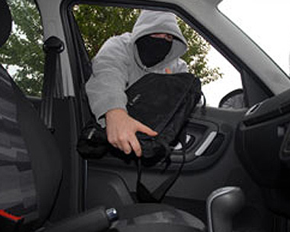
Laptop Care Procedures – At School
New Devices – You have the best in the building !
Between Classes
Close the lid
Put in bag
Do Not Leave Device Unattended

Slide 3
Laptop Care Procedures – At Home
Filtering Applies at Home as Well as School
Not the Family Computer
Charge Each Night Ready for School the Next Day
Shutdown Laptop Before Returning to School

Slide 4
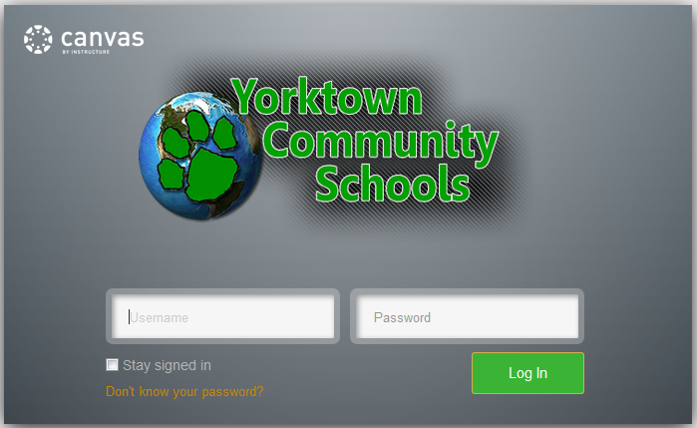
Canvas – Replacing MBC
Navigate to
Yorktown.instructure.com
Login
Same Username and Password From PowerSchool

Slide 5
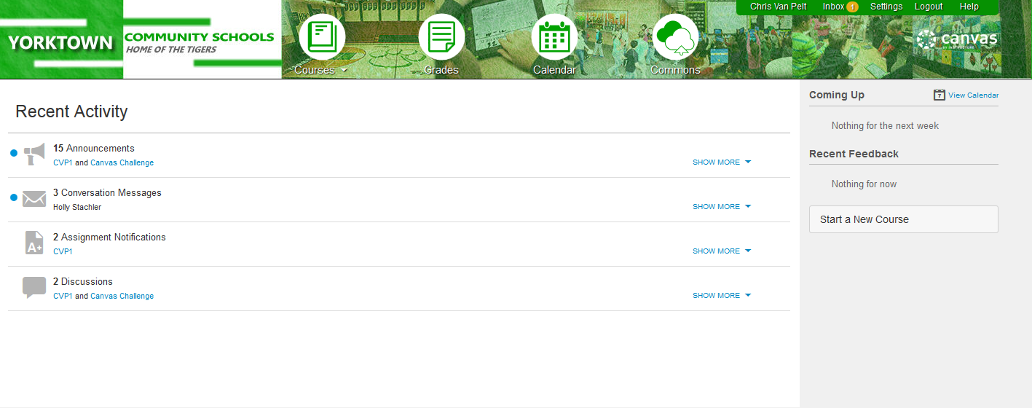
Canvas Layout

Slide 6
Options For Saving Work
At School
Documents (H:)
Canvas Files
At Home
The Cloud
Canvas Files

Slide 7
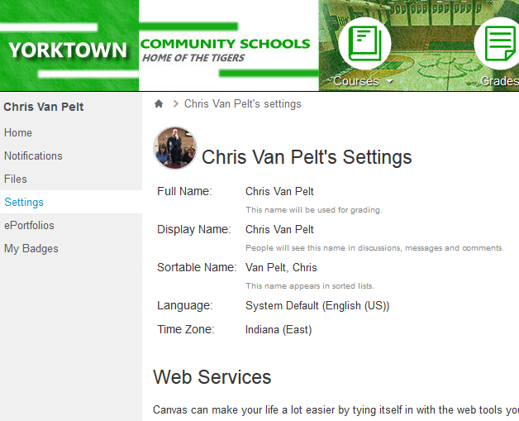
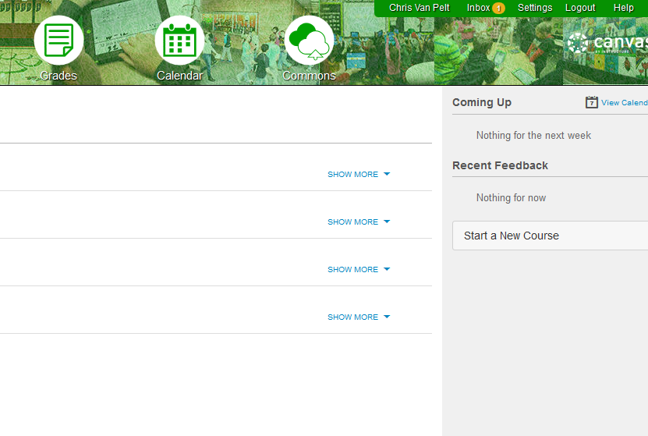
Saving Documents – At School
Documents (H:)
File – Save – Documents
Canvas Files

Slide 8
Saving Documents – At Home
Yorktown Cloud: my.yorktown.k12.in.us
Cloud systems allow documents to be saved and edited from anywhere.
All documents saved in “Documents” can be accessed from any location.

Slide 9
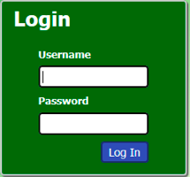
Saving Documents – At Home
Navigate to http://my.yorktown.k12.in.us
Login with PowerSchool Username and Password

Slide 10
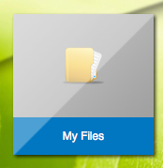
Saving Documents – At Home
Once logged in, click “Desktop” at the Top of the Page
Click “My Files”

Slide 11
Laptop Issues –What to do ... Or nah
If Your Laptop is Not Working:
Take Laptop to YHS library – Mrs. Belt
Netbook Loaner Will Be Issued During Fix
If Damage
Fill out incident report – explaining what is wrong
Laptop will be returned when work is complete
Repair Plans Can Be Found on YCS Technology Page – Forms and Policies – Technology Agreements and Policies

Slide 12
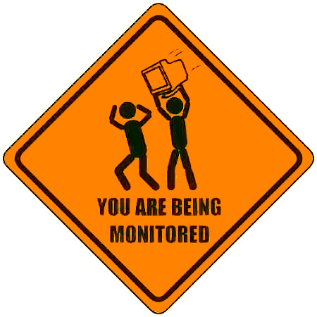
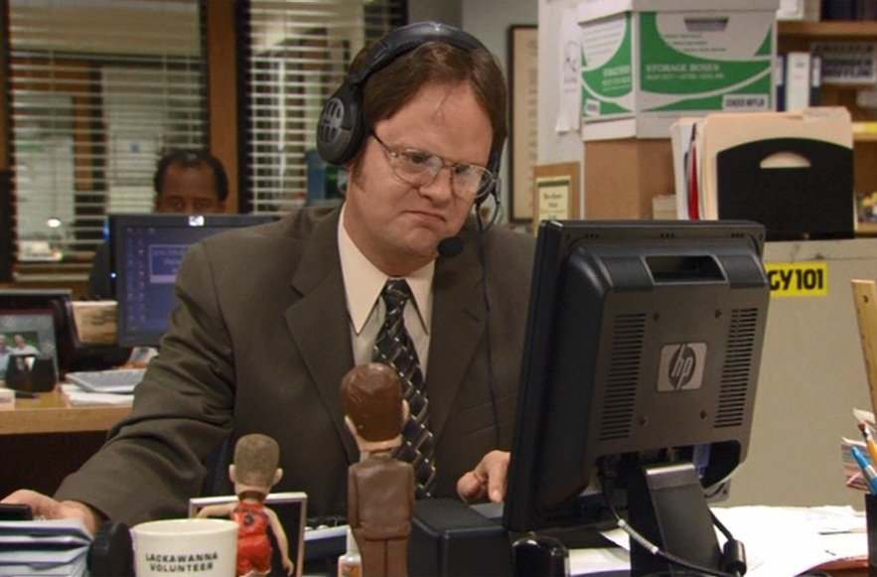
Enjoy!
Remember…..

