Slide 1
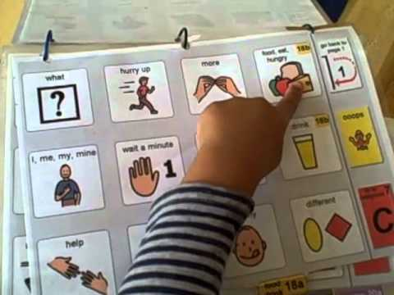
Introduction to PODD
Marnina Allis, M.S. CCC-SLP, ATP Stefanie Blanco, M.S. CCC-SLP, ATP

Slide 2
Before We Start PODD…
Presume competence
Follow the Least Dangerous Assumption (e.g. Everyone can and will learn language. It may be difficult. It may take a long time)
Goal of AAC: The long term goal for anyone learning language is to be able to spontaneously generate novel utterances (SNUG).

Slide 3
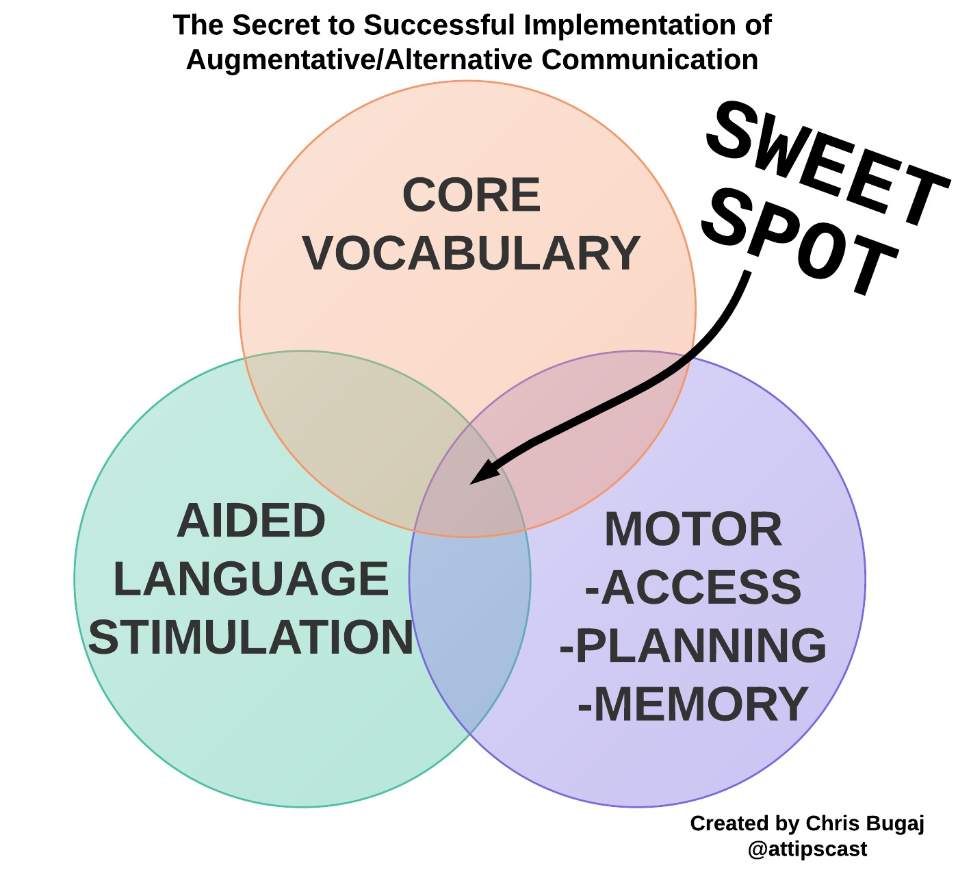
http://bit.ly/aacsweetspotthinglink

Slide 4
Aided Language Stimulation
NOT HERE
Model language by using the same expressive communication system the student uses
Encourage attention, but don’t demand it
Continue to model even if child does not appear to be attending
Aided Language Stimulation
E
EDUCATORS
G
A
STUDENT
U
G
Model one step above
N
A
L

Slide 5
Pragmatic Organization Dynamic Display (PODD)
Developed in Australia by Gayle Porter 15 years ago
PODD is a means of selection and organizing symbols so that people with complex communication needs and their communication partners can communicate more easily
GOAL: to provide vocabulary for continuous communication all the time, for a range of messages across a range of topics, in multiple environments

Slide 6
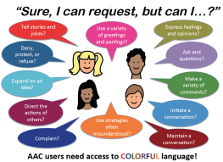
Positives of PODD
Robust Language Organizational system
Offers a full range of communicative functions such as requesting, commenting, greetings, etc
Compatible with Aided Language Stimulation
Contains both core and fringe vocabulary

Slide 7
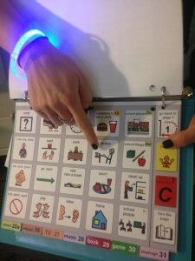
Positives of PODD continued…
Reduces load on working memory, promotes automaticity
Thousands of repetitions with intent, purpose, and variation
Requires less sophisticated motor skill
Systemized presentation of vocabulary (child learns patterns)
Books/ Video (43 sec)

Slide 8
Partner-Assisted Scanning
Teach “typical” movements of a head nod for “yes” and a head shake, or turning head away for “no” whenever possible
These movements will be more easily reconigzed by untrained communication partners- especially future partners
Doesn’t require a partner to stop and hold up yes/no cards for each scanned item
Will allow the child to use intelligible head movement to agree or disagree during a conversational discourse when listening a partner
Video

Slide 9
References
Binger & Light, 2007
Bruno & Trembath, 2006
Burkhart & Porter, 2016
Cafiero, 2001
Drager et al, 2006
Harris & Reichle, 2004
Light, J & McNaughton, D. (2015)

Slide 10
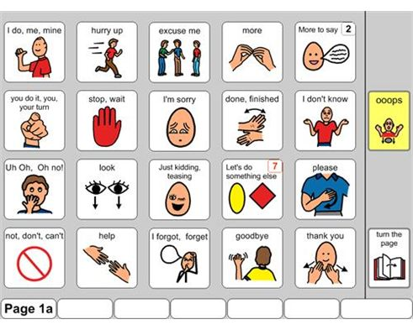
QUESTIONS?

