Slide 1
The College Application Process Overview
Guiding Your Student Through
The Senior Year
September 2023

Slide 2
Counseling Office Staff
COUNSELORS
Ms. Heather Jaffe, chairperson
Mr. Tom Feliciotto
Mr. Tim Mahon
Mrs. Kristen Mancini
Ms. Juliet Powers
Mr. Nick Ruotolo
Mrs. Danielle Schulman
SUPPORT STAFF
Mrs. Liso, Transcript Coordinator
Mrs. Harrison, Administrative Assistant

Slide 4
Topics for tonight:
Application Timeline
Admission Lingo/Terms
College Visits to CHS
College Fairs/College Visits
Applications (Common App & Others)
Scoir
Transcript Requests
Teacher/Counselor Recommendations
SAT and ACT scores (optional)
Financial Aid/Scholarships Overview & Terms
Question & Answer time

Slide 5
Timeline-Important Dates
NOW --- FALL
Review high school transcript
Students meet with their counselor to review/revise college list, answer questions, etc.
Students ask teachers (2 max) to write letters of recommendation
Students finalize college essays/supplementals
Student-Athletes (planning to play in college): register with NCAA Clearinghouse www.eligibilitycenter.org and see Mrs. Liso in Guidance
OCTOBER 13th:
Inform your counselor of intent to apply Early Action/Early Decision
OCTOBER 13th:
Complete Senior Autobiography packet & Parent Brag Sheet (if you would like your counselor to write you a college recommendation.)
THANKSGIVING:
Plan to have all applications complete by Thanksgiving and request your transcript in SCOIR. (move college to “applied”=transcript request)

Slide 6
Common Terms in College Admissions
Early Decision
Early Action
Rolling Admission
Regular Admission
Score Choice/Test Optional
Waitlisted vs. Deferred
The Common Application
SUNY & CUNY

Slide 7
College Visits to CHS: on Scoir dashboard, under “me” click “Visits/Deadlines:
If your student plans to attend, please have them REGISTER on SCOIR so we have a head count

Slide 8
College Fairs:
Virtual and In-Person Options

Slide 9
NACAC Virtual College Fairs
www.virtualcollegefairs.org

Slide 10
New York Black College Expo
Saturday, September 23, 2023
10:00am - 4:00 PM
Medgar Evers College
Brooklyn, NY
www.ncrfoundation.org

Slide 11
Local In-Person College Fairs
www.nysacac.org
NYSACAC College Fair
Wednesday, September 27, 2023
6:30 - 8:30 PM
Sarah Lawrence College
Bronxville, NY

Slide 12
Long Island SUNY College Fair
October 1, 2023
12:00 - 5:00 PM
Farmingdale State College
Nold Athletic Complex
Farmingdale, NY
New York City SUNY College Fair
October 5, 2023
4:00 - 7:00 PM
Jacob Javits Convention Center
Exhibit Hall 1E
SUNY College Fairs:
https://engage.suny.edu/portal/suny_college_fairs

Slide 13
Local In-Person College Fairs
www.wpccc.org
Southern Westchester College Conference
Tuesday, October 24, 2023
6:00 - 8:30 PM
Westchester County Center
White Plains, NY
Northern Westchester College Conference
Wednesday, October 25, 2023
6:00 - 8:30 PM
Jefferson Valley Mall
Yorktown Heights, NY

Slide 14
Local In-Person College Fairs
CASDA College Fair
Carmel High School
Thursday, October 26, 2023
6:30 - 8:00 PM

Slide 15
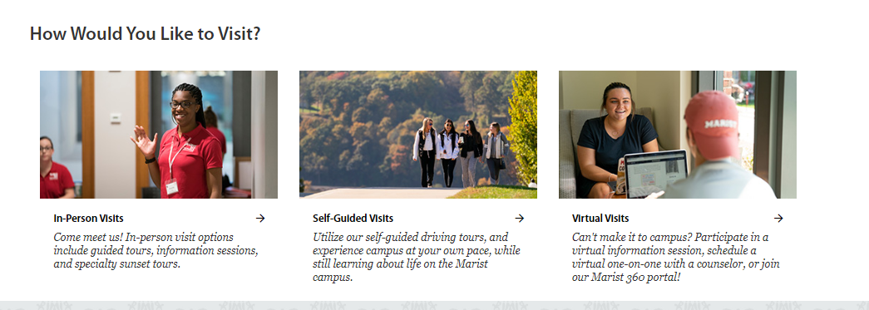
College Visits
CHS strongly encourages visiting a campus when possible
Visits can be in-person or virtual (depending on the college)
Information can typically be found right on each school's Admission website
Fall College Fairs
www.marist.edu/admission/visit (7.21.23)

Slide 16
Student Responsibility: The Application
Application Types:
Common App, SUNY App, CUNY App, Universal App, Coalition App, or an application for a specific college
Many applications also require a SUPPLEMENT (school specific) application.
Think of this as a “part 2”

Slide 17
What is Scoir?
Scoir is a customized, secure website that supports post-secondary, college and career planning. It is designed to assist students and their parents/guardians in making informed decisions about college opportunities and career choices.
SCOIR includes:
Tool to search for and review colleges
Provides historical (anonymous) data from CHS applicants
Career exploration inventory
Resources to design/build a student resume
Provides schedule of all college representatives visiting CHS
Secure platform for electronic submission of application documents

Slide 18
Drag & Drop from “Applying” to “Applied” (in Scoir)
How does CHS know to send my student's transcript?
**AFTER you SUBMIT your application**

Slide 19
Release of Records Form (purple)
We cannot send a transcript without this form on file or completed electronically on Scoir

Slide 20
The SRAR & SSAR (Self-Reported Academic Record)
A self-reported listing of your academic record which REPLACES CHS sending a transcript.

Slide 21
Letters of Recommendation From Teachers
**Students should SPEAK to the teacher they wish to have a recommendation from. After they say YES….
They may ask for a blue form (available in "My Drive" in Scoir)
Students will need make a request in SCOIR
CHS will send the letter directly to schools
Students should check if a letter is required and if there is a maximum number of recs allowed

Slide 22
Teacher Recommendation Form (blue):
Some teachers may ask for this form

Slide 23
Counselor Recommendation
Students submit “Senior Autobiography” & “Parent Brag Sheet” to their counselor. (Documents are available in your “Drive” on Scoir)
The deadline to request a letter of recommendation from your counselor is October 13th
Counselor recommendations are sent directly to colleges.
Please check to see if a counselor recommendation is required by the college

Slide 24
Senior Autobiography (orange)
DUE OCTOBER 13th

Slide 25
Parent Brag Sheet (green)
DUE OCTOBER 13th

Slide 26
How does a college receive Test Scores?
SAT & ACT Scores are NOT on your transcript. CHS does NOT send SAT or ACT scores.
Students may need to submit official scores or may be able to self-report scores.
PLEASE be aware of each school’s Standardized Test Policy. Many are TEST OPTIONAL
Score Choice: Do I send???

Slide 27
Financial Aid & Scholarships
Financial Aid Night:
October 16th @7pm
Casey Hall (CHS)

Slide 28
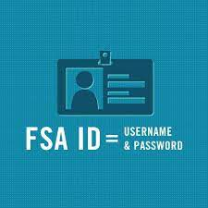
Financial Aid & Scholarships What You Can Do Now
Obtain your FSA ID:
Faster processing of FAFSA
Ability to correct info online
Student & Parent(s) need FSA ID
www.StudentAid.Gov

Slide 29
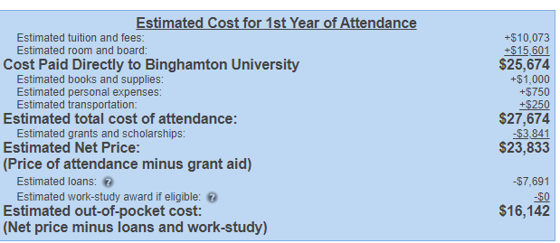
Financial Aid & Scholarships What You Can Do Now: Net Price Calculator
SUNY Binghamton (family of 4, 100k+, 1 student in college)
Net Price Calculator - SUNY 7.20.23

Slide 30
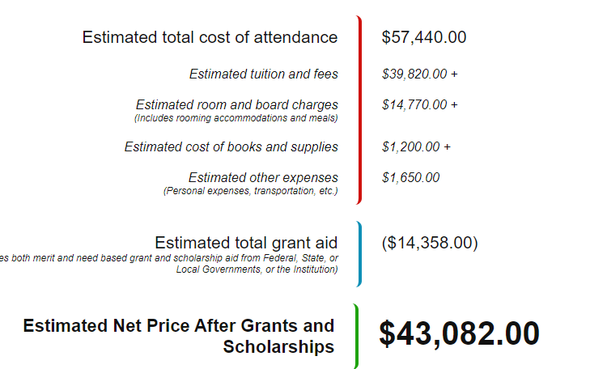
Financial Aid & Scholarships What You Can Do Now: Net Price Calculator
Sacred Heart University (family of 4, 99k+, 1 student in college)

Slide 31
Financial Aid & Scholarships What You Can Do Now
Identify What Financial Forms Will Be Required
FAFSA
TAP (NY specific)
CSS/Profile

Slide 32
Financial Aid & Scholarships What You Can Do Now
Identify & Research Scholarship Sources
College-specific Scholarships
NY State Scholarships (Excelsior/STEM)
Employer scholarships (student & parent)
Local/Community Scholarships
Scholarship Search Database

Slide 33
Questions?

