Slide 1
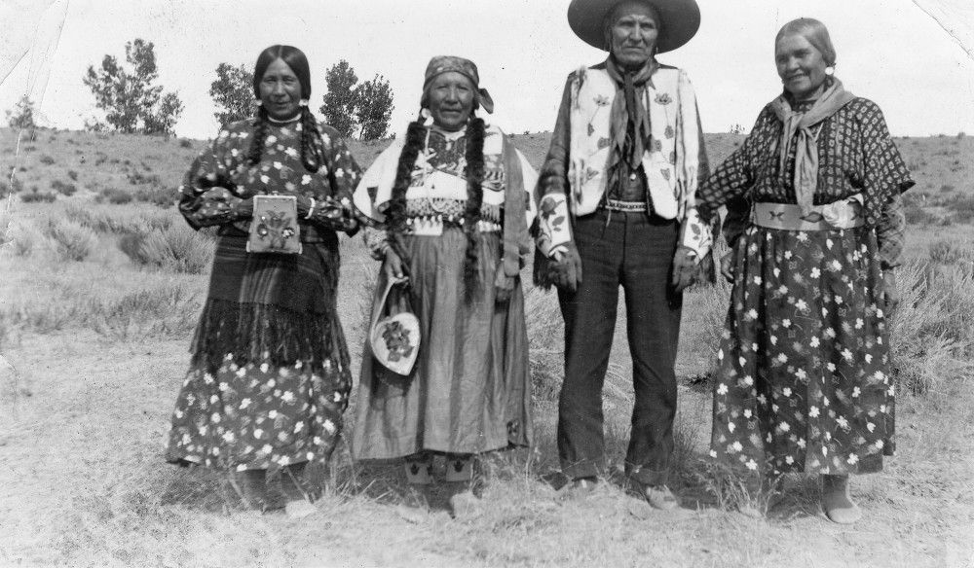
kʷu snəqsílxʷ
snəqsilxʷ naqs

Slide 2
tum̓
Mother female
sk̓ʷuy
mother male

Slide 3
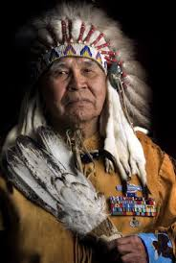
mistm̓
Father for female
lʔiw̓
Father for male

Slide 4
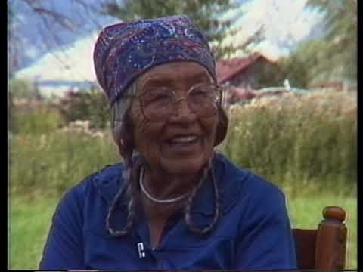
stm̓tímaʔ
Maternal grandmother

Slide 5
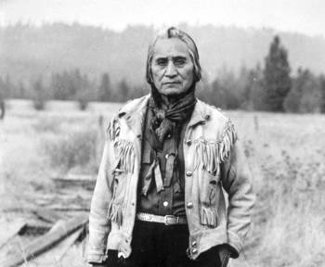
k̓ík̓waʔ
Maternal grandfather

Slide 6
qáqnaʔ
Paternal grandmother

Slide 7
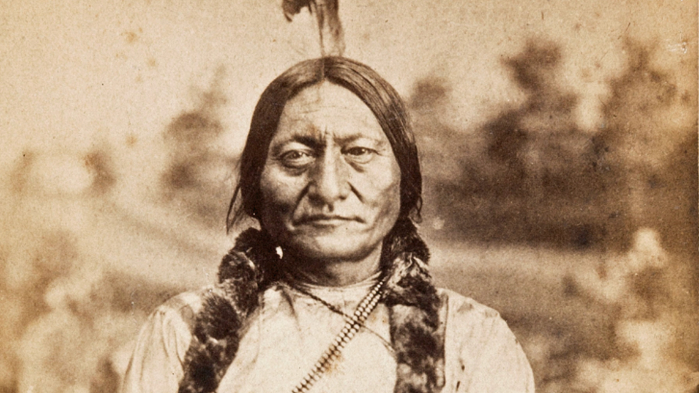
sx̌áx̌paʔ
Paternal grandfather

Slide 8
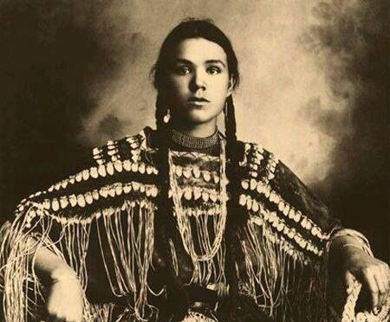
łcəcʔups
Little sister

Slide 9
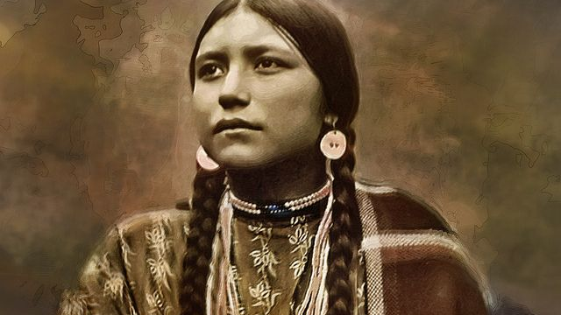
łkíkxaʔ
older sister

Slide 10
łsísn̓ca
Little brother

Slide 11
łqáqcaʔ
Older brother

Slide 12
When we are introducing ourselves, we can always remember through body memory how to recall our mother's and father's side.
Mother is left hand over heart. Put your left hand on your heart and say your mother's side of the family.
Fathers side is right hand over the right side of chest and say father's side.

Slide 13
incá iskʷist

Slide 14
intum̓ iʔ skʷists
inmistm̓ iʔ skʷists

Slide 15
isk̓ʷuy iʔ skʷists
inlʔiw̓ iʔ skʷists

Slide 16
istm̓tímaʔ iʔ skʷists
ink̓ík̓waʔ iʔ skʷists

Slide 17
inqáqnaʔ iʔ skʷists
isx̌áx̌paʔ iʔ skʷists

Slide 18
iłcəcʔups iʔ skʷists
iłkíkxaʔ iʔ skʷists

Slide 19
iłsísncaʔ iʔ skʷists
iłqáqcaʔ iʔ skʷists

