Slide 1
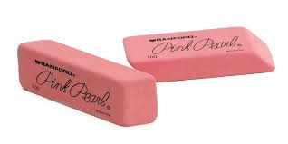
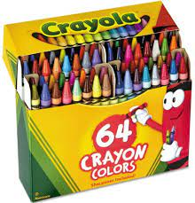
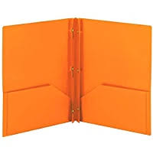
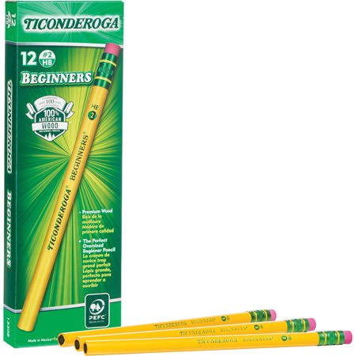
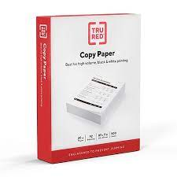
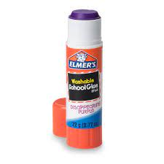
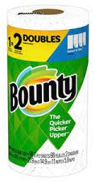
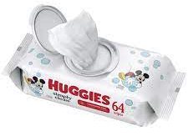
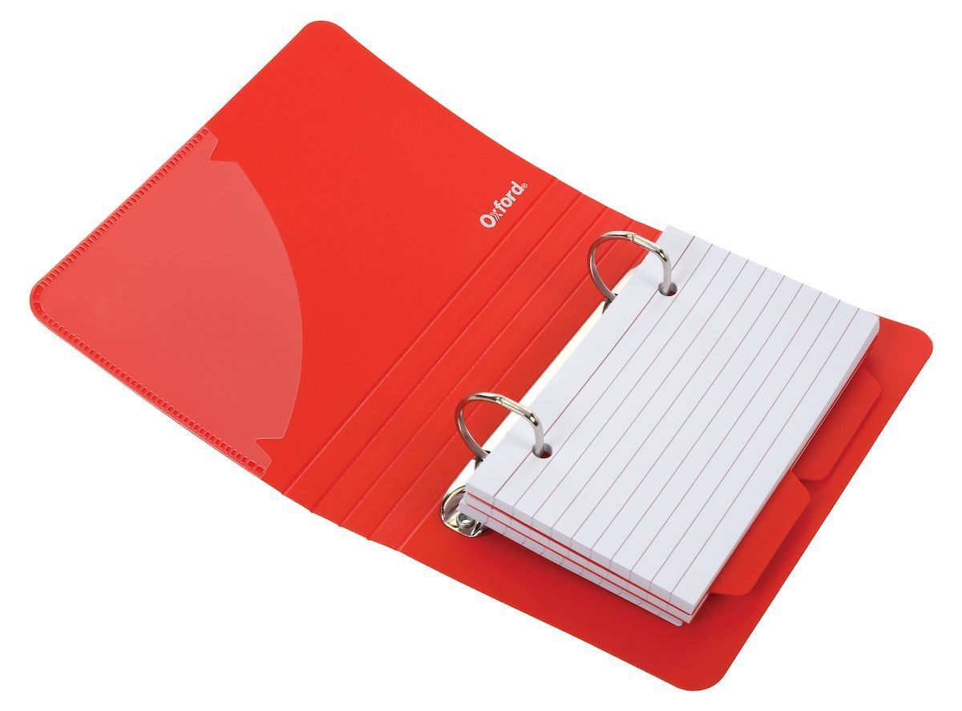
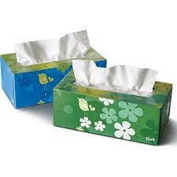
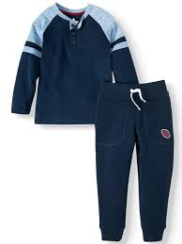
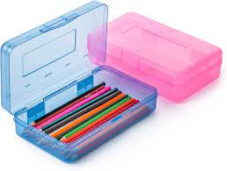
KINDERGARTEN
Lucero Elementary School 1425 Walton Avenue Bronx NY 10452 Angela Tolano Principal
SUPPLY LIST 2023 - 2024
 | 1- backpack (without wheels) 1- Mochila (sin ruedas)
 | 4- Primary composition notebook K-2nd with drawing space at the top and lines at the bottom. 4- Cuadernos de composición K-2nd con espacio para dibujar arriba y lineas abajo
 | 2- Red Pocket Plastic Folder with Prongs
 | 1-box of 24, #2 pencils(12 to keep at home) 1-caja de 24 lápices #2 (!2 para dejar en casa)
 | 2- large (flat)Elmer’s glue sticks (2 to keep at home) 4- Barras de goma Elmer’s (2 para la casa)
 | 2-Elmer’s glue 4oz. (1 to keep at home) 2- pegamentos Elmer’s (Uno para casa)
 | 1-index card binder 1-folder de index cards with index cards. 1-binder para index cards, con las tarjetas.
 | 1- supply plastic box
 | 1-pais of safety scissors 1- tijeras
 | 2- Erasers 2-gomas para borrar.
 | 1- 64 crayon box 1- caja de crayolas por 64
 | 1-pack of white copy paper 1-paquete de papel blanco para impresora.
 | 2-rolls of bounty 2- rollos de bounty.
 | 1-packet of wipes 1-paquetre de toallitas humedas.
 | 2-boxes of tissues 2-cajas de pañuelos desechables.
 | 1-change of clothes (in case of accident) 1-cambio de ropa (en caso de accidente).

Slide 2
KINDERGARTEN
Lucero Elementary School 1425 Walton Avenue Bronx NY 10452 Angela Tolano Principal
SUPPLY LIST 2023 - 2024
 | 1- backpack (without wheels) 1- Mochila (sin ruedas)
 | 4- Primary composition notebook K-2nd with drawing space at the top and lines at the bottom. 4- Cuadernos de composición K-2nd con espacio para dibujar arriba y lineas abajo
 | 2- Red Pocket Plastic Folder with Prongs
 | 1-box of 24, #2 pencils(12 to keep at home) 1-caja de 24 lápices #2 (!2 para dejar en casa)
 | 2- large (flat)Elmer’s glue sticks (2 to keep at home) 4- Barras de goma Elmer’s (2 para la casa)
 | 2-Elmer’s glue 4oz. (1 to keep at home) 2- pegamentos Elmer’s (Uno para casa)
 | 1-index card binder 1-folder de index cards with index cards. 1-binder para index cards, con las tarjetas.
 | 1- supply plastic box
 | 1-pais of safety scissors 1- tijeras
 | 2- Erasers 2-gomas para borrar.
 | 1- 64 crayon box 1- caja de crayolas por 64
 | 1-pack of white copy paper 1-paquete de papel blanco para impresora.
 | 2-rolls of bounty 2- rollos de bounty.
 | 1-packet of wipes 1-paquetre de toallitas humedas.
 | 2-boxes of tissues 2-cajas de pañuelos desechables.
 | 1-change of clothes (in case of accident) 1-cambio de ropa (en caso de accidente).

