Slide 1
Productive Struggle
February 3, 2020

Slide 2
What is productive struggle and what does it look like in the classroom?

Slide 3
By the end of this professional development session I can….
Define productive struggle
Identify strategies to help my students with productive struggle
Ways to promote productive struggle within the classroom

Slide 4
Which of these images resonates most with you when you think of productive struggle?

Slide 5
How would YOU define productive struggle?

Slide 6
“Productive struggle = responsive teaching”
Productive struggle is between scaffolding and support. Rather than immediately helping students at the first sign of trouble, we should allow them to work through struggles independently before we offer assistance.

Slide 7
What does it look like in every setting?
12:1:1: Allowing students thinking time, allowing time to connect to prior knowledge,
8:1:1: Wait time to allow for processing
6:1:1: Errorless Learning, Hierarchy of prompting
12:1:4: Having staff take a back seat to allow students time to respond. Not rushing prompting or speaking on behalf of the students, errorless learning
All Across: Multimodal entry points (visuals, auditory, kinesthetic), multisensory, prompting, referring back to data collection

Slide 8
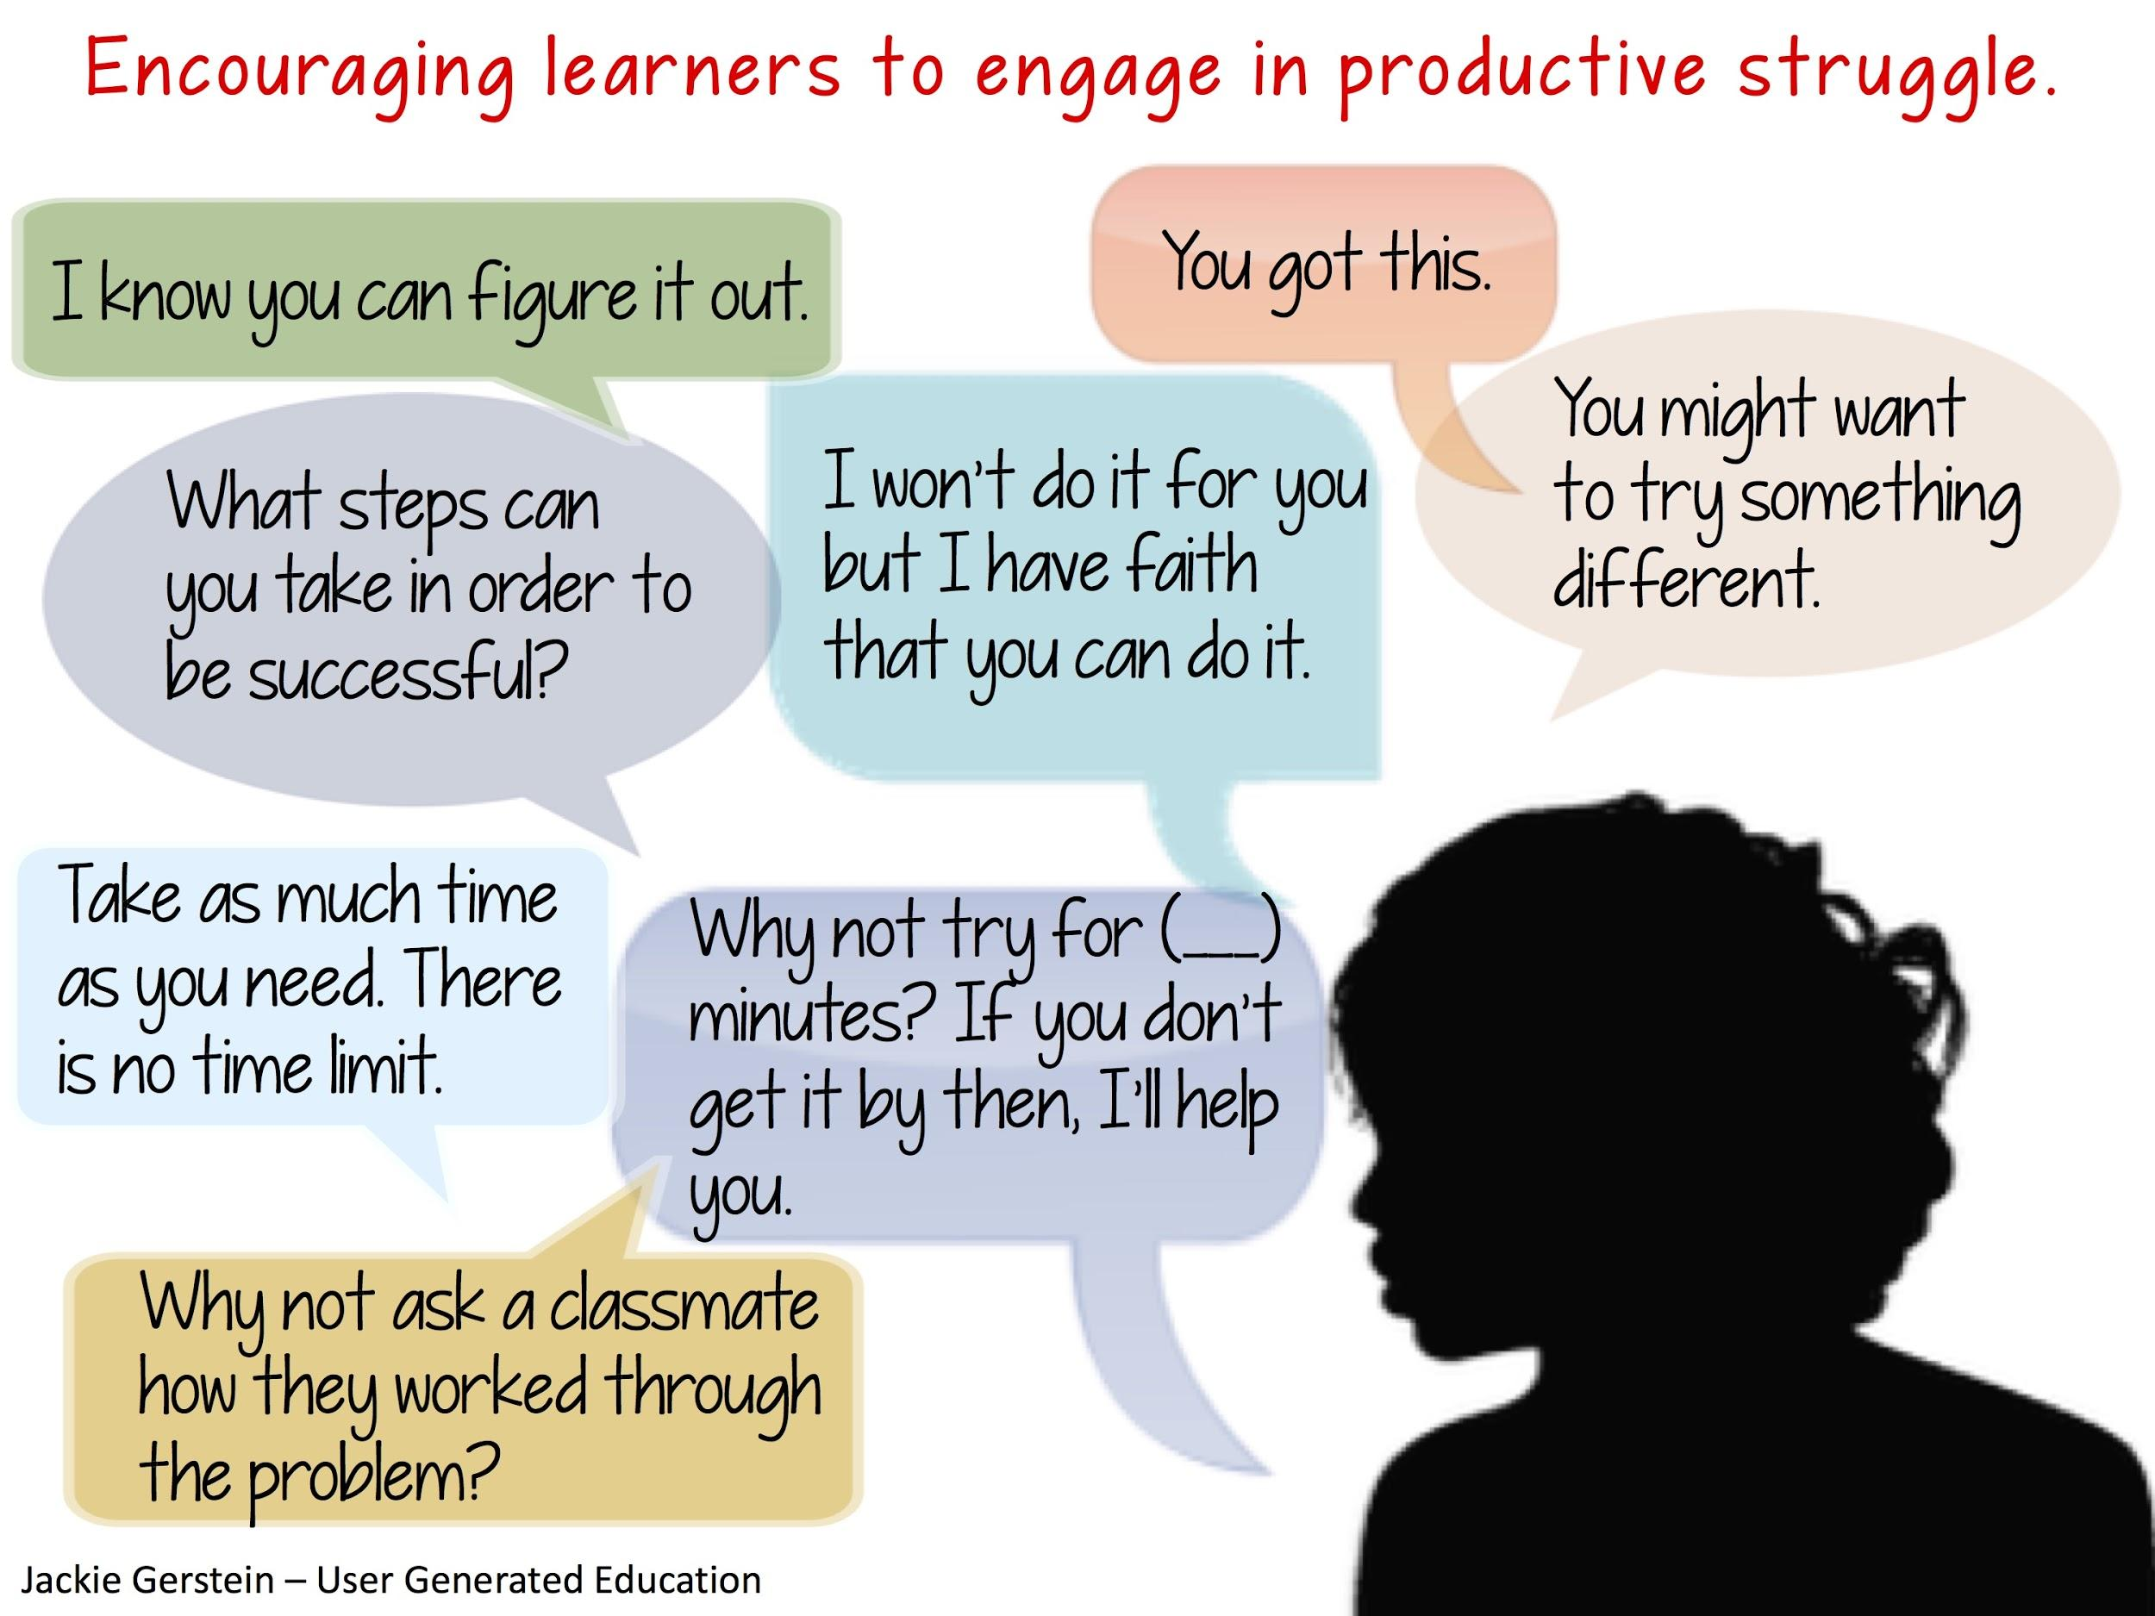

Slide 10
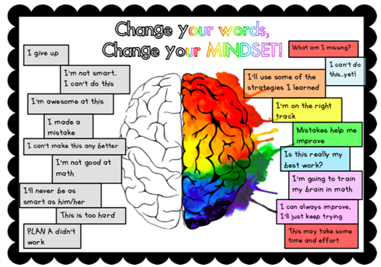
Fixed Mindset vs Growth Mindset

Slide 11
How to Develop a Growth Mindset

Slide 12
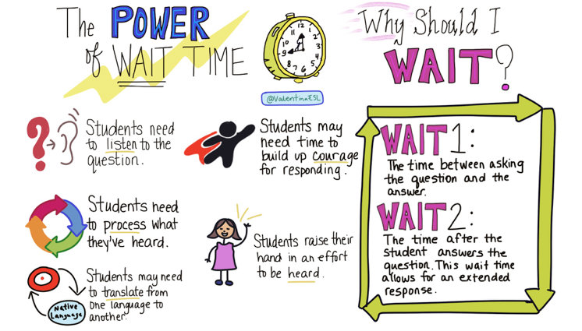
How to Support Productive Struggle
Find tasks the students will be interested in.
Make sure each student will be able to have an entry point.
Find tasks that students believe are worth solving. Provide time!

Slide 13
How to Support Productive Struggle
Acknowledge students for their perseverance and effort in reasoning and sense making
Provide students with specific feedback on their progress (advice, evaluation, and praise are NOT feedback)
Support the students in considering what they know and what they need to figure out.

Slide 14
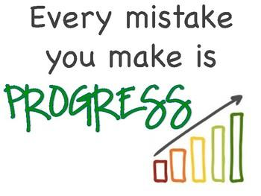
How to Support Productive Struggle
Create a classroom climate where it is okay to make mistakes.
“In this class, mistakes are expected, respected, inspected, and corrected.”
“Something wonderful happens when I make a mistake, I LEARN!”

Slide 15
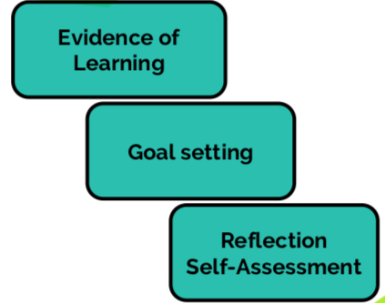
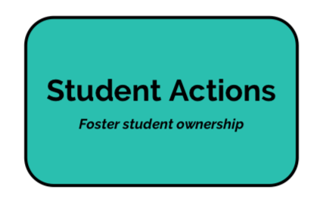
Creating a Classroom that Supports Productive Struggle

Slide 16
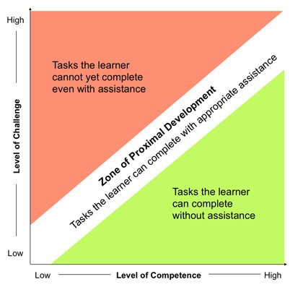
How can teachers plan for productive struggle?
1. Set goals and select appropriate tasks.
2. Prepare ahead of time for possible struggles and misconceptions the students might have.
3. Prepare ahead of time questions NOT to ask.

Slide 18
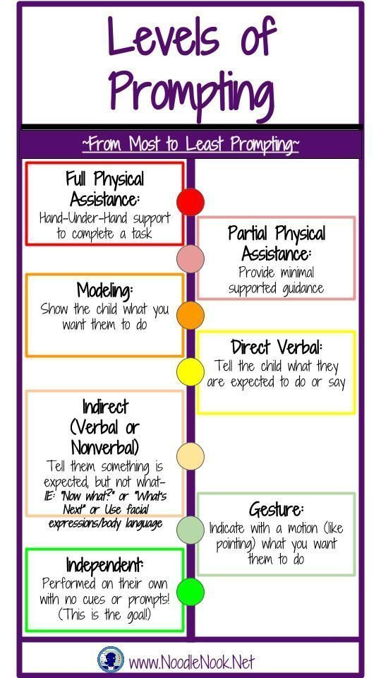

Slide 19
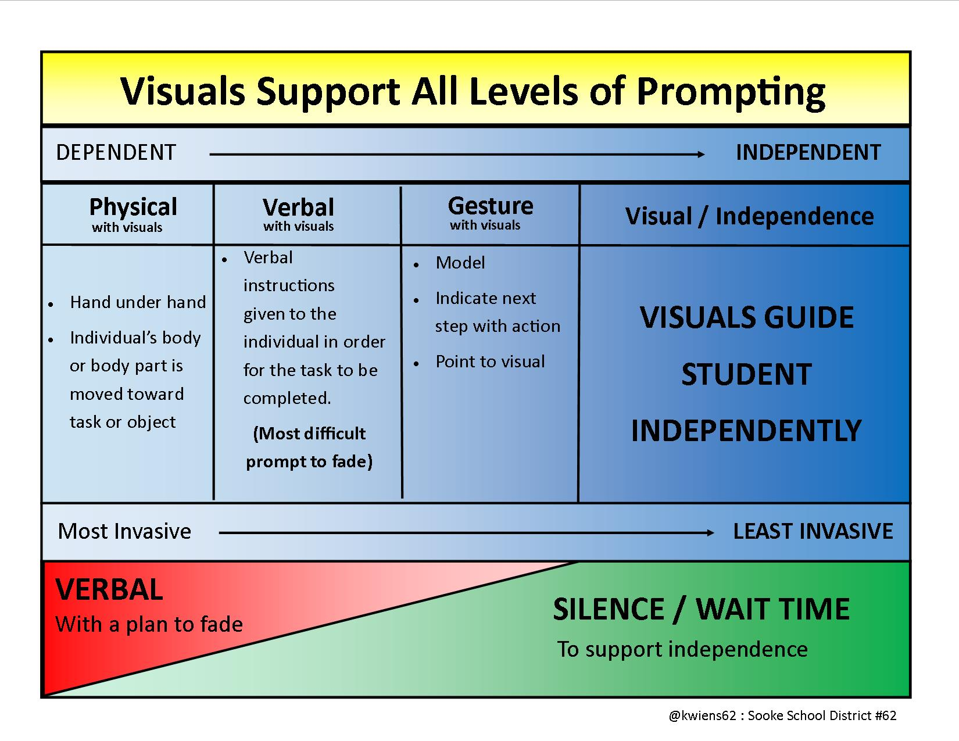

Slide 20
Prompting vs Reinforcement
Prompting is an extra stimulus inserted that is designed to evoke a desired response
Positive reinforcement is a consequence to a behavior that increases and/or maintains the occurrence of that behavior

Slide 21
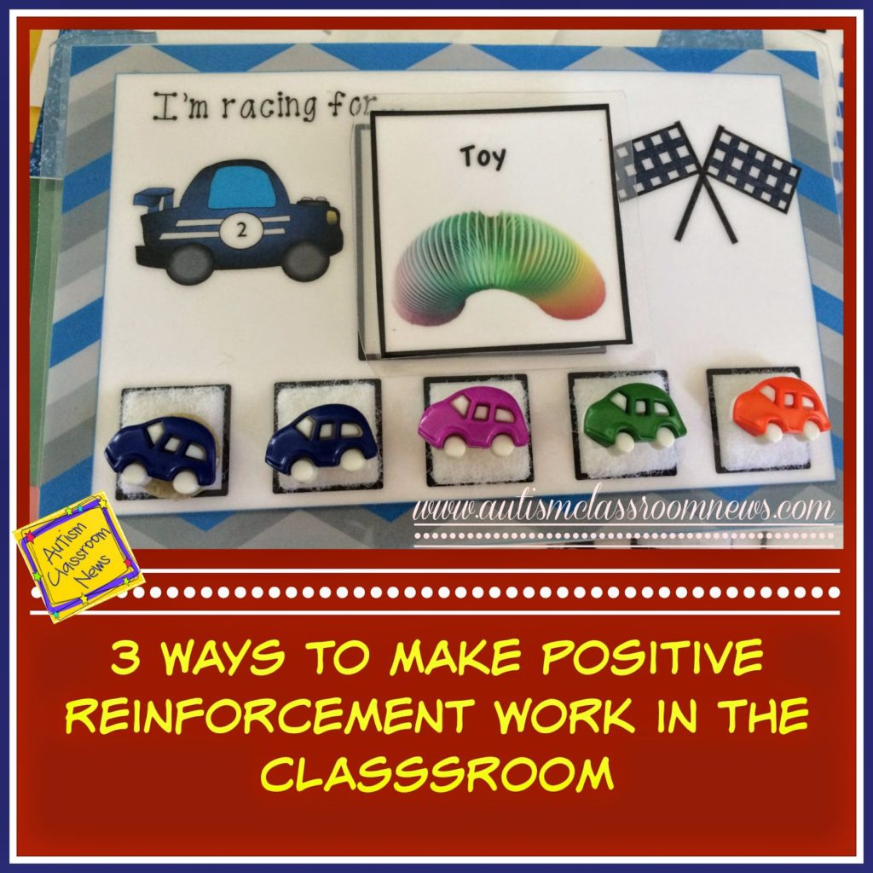
Types of Reinforcement
Primary Reinforcers (Life sustaining): Food, Drink, Warmth
Secondary Reinforcers:
Social (hugs, high-fives, verbal praise)
Activity (breaks, toys, listening to music)
Token(points, stars, coins)

Slide 22
Reinforcement and Productive Struggle
Providing reinforcements encourages a growth mindset which helps students with productive struggle

Slide 23
Questions?

