Slide 1
Personal Finance
Checking Accounts
Presented By
Mrs. Bowden

Slide 2
Warm Up:
Use pages 186 – 203 to answer the items on the worksheet

Slide 3
Today we will:
Discuss checking accounts: basics, opening an account, parts of a check, types of checking accounts, and checking account forms.

Slide 4
Basic Definition of a Check:
A written order to a bank to pay the amount stated to a business or a person.
What do we write checks for?
Checking Account – an account that holds money that a depositor puts in and may be with drawn on demand or at anytime and paid to a payee who then cashes the check and receives cash dollars.

Slide 5
Advantages of Checking Accounts:
Provides a convenient way to pay bills
Safer than carrying cash
Build in record keeping system – check register to help create budgets by tracking expenses
Gives you access to other banking services such as loans, ATM, and savings accounts

Slide 6
Opening a Checking Account:
Many bank differ on the process and the types of account that you offer
You will need to have some money to begin with and will need to sign a signature card p. 187
Some banks require a certain amount to open an account.
Some banks have special fees attached to certain types of accounts.

Slide 7
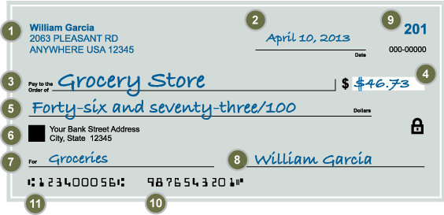
Parts of a Check:

Slide 8
When writing a check:
Always use pen
Write legibly keep numbers and letter clear and distinct
Sign your name as it appears on your signature card
Avoid mistakes – VOID and start over
Be sure you have enough money in your account to cover the check.

Slide 9
Other terms associated with checking accounts:
Deposit slip – a form that you use when depositing money into your account. Includes areas for cash and check deposits, and a way to get cash back
Check Register – the booklet used to record ALL transactions and shows you how much is in your account at a given time.
Check reconciliation – comparing what you think you have according to your register and what the bank says you have considering outstanding checks not cleared yet

Slide 10
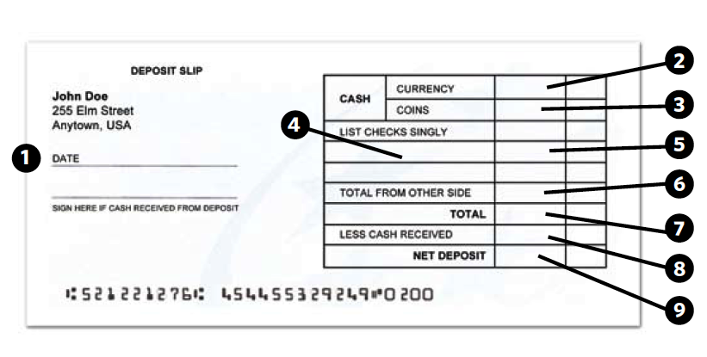
Making a Deposit:
1. Write the date of the deposit in this field.
2. If you are depositing currency (paper bills), write the total amount here.
3. If you are depositing coins, write the total amount here.
4. If you are depositing a check, write the bank transit number here, which is the top portion of the two-part number printed in the upper corner of the check.
5. Write the amount of the check here.
6. If you are depositing more checks than can be listed on the front, continue to list them on the back, and write the total amount of the checks on back here.
7. Write the total amount you are depositing here.
8. If you are making a deposit inside a bank with
a teller and you want to receive cash back from your deposit, write the amount you want in this field.
9. Write the total amount (less cash back) of your deposit in this field.
teens – lesson 6 - slide 6-D

Slide 11
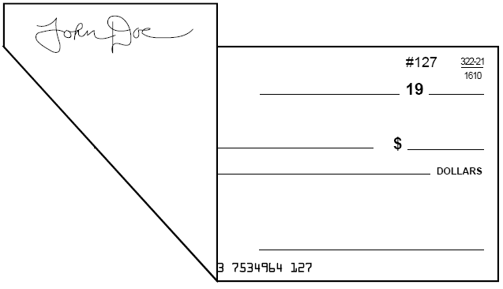
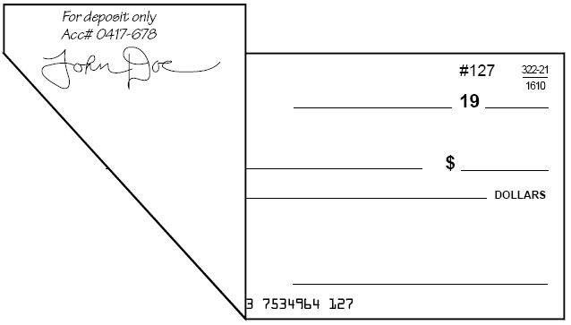
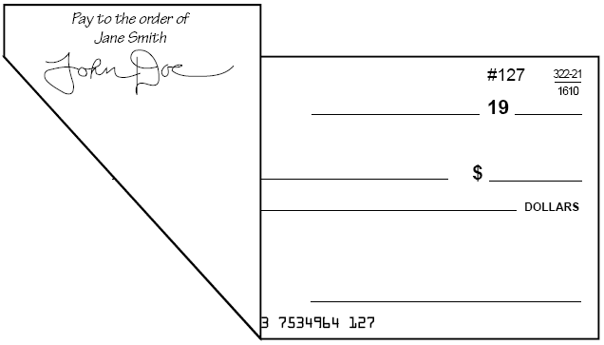
Endorsing Checks:
blank endorsement
Anyone can cash check
restrictive endorsement
More secure than blank endorsement
special (or full) endorsement
Transfer check to another party
teens – lesson 6 - slide 6-E

Slide 12
Types of Checking Accounts:
Individual Account – one person opens it and only that person has rights to withdrawal money or write checks
Joint Account – is opened by two individuals and both have equal rights.
Special Accounts – account for people who have small amounts of activity for example and they sometimes carry fees
Interest bearing account – a checking account that earns a small amount of interest on the amount in the account up to a certain dollar amount usually $500

Slide 13
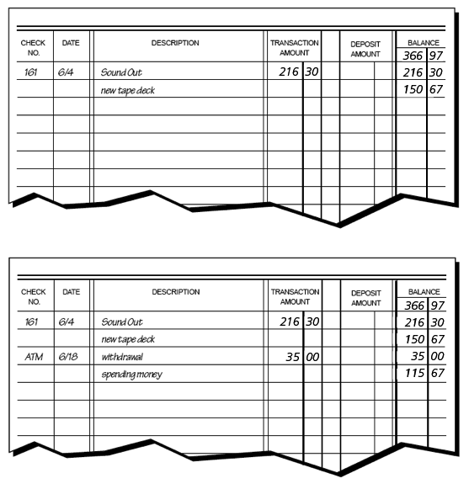
Keeping a running balance
(a) Keeping a Running Balance: Check Transaction
(b) Keeping a Running Balance: ATM Cards
teens – lesson 6 - slide 6-Ga

Slide 14
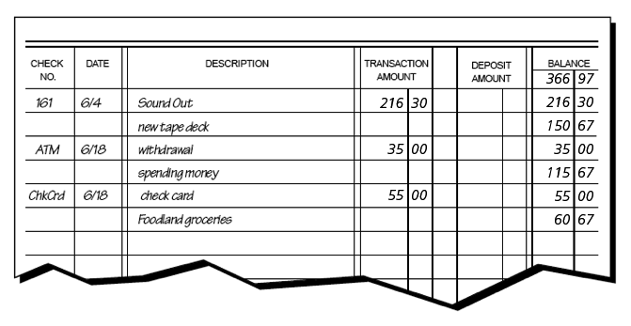
Keeping a running balance (continued)
(c) Keeping a Running Balance: Check Cards
teens – lesson 6 - slide 6-Gb

Slide 15
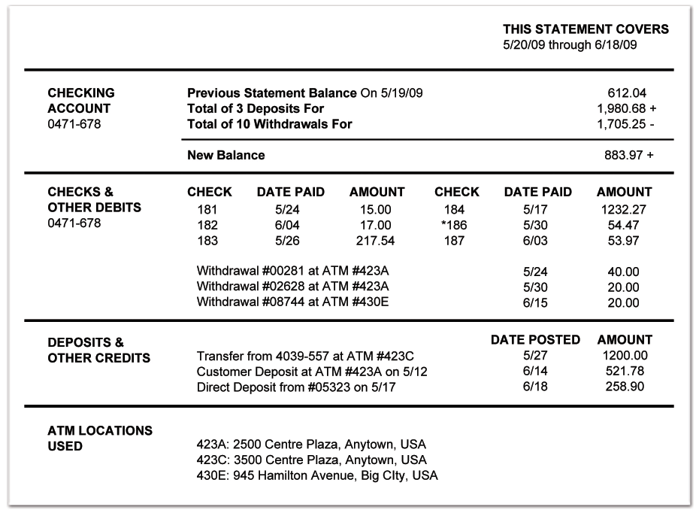
Reading a bank statement:
teens – lesson 6 - slide 6-H

Slide 16
Reconciling a checking account
step 1: Obtain the current balance from your bank statement.
step 2: Add any deposits that you have recorded in your check register but that are not on this statement.
step 3: Subtract any outstanding checks (checks you have written but that have not yet cleared the banking system).
step 4: Compare the result with the current balance in your check register.
Note:
The balance in your check register should be adjusted to include: (a) deductions for service fees or other charges; (b) additions for direct deposits and interest earned.
teens – lesson 6 - slide 6-I

Slide 17
Smart Cards: Banking of the Future
smart cards, sometimes called “electronic wallets,” look like ATM cards; however, they also include a microchip.
This minicomputer stores prepaid amounts for buying goods and services.
A smart card can also store data about a person’s account balances, transaction records, insurance information, and medical history.
Uses for smart cards may expand in the future.
teens – lesson 6 - slide 6-K

Slide 18
Discussion:
Do you have a checking acount? What type is it?
Are many people using checks anymore? Why or why not?

