Slide 1
WELCOME TO
CARMEL HIGH SCHOOL
8th Grade Parent Orientation
Presented by John Fratto, Assistant Principal and Danielle Schulman, School Counselor - CHS

Slide 2
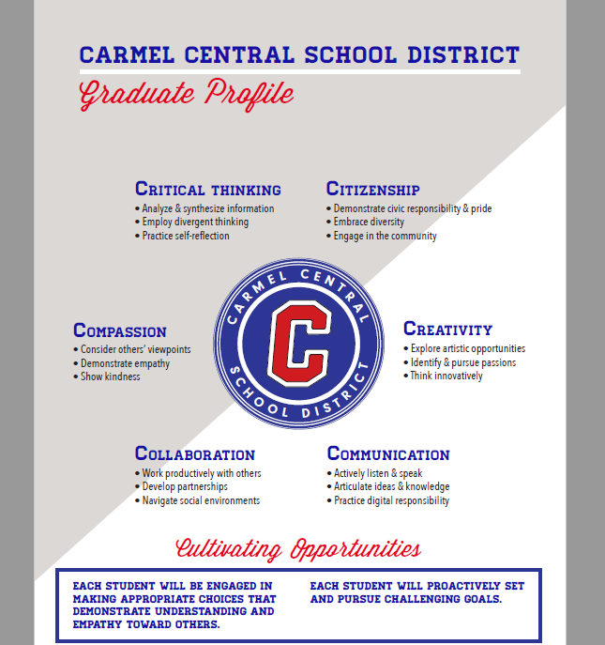

Slide 3
Transitioning to the High School
GFMS Counselors meet with students to complete course selections
Carmel High School Program of Studies is posted on CHS website
4 Counselors for 9th Grade:
- Danielle Schulman
- Tom Feliciotto – Bridge Program +
- Juliet Powers – Special Education
- Timothy Mahon – ENL Students
Schedules available via Home Access in late August
Freshmen Orientation in early September
Each 9th grader has an assigned mentor for the year

Slide 4
Supports for Freshmen
The counselor provides personalized education to all freshmen through a variety of activities, programs and events.
Freshmen Orientation for a smooth transition from Middle School
Students are introduced to careers through the SCOIR program.
Students are encouraged to meet with their counselor to develop academic, social emotional and career goals

Slide 5
Keys to a Successful Freshman Year
Organization
Time Management
Study/Homework
Utilizing Extra Help
Involvement in Extra-Curricular Activities

Slide 6
Graduation Requirements
A total of 22 credits are needed to graduate.
Required Credits by Department:
English - 4
Social Studies – 4
Math - 3
Science - 3
World Language - 1
Art or Music - 1
Physical Education – 2
Health - .5
Electives (Business, Tech, Etc.) – 3.5
A minimum of 5.5 credits is required each year to be considered a full-time student and to participate in extracurricular activities (5 credits for seniors).

Slide 7
Regents Diploma
1 Science Regents Exam
1 Math CC Regents Exam
1 Global Regents Exam
1 U.S. History Regents Exam
1 English CC Regents Exam
Students must earn the required sequence of 22 credits and pass the Regents exams with a 65 or above.

Slide 8
Attendance Policy
24/12 absences maximum
CDA
Regular Notifications
Documentation
Appeal Process

Slide 9
The Freshman Course Schedule
Subject | Course Options | Credits
Science | Biology, Biology H, Biology A or Earth Science Plus Lab Period | 1
Social Studies | Global History I or Global History I Honors | 1
English | English 9, English 9 Honors | 1
Math | Algebra I, Algebra Ext. 9, Geometry, Geometry Honors or Algebra II Honors | 1
World Language | Spanish, Italian or French, level depends on placement | 1
Physical Education | Physical Education A, B or Introduction to Dance | .5
Electives | Art, Music, Business, Technology, S.S., Science | 1
* Students have room in their schedules for two periods of electives and a lunch period *

Slide 10
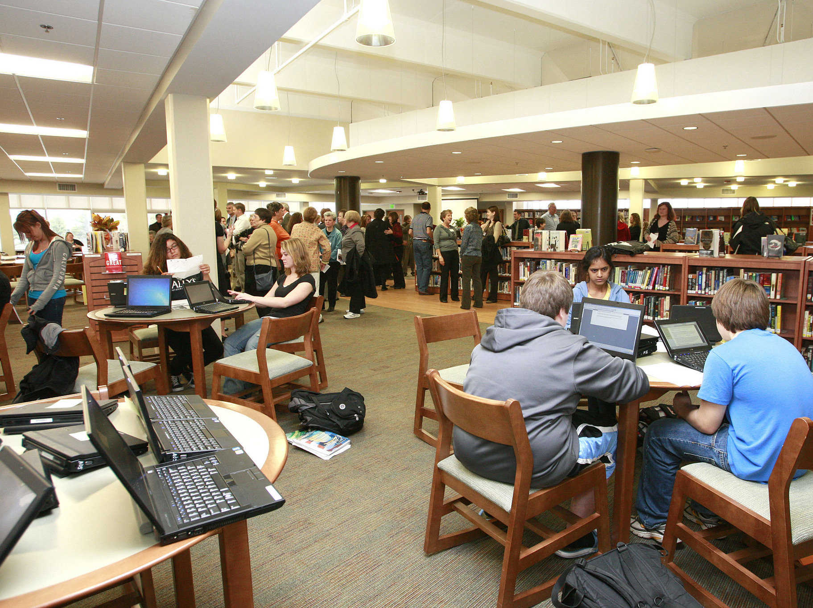
Lunch Period Options
< Cafeteria
< Library/Academic Center
< Extra Help w/Teacher
< Study Hall
< Upper Courtyard
* After 10 minutes, students must
choose a location *

Slide 11
Sample 9th Grade Course Schedule
1. English 9
2. Spanish II
3. Studio Art
4. Intro to Engineering
5. Lunch
6. Earth Science
7. Earth Science Lab (1,3,5)
7. Physical Education A (2,4,6)
8. Algebra
9. Global History I

Slide 12
Sample 9th Grade Report Card – Q2

Slide 13
Communication
Carmel High School Website
Connect Ed - (Automated Phone Calls/Emails)
Phone/Email – Teachers, Counselors, & Administrators
Parent Square
Twitter- @Carmelschools, @CarmelHS_info, @CHSCounselingCenter16
Organization & Academic Support
Student Agendas
Office 365/Teachers’ Class platforms – Teams/One Note
SCOIR
Educational Apps - MyHomework App, Quizlet, Khan Academy

Slide 14
School Culture and Transition
Dedicated 9th Grade Counselors
Clinical support staff
Administrative support
Mentor Program
PBIS Implementation
The 6 C’s
9th Grade Orientation: activities/sports

Slide 15
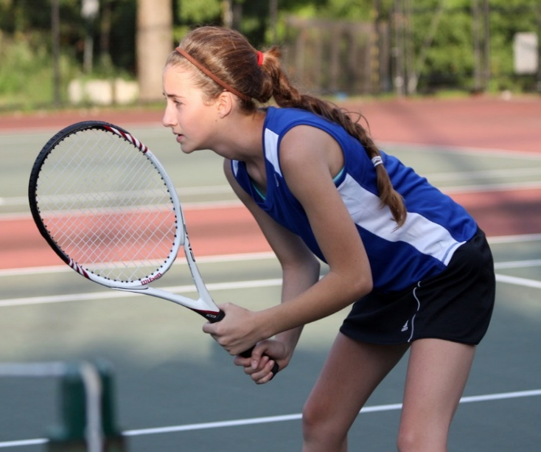
Sports
Baseball – Freshman, JV, Varsity
Basketball Girls – JV, Varsity
Basketball Boys – Freshman, JV, Varsity
Bowling - Varsity
Cheerleading – JV, Varsity
Cross Country, Varsity
Dance – Varsity
Gymnastics - Varsity
Ice Hockey – Varsity
Field Hockey – JV, Varsity
Football – Freshman, JV, Varsity
Golf – Boys and Girls
Lacrosse Boys – JV, Varsity
Lacrosse Girls – JV, Varsity
Skiing - Varsity
Soccer Boys – JV, Varsity
Soccer Girls – JV, Varsity
Softball – JV, Varsity
Swim
Tennis Boys – Varsity
Tennis Girls – Varsity
Track and Field
Volleyball – JV, Varsity
Winter Track – Varsity
Wrestling - Varsity

Slide 16
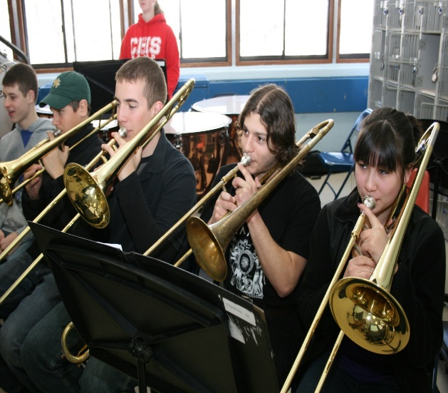
Clubs and Activities
Art Club
Bella Voce
Best Buddies
Book Club
Cancer Awareness
Dance Club
Drama Club
Equity
FBLA
Film Club
French Club
Gay Straight Alliance (GSA)
Go Green
Good News Club
Italian American Club
Jazz Band
Music Honor Society
Music Production Workshop
Rock Club ‘N Roll Club
SSA -Safe School Ambassador Program
Science Club
Select Strings
Spanish Club
Small Chamber Ensemble
Student Organization
Tri-M
Yearbook
Newspaper

Slide 17
Thank you!
The Carmel Central School District educates the whole student
through partnerships to become lifelong learners
in an ever-changing world.

