Slide 1
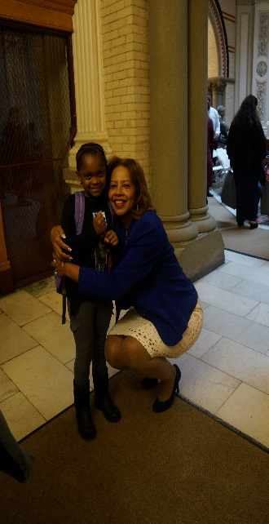
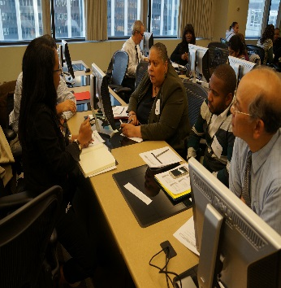

Slide 2
Introduction
Hi, I’m Bill and I’m Karen
We’re here to remind you to complete, file and submit your Interim or Annual Financial Report by January 31st.
If you’re a new executive board member or treasurer, let us help you fill out the different parts of the Financial Report.
If you are a veteran executive board member or treasurer, we can help you too.
Let’s get started, okay?

Slide 3
Introduction - Income
I am sure that many of you are aware of the Financial Report and filed a copy of the report last year, with both your membership and your school’s principal. But if you have not seen it, let me show it to you.
If you use an accounting program, or an online resource, you can use a printable report as a substitute.

Slide 4
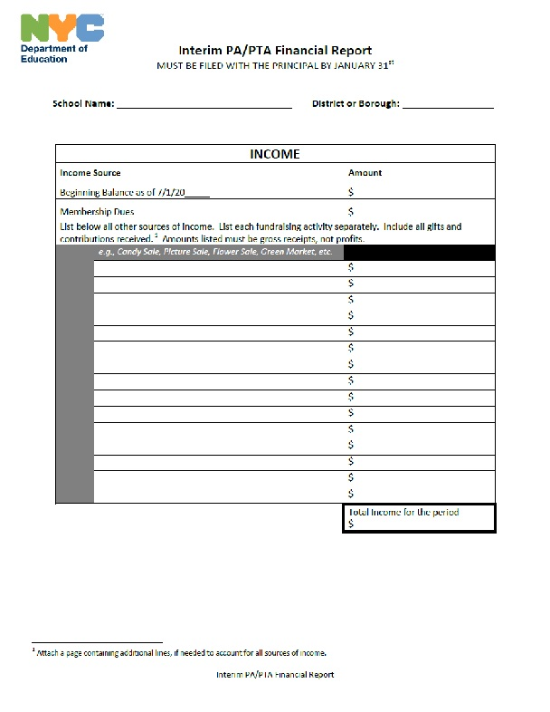
This is a copy of the Interim Financial Report. It’s really simple and easy. And the Annual Report looks very similar…

Slide 5
Income page
Start by indicating what was the Beginning Balance as of July 1st (aka Opening Balance).
The beginning balance is the amount of money the PA/PTA begins with on the 1st of July.
Bank Account

Slide 6
Membership Dues
If you collected dues from your membership, place that amount here.
Bank Account
If Applicable
If you did not collect dues from your membership; write in a zero (0).

Slide 7
Sources of Income
Now list all the other sources of income individually.
List things such as donations and fundraisers.
Bank Account
If Applicable
Other Sources of Income
Amount Received

Slide 8
Total Income Amount
Once you have listed all your income sources; add them up and put the total in the box at the bottom of the page.
Total Amount

Slide 9
Introduction - Expenses
That was really simple, right?
Now lets look at the other side of the form, and do the same with the expenses page.

Slide 10
Expenses
Expenses are items, goods and services and the cost needed to pay for them.
Supplies, refreshments, decorations, reimbursements and refunds, are all expenses, also known as expenditures.

Slide 11
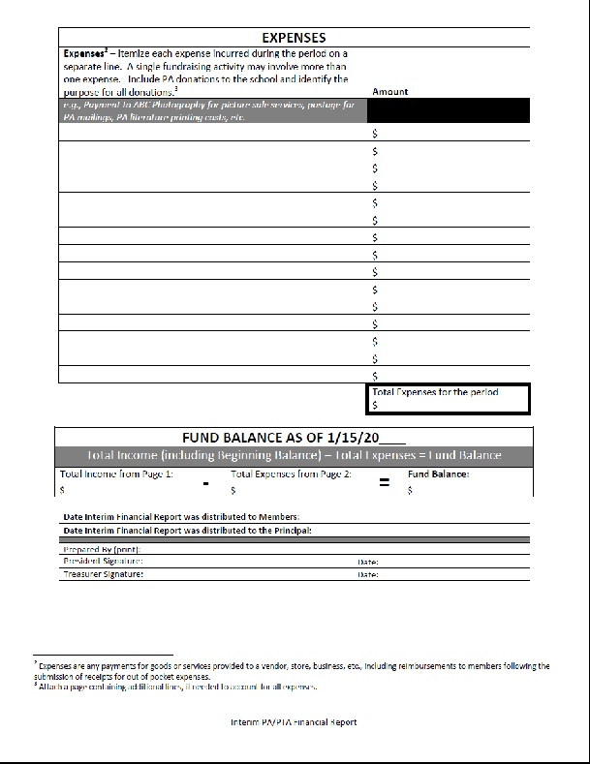
This is a view of the expenses page
List of Expenses
Amount Spent
List all of your expenses to date, individually.

Slide 12
Total Expense Amount
Add it all up and put that amount in the box here.
Total Amount

Slide 13
Fund Balance
In the Fund Balance Box; bring the total amount of your income from the first page, and subtract the total amount of your expenses from above on the second page.
The amount difference is the Fund Balance.
Income – Expenses = Fund Balance

Slide 14
Signatures
The last thing to do is:
Indicate the date the report is shared with the members of your PA/PTA;
The date the report is shared with your principal;
And add the signatures of the PA/PTA President and Treasurer and the date .

Slide 15
Conclusion
That was so easy, right?
If you use any kind of accounting software, you can use the printed reports that come with your program. But if you don’t use a software program you can use the form we just showed you.
If you click on the highlighted link you can download a copy of the Financial Report that you can complete, file and share with your membership and your school’s principal.
Don’t forget, you have to file your Interim Financial Report by January 31st and the Annual Financial Report by June 30th.

Slide 16
Want to know more? Click on any of the links below.
Chancellor’s Regulation A-660
(CR A-660) governs all aspects of PA/PTAs including elections, finances, conflicts of interests, grievances, fundraising activities and events. It is essential that all members of a school's PA/PTA board read the CR A-660 and are familiar with the overview of the regulations.
PA/PTA DOE Website Page
located on the DOE Website has a variety links and other resources that will support your day to day operations
Borough or District Family Advocate provide information for the community and support the resolution of family inquiries and concerns.
Your School’s Parent Coordinator
Your Local Presidents Council
Other Resources
PTALINK.org - it also provides an effective way for schools to learn from each other and share best practices, and creates a community of parent organizations that work together.
Apply for an EIN Number Online – to open a bank a PA/PTA must have an EIN number from the IRS

