Slide 1
Agenda
Bell Schedule
How to Read a Student Schedule
What Parents/Guardians Should Do to Set Their Child Up For Success
Q+A
In-Person Students and Families: Safety and Procedures
Q+A
We will stop several times to take questions. If you have a question, please type it in the chat!

Slide 2
Bell Schedules Student School Day is 9:00-2:30, Whether Remote or In-Person
The first two and last two periods of the day are 62 or 64 minutes long (this is when most students, both In-Person and Remote, have their Core Classes). 3rd and 4th period are 40 minutes long, and this is when most students, both in-person and remote, have lunch, Advisory, electives, or work time.
Period | Begins At… | Ends No Later Than…
1 | 9:00 | 10:02
2 | 10:02 | 11:04
3 | 11:04 | 11:44
4 | 11:44 | 12:24
5 | 12:24 | 1:26
6 | 1:26 | 2:30
OFFICE HOURS | 2:30 | 2:50
For Remote classes (for students who are 100% Remote, or for classes that students have on days when they learning from home) may end earlier than the times shown on this chart. This is due to a DOE policy that limits the amount of screentime students can have on Remote days. Teachers of these Remote classes will dismiss students from their Remote class at the appropriate time.
All teachers have Office Hours each day from 2:30-2:50. Students and families can contact any teacher during this time, or make an appointment in advance. Please note that, depending on how many students want to talk to the same teacher at once, a teacher might ask a student or family to reschedule for another day. They will do their best to respond to all families and students during that time.

Slide 3
How to Read a Student Schedule
“Synchronous” refers to live classes that a student must attend at a specific time, either in-person or Remote. If a student has a Remote Synchronous class, then they MUST log in at the right time and attend class during that time to be counted “present” for that class.
“Asynchronous” refers to time during the school day that a student doesn’t have a live class, but that they should spend working on homework, extended project assignments, posted work in Google Classrooms, or reaching out to teachers with any questions they have.
All In-Person students are in the building at least two days a week. Select students with specific needs are also programmed for in-person classes on Mondays. All students have a schedule for Synchronous and Asynchronous Learning five days a week.

Slide 4
Sample “A” Group "Blended" Student - No Monday Intervention
Period | Time | Monday | Tuesday | Wednesday | Thursday | Friday
1 | 9:00 - 10:02 | Asynchronous Work Time | Social Studies - Frasier | 6th Grade Elective - Miller | Social Studies - Frasier | 6th Grade Elective - Miller
2 | 10:02 - 11:04 | Asynchronous Work Time | Math - Alexander | 6th Grade Elective - Williams | Math - Alexander | 6th Grade Elective - Williams
3 | 11:04- 11:44 | Asynchronous Work Time | Gym/ Free Play | Asynchronous Work Time | Gym/ Free Play | Asynchronous Work Time
4 | 11:44 - 12:22 | Lunch | Advisory - McBean | Lunch | Advisory - McBean | Lunch
5 | 12:22 - 1:26 | Asynchronous Work Time | ELA - Williams | Asynchronous Work Time | ELA - Williams | Asynchronous Work Time
6 | 1:26 - 2:30 | Asynchronous Work Time | Science - Wyatt | Remote PE - Scannell | Science - Wyatt | Remote PE - Scannell
Sample B & C Group "Blended" Student - w/ Monday Intervention
Period | Time | Monday | Tuesday | Wednesday | Thursday | Friday
1 | 9:00 - 10:02 | ELA Intervention - Williams | 6th Grade Elective - Miller | Social Studies - Frasier | 6th Grade Elective - Miller | Social Studies - Frasier
2 | 10:02 - 11:04 | Math Intervention - Vilbrun | 6th Grade Elective - Williams | ELA - Williams | 6th Grade Elective - Williams | ELA - Williams
3 | 11:04- 11:44 | Lunch | Asynchronous Work Time | Gym/ Free Play | Asynchronous Work Time | Gym/ Free Play
4 | 11:44 - 12:22 | Science Intervention - Vilbrun | Lunch | Advisory - Williams | Lunch | Advisory - Williams
5 | 12:22 - 1:26 | PE/Free Play | Asynchronous Work Time | Math - Alexander | Asynchronous Work Time | Math - Alexander
6 | 1:26 - 2:30 | Social Studies Intervention - Frasier | Remote PE - Scannell | Science - Wyatt | Remote PE - Scannell | Science - Wyatt
Key:
Asynchronous Instruction
Synchronous Instruction

Slide 5
Sample D Group "Remote" Student - No Monday Intervention
Period | Time | Monday | Tuesday | Wednesday | Thursday | Friday
1 | 9:00 - 10:02 | Asynchronous Work Time | Music Elective - Adkinson | ELA - Williams | Music Elective - Adkinson | ELA - Williams
2 | 10:02 - 11:04 | Asynchronous Work Time | Social Studies - Frasier | Math - Alexander | Social Studies - Frasier | Math - Alexander
3 | 11:04- 11:44 | Asynchronous Work Time | Asynchronous Work Time | Lunch | Asynchronous Work Time | Lunch
4 | 11:44 - 12:22 | Lunch | Lunch | Advisory - Wyatt | Lunch | Advisory - Wyatt
5 | 12:22 - 1:26 | Asynchronous Work Time | Science - Wyatt | 6th Grade Elective - Williams | Science - Wyatt | 6th Grade Elective - Williams
6 | 1:26 - 2:30 | Asynchronous Work Time | Remote PE - Scannell | Asynchronous Work Time | Remote PE - Scannell | Asynchronous Work Time
Sample D Group "Remote" Student w/ Monday Intervention
Period | Time | Monday | Tuesday | Wednesday | Thursday | Friday
1 | 9:00 - 10:02 | Science Intervention - Wyatt | Music Elective - Adkinson | ELA - Williams | Music Elective - Adkinson | ELA - Williams
2 | 10:02 - 11:04 | Math Intervention - Alexander | Social Studies - Frasier | Math - Alexander | Social Studies - Frasier | Math - Alexander
3 | 11:04- 11:44 | Social Studies Intervention - Frasier | Asynchronous Work Time | Lunch | Asynchronous Work Time | Lunch
4 | 11:44 - 12:22 | ELA Intervention - McBean | Lunch | Advisory - Wyatt | Lunch | Advisory - Wyatt
5 | 12:22 - 1:26 | Lunch | Science - Wyatt | 6th Grade Elective - Williams | Science - Wyatt | 6th Grade Elective - Williams
6 | 1:26 - 2:30 | Asynchronous Work Time | Remote PE - Scannell | Asynchronous Work Time | Remote PE - Scannell | Asynchronous Work Time
Key:
Asynchronous Instruction
Synchronous Instruction

Slide 6
Sample A Group "Blended" Student
Period | Time | Monday | Tuesday | Wednesday | Thursday | Friday
1 | 9:00 - 10:02 | Asynchronous Work Time | Social Studies - Frasier | 6th Grade Elective - Miller | Social Studies - Frasier | 6th Grade Elective - Miller
2 | 10:02 - 11:04 | Asynchronous Work Time | Math - Alexander | 6th Grade Elective - Williams | Math - Alexander | 6th Grade Elective - Williams
3 | 11:04- 11:44 | Asynchronous Work Time | Gym/ Free Play | Asynchronous Work Time | Gym/ Free Play | Asynchronous Work Time
4 | 11:44 - 12:22 | Lunch | Advisory - McBean | Lunch | Advisory - McBean | Lunch
5 | 12:22 - 1:26 | Asynchronous Work Time | ELA - Williams | Asynchronous Work Time | ELA - Williams | Asynchronous Work Time
6 | 1:26 - 2:30 | Asynchronous Work Time | Science - Wyatt | Remote PE - Scannell | Science - Wyatt | Remote PE - Scannell
Key:
Asynchronous Instruction
Synchronous Instruction

Slide 7
Sample B & C Group "Blended" Student
Period | Time | Monday | Tuesday | Wednesday | Thursday | Friday
1 | 9:00 - 10:02 | ELA Intervention - Williams | 6th Grade Elective - Miller | Social Studies - Frasier | 6th Grade Elective - Miller | Social Studies - Frasier
2 | 10:02 - 11:04 | Math Intervention - Vilbrun | 6th Grade Elective - Williams | ELA - Williams | 6th Grade Elective - Williams | ELA - Williams
3 | 11:04- 11:44 | Lunch | Asynchronous Work Time | Gym/ Free Play | Asynchronous Work Time | Gym/ Free Play
4 | 11:44 - 12:22 | Science Intervention - Vilbrun | Lunch | Advisory - Williams | Lunch | Advisory - Williams
5 | 12:22 - 1:26 | PE/Free Play | Asynchronous Work Time | Math - Alexander | Asynchronous Work Time | Math - Alexander
6 | 1:26 - 2:30 | Social Studies Intervention - Frasier | Remote PE - Scannell | Science - Wyatt | Remote PE - Scannell | Science - Wyatt
Key:
Asynchronous Instruction
Synchronous Instruction

Slide 8
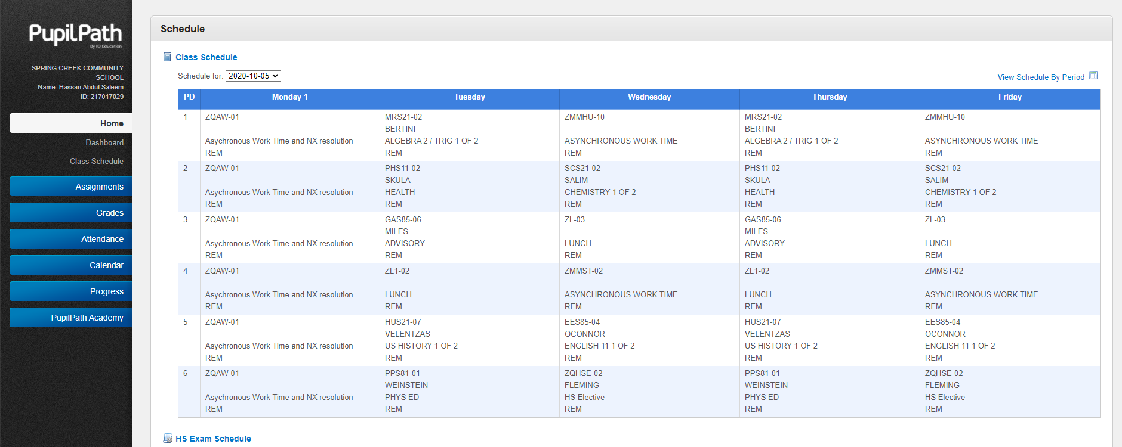
Helpful Hint #1: You look here to see where the class is taking place. If it’s a Remote class, it will say “REM.” If it’s an in-person class, it will say the Room Number of the classroom it takes place in!
Helpful Hint #2: You can switch between the two views (daily schedule or weekly schedule).

Slide 9
Blended Student w/ Monday Intervention

Slide 10
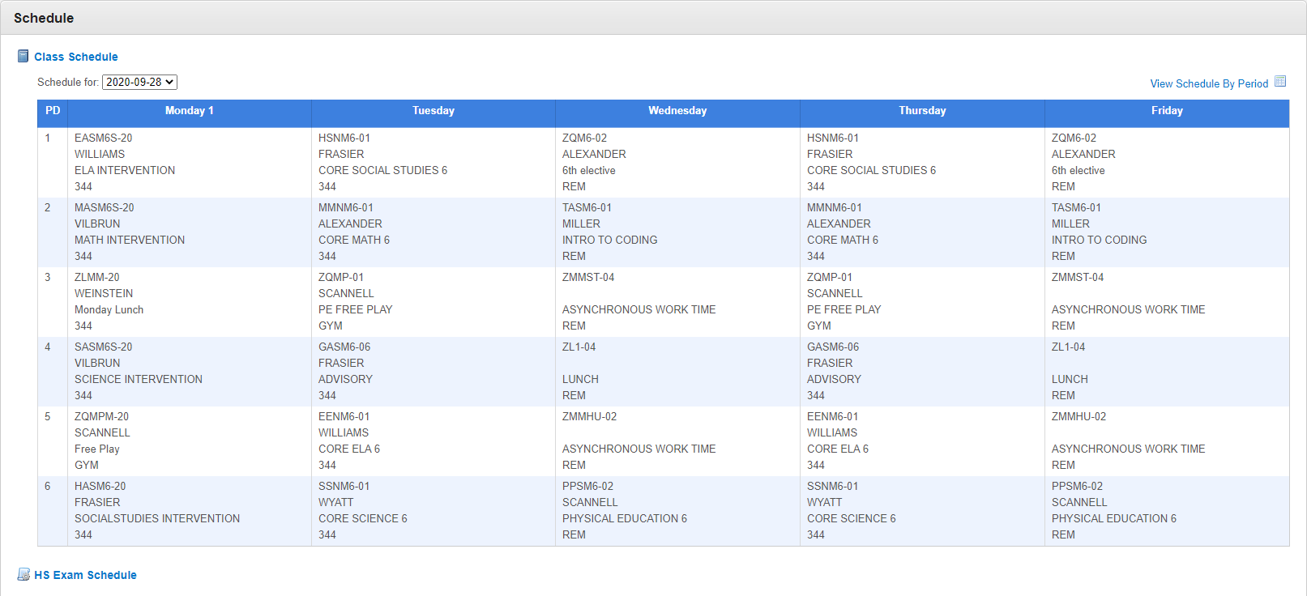
Blended Student w/ Monday Intervention

Slide 11
100% REMOTE STUDENT w/out Monday Intervention

Slide 12
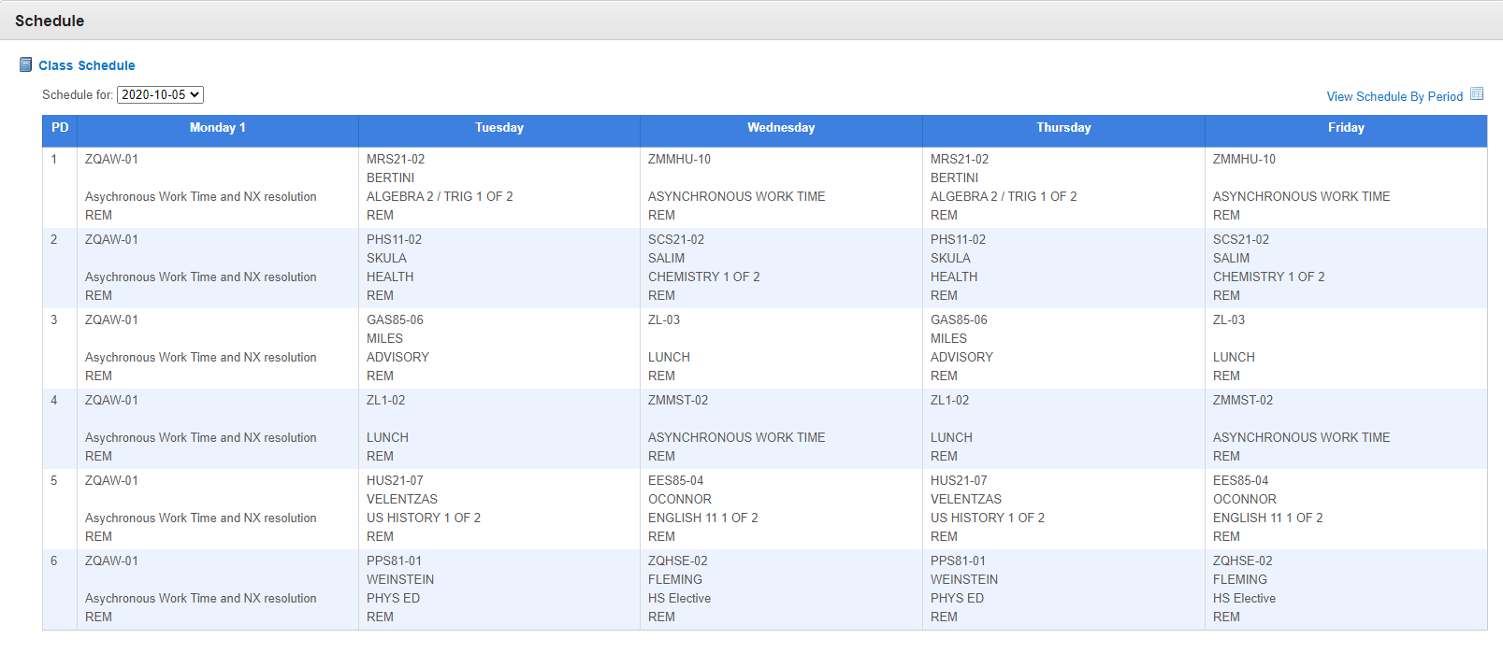
100% REMOTE STUDENT w/out Monday Intervention

Slide 13
Schedule for Next Week
Monday is a final Orientation Day. All students will be sent a link to log-in from 11:00-12:30. Students will be sent a link for attendance as well.
All students will begin their full 9:00-2:30 school day schedule on Tuesday. Students that would normally be In-Person/Blended should log in to their classes according to their schedule.
All SCCS students will attend a 100% Remote schedule through September 30th. Starting on October 1st, the Blended Schedule will begin, and students should report to school in the building on the days they are scheduled for In-Person learning.

Slide 14
What Parents/Guardians Can Do to Set Their Child up For Success
Make sure there is a place in your home for your child to be during Remote Learning that:
Has a neutral backdrop, and/or where nothing inappropriate or private would be visible behind them.
Has a flat work surface with room for their computers, pens and paper, etc.
Sit down with your child this weekend and do the following:
Read their schedule together and make sure they understand it.
Ask them to show you how to log into each of the classes on their PupilPath Schedule.
Have your child write down any questions they have about their schedule or logging into their Google Classrooms, so they remember to ask them in Monday’s Orientation Session with their teachers.
Every night that your child attends school from home/in a Remote setting, ask your child these questions:
Did you log into your scheduled classes on-time today?
Did you submit all the work that was due today? Did you make sure to submit assignments that were completed, and didn’t leave any parts of them blank?
Did you complete all the required online attendance tasks?
If you have any questions about your classes or assigned work, have you emailed your teacher to let them know your questions/issues?
Every Friday evening or Saturday during the day, ask your child to log into their Google Classrooms and show you the work they submitted that week!

Slide 15
Questions? Put them in the Chat!

Slide 16
In-Person Student/Family Information

Slide 17
General Safety Measures
The Campus is well-equipped with masks, cleaning equipment, hand sanitizer, soap, and Social Distancing Signage on walls and floors.
All furniture in classrooms, offices, and counseling and disciplinary spaces have been spaced and measured to ensure Social Distancing.
Administrators from all schools in the building have collaborated on planning to make sure that student and staff spaces and movement through the building is appropriately and safely monitored and structured.

Slide 18
If a Student Attends School On The Wrong Day
Students will be escorted to the “Wrong Day” room, and families will be contacted.
Families may sign a waiver that gives the school permission to send the child home if this happens; we ask that all families sign this waiver (available from Ms. Holland or on Operoo).
Students whose families have not signed and submitted this waiver must remain in the Wrong Day room, along with any other students who have also attended on the wrong day, and a parent or guardian must come to the school immediately and pick them up.

Slide 19
If an Student Has COVID-19 Symptoms in the Building
Students showing symptoms of COVID-19 will be escorted to the Isolation Room by a designated staff member wearing appropriate PPE.
Symptoms of COVID-19 are:
Fever of 100.0°F or higher or chills,
Cough, shortness of breath or difficulty breathing,
Fatigue,
Muscle or body aches,
Headache,
Loss of taste or smell,
Sore throat, congestion or runny nose,
Nausea or vomiting,
Diarrhea.
The area where the student was showing symptoms will be immediately cleaned and disinfected.
The nurse or health professional, wearing appropriate PPE, will evaluate the student in the Isolation Room for symptoms of COVID-19.
If no nurse or health professional is available, the student will wait in the supervised Isolation Room until picked up.
A family member or guardian will be contacted by a staff member and asked to pick up the student.
Upon pick up, the nurse/health professional and school staff will strongly advise the family to visit a doctor and get the student tested for COVID-19, and provide the information of the closest testing site, if asked.
The Isolation Room will be closed and a deep cleaning performed before it is used again.

Slide 20
What Happens if There’s a Confirmed Case of COVID in the School Building?
School Administrators will contact the DOE and the NYC Test + Trace Crops via a special hotline, and a team from the DOE and City will take over investigation. School staff will keep families informed as we receive information that may impact you or your child.
Depending on the case and how many cases there are, individual cohorts of students, certain classes, or all in-person learning may be temporarily shifted to 100% Remote. In that case, you would be notified by the school, and your child would attend classes 100% Remote, from home, until the Department of Health notifies us we can reopen in-person.

Slide 21
Random Temperature Checks and Daily Health Screening
Daily Health Screenings for students and school-based staff, including temperature checks, must be completed at home by families and by school-based staff. School-based staff and students cannot report to school if they have:
Experienced any symptoms of COVID-19 (chills, cough, shortness of breath or difficulty breathing, fatigue, muscle or body aches, headache, loss of taste or smell, sore throat, congestion or runny nose, nausea or vomiting, or diarrhea), including a temperature of greater than 100.0°F, in the past 14 days;
Been knowingly in close or proximate contact in the past 14 days with anyone who has tested positive through a diagnostic test for COVID-19 or who has or had symptoms of COVID-19 (fever or chills, cough, shortness of breath or difficulty breathing, fatigue, muscle or body aches, headache, loss of taste or smell, sore throat, congestion or runny nose, nausea or vomiting, or diarrhea);
Tested positive through a diagnostic test for COVID-19 in the past 10 days; AND/OR
Traveled internationally or from a state with widespread community transmission of COVID-19 per the New York State Travel Advisory in the past 14 days.
Every morning, prior to entering the school, specific staff will perform random samplings of temperatures for both students and school-based staff using non-touch thermometers. Schools will never record or track student and/or staff temperatures or other health information. Face coverings and gloves will be worn continually by designated staff taking temperatures. Any student exhibiting a fever from a random temperature check must be evaluated by the nurse or health professional in the Isolation Room. The student must stay in the building’s Isolation Room until picked up.
All people entering a DOE building, including students and staff, must complete a Daily Health Screening form, either online or in-person. If a staff member or student arrives without having completed the Screening Online, they will have to complete the Screening Questionnaire on paper and have their temperature taken.

Slide 22
Mandatory Daily Health Screening
All students must complete before being allowed inside the building. This form can be completed either online or in-person. If a staff member or student arrives without having completed the Screening Online, they will have to complete the Screening Questionnaire on paper and have their temperature taken.
It is a four-question survey. If a student answers “No” to any of the questions, they cannot attend school, and must be placed in the Isolation Room and a parent/guardian must come to the school immediately to pick them up.
We strongly encourage students to complete this form on their phones, so there is no crowding at entry. When a student completes it online, they also receive an email that says they can go into the building. Students must show this confirmation screen to school staff on their phones in order to be allowed into classrooms.

Slide 23
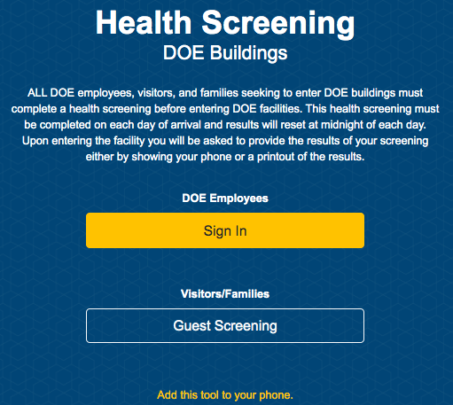
Mandatory NYC DOE Health Screening Protocol
Step 1: Go to the DOE Health Screening Site
healthscreening.schools.nyc

Slide 24
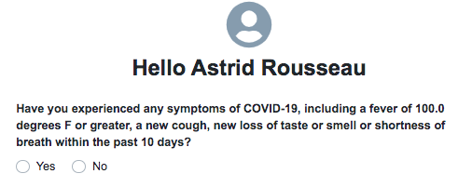
You will be asked to respond to 4 questions:
Questions will show up one at a time

Slide 25
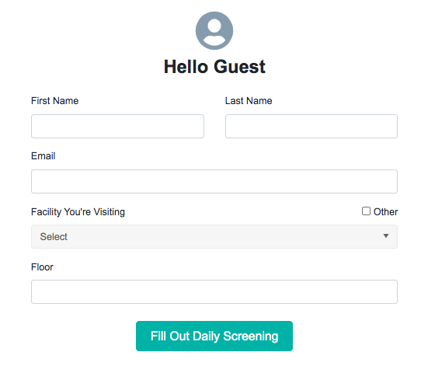
Step 2 - Fill out the “Hello Guest” page with the requested information

Slide 26
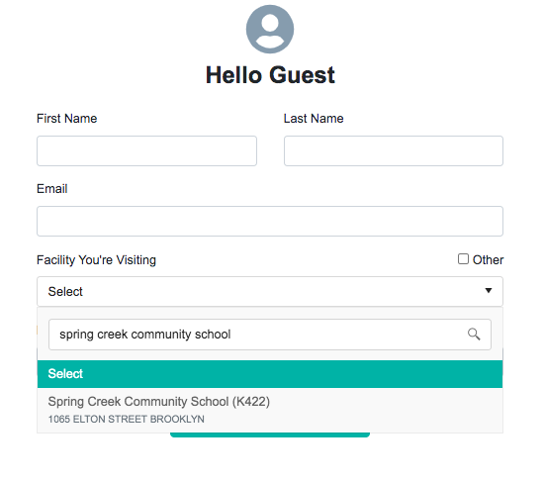
In the “Facility You’re Visiting” section, type in or choose “Spring Creek Community School (K422)” from the drop down list.

Slide 27
You will be asked to respond to 4 questions:
Questions will show up one at a time

Slide 28
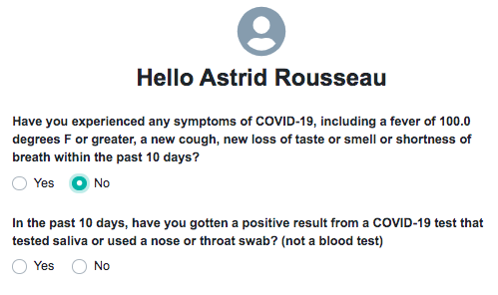
You will be asked to respond to 4 questions:
2.

Slide 29
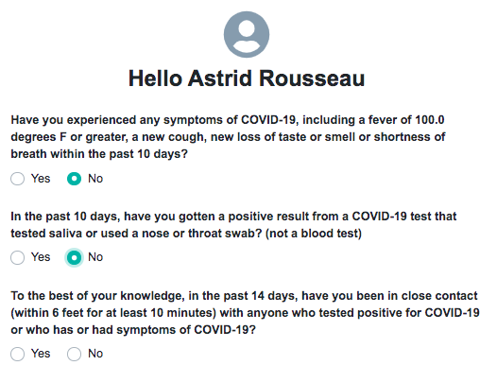
You will be asked to respond to 4 questions:
3.

Slide 30
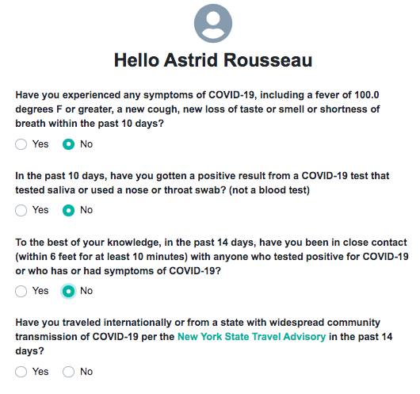
You will be asked to respond to 4 questions:
4.

Slide 31
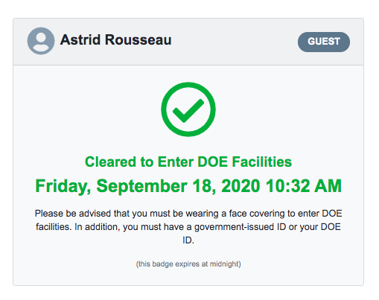
Students MUST present their clearance screen (below) when they arrive to school in order to enter the building.
NOTE: This must be completed EACH time a student reports to the building.

Slide 32
Students MUST present their clearance screen (below) in order to enter the building.
If the site indicates that a student is not cleared to enter the building…
Their parent/guardian MUST notify the school before 8:30am
The student CANNOT enter the building that day

Slide 33
Random Student Testing
DOE policy states:
“Once in-person learning has commenced, the NYC DOE will implement the Random Sample Survey of COVID-19 in Schools, a robust program of repeated random sampling and COVID-19 testing of adults and students present in DOE schools.
Schools will request written parental /guardian consent for students to be tested in school at the beginning of the school, including consent to have results shared with NYC Department of Health and Mental Hygiene, Test & Trace Corps, and Department of Education as necessary. As testing is performed throughout the year, if parental/guardian refuses to provide consent for a student who has been selected randomly for testing, the student will be moved to the remote learning cohort.”

Slide 34
Movement Between Campus Spaces
The majority of students will remain in the same classroom for the full day, while teachers rotate between classrooms. The exceptions are:
Going to a Physical Education or Activity Time in the gymnasium or at Jefferson Field
High School students who need to change classrooms to attend a different Math, Science, or Advanced Placement Class
Students will be supervised and escorted by school staff any time a group of students moves at the same time.
Students may not leave the classroom for the bathroom or any other reason unless the classroom teacher has given them permission and confirmed that the hallway they are traveling through is being supervised by an adult. Students will be given permission to use the bathroom one at a time, to ensure Social Distancing and safety.
Students who have appointments with, or need urgent access to the nurse, dean, a counselor, or main office staff, must be escorted by a support staff member.
Students must remain seated the entire time they are in a classroom. Moving around without permission violated State, City, and DOE mandates around Social Distancing Requirements.
SCCS students will enter the building through the playground, and travel to the 3rd floor via Stairwell B. At the end of the day, classrooms will be dismissed one at a time. MS students will exit through Stairwell B/Playground Exit, and HS students will exit through Stairwell D and the D Exit on Flatlands.
Students are not allowed on the 2nd or 4th floor at any time, for any reason. Students are not allowed in any hallways, stairwells, or classrooms without staff supervision.

Slide 35
Entry and Dismissal
Students will enter through the Playground entrance on Linwood. Students will be required to remain socially distant while waiting to enter (the playground will be painted with lines to help remind students), and a covering will be put up during any inclement weather. Students must be wearing a mask and show their completed Daily Screening to be allowed up to the 3rd Floor. Students must go directly to their classroom and sit in their assigned seat.
At the end of the day, students will be dismissed by classrooms on a staggered schedule. At the end of the day, classrooms will be dismissed one at a time. MS students will exit through Stairwell B/Playground Exit, and HS students will exit through Stairwell D and the D Exit on Flatlands.

Slide 36
How to Reach Key Staff
Email (All staff emails are on our website, posted in Google Classrooms, and on Grade Team and Individual Teacher syllabi and Welcome Letters).
Office Hours (Teachers have Office Hours from 2:30-2:50 each day)
By Appointment (email specific staff members to set up an appointment.)
Call the Main Office to leave a message with our main office staff (718-688-7200, staffed 8:00 AM to 2:50 PM each day)
Please allow teachers and staff 48 hours to respond to non-emergency communications.
STAFF MEMBER | BEST WAY TO CONTACT | CONTACT THIS PERSON ABOUT…
Parent Coordinator Paulette Holland | Email: pholland@sccsbrooklyn.org Phone: 347-463-4123 | Always start with Ms. Holland! ☺ General questions or assistance
Avalene Persad (High School Guidance Counselor) Crystal Moss (Middle School Guidance Counselor) Ty Browne, Social Worker | apersad@sccsbrooklyn.org cmoss@sccsbrooklyn.org tbrowne@sccsbrooklyn.org | Counseling, Socio-Emotional needs or concerns, student emotional or social support
Lucy Ramos | Community School Director | General Community School Questions Family Night Events
Assistant Principal Brandy Huxtable | Brandy Huxtable | Program or Schedule Issues 12th Grade/Academic-specific Transcript Questions
Assistant Principal Jeffrey Hammer | jhammer2@sccsbrooklyn.org | Attendance Technology/Device Issues Discipline Concerns or Issues Non-emergency Safety Issues/Questions
Principal Christina Koza | ckoza@schools.nyc.gov | Issues you have not been able to resolve in other ways Larger Community Concerns Campus-wide Issues

Slide 37
Questions? Put them in the Chat!

