Slide 1
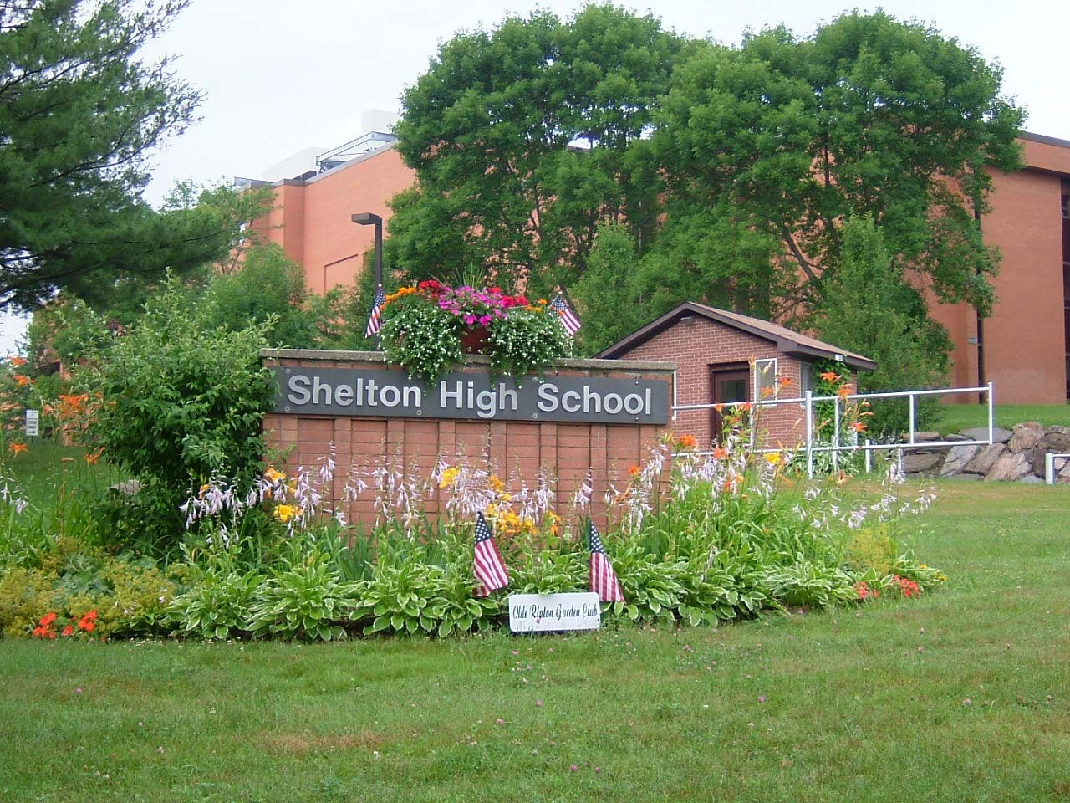
Welcome to
Shelton High School

Slide 2
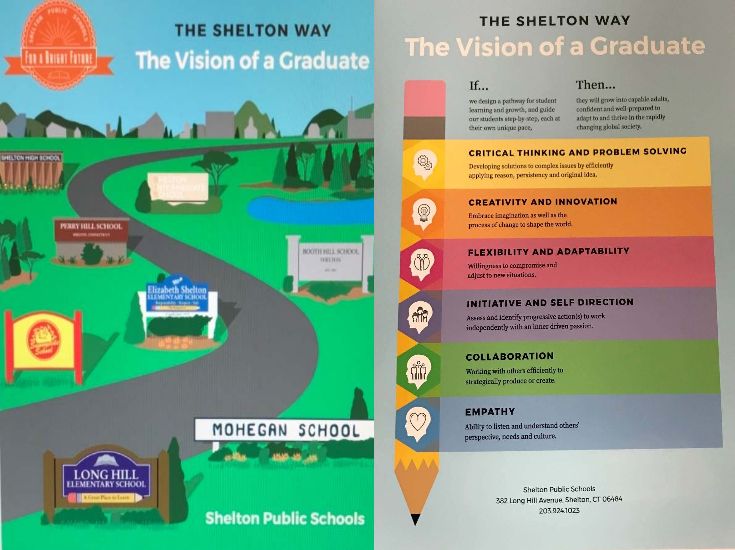

Slide 3

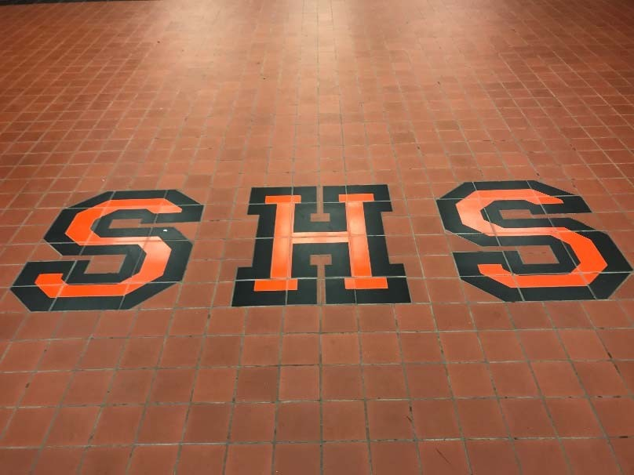
Who we are at SHS
What we offer at SHS
What we offer for Grade 9

Slide 4
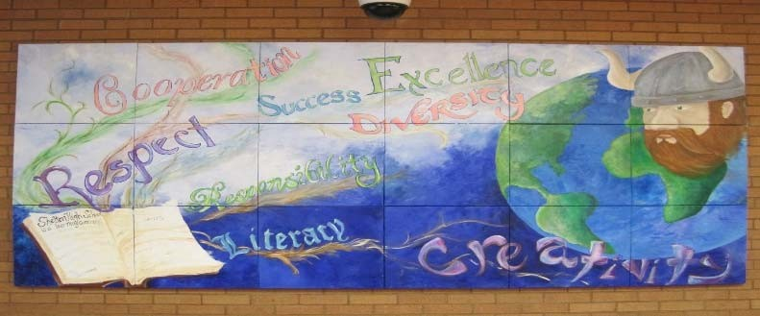
The Shelton High School community believes that a safe, respectful atmosphere must be established and maintained for all students to achieve excellence and become responsible citizens. Within this environment, we expect all students to be engaged learners and critical thinkers who demonstrate technological literacy.

Slide 5

A respectful, safe atmosphere must be established and maintained for successful teaching and learning;
Students, staff and parents, in cooperation with community members, must share responsibility in the teaching and learning process;
A rigorous curriculum must be provided to accommodate and challenge students in order to prepare them to participate productively in a global society;
Instruction must provide students opportunities for all students to work independently and collaboratively.

Slide 6

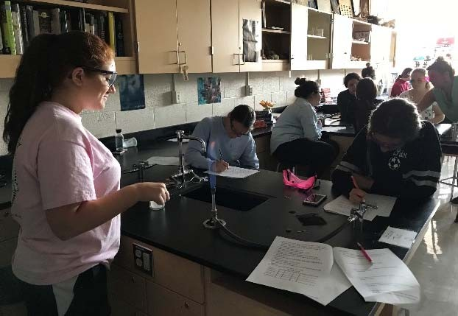
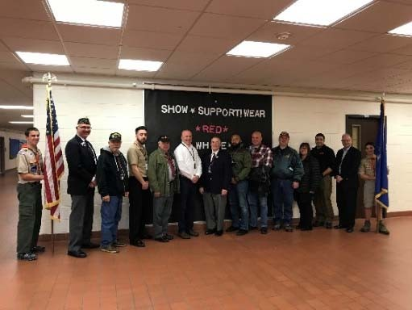
Academic, Social and Civic Competencies:
Reads and writes effectively
Researches effectively to investigate topics
Thinks critically to solve problems
Presents information and ideas fluently
Participates actively in civic life

Slide 7

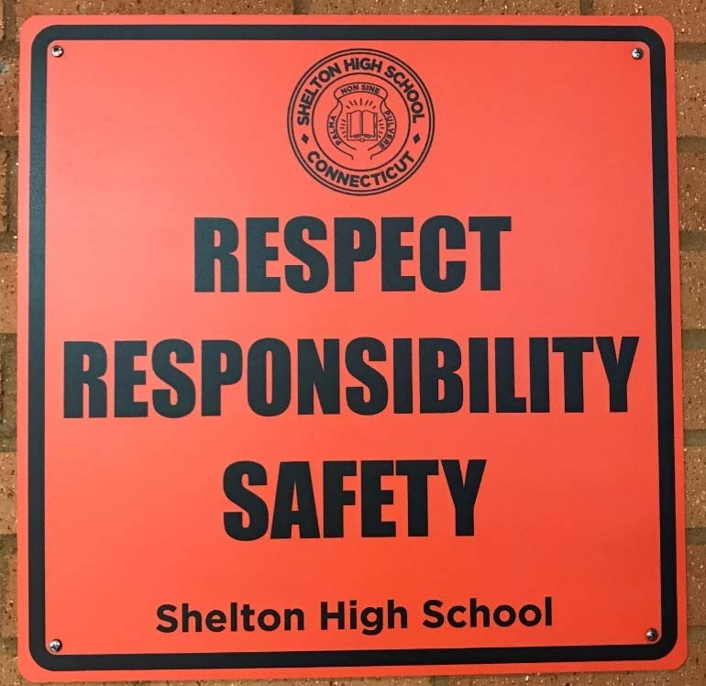
Respect – to show consideration for oneself, others, school and community
Responsibility – to take ownership of one’s
learning and exhibit appropriate behaviors toward oneself, others, school
and community
Safety – to feel physically and emotionally secure in a
non-threatening environment

Slide 8

Challenging a student’s intellect at the appropriate academic level
Providing opportunities to explore new interests
Allowing students to make informed college, career and citizenship choices

Slide 9

Main Office: Interim Principal – Kathleen Riddle
Houses 1, 2, and 3:
  Assistant Principals – Mr. Robert Ayer, Mrs. Victoria Sargeant, and Mr. James Colandrea
  School Counselors
    - Ms. Lynn Giordano, Mr. Ed Hilser
    - Mrs. Casey DeGennaro, Ms. Lisa Papa 3 - Ms. Lisa Sapienza, Mr. Spencer Szabo
Career Center - K-12 School Counselor Curriculum Leader – Mr. Erik Martire
Athletic Office – Director of Athletics
-Mr. John Niski

Slide 10

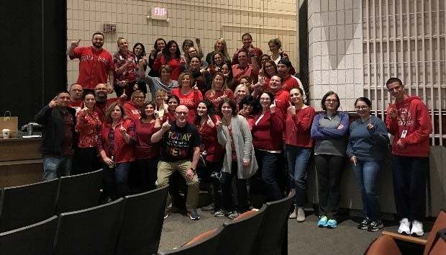
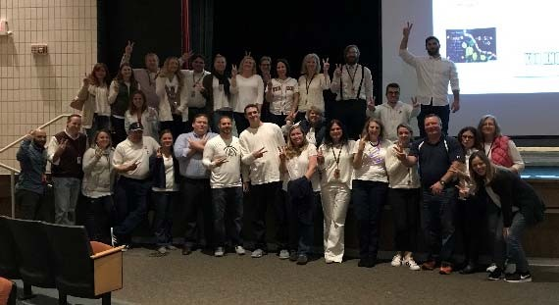
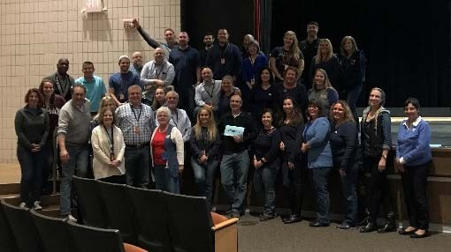
Principal
Assistant Principals
Certified Teachers
Curriculum Leaders
Athletic Director
Library/Media Specialists
School Counselors
Advanced Placement Coordinator
School Psychologists
Speech/Language Pathologists
Social Workers
Instructional Tutors
Paraprofessionals
Reading Consultant
Job Coaches
Security Guards
School Resource Officer
Nurses
Secretaries

Slide 11
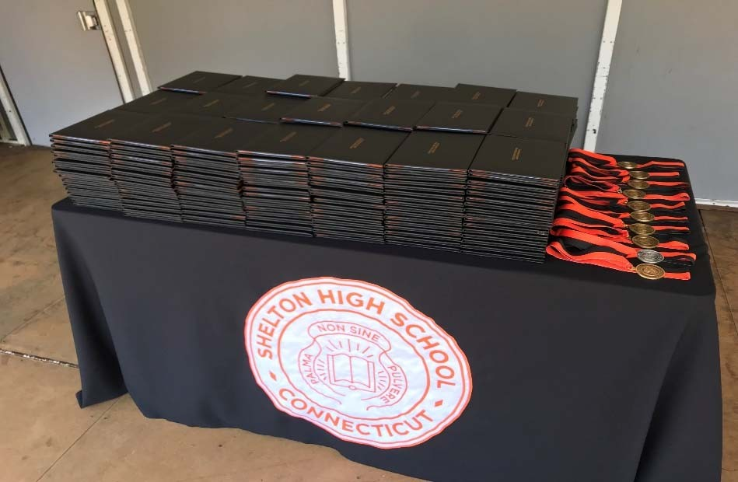
25.4 credits required
Full year course = 1 credit
*1/2 year course = .5 credit

Slide 12
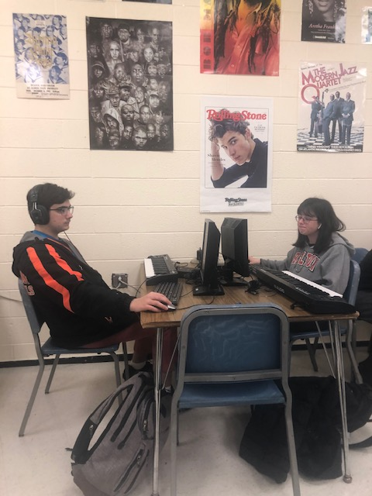
9.0 credits
Current Graduation Requirements
Humanities
  English – 4 credits
  History – 3 credits
The Arts - .5 credit

Slide 13
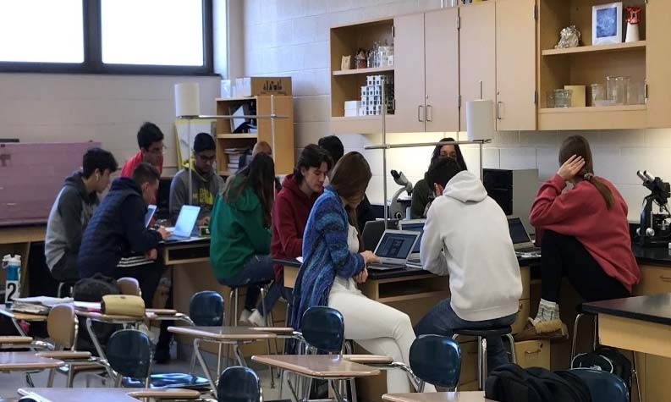
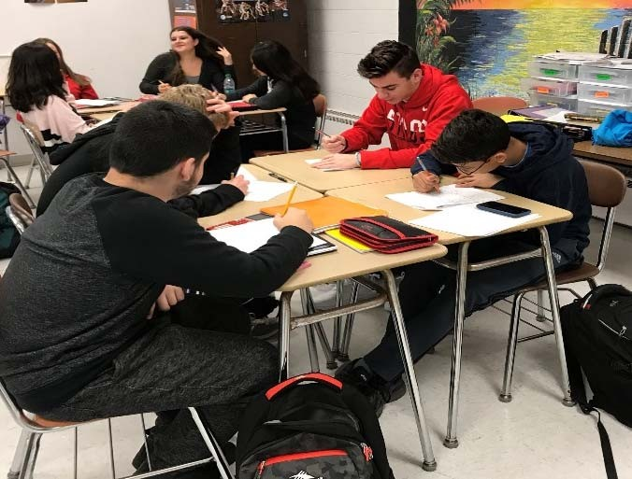
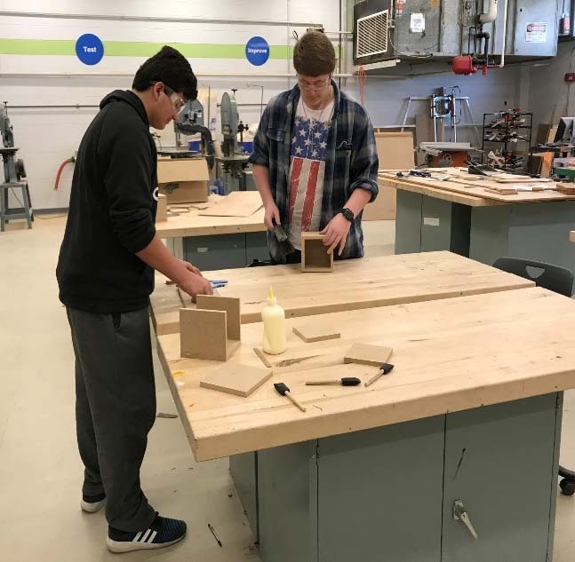
9.0 credits
Current Graduation Requirements
STEM
Science
3.0 credits
Mathematics 3.0 credits
Technical Education .5 credit

Slide 14
Current Graduation Requirements
World Languages
Physical Education/Wellness
Health and Safety Education
Mastery-Based Assessment
Electives
1.0 credit
1.0 credit
1.0 credit
1.0 credit
3.0 credits
Community Service .4 credit (including .1 credit for 10 hours of service each year)
Total for graduation
25.4 credits

Slide 15

Current Graduation Requirements
Community Service 10 hours = .1 credit
Students will be required to complete 10 hours of community service per year, a total of 40 hours for .4 credits.
Mastery-Based Assessment 1 credit
Through the Capstone experience, students demonstrate proficiency in milestones of the Shelton Public Schools Vision of a Graduate.

Slide 16
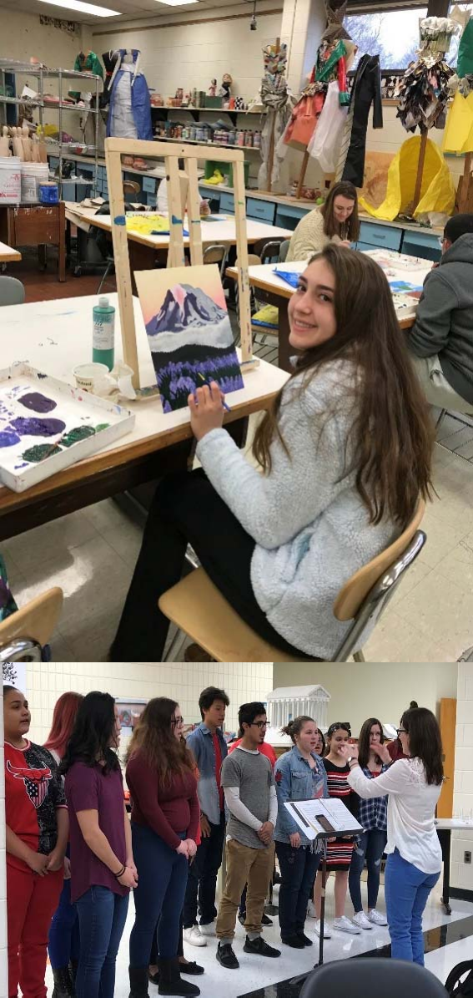
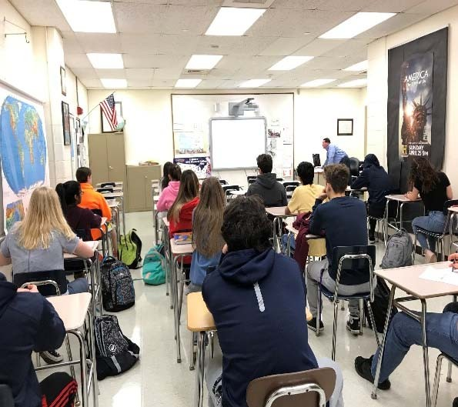
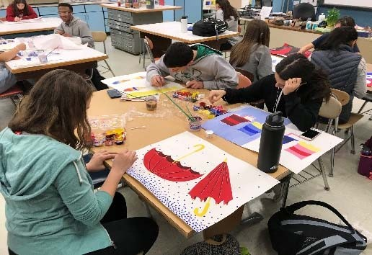
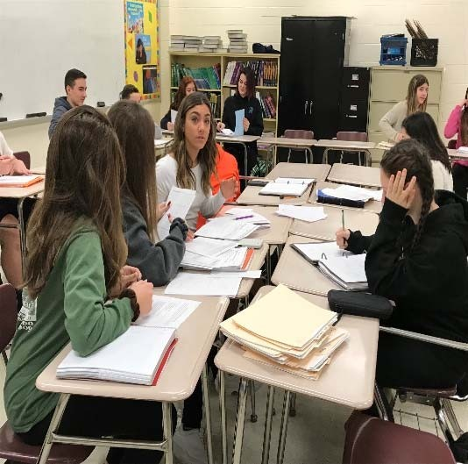

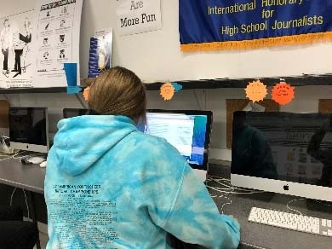
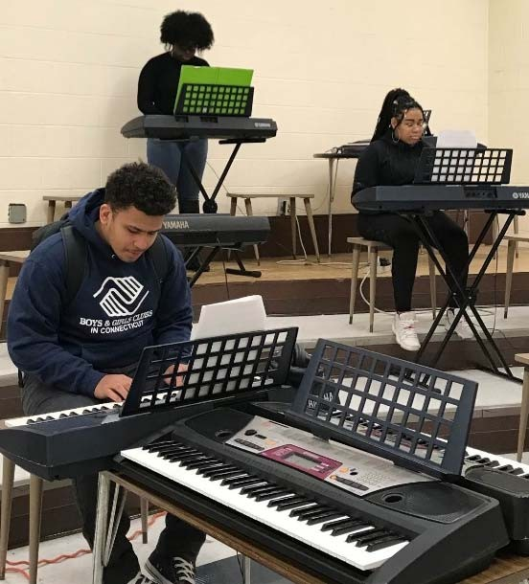
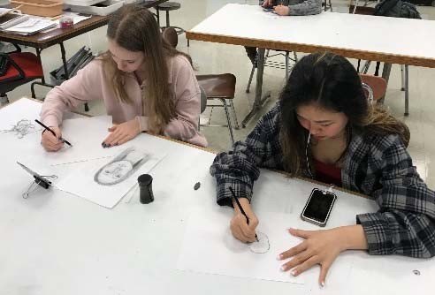
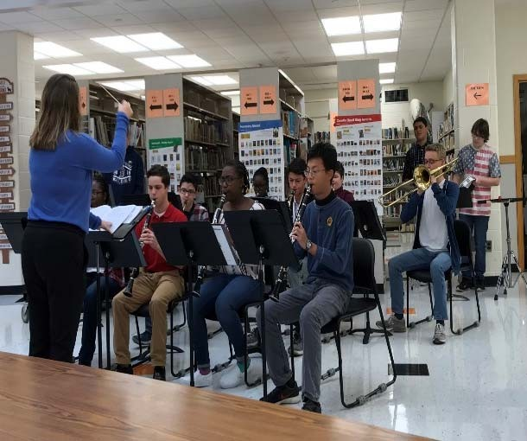
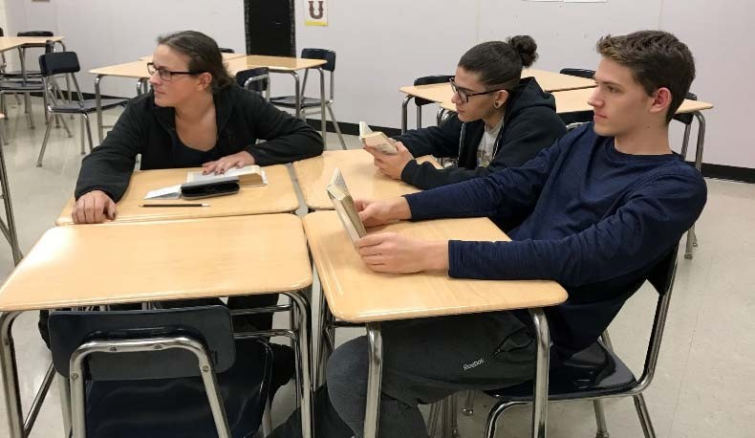
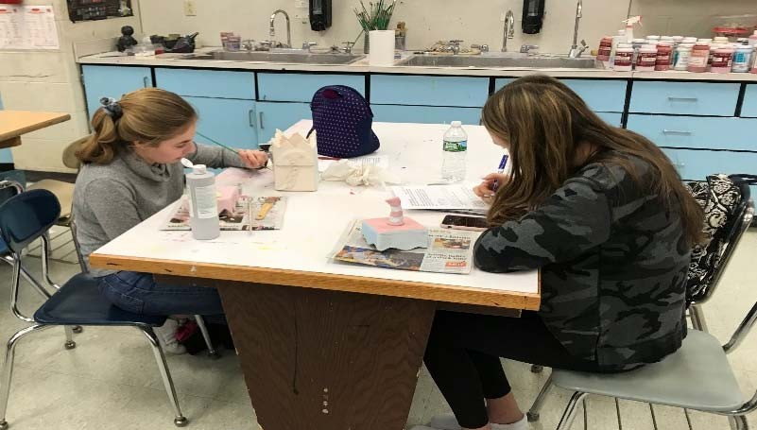

Slide 17

*Acting I, *Acting II, AP English Language and Composition, AP English Literature and Composition,
*Classical Mythology, *Creative Writing I, *Creative Writing II, * Detective Story, English I, English II, English III, English IV, English for Speakers of Other Languages, *Fiction and Film, Humanities 1, *Imaginary Worlds, *Introduction to Theatre, Journalism I, Journalism II, Journalism III, *Playwriting, *Reading Strategies, *SAT Preparation, *Speech & Communication, UCONN Seminar in Academic Writing, *World Mythology, Yearbook Journalism, Yearbook Journalism II

Slide 18

AP European History, AP Psychology, AP United States Government & Politics, AP United States History, AP World History, * Civics,
*Connecticut History, *Cultural Anthropology,
*Current World Events, *Forensic and Legal Psychology, *Geography, *History Through Film, Humanities 1, *Modern Culture Through Hip Hop, Modern World History, *Psychology, *Sociology, *UCONN Principles of Macroeconomics, *UCONN Principles of Microeconomics, United States History I, *United States History II, *You and the Law

Slide 19

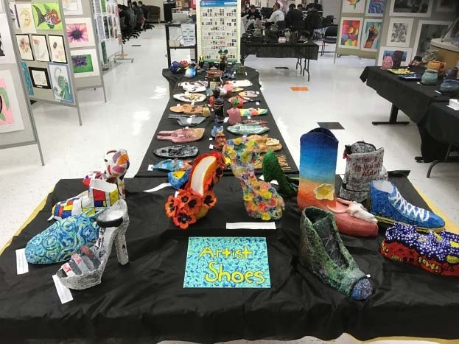
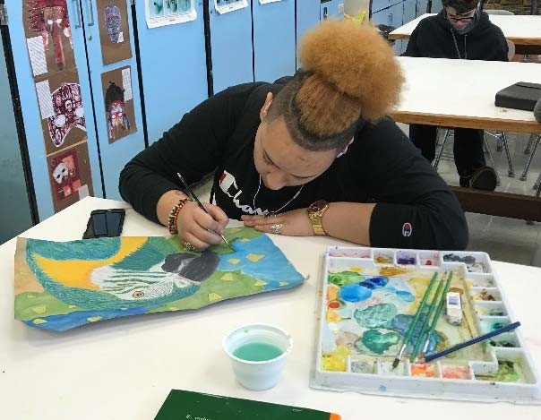
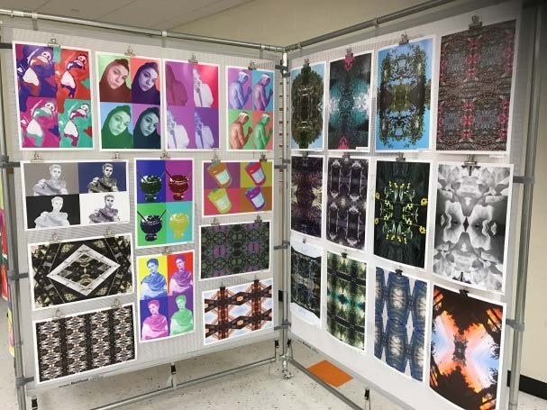
*Advanced 2D Art Techniques, *Advanced Painting, *Advanced Pottery, AP Studio Art: 2D Design,
*Art Foundations, *Art Through the Ages, *Artist's Studio, *Biological Drawing,
*Ceramic Handbuilding,
*Designing Spaces
*Designer’s Workshop,
*Drawing, Fine Art Photography, HCC Ceramic Handbuilding, HCC Drawing, *Illustration,
*Painting

Slide 20

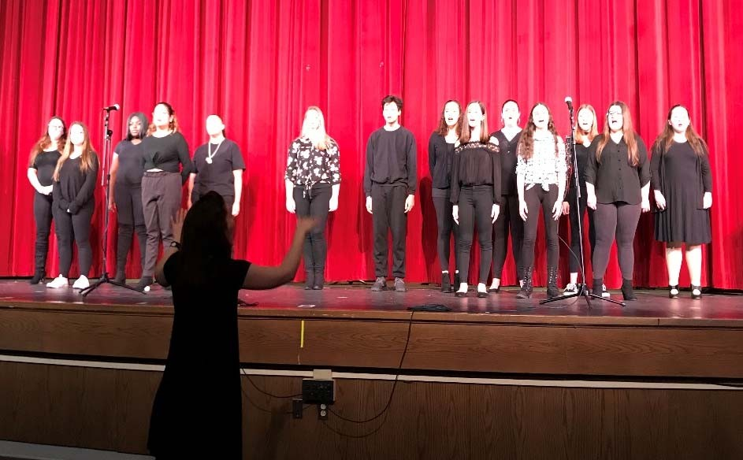
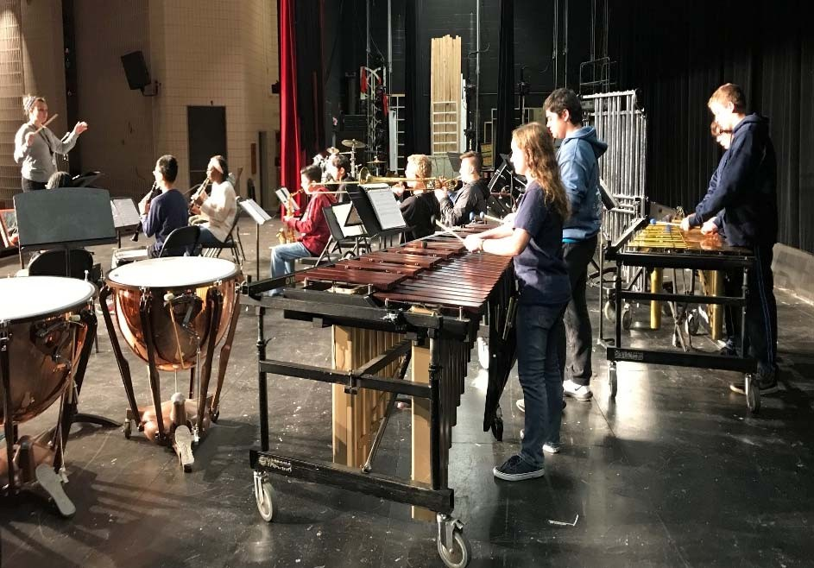
Band, Concert Choir,
*Introduction to Piano Keyboarding, *Fundamentals of Music, *History of Jazz and Rock, *Music Appreciation I,
*Music Appreciation II,
*Music Technology, Music Theory I, *Music Theory II,
*Piano Keyboarding II, *Piano
Keyboarding III, String Ensemble, UCONN Fundamentals of Music with Music Theory I, *UCONN Music Appreciation 1001,
*Ukulele 1

Slide 21
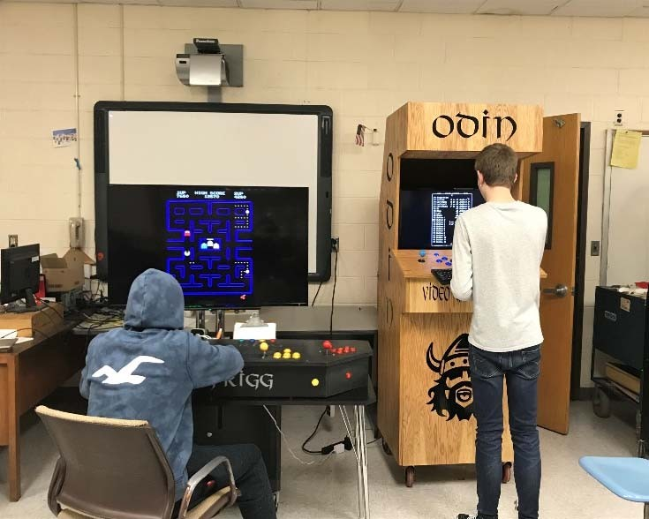
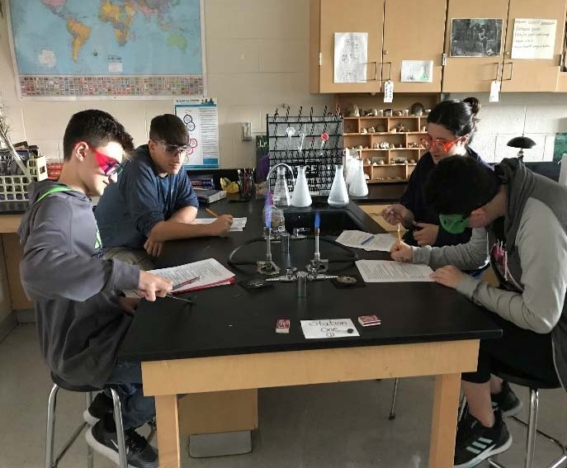
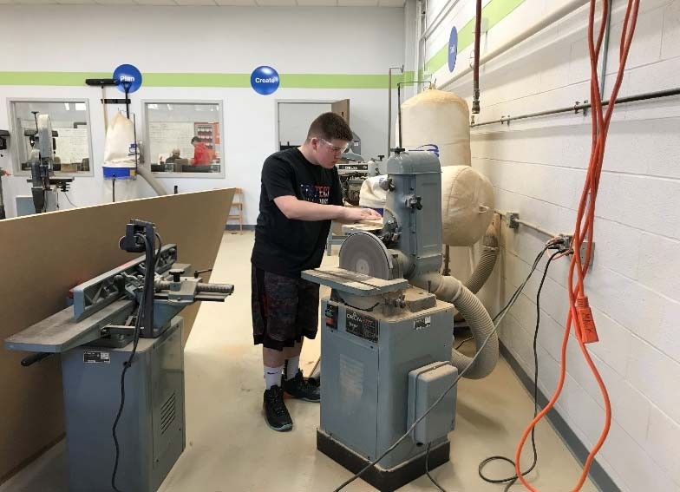
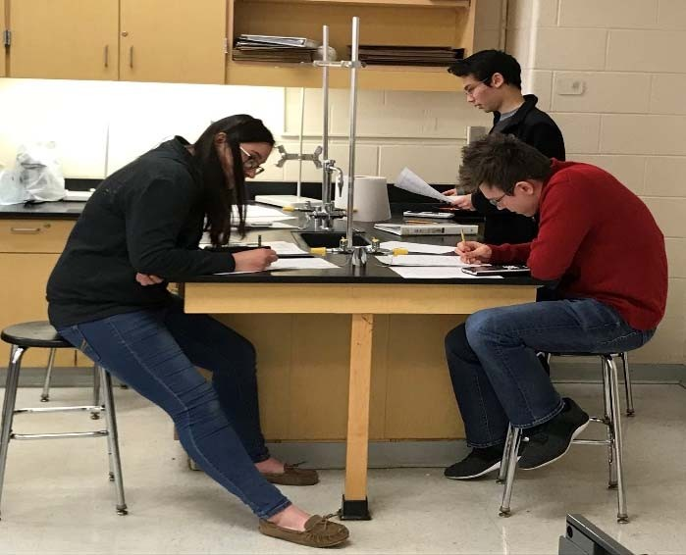
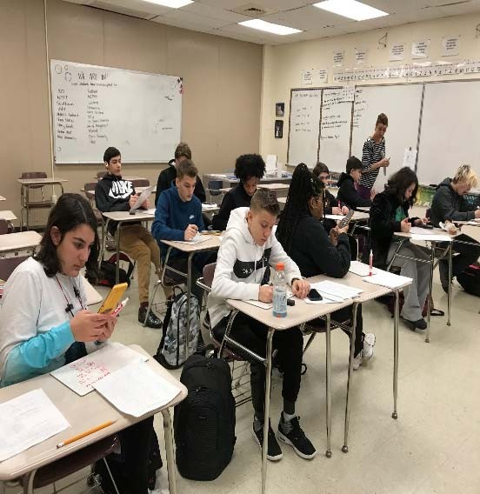

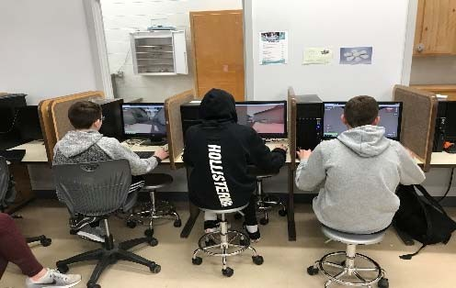
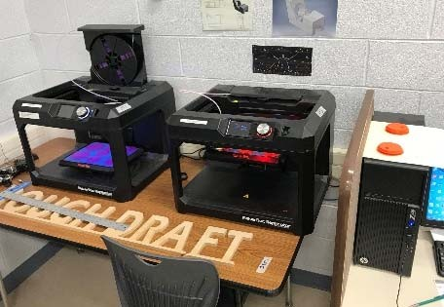
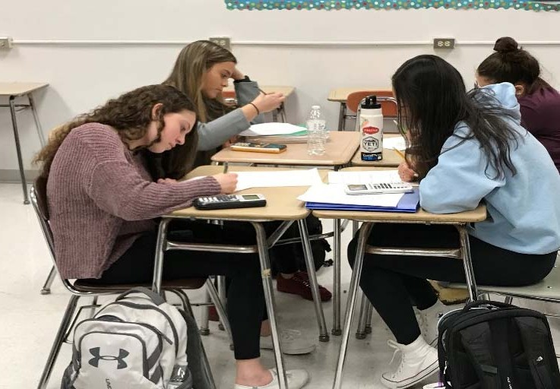
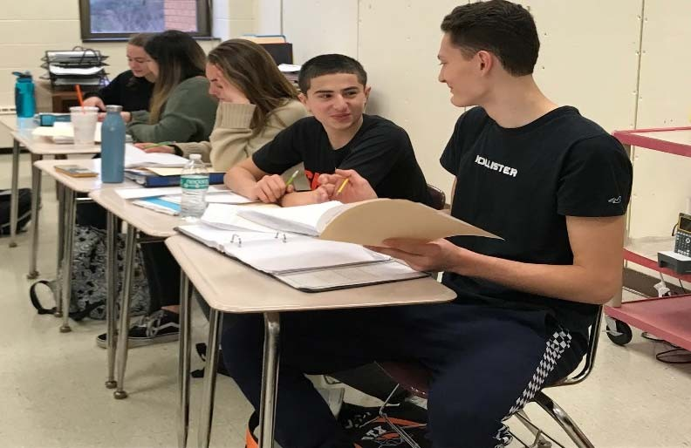
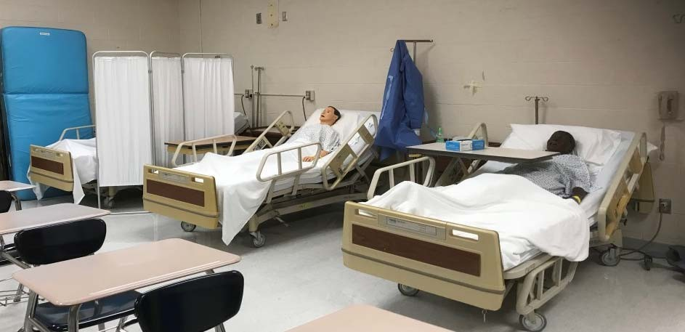

Slide 22

*Agricultural Systems from Global to Local, Anatomy and Physiology, AP Biology, AP Chemistry, AP Environmental Science, AP Physics 1 Algebra-Based, AP Physics 2 Algebra-Based, Applied Research, Biology, *Aviation, Biology II, Chemistry I, Conceptual Biology, Conceptual Chemistry, Conceptual Physics I, *Dynamic Earth, *Engineering Through Nature, *Environmental Science, Environmental Science, *Forensic Science, Forensic Science, Fundamentals of Health Science, *Genetics, *Herpetology, *Human Body, *Marine Science, Physics I, *Space Frontiers, STEM 1,
UB Chemistry, UB Physics, UCONN Physics

Slide 23

Technology Education:
*Architecture, *CAD (Computer Aided Design), *Construction, Construction II, *Digital Art Using Photoshop, Engineering and STEM Careers, Gael News, Graphic Arts, *Manufacturing I, *Manufacturing II, *Robotics,
*Video Game Design I, *Video Game Design II, Video Game Design III,
*Video and Photography, UCONN Engineering, Video Production, UB Video Production

Slide 24

Advanced College Algebra, Algebra I, Algebra II, AP Calculus AB, AP Calculus BC, AP Computer Science, AP Computer Science Principles, AP Statistics, Calculus, Geometry, College Algebra, Integrated Math, *Math Strategies for Success, Math with Business Applications, Precalculus, Probability and Statistics, Programming I, *SAT Prep Math,
*Sports and Statistics, STEM 1, UCONN Calculus,

Slide 25

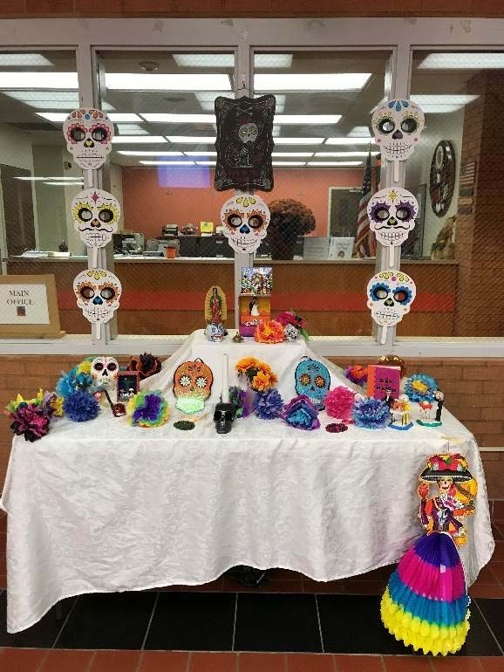
AP Spanish Language, Spanish I,
Spanish II, Spanish III, Spanish IV,
UCONN Intermediate Spanish
Composition, UCONN Spanish Conversation
Italian I, Italian II, Italian III, Italian IV
French I, French II, French III, AP French

Slide 26

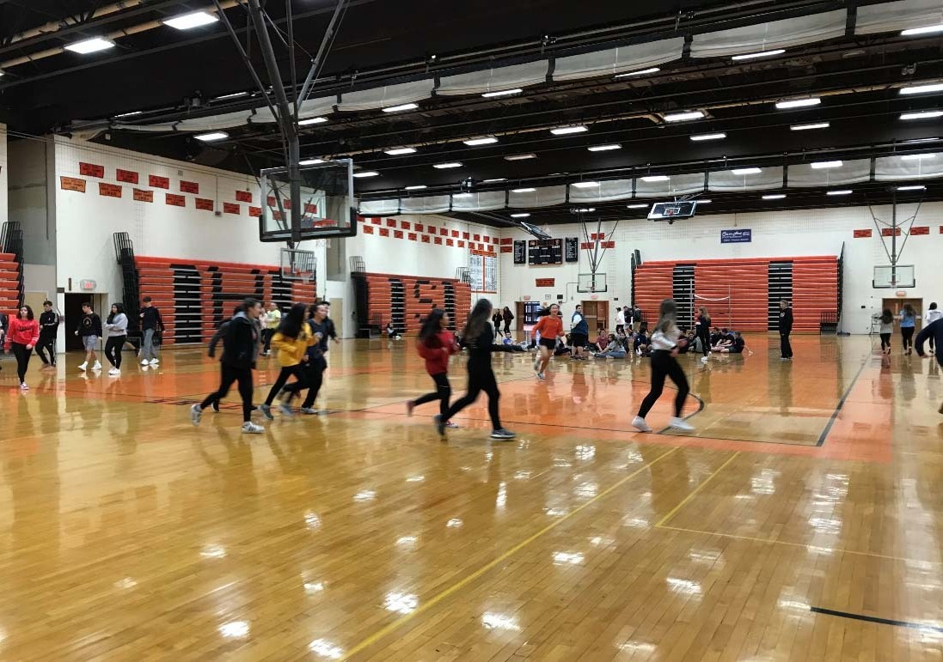
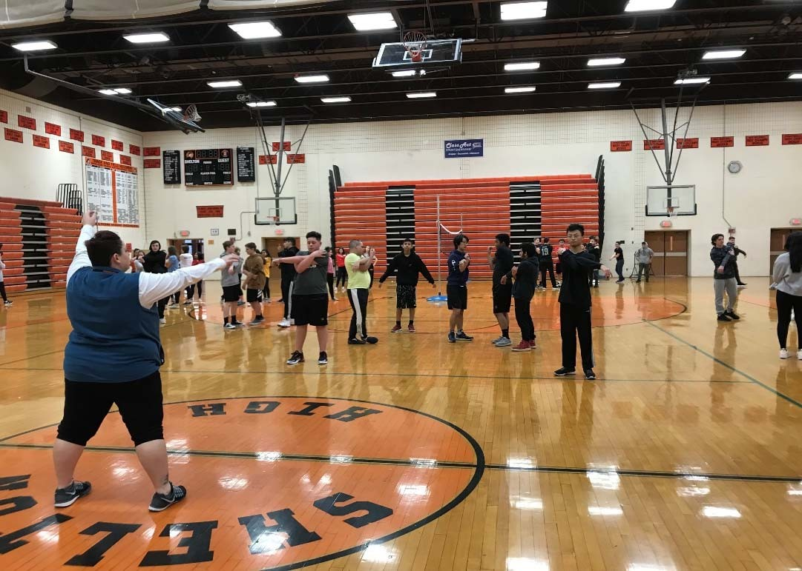
*Physical Education
*PE Sport Education
*PE Fitness for Life

Slide 27

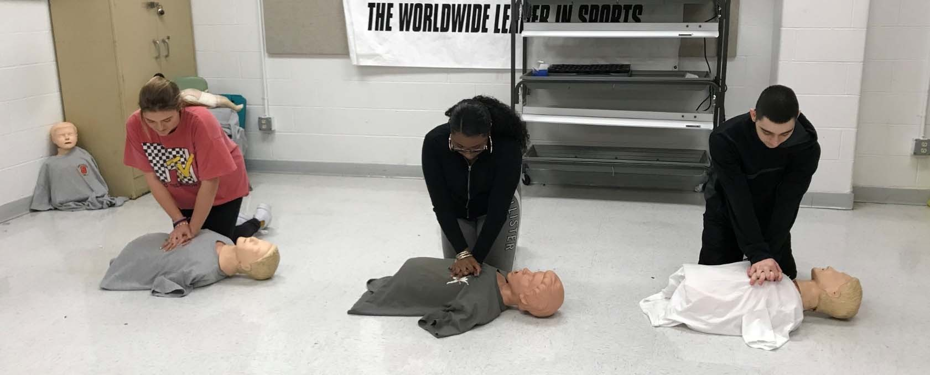
*Current Health Issues
*Nutrition for Health
*Personal Health & Fitness
*Standard CPR/First Aid
*Strength and Conditioning

Slide 28
Business Adminstration & Managment, Marketing & Finance: *Accounting I, Advanced Accounting II, * Business Law, *Business Management, *Computer Applications I, *Computer Applications II, Cooperative Work Experience, *Economics, *Entrepreneurship, *Gaels Mean Business, *Global Business Studies, HCC Financial Accounting H, HCC Marketing H, * *Investing and the Stock Market, Marketing I, *Marketing Style, *Money Management, *Sports and Entertainment Marketing, *UB Entrepreneurship, *UCONN Economics
Culinary Arts: Hospitality Studies: *Baking and Pastry Arts,
*Culinary Arts I, *Culinary Arts II, *Foods and Nutrition I,
*Foods and Nutrition II, *Regional and Ethnic Cuisine

Slide 29
Shelton High School offers a continuum of Special Education and
related services to meet the individual needs of identified students.
In accordance with the Individuals with Disabilities Education Act
(IDEA), students receive their instruction in the Least Restrictive
Environment. Recommendation to all Special Education classes is made via the Planning and Placement Team (PPT) process.
This plan could include:
Collaborative Classes
Adjusted Curriculum
Behavior Therapeutic Classes
Life Skill Classes
Additional services could include:
  Physical Therapy
  Occupational Therapy
  Speech and Language Therapy
  Counseling Services

Slide 30

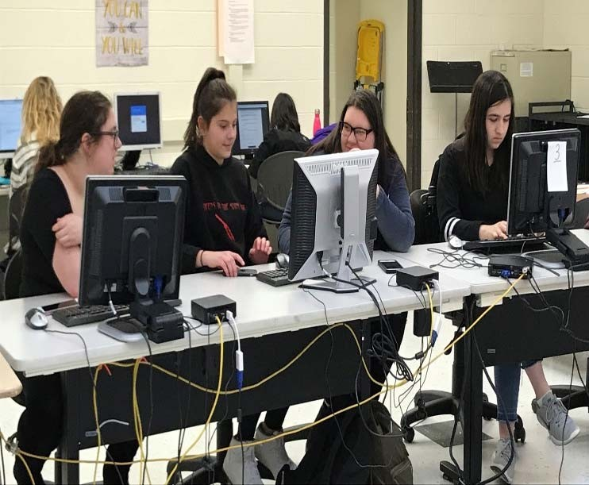
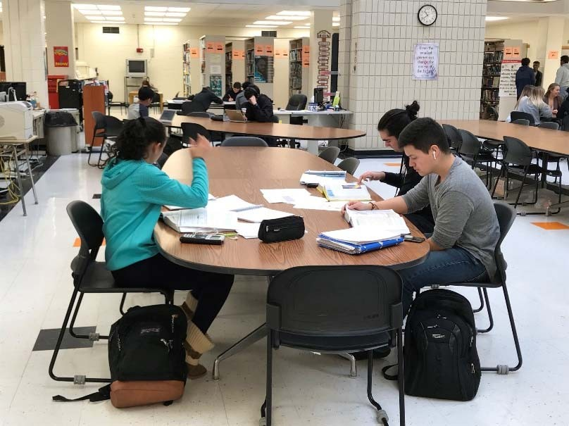
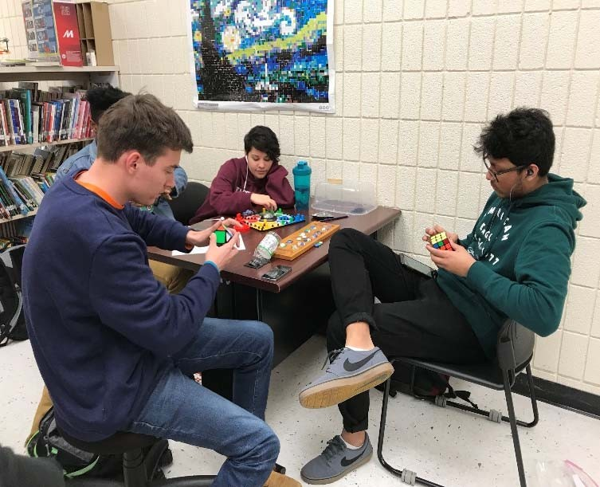
At the SHS Library Media Center students will:
Develop media literacy and lifelong habits of reading for information & pleasure
Independently apply 21st Century Information, Research & Technology Skills
Complete Maker Space activities

Slide 31
New Course Proposals for 2020-2021
AP Art History
AP Studio Art: 3D
AP Studio Art: Drawing
*Digital Drawing & Painting
*Business Communications
*Construction II
*Manufacturing II
UB Marketing Principles
UB Principles of Accounting
UB Video Editing &
Post Production
*Senior Seminar English *Project Aviation
*Introduction to Philosophy
*Humanities Seminar I
*Humanities Seminar II, III, IV
*Freshman Seminar
*STEM Seminar I
*STEM Seminar II, III, IV
French IV
Intro to Spanish Language & Culture

Slide 32
Advanced Placement (AP) is a rigorous academic program that provides students with exposure to college-level work during high school. Through these courses AP certified teachers assist students to develop and apply the skills, abilities, and content knowledge they will need later in college.
AP courses culminate in a college-level assessment developed and scored by college, university, and secondary school faculty.
AP courses allows students to:
  Earn college credit while in high school.
  Remain competitive in the college admission process.
  Broaden intellectual horizons.
  Build confidence in their readiness for college.
  Gain a financial head start on college costs.

Slide 33
Capstone: Seminar, Research
English: English Language and Composition, English Literature and Composition
Fine Art: Studio Art: 2D Design
Mathematics: Calculus AB, Calculus BC, Computer Science, Computer Science Principles, Statistics
Science: Biology, Chemistry, Environmental Science, Physics I Algebra-Based, Physics II Algebra-Based
Social Studies: European History, Psychology, U.S. Government & Politics, U.S. History, World History
World Languages: French Language, Spanish Language

Slide 34

CTE: Engineering – 3 UCONN credits
Essentials of Economics – 3 UCONN credits
English: Seminar in Academic Writing- 4 UCONN credits
Mathematics: Calculus I and II- 8 UCONN credits
Music: Music Appreciation- 3 UCONN credits Fundamentals of Music- 3 UCONN credits
Science: General Physics I & II- 8 UCONN credits
Social Studies: Principles of Macro Economics- 3 UCONN credits; Principles of Micro Economics- 3 UCONN credits
World Languages:
Intermediate Spanish Composition- 3 UCONN credits;
Spanish Conversation: Cultural Topics- 3 UCONN credits

Slide 35
UB Calculus 1
UB Engineering
UB Engineering Graphics
UB Entrepreneurship
UB General Chemistry 1
UB Chemistry
UB General Physics
3 UB credits
3 UB credits
3 UB credits
UB credits
UB credits
4 UB credits
4 UB credits

Slide 36
Bridgeport Regional Aquaculture Science & Technology Education Center
Courses in marine and environmental sciences as well as marine and science- related technology
Regional Center for the Arts (RCA) - Trumbull
  Meets the needs of artistically talented high school students wishing to pursue their interests in arts training (dance, theatre, musical theatre, film/video production, creative script writing)

Slide 37
Community Service
Diploma with Distinction
Independent Study
Internship
Mastery-Based Assessment: Capstone
Online Learning: Virtual High School
Seal of Biliteracy
Volunteer Course for Credit: School and Community
CLEP (College Level Examination Program)

Slide 38

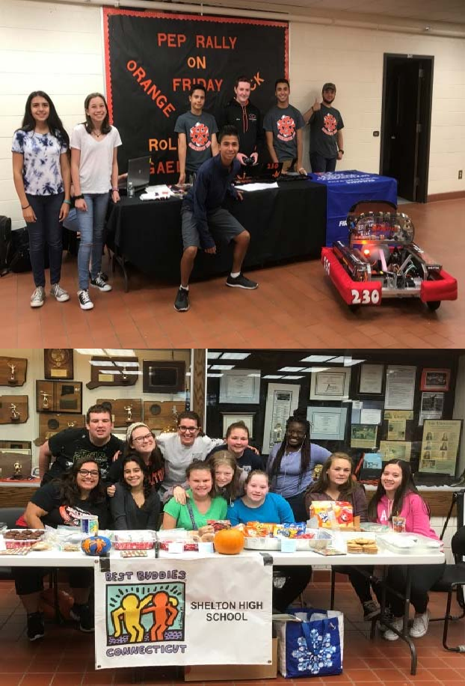
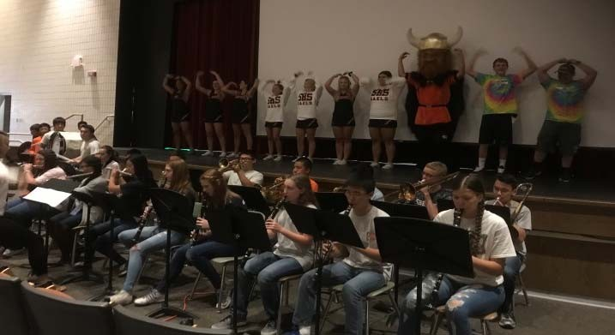
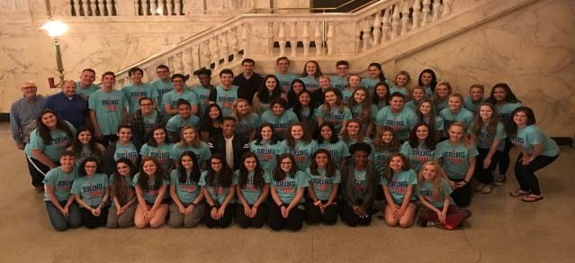


Participate in clubs, co- curricular activities, extra- curricular activities, clubs and athletics.

Slide 39





Slide 40

Action for Change Club
Art Open Studio
Band: Marching Gaels
Best Buddies
Board Games Club
Chess Club
Color and Create Club
Color Guard
Computer Science Club
Dance Club
DECA
Diversity Team
Drama Club
E-Sports Club
Extraordinary Changes Club
Federal Challenge
Film Club
French Club
Future Business Leaders of America
Gael Goodies
Indoor Percussion
Italian Club
Journalism (The Gael)
Junior Statesmen of America
Kan Jam Club
Math Club
Model United Nations
Motivational Media
Movement and Meditation
Multicultural Ambassadors
National Honor Society
Poetry Club
Polish Club
Quill and Scroll Honor Society
Robotics: GaelHawks
SAGA (Sexuality and Gender Alliance)
Science Club
Spanish Club
Spike Ball Club
Step Club
Student Council
Teen Sociology Through Film
Winter Guard
World Languages Honor Societies
Yearbook Journalism (The Argus)
Youth Ambassadors
Youth 2 Youth
Wii Sports Club

Slide 41






Requirements for participation in athletics:
Students must maintain a cumulative average of at least a 70
Current physical exam
Concussion baseline
Pay to Participate Fee

Slide 42


Fall Sports: Boys’ & Girls’ Cross Country, Field Hockey, Football, Boys’ & Girls’ Soccer, Girls’ Swim, Girls’ Volleyball
Winter Sports: Boys’ & Girls’ Basketball, Cheerleading, Boys’ Swim, Boys’ and Girls’ Indoor Track, Wrestling, Unified Basketball, Unified Cheerleading
Spring Sports: Baseball, Softball, Golf, Boys’ & Girls’ Lacrosse, Boys’ & Girls’ Tennis, Boys’ and Girls’ Track and Field, Unified Track, Boys’ Volleyball

Slide 43










Slide 44






Slide 45






Students of the Month
Quill and Scroll Honor Society

Slide 46
#Gaelspirit, #Gaelpride
https://drive.google.com/file/d/1HBGpZ5EwYzXPvPX_eRLocVMlV00PkJ7N/view?usp=sharing_eil&ts=5e308683

Slide 47
Daily Bell Schedule
Period 1 Period 2 Homeroom Period 3 Period 4 Period 5 Period 6 Period 7 Period 8 SHS uses an alternating A& B Day schedule. | 7:25-8:11 8:15-9:01 9:05-9:10 9:14-10:00 10:04-10:50 10:54-11:40 11:44-12:30 12:34-1:20 1:24-2:10 | 46 min. 46 min. 5 min. 46 min. 46 min. 46 min. 46 min. 46 min. 46 min. .

Slide 48

Honors courses are closely aligned with the academic demands of most four-year colleges and require exceptional proficiency in all areas. Honors courses demand in-depth study and significant time out of class for completion of independent reading and research and preparation of comprehensive papers, reports and other assignments.
Honors level courses are for the student who:
is highly self-motivated and capable of extensive independent study.
is willing to extend beyond specific assignments.
shows continual willingness to be challenged intellectually through the use of critical thinking and complex problem solving.

Slide 49

College Preparatory courses reflect the academic demands of many four-year colleges and require proficiency in the skills related to the field of study. Projects, reading and assignments require a significant amount of time out of class to complete.
College Preparatory level courses are for the student who :
demonstrates motivation and effort.
demonstrates responsibility and promptly completes independent reading and research.
shows a willingness and ability to use critical thinking and complex problem solving.

Slide 50

Academic courses offer students a solid foundation for a variety of post-secondary options. Students who enroll in these courses are taught strategies to further develop academic proficiency in the subject area. Reinforcement of academic skills and motivation are emphasized.
Academic level courses are for the student who :
shows a need to improve subject area proficiency.
demonstrates a need to develop stronger academic skills.
demonstrates a need for reinforcement of problem solving and critical thinking skills.

Slide 51
Advanced Placement (AP) is a rigorous academic program that provides students with exposure to college-level work during high school. Through these courses AP certified teachers assist students to develop and apply the skills, abilities, and content knowledge they will need later in college.
AP courses culminate in a college-level assessment developed and scored by college, university, and secondary school faculty.
AP courses allows students to:
  Earn college credit while in high school.
  Remain competitive in the college admission process.
  Broaden intellectual horizons.
  Build confidence in their readiness for college.
  Gain a financial head start on college costs.

Slide 52
Humanities:
English I
Modern World History/ AP World History
STEM:
Algebra I
Environmental Science
Lunch/Study Hall
Physical Education/Wellness & Health
Elective - 2 half-year electives or 1 full-year (World Language) Elective - 2 half-year electives or 1 full-year

Slide 53
Grade 9 Sample Traditional Pathway
Students enrolled in Alg I or Alg II at SIS
Humanities:
English I
Modern World History/ AP World History
STEM:
Algebra II, Geometry
Biology/Lab, AP Biology/Lab, AP Physics I/Lab
Lunch/Study Hall
Physical Education/Wellness & Health
Elective - 2 half-year electives or 1 full-year (World Language)
Elective - 2 half-year electives or 1 full-year

Slide 54
Innovation Options
Humanities 1 (2 credits) - students contract for college preparatory or honors level
STEM 1 (2 credits) - students contract for college preparatory or honors level
Additional course option:
Project Lead the Way: Introduction to Engineering Design (1 credit)

Slide 55
Course selection materials will be distributed to students Spring, 2020
Mrs. Riddle and Mr. Martire will visit SIS to outline procedures for 8th grade students.
Course selection sheets will be collected by Spring, 2020
Selections will be processed
Master schedule building begins
Schedules distributed to students toward the end of the summer

Slide 56
Read the Course Selection Guide carefully.
Course selections must be made thoughtfully.
All graduation requirements and courses of study are clearly outlined.
Use the Course Selection Guide to find your answers.
Build you high school career on a solid foundation which fits your needs, abilities, and interests and helps you to be college, career and citizenship ready.

Slide 57
Life After SHS: Class of 2019
Sample of colleges selected by the Class of 2019: Boston College, Boston University, Clemson, CCSU, Dartmouth College, Embry-Riddle, Fairfield University, George Mason, George Washington University, John Hopkins University, Michigan State University, Northeastern University, Rensselaer Polytechnic University, Sacred Heart, Springfield College, University of Connecticut, University of Delaware,
University of Montana, University of Rhode Island, U of Tampa, Villanova University, Worcester Polytechnic Institute
371 graduates
87% enrolled in institution of higher education
  67% four year colleges
  20% two year community or technical colleges

Slide 58



Class of 2020
Members of the Class of 2020 have already been accepted to:
Rutgers University
Seton Hall University
Springfield College
SUNY Albany
University of Bridgeport
University of Colorado
University of Delaware
University of New Hampshire
University of New Haven
University of Vermont
Western New England
WPI
Yale University
  and many more…..
Bentley University
Boston College
Embry Riddle University
Fairfield University
George Mason University
Manhattanville College
Marist College
Pace University
Penn State University
Quinnipiac University
Rensselaer Polytechnic Institute

Slide 59

sheltonhigh.sheltonpublicschools.org

Slide 60
Building tours by SHS Students

Slide 61
We remain in the main lobby to answer any questions you may have.
Enjoy your building tour and have a safe ride home.

