Slide 1
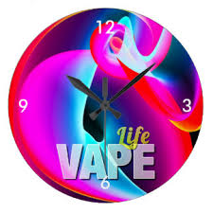
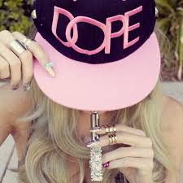
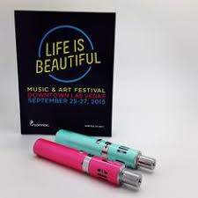
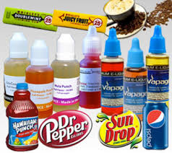
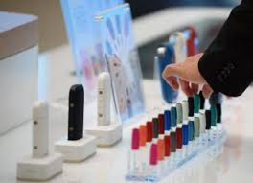
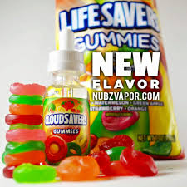
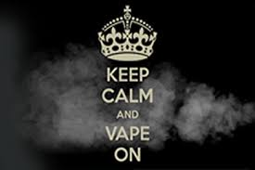
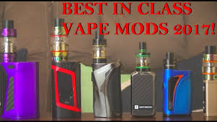
Vape Culture:
Notes:
So how do try to fight against this “Vape Culture?”
Can’t you see how attractive this might be to a teen?
Doesn't it look like someone is shopping for a new phone or buying candy?

Slide 2
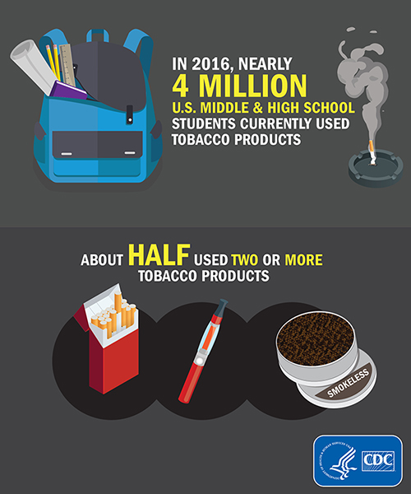
Notes:
Now let’s take a look at some statistics.
This is just an overview of how many students currently use tobacco and tobacco products

Slide 3
Notes:
This one compares traditional cigarettes
to e- cigarettes. The graphic on the right shows what teens think is in their e-cigg but I have a better one coming up.

Slide 4
Notes:
This graphic looks at what teens are reporting is in their e-cigg from 8-12 grade.

Slide 5
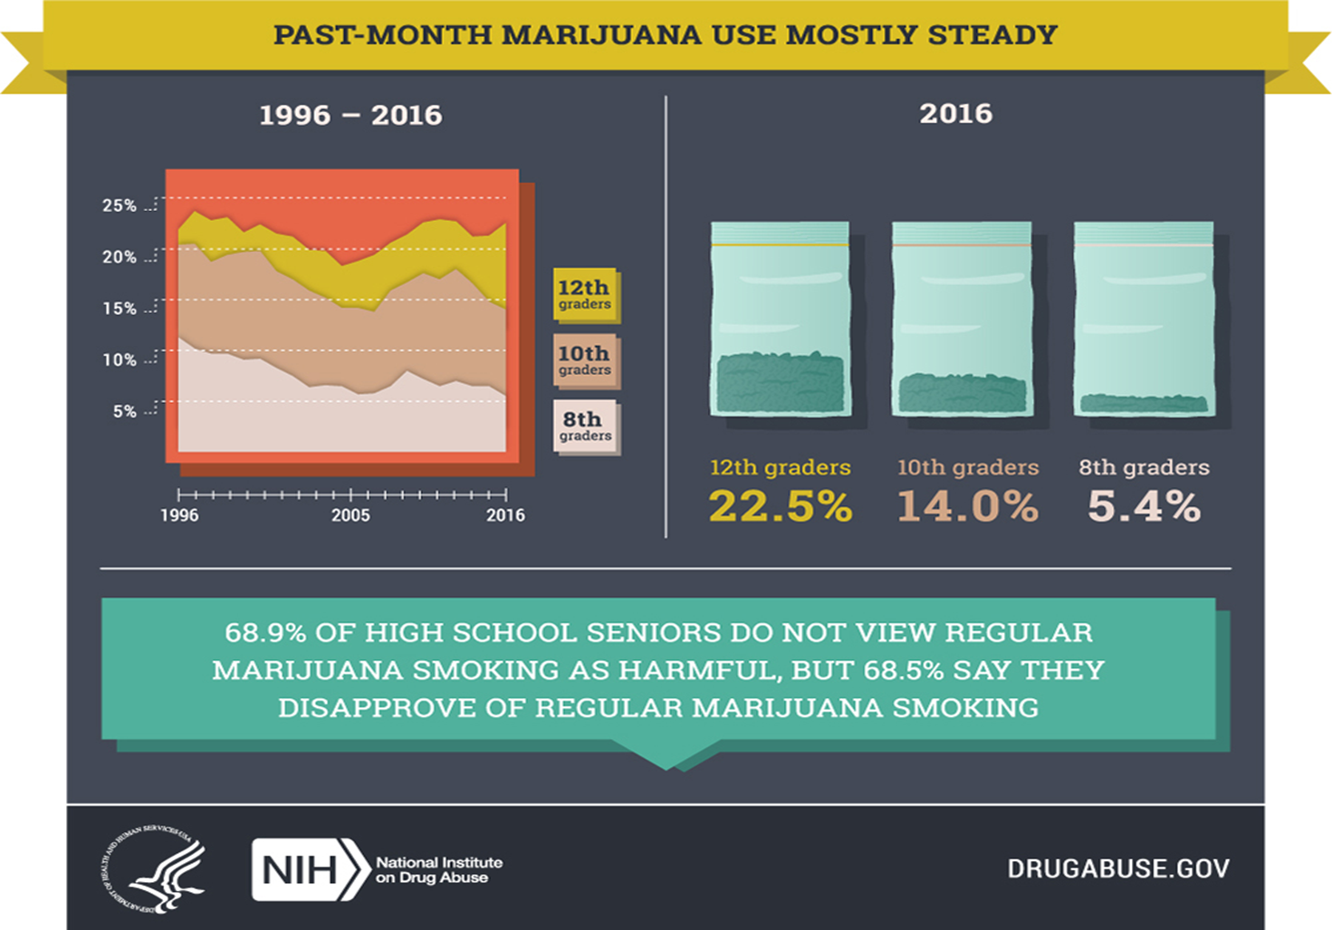
Notes:
This looks at teens and marijuana use
The info on the bottom is key
Perception of harm

Slide 6
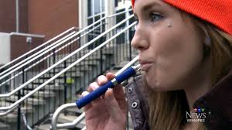
Vaping and schools
Products that look like pens or highlighters can easily be hidden
by students in schools and classrooms
Teachers may not recognize e-cigs, and smoke detectors won’t catch the aerosol
There is no odor
Notes:
Schools across the country are trying to tackle this issue. Schools are educating parents, students but we cant do it alone.

Slide 7
Notes:
This is very true. Let’s take a look at what prevention looks like

Slide 8
Legal:
Require age verification by photo ID for purchase of these products
Require manufacturers of products to register with the FDA and submit their products for approval — disclosing ingredients, safety and emissions data, and manufacturing processes.
Require companies to put health warning labels on e-cigarettes and other tobacco products, including warnings of the possibility of addiction and the health effects of nicotine
Prohibit selling of covered tobacco products in vending machines (unless in an adult-only facility)
Ban free samples of e-cigarettes and other tobacco products
Currently, the NYS age to buy cigarettes and e-cigarettes is 18 years old. Westchester County is considering raising the age from 18 to 21 years old. If the bill becomes law, Westchester would join New York City, Suffolk County and four other counties.
E-cigarettes and vaping are being banned in indoor public areas in New York under the state's Clean Indoor Air Act.
In May 2016, the FDA outlined regulations that extended its authority to electronic cigarettes and eliquids:
Any e-cigarette or vaping product released after Feb 15, 2007, would require the same expensive, lengthy FDA approval as regular smokes.
Ban e-cigarette, hookah, pipe tobacco, and cigar sales — either in person or online — to minors (some states have already done this)

Slide 9
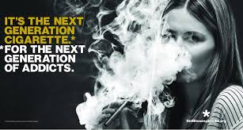
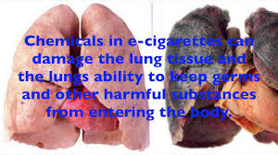
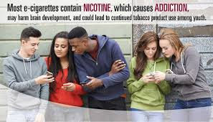
Public:
Notes:
New PSA’s and school/community wide prevention campaigns

Slide 10
School:
Meetings were held with the HS Prevention Awareness Council. Meetings with other groups will continue
District Letter to all parents encouraging them to have conversations with their children and to attend this evening’s presentation
Northern Westchester Hospital presented to a HS Peer Leaders and PAC members, “Vaping and Smoking Stinks”
HS/MS staff will continue to discuss how to educate our students, staff and families
MS/HS PTO presentations to parents, faculty/staff, KLSD Bus Drivers
PowerPoint available on our web site
MS/HS will continue with lessons on vaping in health classes
HS/MS Faculty presentations
HS school-wide presentation on vaping
The HS Administration reviewed Code of Conduct and consequences of being caught vaping or being in the possession of vaping paraphernalia.
MS teachers reviewed dangers of vaping and the potential consequences per the Code of Conduct

Slide 11
Home:
As a parent, you have the power to influence your teen’s decisions. Many parents don’t talk to their kids about drugs, addiction, smoking or drinking, but for those who do, the results are positive.
Teens whose parents talk to them about these difficult subjects make better choices
When talking about vaping, play it casual. Ask them if they have heard of it and what they know.
Keep it open-ended. Teenagers will look for any chance to answer a question with a yes or no. What do you think about vaping?
Today's teens are more health-savvy. Teach your teen about e-cigarettes and regular cigarettes.
Talk about the uncertainty of e-cigarette safety and about the definite possibility of addiction to nicotine that goes along with vaping
Stress the seriousness of vaping as a decision to not just make on a whim, but one with potential consequences of lifelong problems
Be the message. If you don't want your kids to vape, don't vape, either.
Children of people that use products like vaping and nicotine products are more likely to use them

Slide 12
Prevention Works:
The CDC attributed the drop in e-cigarette use to a variety of factors, including high-profile public education campaigns and new restrictions on sales to minors.
If smoking continues at the current rate among U.S. youth, 5.6 million of today’s Americans younger than 18 years of age are expected to die prematurely from a smoking-related illness. This represents about one in every 13 Americans aged 17 years or younger who are alive today.¹
According to the CDC the use of electronic cigarettes by middle and high school students in the United States has dropped for the first time since the federal government started tracking the use of these products by young people.
The number of teenagers using e-cigarettes fell from 3 million in 2015 to 2.2 million in 2016.
High school students fell from 16 % in 2015 to 11.3 % in 2016 Middle school students fell from 5.3 % to 4.3 %.
Before the drop, the CDC had documented an exponential increase in the use of e-cigarettes by young people between 2011 and 2015
Notes:
But…….
We still have a long way to go

Slide 14
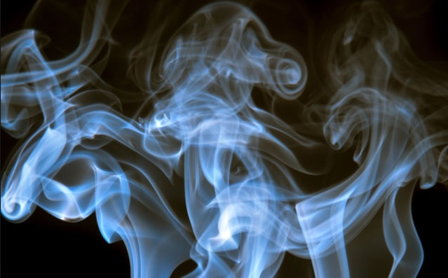
VAPING

Slide 15
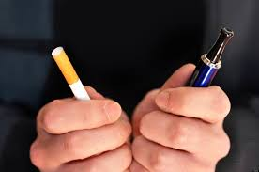
What is VAPING? The act of inhaling vapor produced by any kind of e-cigarette or personal vaporizer. Users load a liquid solution containing their drug of choice into the device. When they draw on the device, the battery heats the liquid, which is then atomized into an inhalable vapor.

Slide 16
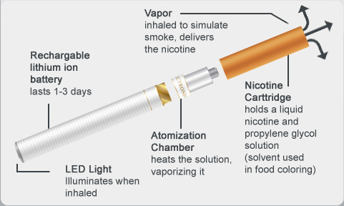
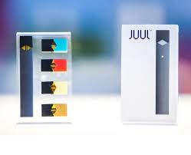
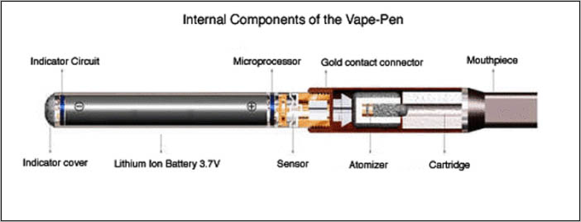
Vaping Devices:
Electronic cigarette: smokeless, battery operated device used to
deliver nicotine with flavorings or other chemicals to the lungs.
Vaporizer pen or vape pen: a device ranging in size from a standard
pen to a large cigar used to generate an inhalable vapor from a solid,
semi-solid, or liquid substance.
Three components: A liquid cartridge used to produce the vapor.
A heating element known as the atomizer and a rechargeable
battery to power the atomizer.

Slide 17
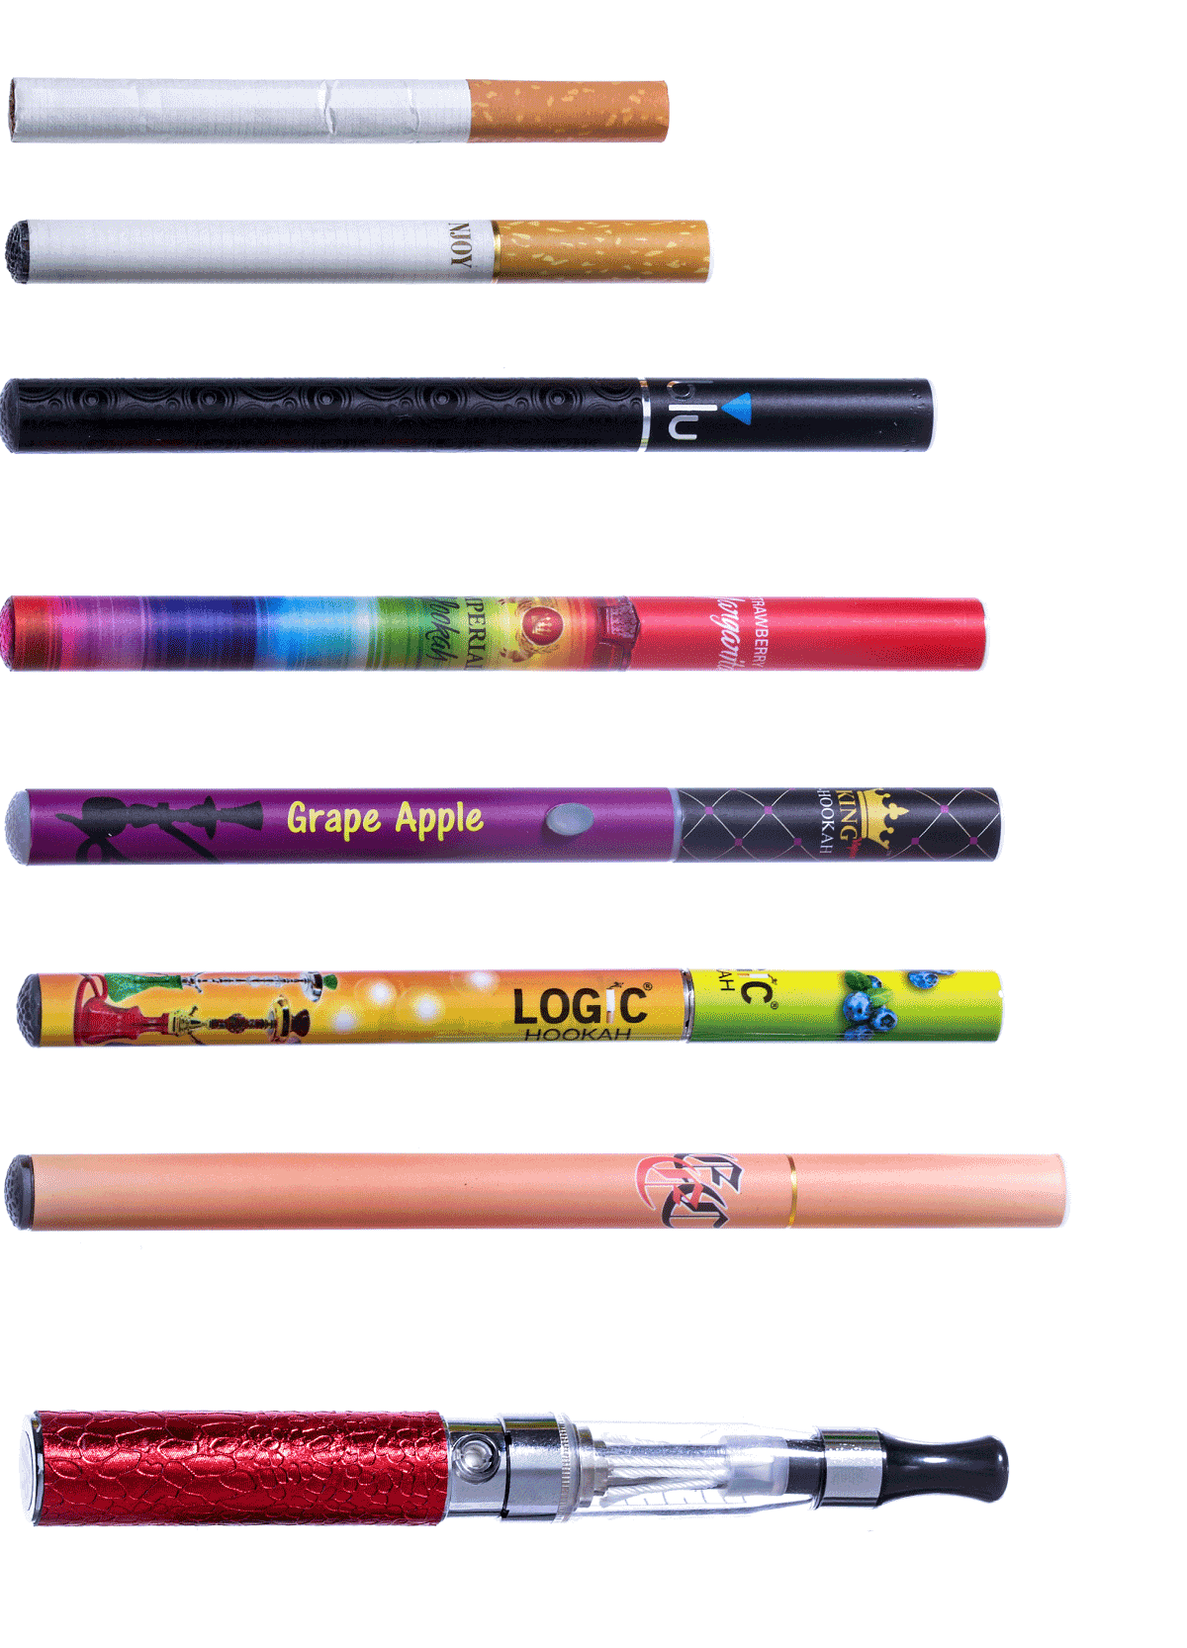
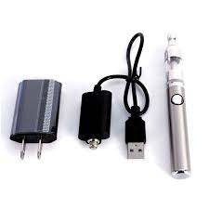
Teens may not call them e-cigarettes:
“cartridges”
“carts”
“water pipe”
“vape pipe/pen”
“Juul”
Note. Some e-cigs connect to other electronic devices to play music and answer calls

Slide 18
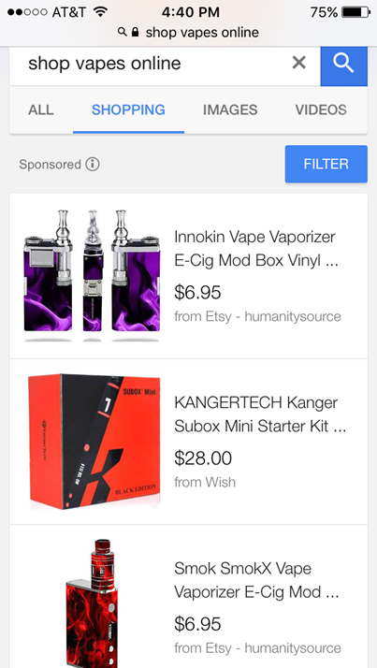
How do teens get Vapes and how much do they cost?

Slide 19
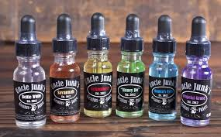
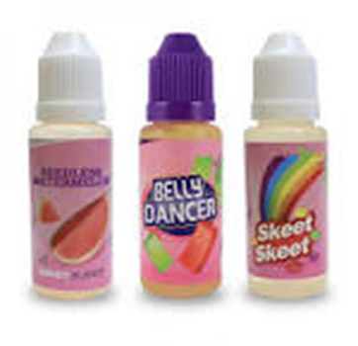
E-Liquid/E-Juice
Main ingredient: propylene glycol (PG ) and/or vegetable glycerin (VG) usually with water-soluble food flavorings. With or without nicotine, THC
Allergies to PG are rare, but it can irritate the lungs and eyes and may be more harmful to people with chronic lung diseases like asthma and emphysema.
The FDA generally views both PG and VG as safe in food, drugs and cosmetics BUT there have not been sufficient scientific studies done on what the impact of inhaling them on a short or long term basis may be
It is not always clear what is in e-liquids

Slide 20
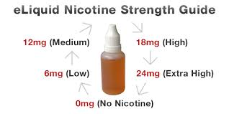
Nicotine
E-cigarettes can increase nicotine addiction among young people and may lead kids to try other tobacco products, including conventional cigarettes
Teens don’t always know how much nicotine they are inhaling

Slide 21
THC :tetrahydrocannabinol is the chemical responsible for most of marijuana's psychological effects (NIDA).
Dry herbal marijuana (flowers),marijuana oil or wax and synthetic forms of marijuana
Liquid THC is applied to a vaping device the same way that flavored nicotine liquid is
Use of hash oil, is becoming more common

Slide 22
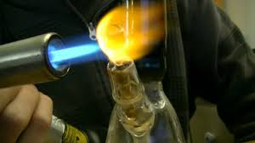
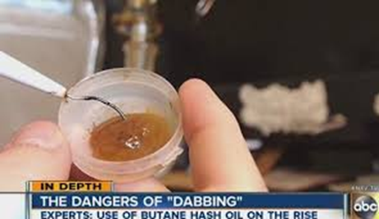
Dabbing: may mean something else
Dabbing is a method used to convert marijuana into a concentrate.
It uses butane, which is highly flammable, to extract THC from the cannabis plant
Also known as butane hash oil (BHO), honey oil, budder, crumble, shatter and/or wax
While marijuana in its traditional plant form has a THC concentration of about 20 percent, the wax used for dabbing can have a concentration of up to 80 percent

Slide 23
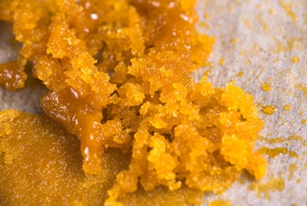
WHAT ARE MARIJUANA CONCENTRATES?
Also known as: 710 (the word “OIL” flipped and spelled backwards), wax, ear wax, honey oil, budder, butane honey oil (BHO), shatter, dabs
WHAT IS IT?
highly potent THC- (Tetrahydrocannabinol) concentrated mass that looks like honey or butter.
HOW POTENT IS THIS FORM OF MARIJUANA?
Marijuana concentrates contain extraordinarily high THC levels ranging from 40 to 80 percent THC amounts. This form of marijuana can be up to four times stronger in THC content than high grade or top shelf marijuana, which normally measures around 20 percent THC levels
HOW IS IT ABUSED?
Orally by infusing marijuana concentrates in various food or drink products. Smoking by use of water or oil pipes, e-cigarette/vaporizer because it is smokeless, odorless and easy to hide. The user takes a “dab” of the concentrate, then heats the substance producing vapors that ensure an instant high.
WHAT ARE THE EFFECTS OF USING MARIJUANA CONCENTRATES?
Being a highly concentrated form of marijuana, the effects upon the user may be more psychologically and physically intense than plant marijuana use. To date, long term effects of marijuana concentrate use are not yet fully known; but, we do know the effects of plant marijuana use.
These effects include paranoia, anxiety, panic attacks, and hallucinations. Additionally, the use of plant marijuana increases one’s heart rate and blood pressure. Plant marijuana users may also experience withdrawal and addiction problems.

Slide 24
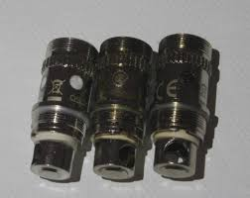
Dripping: a more labor-intensive method of vaping in which the user manually applies a few drops of liquid directly to the exposed heating coil of the e-cig every so few puffs
1 in 4 teens who vape say they’ve used this method
Dripping produces thicker clouds of vapor, gives a stronger sensation in the throat and makes flavors taste better (Journal of Pediatrics)
Dripping generates higher heating coil temperatures than conventional use of e-cigarettes, which lead to greater emissions of a class of harmful chemicals.
Some chemicals released are associated with cancer, chronic obstructive pulmonary disease
Handling liquid exposes teens to direct skin contact with nicotine which is absorbed rapidly through human skin

Slide 25
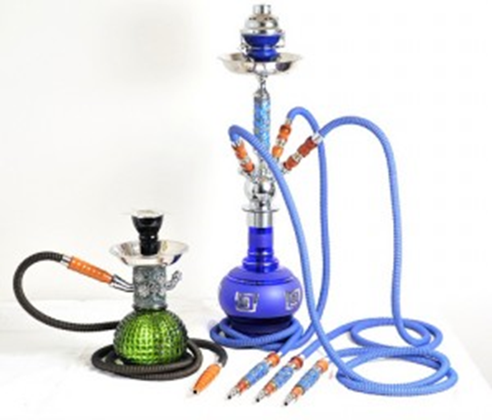
Hookah: water pipes that are used to smoke specially made tobacco that come in different flavors
In the US it has become more popular among teens and young adults and in college towns, seen as a “popular social activity”
Even after it has been passed through water, the tobacco smoke in a hookah pipe contains high levels of cancer-causing chemicals
Smoke inhaled in a typical one-hour hookah session can equal 100 cigarettes or more (WHO 2011)

Slide 26
Just Water Vapor?

Slide 27
“Harmless” Vapor: Toxic chemicals are formed as the e-liquid heats up to make the aerosol that e-cig users inhale

Slide 28
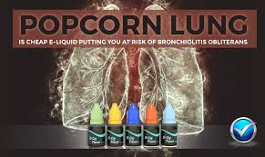
POPCORN LUNG ?
Diacetyl is added to food to produce a buttery taste and is perfectly harmless when ingested this way. The issue is that when heated up and then inhaled diacetyl is not so benign
Inhaling it over a long period may prove harmful to health, specifically being linked to bronchiolitis obliterans (a lung disease). This may, in some cases, develop to the stage where a lung transplant is necessary
Findings confirm the presence of diacetyl and “other flavoring chemicals” in e-juices
Because of the associations between diacetyl and bronchiolitis obliterans and other severe respiratory diseases among workers inhaling heated vapors containing diacetyl, urgent action is recommended to further evaluate the extent of this new exposure to diacetyl and related flavoring compounds in e-cigarettes (CDC)

Slide 29
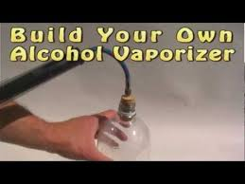
Alcohol
When you drink alcohol, it is absorbed through the body over-time
When you vape alcohol, it goes directly into your bloodstream
There is a rapid rush of alcohol to the brain
Rates of alcohol poising are much higher and there is no way to “detox” from it

Slide 30
Signs to look for:
Caffeine Sensitivity Vapers develop caffeine sensitivity. If your kid loved coffee or Red Bulls but suddenly stops chugging on them, vaping could be the cause. Batteries and Chargers Just like you have to charge your smartphone every single day, vapers need to charge their vaporizers on a regular basis. While some e-cigs can be charged with just a USB cable, most of the powerful e-cigs like box mods support 18650 batteries. If you see unfamiliar batteries on the charger, take a look around and you might find a vaping device. Metallic Wires and Cotton Wicks If you find organic cotton, empty plastic vials or thin metallic coils lying in your child’s room, this is yet another red flag. Discarded Atomizers The atomizers are a vital part of e-cigs as they turn e-juice into vapor. However, they are disposable and after a while usually burn out. If you come across a discarded atomizer in your kid's trash can, it's a pretty clear indication that he/she has been vaping.
Mysterious Aroma E-cigarettes don't smell bad like the smoke from burning tobacco; however, most e-liquids have flavors in them that usually smell like candy, mint, vanilla, fruit punch, etc. Unfamiliar Handheld Gadgets E-cigarettes come in various shapes. The most common ones resemble a pen and are known as vape pens. If you come across a pen that isn't a pen or other unfamiliar gadget, be aware that it could be a vaporizer. Look for holes on each end
Increased Thirstiness Vapor from e-cigs is made of VG (Vegetable Glycerin), PG (Propylene Glycol), and flavors. The chemical characteristics of PG make it attract water molecules from its surroundings. When vapor enters the mouth, PG does its trick and keeps the vaper in a state of dry mouth. So if your kid is suddenly drinking more water, you might want to find out why. (Increased thirst can signal a variety of concerns.)

